Slide 1
Less is More: One-shot Subgraph Reasoning on Large-scale Knowledge Graphs
Zhanke Zhou
Hong Kong Baptist University
with Yongqi Zhang, Jiangchao Yao, Quanming Yao, and Bo Han
ICLR 2024 Paper: https://arxiv.org/pdf/2403.10231.pdf Code: https://github.com/tmlr-group/one-shot-subgraph
Notes:
Hi, everyone.
This is Zhanke Zhou from Hong Kong Baptist University.
I am glad to share our work, which title is “Less is More: One-shot Subgraph Reasoning on Large-scale Knowledge Graphs”.

Slide 2
Outline
Background
Method
Experiments
Summary
Notes:
This presentation contains four parts.
Let us go to the first part, the background.

Slide 3
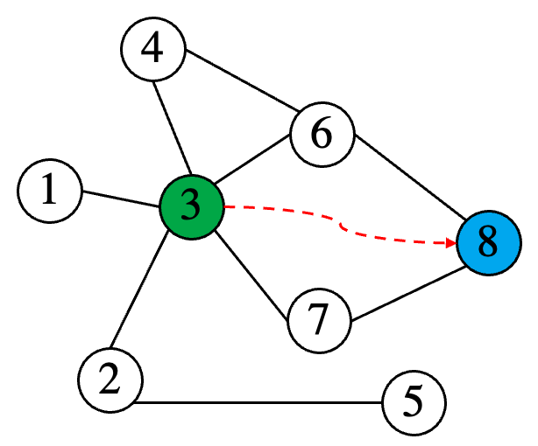
Background
Link prediction task in knowledge graph (KG)
Given a query $\left(u,q,?\right)$, to find the answer $v$, making $\left(u,q,v\right)$valid
$u$: query entity, $q$: query relation, $v$: answer entity
Namely, to predict the latent (unknown) edges, based on the observed (known) edges
query =$\left(u,q,?\right)$
$u←$ ③$,q←$ relation$,v←$ ⑧
a KG $𝒢$
Notes:
To deduce new facts on a knowledge graph,
a link predictor learns from the graph structure and collects local evidence to find the answer to a given query.
For example, given the query, including the query entity in green and query relation in red, the model need to find the answer entity in blue

Slide 4
Background
Two classes of existing works
semantic models (computation-efficient but parameter-expensive)
$p\left(u,q,v\right)$ is measured by a scoring function, utilizing their representations $h_{u},h_{q}, h_{v}$
structural models (parameter-efficient but computation-expensive)
learn the sequential order of structures by leveraging the relational paths between $u$ and $v$
or, directly use the graph structure for reasoning, capturing more complex semantics
Computation Complexity
$$(u,q,?)$$
$$(u,q,?)$$
structural
$$𝒢$$
$$H$$
$$\hat{Y}$$
$$𝒢$$
$$\hat{Y}$$
Abstraction:
$$f_{θ}$$
$$f_{θ}$$
$$f_{θ}$$
semantic
Parameter Complexity
semantic models structural models complexity comparison
➔ The whole graph ($𝓖$), model ($f_{θ}$), and prediction ($\hat{Y}$) are coupled
➔ $f_{θ}$acts on $𝓖$ to obtain $\hat{Y}$ of all entities
Notes:
However, existing methods suffer from a severe scalability problem
due to the utilization of the whole KG for prediction.
This manner of reasoning hinders their application on large-scale data.

Slide 5
Research Problem
Graph sampling is an intuitive solution, however, existing sampling methods are not good enough
non-learnable sampling methods are designed to solve scalability issues of node-level tasks
e.g., GraphSAGE, FastGCN, and Cluster-GCN
cannot guarantee the coverage of answer entities
do not perform good on KGs
learnable sampling methods are bundled with specific GNN models
e.g., DPMPN, AdaProp, and AStarNet
the sampling and reasoning in each layer are highly coupled
the computation cost can be still high on large-scale KGs
fast but not good
good but not fast
Computation Complexity
$$(u,q,?)$$
structural
$$𝒢$$
$$𝒢_{s}$$
$$\hat{Y}$$
???
$$f_{θ}$$
???
semantic
Parameter Complexity
➔ how to efficiently and effectively conduct subgraph reasoning on KG? 🤔
Notes:
Graph sampling is an intuitive solution for the scalability issue.
However, existing sampling methods are not good enough for knowledge graph.
Therefore, we need to find an efficient and effective sampling method to conduct subgraph reasoning on knowledge graph.

Slide 6
Outline
Background
Method
Experiments
Summary

Slide 7
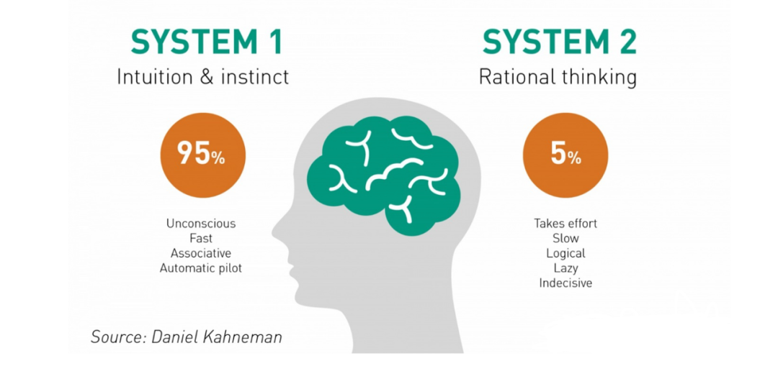
Motivation
Only partial knowledge stored in human brain is relevant to a question
extracted by recalling
and then utilized in the careful thinking procedure
Generating candidates and then ranking the promising ones are common
in large-scale recommendation system
for handling millions even billions of users and items
Notes:
Intuitively, only partial knowledge stored in human brain is relevant to a question
Generating candidates and then ranking the promising ones are common in practice
Therefore, a new reasoning manner should avoid reasoning on the entire KG

Slide 8
One-shot-subgraph link prediction on KGs
Design principle
first to efficiently identify a subgraph (system1)
relevant to the given query
then effectively reason on the subgraph (system2)
to obtain the precise ranking results
$$(u,q,?)$$
Abstraction:
$$𝒢$$
$$𝒢_{s}$$
$$\hat{Y}$$
$$g_{φ}$$
$$f_{θ}$$
two key components
sampler $g_{φ}$ efficiently samples a subgraph
predictor $f_{θ}$ effectively reasons on the subgraph
➔ decoupling predictor $f_{θ}$ and original graph $𝒢_{ }$
➔ only require subgraph $𝒢_{s}$ for reasoning
Notes:
In this work, we propose the novel one-shot-subgraph link prediction on knowledge graphs.
Here, the “one-shot” means we only need to sample one subgraph for answering one query.
Technically, we decouple the prediction procedure into two steps with a corresponding sampler and a predictor.
Thereby, the prediction of a specific query is conducted by
first --- fast sampling of one query-dependent subgraph with the sampler
and then --- slow prediction on the subgraph with predictor.

Slide 9
Formal Definition
Notes:
Formally, we have this definition of the new reasoning manner.
Analytically, we show that this manner enjoys the benefits of
Low complexity of computation and parameter,
Flexible propagation scope,
and High efficiency in subgraph sampling.

Slide 10
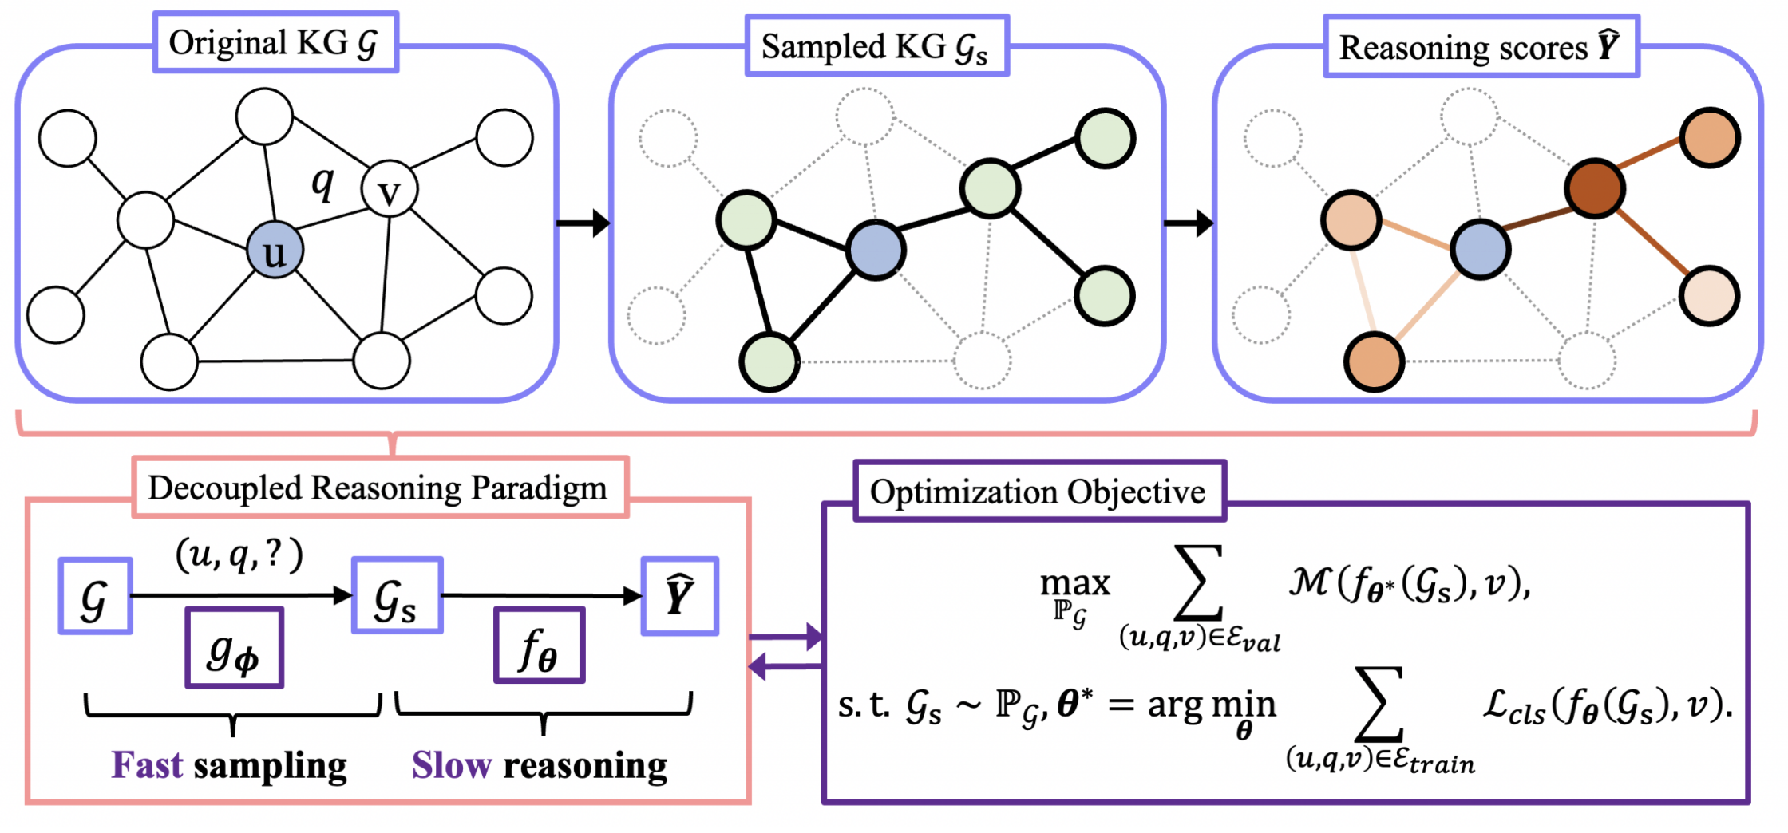
Implementation | overview
Q: how to build the predictor’s architecture
The three key steps of
one-shot-subgraph LP are
generate the sampling distribution
extract a subgraph with top entities and edges
inference on the subgraph and get the final prediction
Q: what kind of sampler is suitable here?
Q: how to optimize the sampler and predictor?
Notes:
Then, we introduce the implementation of this one-shot-subgraph reasoning framework.
Overall, there are three key steps:
first, we will generate the sampling distribution
next, we will extract a subgraph with top entities and edges
finally, we will inference on the subgraph and get the final prediction

Slide 11
Implementation | step1/3 Generate Sampling Distribution
Notice that the answer entity are generally near the query entity.
Hence, we choose the single-source and non-parametric heuristic Personalized PageRank (PPR) as the indicator for sampling
$p^{(k)}$: the sampling importance of each entity
Notes:
To efficiently capture the local evidence of query entity,
we choose the heuristic Personalized PageRank (PPR for short) as the sampling indicator.
PPR starts propagation from query entity to evaluate the importance of each neighbor.
The generated PPR score works as the sampling distribution that encodes the local neighborhood.

Slide 12
Implementation | step2/3 Extract Subgraph
Notes:
Then, based on the PPR scores, a query-dependent subgraph is extracted with the most important entities and edges.

Slide 13
Implementation | step3/3 Reason on the Subgraph
intra-layer
design
inter-layer
design
Notes:
In the last step, we conduct reasoning on the subgraph to get the final results.
From the model’s perspective, we build the configuration space of the predictor
and further utilize the advantages of existing structural models

Slide 14
Implementation | the full algorithm
hyperparameters $r_{𝒱},r_{ℰ}$ and $L$ are important
but how to find the optimal configure? 🤔
Notes:
The three-step subgraph reasoning procedure is summarized in Algorithm 1
there are several hyperparameters important to this algorithm
So, how can we find the optimal configure? 🤔

Slide 15
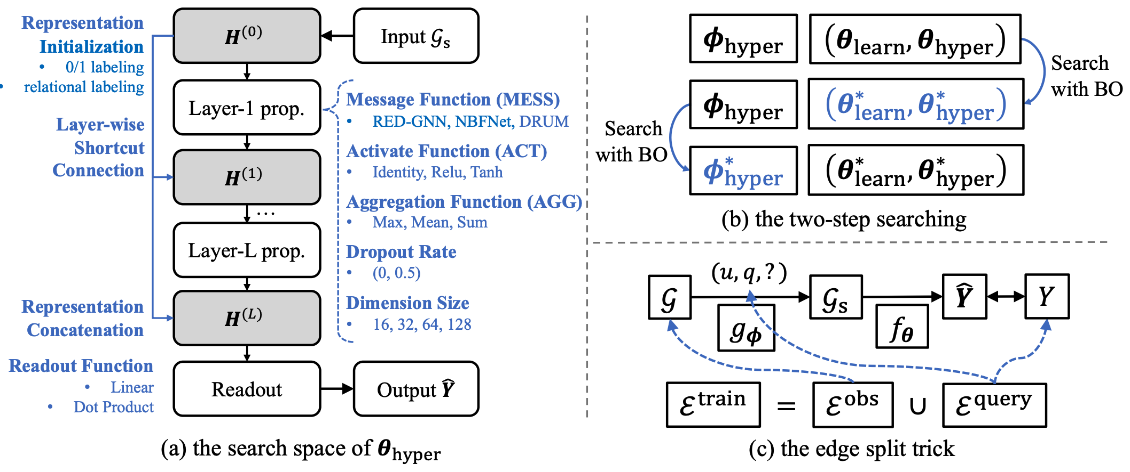
Implementation | optimization
Search Problem to find the optimal configuration $φ_{hyper}^{∗}$
Notes:
To solve this, we setup the bi-level optimization problem to adaptively search for the optimal configuration
we split the search into two sub-processes, and follow the Bayesian Optimization to obtain the optimal configuration.
In addition, we adopt a data split trick that balances observations and predictions. It saves time as the training does not necessarily traverse all the training facts.

Slide 16
Outline
Background
Method
Experiments
Summary

Slide 17
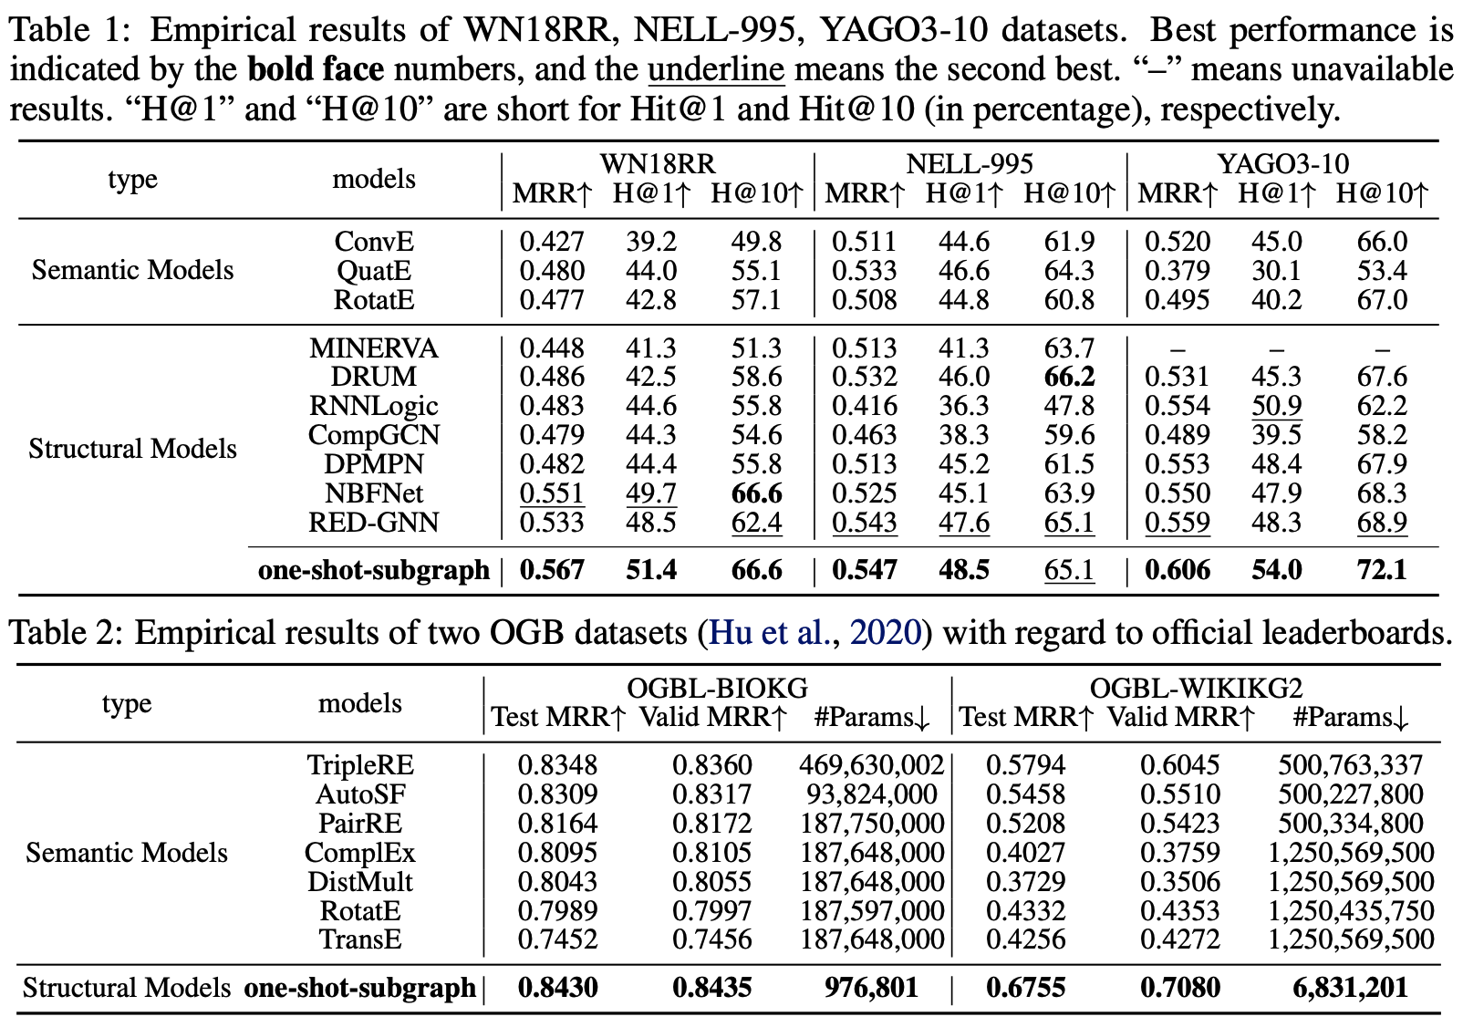
Experiments | main results
Notes:
Empirically, our method performs well in five KG datasets.
Notably, we show that it is unnecessary to utilize the whole KG in reasoning
only a small proportion (i.e., 10%) of entities are essential
that can be identified by PPR without learning

Slide 18
Experiments | ablation study
10% entities
10% entities
10% entities
Notes:
Besides, in ablation study, we show that PPR is much better than other heuristics,
especially in identifying potential answer entities.
In most cases, PPR can cover 90% answer entities by sampling only 10% entities.

Slide 19
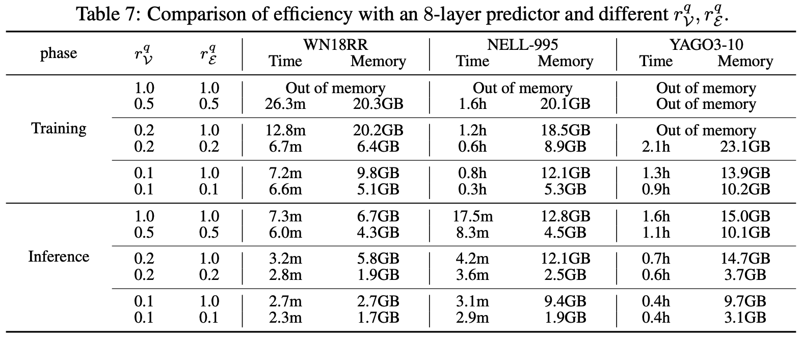
Experiments | efficiency comparison
Notes:
in efficiency, we justify that the one-shot-sampling method
is with
less computing cost in both terms of less running time and also less memory cost.

Slide 20
Outline
Background
Method
Experiments
Summary
Notes:
Let’s take a quick summary

Slide 21
Summary
Main contributions
We propose a new manner of one-shot-subgraph reasoning on KGs to alleviate the scalability problem of existing methods and achieve efficient as well as adaptable learning on KGs
We further introduce the automated searching for adaptive configurations in both data space and model space that benefits from the high efficiency of subgraph reasoning
Extensive experiments on three common datasets and two large-scale benchmarks show that our method achieves leading performances with significantly improved effectiveness and efficiency
Extension
adapt the decoupled reasoning framework to other graph learning tasks
e.g., sample a local subgraph for node classification or a global subgraph for graph classification
enhancing the one-shot-subgraph reasoning with instance-wise adaptation
e.g., sampling a subgraph of suitable scale for each given query
Notes:
In this work, we propose the new manner of one-shot-subgraph reasoning on KG to alleviate the scalability problem of structural models.

Slide 22
Take home message
how to efficiently and effectively conduct subgraph reasoning on KG? 🤔
[FAST Sampling]
To identify a query-dependent
subgraph without learning
[SLOW Reasoning]
To build an expressive GNN that
is adaptive to the extracted subgraph
$$(u,q,?)$$
$$𝒢$$
$$𝒢_{s}$$
$$\hat{Y}$$
$$g_{φ}$$
$$f_{θ}$$
Fast sampling
Slow reasoning
Notes:
Backing to the research question, that is , how to efficiently and effectively conduct subgraph reasoning on KG?
Our answer is the one-shot-subgraph reasoning.
Namely, FAST Sampling to identify a query-dependent subgraph,
and then SLOW Reasoning with an adaptive model to get the final result

Slide 23
Thanks for your listening!
Zhanke Zhou cszkzhou@comp.hkbu.edu.hk
Notes:
Thank you

