Slide 1
Combating Bilateral Edge Noise for Robust Link Prediction
Zhanke Zhou
Hong Kong Baptist University
with Jiangchao Yao, Jiaxu Liu, Xiawei Guo, Quanming Yao, Li He, Liang Wang, Bo Zheng, Bo Han
[NeurIPS’23 Paper]: https://openreview.net/pdf?id=ePkLqJh5kw [Code]: https://github.com/tmlr-group/RGIB
Notes:
Hi, everyone.
This is Zhanke Zhou from Hong Kong Baptist University.
I am glad to share our work, which title is “Combating Bilateral Edge Noise for Robust Link Prediction”.

Slide 2
Outline
Introduction
Method
Experiments
Summary
Notes:
This presentation contains four parts.
Let us go to the first part, the introduction.

Slide 3
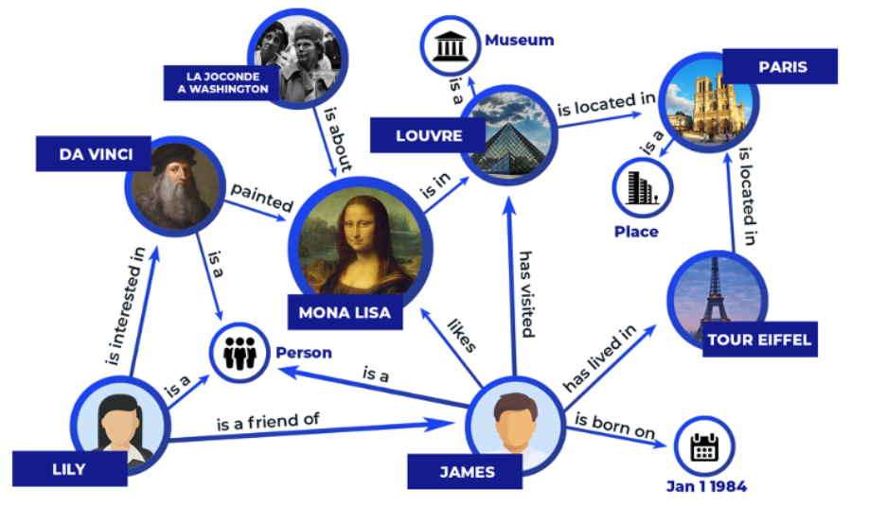
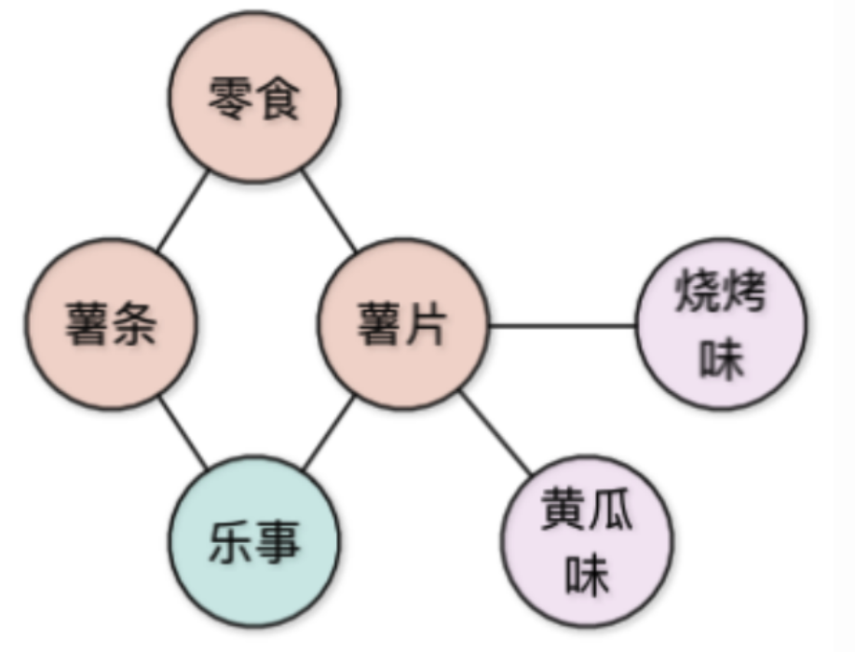
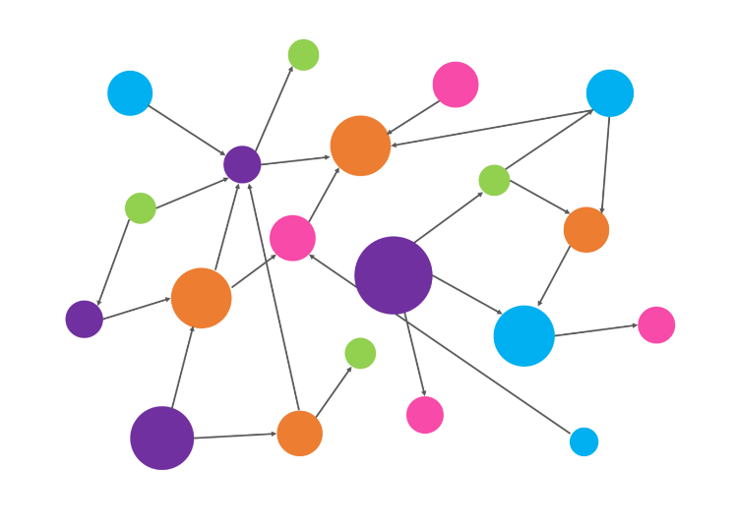
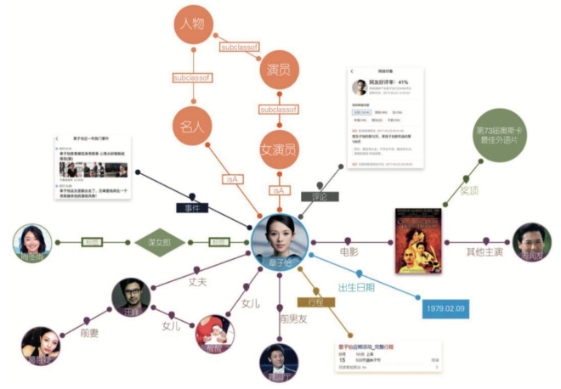
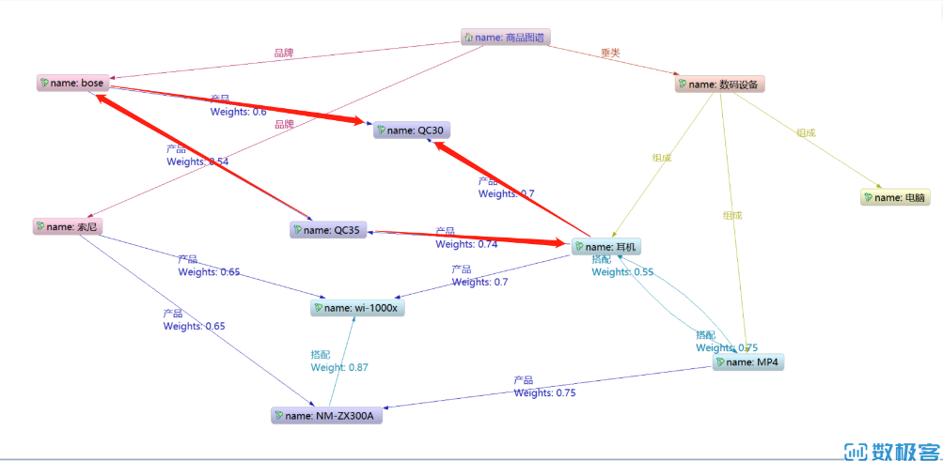
Introduction | background
Graph: a general form
of data expression
Notes:
So, the graph is a general form of data expression.
It is common in practice, such as knowledge graphs, commonsense graphs, user-item graphs, etc.

Slide 4
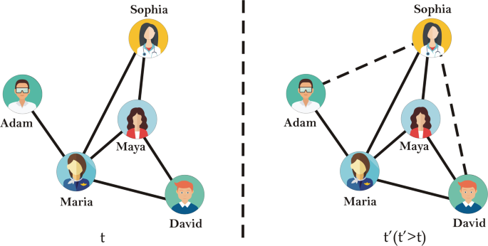
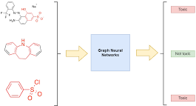
Introduction | background
The link prediction task
based on the observed links
to predict the latent links between the nodes
node-level
link-level
（most relevant to the recommendation system）
graph-level
Observed graph
Predictive graph
GNN
(Graph Neural Network)
Notes:
Among the three levels of graph learning, we will focus on the link-level prediction task.
Here, an GNN is expected to take a graph as input and then predict the latent links in this graph.

Slide 5
Introduction | graph representation learning
GNN for link prediction on graphs
encode: $n_{u}→{h_{u}:ℝ}^{d}$
node
$h_{u}$: node representation
u
$$ℝ^{d}$$
decode: $φ_{uv}=READOUT\left(h_{u},h_{v}\right)→ℝ$
optimization: $ℒ=\sum_{e_{uv}∈ℰ^{train}}{{−y}_{ij}log⁡(φ_{uv})}+\left(1−y_{ij}\right)log⁡(1−φ_{uv})$
Notes:
To this end, the GNN will encode the graph to the representation space.
And then use the representations of two nodes to give the probability of an edge between them.

Slide 6
Introduction | problem setup
Observed graph
Predictive graph
ideal case
(clean data)
practical case
(with bilateral noise)
GNN
$$A$$
$$Y$$
$$\tilde{A}$$
$$\tilde{Y}$$
noisy observed graph
noisy predictive graph
Notes:
Existing graph benchmarks are generally clean.
However, the graph data in practice can be quite noisy.
Several noisy edges could be collected and split into the observation graph and the prediction graph.

Slide 7
Introduction | problem setup
In practical scenarios,
the observed graph is often with noisy edges (input noise)
the predictive graph often contains noisy labels (label noise)
these two kinds of noise can exist at the same time (by random split)
We call this kind of noise as the bilateral edge noise
Research problem: how to improve the robustness of GNNs under edge noise 🤔
Notes:
In other words, this kind of edge noise can be found on the input side and the output side of a GNN.
We call this kind of noise — the bilateral edge noise.
And we raise a problem: How do we improve the robustness of GNNs under edge noise?

Slide 8
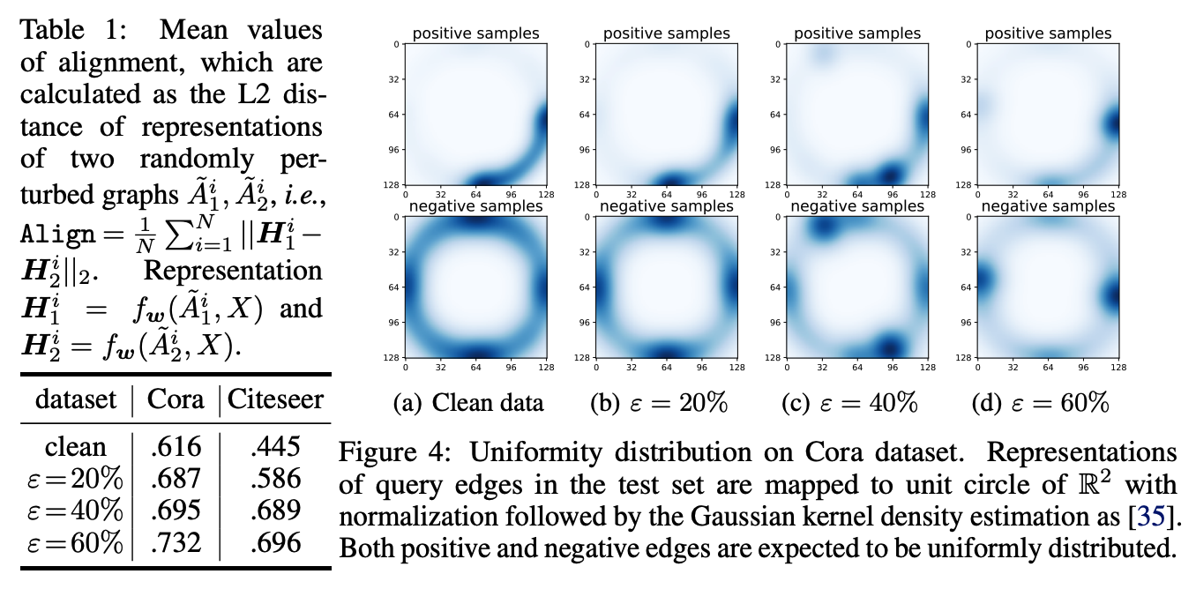
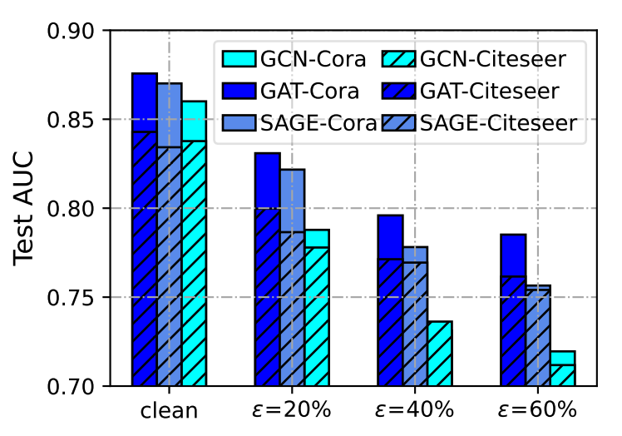
Introduction | problem setup
Inspecting the representation distribution:
Link prediction performance in AUC
with the bilateral edge noise
representation
collapse
performance drop
representation collapse
Research problem: how to improve the robustness of GNNs under edge noise 🤔
Notes:
To close this gap, we first conduct an empirical study with the bilateral edge noise.
We disclose that the edge noise leads to severe degradation of performance and also the representation collapse.

Slide 9
Outline
Introduction
Method
Experiments
Summary

Slide 10
Graph Information Bottleneck (GIB)
$\tilde{A}$: noisy input graph
$\tilde{Y}$: noisy edge labels
$H:$ graph representation
defend the input perturbation
However, GIB is intrinsically vulnerable to label noise
since it entirely preserves the label supervision
Notes:
To robustify the graph representation, one can naturally utilize the information constraint based on the graph information bottleneck.
That is, to maximize the mutual information between representation H and label Y.
Meanwhile, it constrains the mutual information between H and input A to avoid
capturing too much input information, which can be irrelevant and noisy.
However, the GIB is vulnerable to label noise since it entirely preserves and maximizes the label supervision.
Therefore, we need to upgrade this objective to be robust to the bilateral edge noise.

Slide 11
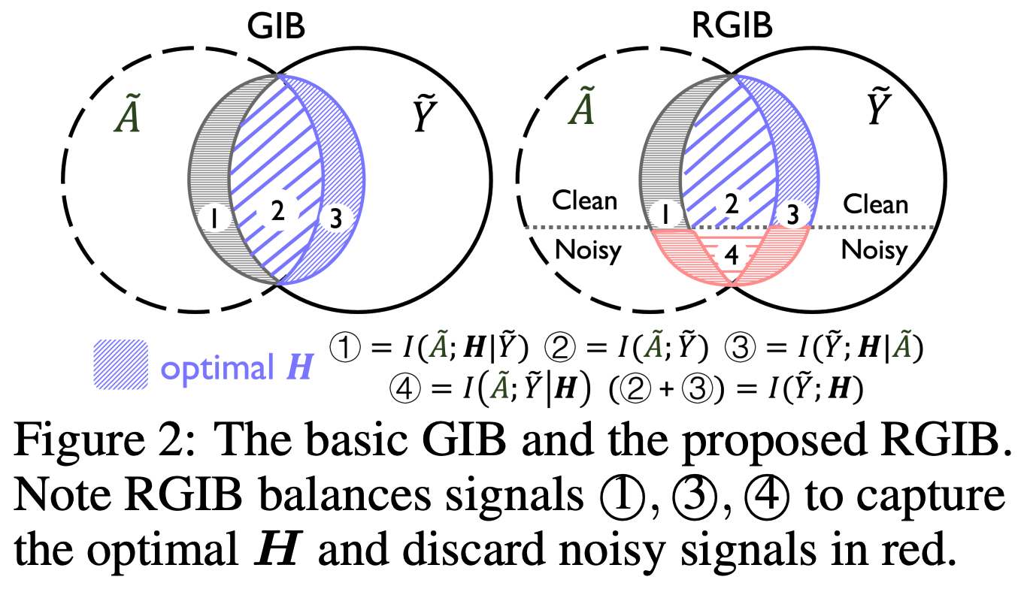
Robust Graph Information Bottleneck (RGIB)
$\tilde{A}$: noisy input graph
$\tilde{Y}$: noisy edge labels
$H:$ graph representation
Notes:
In this work, we further decouple and balance the mutual dependence among graph topology, target labels, and representation.
We build a new learning objective for robust representation against the bilateral noise.
This objective is named robust GIB.
In details,
the first constraint on representation H encourages it to be more diverse to prevent representation collapse and also limit its capacity to avoid over-fitting.
The other two constraints mutually regularize posteriors to mitigate the negative impact of the noise.

Slide 12
Robust Graph Information Bottleneck
RGIB
RGIB-SSL
RGIB-REP
Two practical implementations of RGIB:
RGIB-SSL explicitly optimizes the representation $H$ with the self-supervised regularization
RGIB-REP implicitly optimizes $H$ by purifying the noisy $\tilde{A}$ and $\tilde{Y}$ with the reparameterization mechanism
Notes:
Then, to achieve a tractable approximation of the MI terms, we introduce two practical implementations of robust GIB based on different methodologies.

Slide 13
RGIB with Self-Supervised Learning (RGIB-SSL)
RGIB
RGIB-SSL
RGIB-REP
To achieve a tractable approximation of the MI terms
we adopt the contrastive learning technique and contrast pair of samples,
i.e., perturbed ${\tilde{A}}_{1},{\tilde{A}}_{2}$ that are sampled from the augmentation distribution $ℙ\left(\tilde{A}\right)$
Notes:
Specifically,
For the first instantiation,
RGIB-SSL optimizes the representation with self-supervised learning.
The objective is implemented by integrating a uniformity term and an alignment term with graph augmentation.

Slide 14
RGIB with Self-Supervised Learning (RGIB-SSL)

Slide 15
RGIB with Data Reparameterization (RGIB-REP)
RGIB
RGIB-SSL
RGIB-REP
Latent variables $Z_{Y}$ and $Z_{A}$ are clean signals extracted from noisy $\tilde{Y}$ and $\tilde{A}$.
their complementary parts $Z_{Y^{′}}$ and $Z_{A^{′}}$ are considered as noise, satisfying ${\tilde{Y}=Z}_{Y}+Z_{Y^{′}}$ and $\tilde{A}={Z_{A}+Z}_{A^{′}}$.
$I\left(H;Z_{Y}\right)$ measures the supervised signals with selected samples $Z_{Y}$
$I(Z_{A};\tilde{A})$ and $I(Z_{Y};\tilde{Y}$) help to select the clean and task-relevant information from $\tilde{A}$ and $\tilde{Y}$.
Notes:
While the second instantiation,
RGIB-REP optimizes representation by purifying the noisy input and label with the reparameterization mechanism.

Slide 16
RGIB with Data Reparameterization (RGIB-REP)

Slide 17
Outline
Introduction
Method
Experiments
Summary

Slide 18
Experiments | Method comparison under bilateral noise
➔ Robust GIB achieves the best results in all six datasets under the bilateral edge noise
Notes:
Empirically, we show that the robust GIB achieves the best results in all six datasets under the bilateral edge noise.

Slide 19
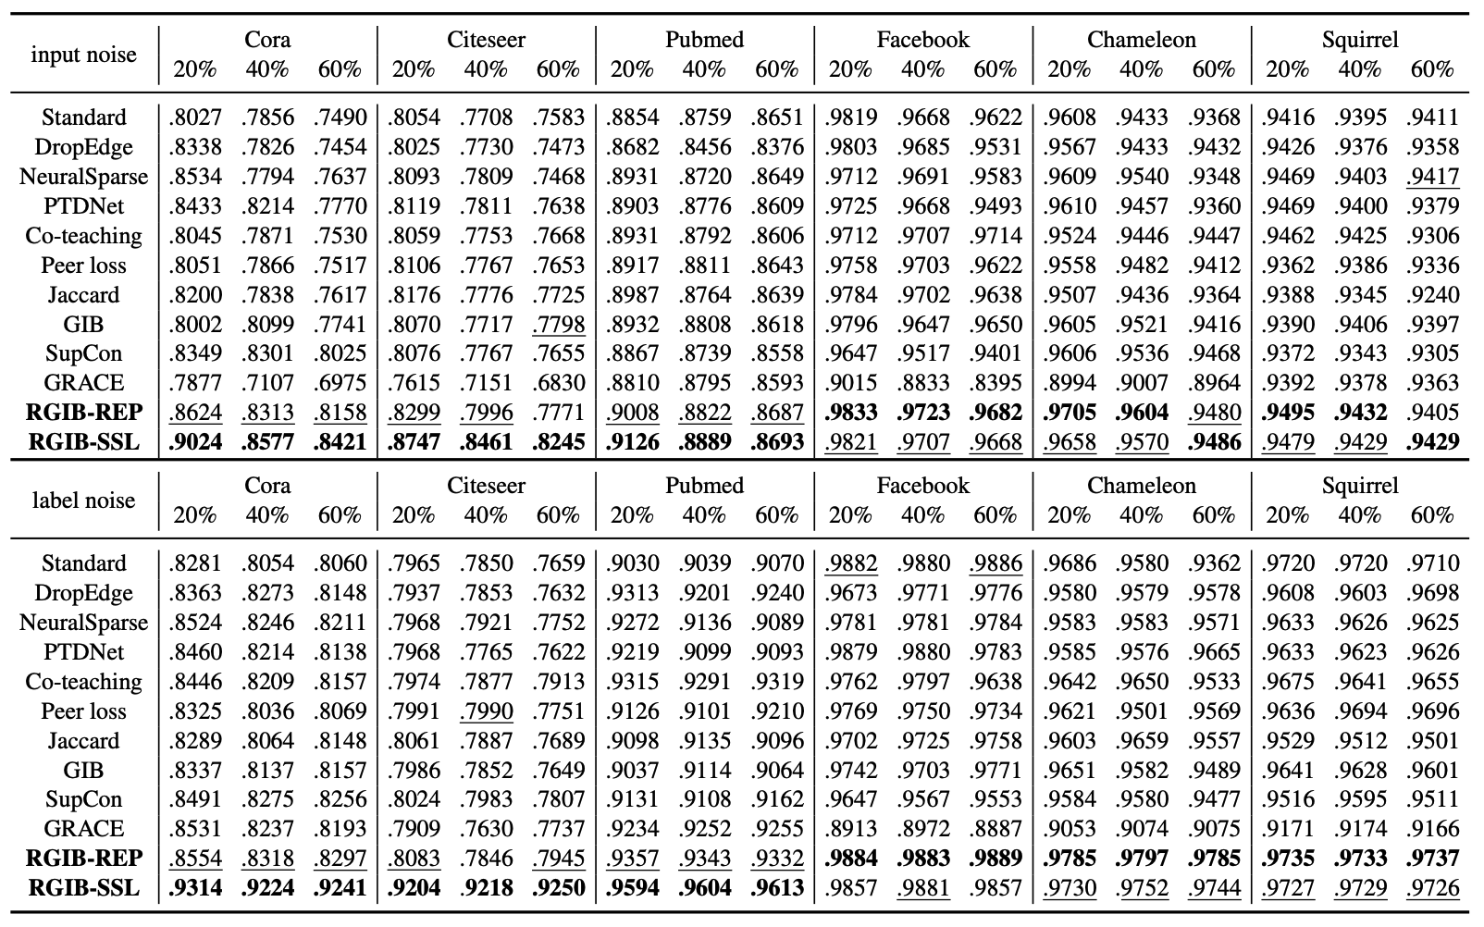
Experiments | Method comparison under unilateral noise
➔ As for the unilateral noise settings, our method still consistently surpasses all the baselines by a large margin
Notes:
As for the unilateral noise settings, our method still consistently surpasses all the baselines by a large margin.

Slide 20
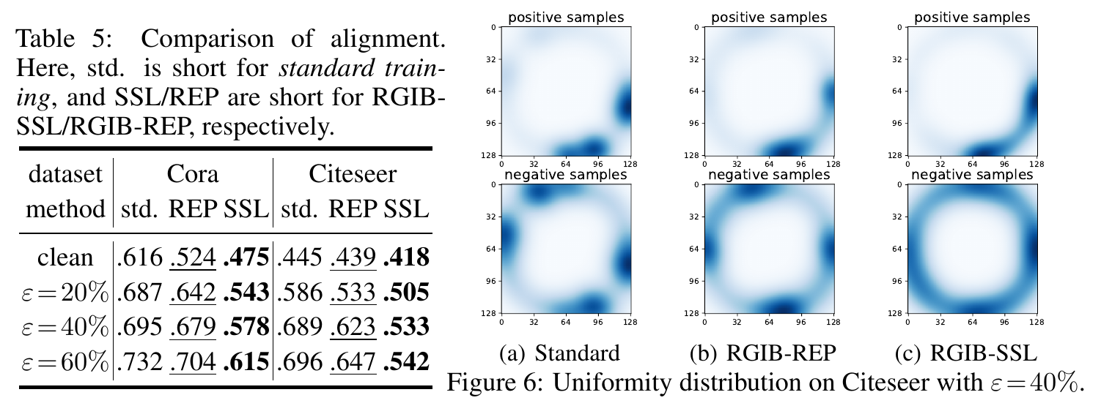
Experiments | The learned representations
➔ The graph representation has obvious improvement in distribution
Notes:
Besides, we show that the graph representation has obvious improvement in distribution.

Slide 21
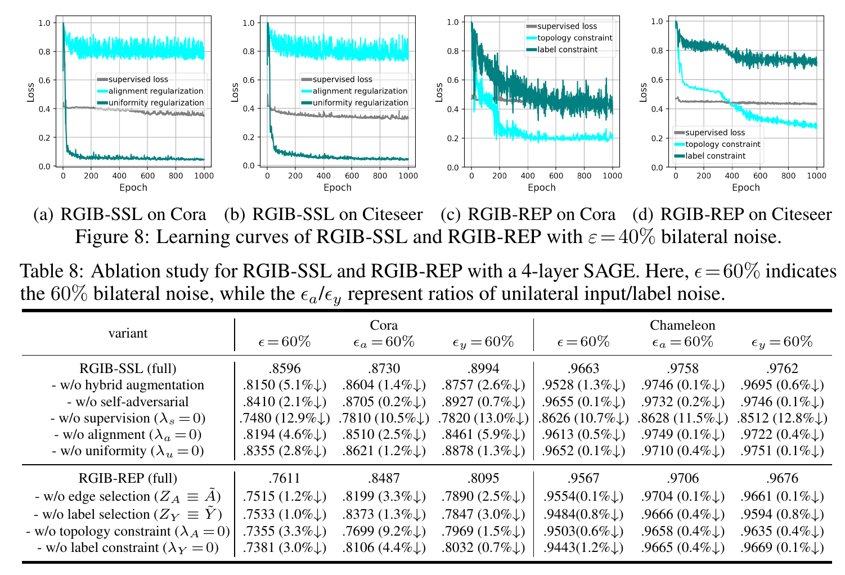
Experiments | Ablation study
More experiments can be found in our paper
Notes:
We also conducted several ablation studies.

Slide 22
Outline
Introduction
Method
Experiments
Summary

Slide 23
Take home messages
In this work, we study the problem of link prediction with the Bilateral Edge Noise.
We propose the Robust Graph Information Bottleneck (RGIB) principle, aiming to extract reliable signals via decoupling and balancing the mutual information among inputs, labels, and representation.
Regarding the instantiation of RGIB, the self-supervised learning technique and data reparametrization mechanism are utilized to establish the RGIB-SSL and RGIB-REP, respectively.
Empirical studies verify the denoising effect of the proposed RGIB under different noisy scenarios.
Notes:
So, in this work, we study the problem of link prediction with the bilateral edge noise.
We propose the robust GIB principle with two practical instantiations to solve the problem.
Empirically, we verify the effectiveness of RGIB under different noisy scenarios.

Slide 24
Future directions
Learning with Graphs
explicit with LLMs¹: LLM-enhanced graph learning, e.g., GraphText on TAG
implicit with LLMs²: graph prompts for in-context learning, e.g., PRODIGY
Reasoning with LLMs
explicit with Graphs³: mount with external graphs, e.g., KG-enhanced reasoning
implicit with Graphs⁴: progressively reasoning, e.g., COT / TOT / GOT
LLMs
2
1,3
We are now collecting and summarizing related works,
and find many works are on the way.
It will be released soon :)
4
Graphs

Slide 25
Research scope
The idea still not works (yet)
What FM cannot do well
e.g., algorithmic/complex reasoning
Emerging
Abilities
What FM can do well
but underexplored
e.g., multi-agent collaboration,
predicting future events
What FM can do well
and well-known
e.g., zero/few-shot with in-context learning,
traditional supervised learning tasks
The idea works
Scaling up
model scale
data scale
computing scale
What FM
shouldn’t do
e.g., jailbreak, privacy leakage
The idea doesn’t work
¹FM: Foundation Models, including LLM, VLM, etc.

Slide 26
Thanks for your listening!
Zhanke Zhou
Email: cszkzhou@comp.hkbu.edu.hk
Notes:
Thanks for your listening!

