Slide 1
On Strengthening and Defending Graph Reconstruction Attack with Markov Chain Approximation
Zhanke Zhou
Hong Kong Baptist University
with Chenyu Zhou, Xuan Li, Jiangchao Yao, Quanming Yao, and Bo Han
2023 / 11 /14
Paper: https://openreview.net/pdf?id=Vcl3qckVyh Code: https://github.com/tmlr-group/MC-GRA
Personal Github: https://github.com/AndrewZhou924 WeChat: zhouzhanke924

Slide 2
Outlines
Background
Problem Statement & Modeling
Experiments
Summary and Discussion

Slide 3
Outlines
Background
model inversion attack: from image to graph
Problem Statement & Modeling
Experiments
Summary and Discussion

Slide 4
Background
Forward pipeline of a neural network:
input
model
output
A neural network
Cat

Slide 5
Background
Question: What if we reverse the pipeline?
output
model
input
A neural network
Cat
Can we recover the cat image from the trained model? 🤔
What if we reverse the process?

Slide 6
Background
Question: What if we reverse the pipeline?
output
model
input
A neural network
Cat
Can we recover the cat image from the trained model? 🤔
➔ Yes! we can recover the training data via model inversion attack

Slide 7
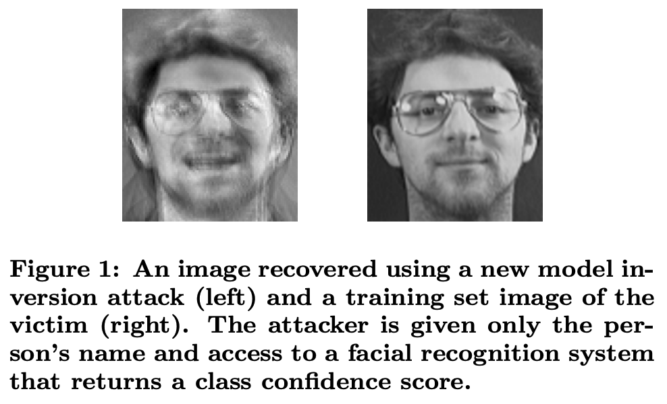
Background
Definition of model inversion attack
a malicious user attempts to recover the private data
that is used to train a neural network
Privacy in Pharmacogenetics: An End-to-End Case Study of Personalized Warfarin Dosing. USENIX Security 2014.
Model Inversion Attacks that Exploit Confidence Information and Basic Countermeasures. CCS 2015.
Variational Model Inversion Attacks. NeurIPS 2021.

Slide 8
Background
Model inversion attack: from images to graphs
“human faces”
but, what about “graphs”?
Only limited research has been conducted on MIA on graphs 🤔
The general principles for strengthening and defending MIA are unknown

Slide 9
Outlines
Background
Problem Statement & Modeling
[problem] graph reconstruction attack: model inversion attack on graphs
[modeling] analyze the problem with Markov chain
[methods] the corresponding attack and defense methods
Experiments
Summary and Discussion

Slide 10
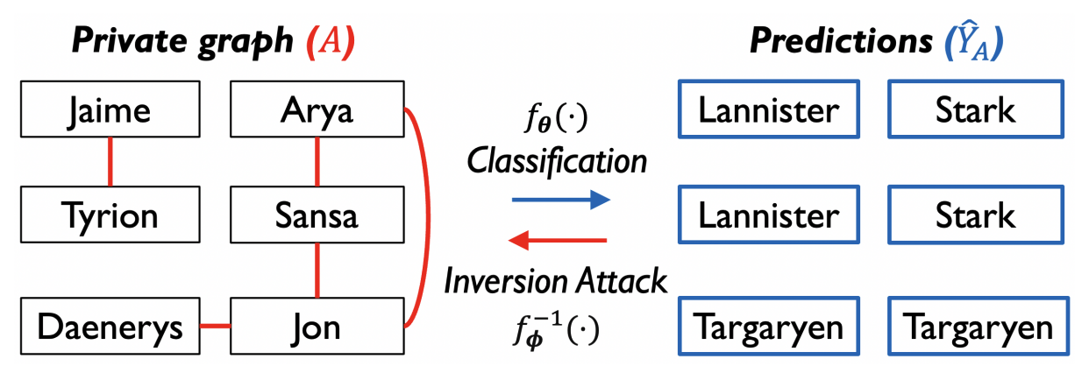
Problem Statement
Graph Reconstruction Attack (GRA):
to recover the original adjacency ($A$) via attacking a trained model ($f_{θ}$)

Slide 11
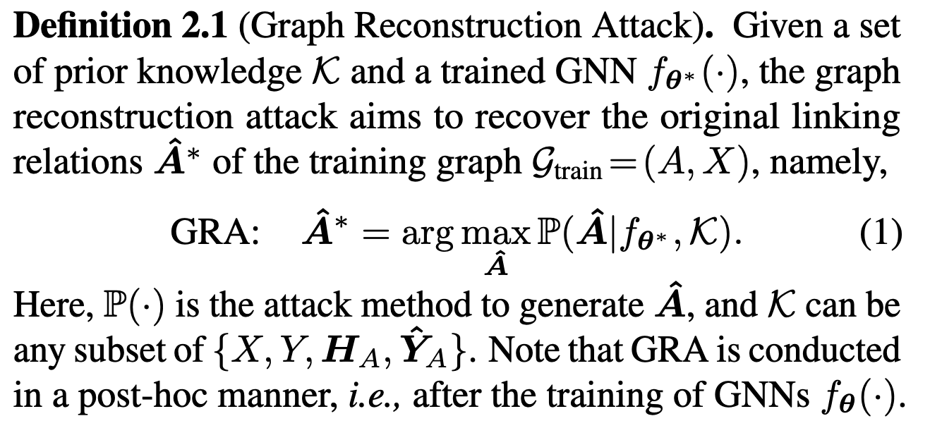
Problem Statement
Graph Reconstruction Attack (GRA):
to recover the original adjacency ($A$) via attacking a trained model ($f_{θ}$)
An illustration of Graph Reconstruction Attack
A formal definition
Notes:
In this work, to catch more attention to the privacy risk of GNNs,
we study the reconstruction of the graph adjacency and term it Graph Reconstruction Attack (GRA).
as elaborated below.
The forward inference of a trained model is to predict the node category YˆA, i.e., the family name of each character;
while the backward inversion attack is to recover the original adjacency A, i.e., the kinship among characters (red edges).

Slide 12
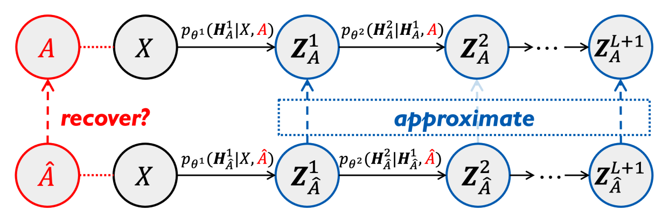
Modeling & Main Results
Markov Chain Modeling:
The main results:
MC-GRA (a new attack method)
MC-GPB (a new defense method)
MC-GRA
MC-GPB
Modeling the GRA problem as approximating the
original Markov chain (upper) by the attack chain (lower)
Recovered adjacency on Cora dataset. Green dots are
correctly predicted edges while red dots are wrong ones.
Notes:
To adaptively support the white-box GRA that leverages the target model and any prior knowledge;
and to properly locate, present, and utilize the interplaying variables of GNN forward in a generic manner;
we cast the GRA problem as approximating the original Markov chain
by the attack chain
Figure
GRA on normal GNN leads to privacy leakage, while GRA on protected GNN cannot recover the private adjacency.

Slide 13
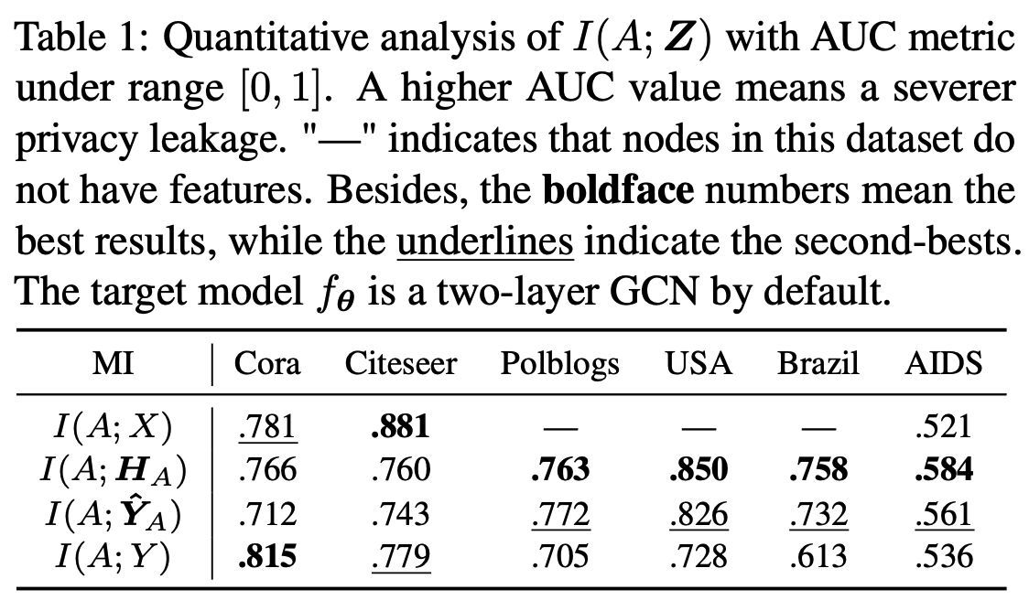
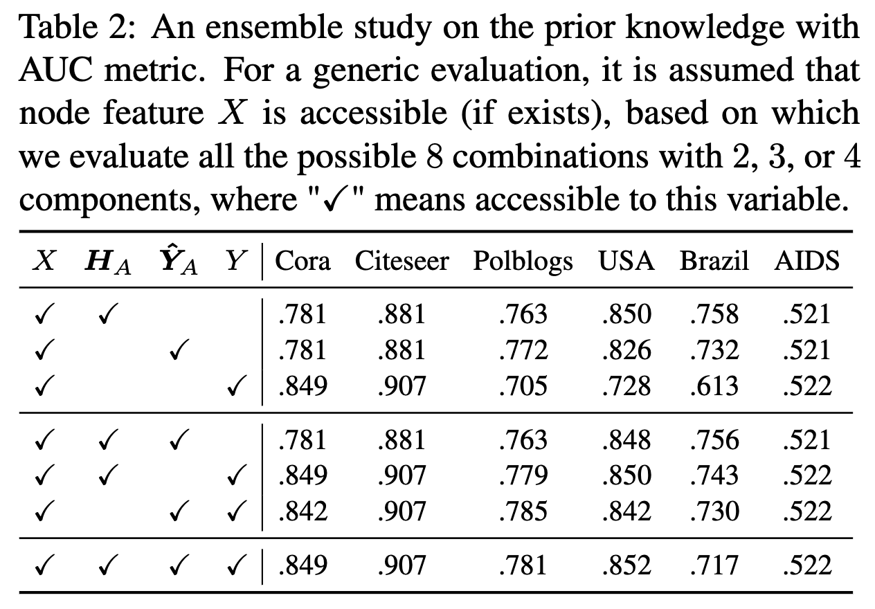
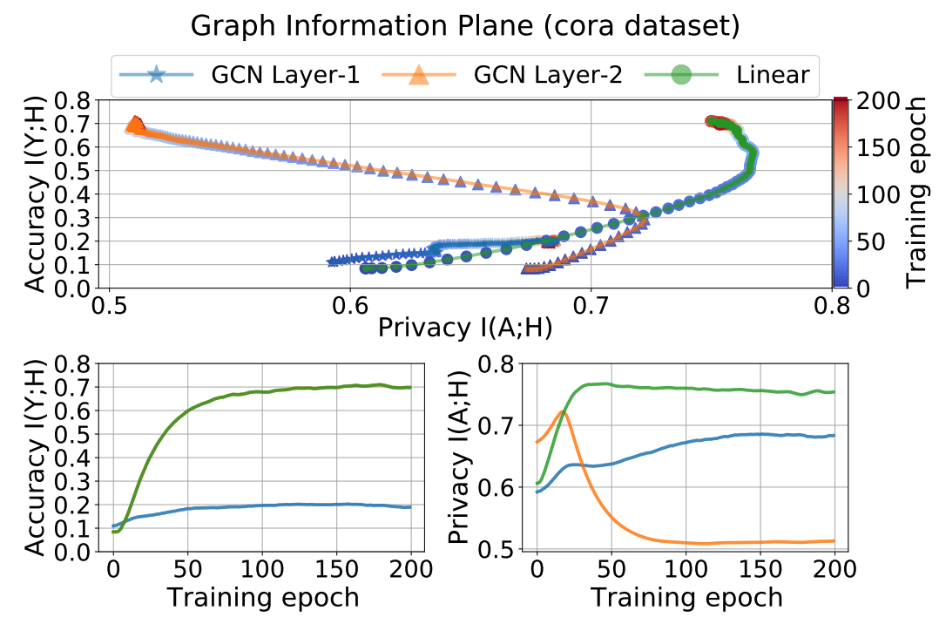
A Comprehensive Study of GRA
Based on the Markov Chain modeling:
Observation 1: a single variable in ORI-chain can recover the original adjacency to some extent
Observation 2: the linear combination of informative terms only brings marginal improvements in recovering
Observation 3: the training procedure contains two main phases, i.e., fitting and compressing
compressing
fitting
please refer to Sec. 4 in our paper
Notes:
Based on the Markov chain modeling
We
quantify the privacy risk of releasing the non-sensitive features (Sec. 4.2),
For further understanding of the learning and memorization mechanisms of ORI-chain
and acquiring inspiration for devising the corresponding defense approach
and investigate the training dynamics of graph representations w.r.t. the privacy leakage

Slide 14
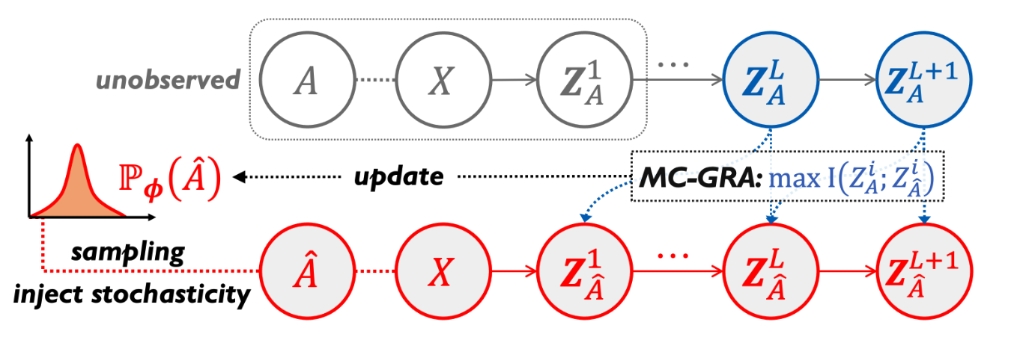
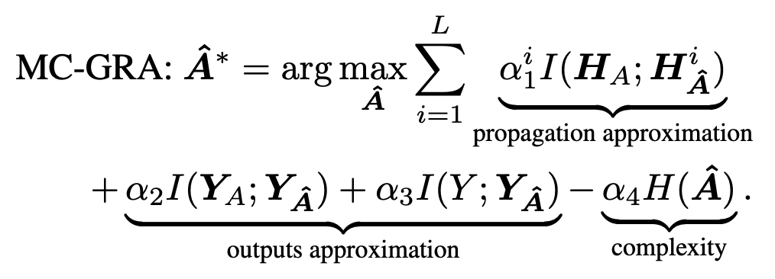
For enhancing the attack: To recover better, you must extract more
A chain-based attack method MC-GRA
extract the knowledge stored in target model
utilize all the prior knowledge simultaneously
Technical designs
the objective of enhanced attack
parametrization of the recovered adjacency
optimize with injected stochasticity
please refer to Sec. 5 in our paper

Slide 15
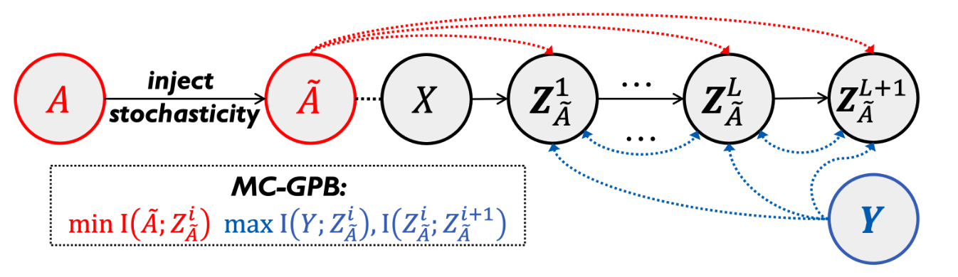
For defending the attack: To learn safer, you must forget more
A chain-based defense method MC-GPB
make the learned representations $H$ contain less information about adjacency $A$
Technical designs
the objective of defensive training
differentiable similarity measurements
optimize with injected stochasticity
please refer to Sec. 6 of our paper

Slide 16
To what extent can we recover or defend? An information-theoretical analysis

Slide 17
Outlines
Background
Problem Statement & Modeling
Experiments
Summary and Discussion

Slide 18
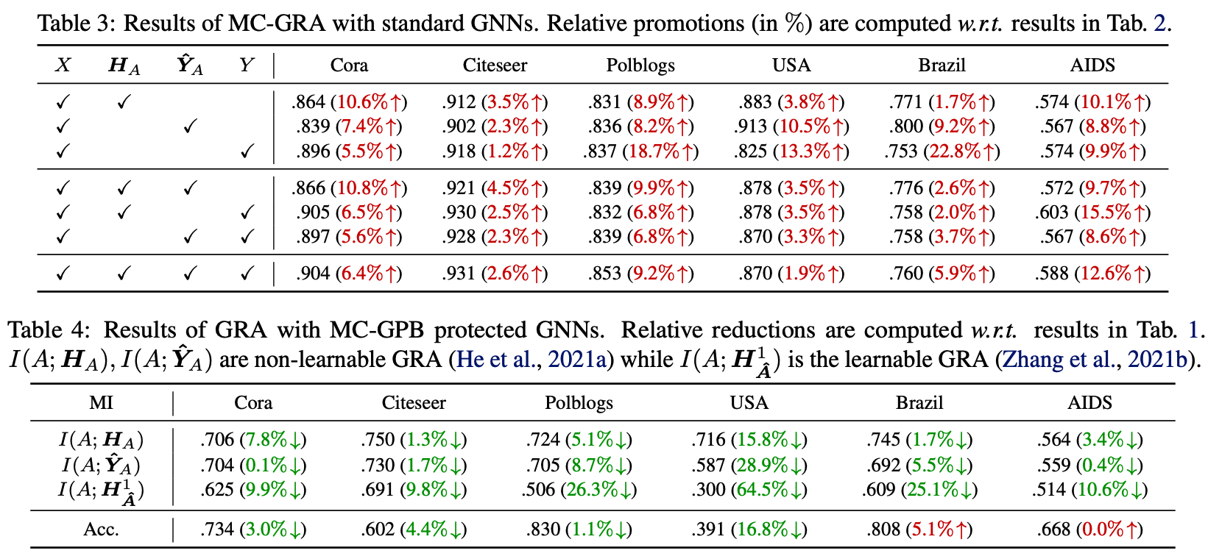
Experiments | quantitative results
MC-GRA is better
than baseline methods
MC-GPB can defend
all the baselines

Slide 19
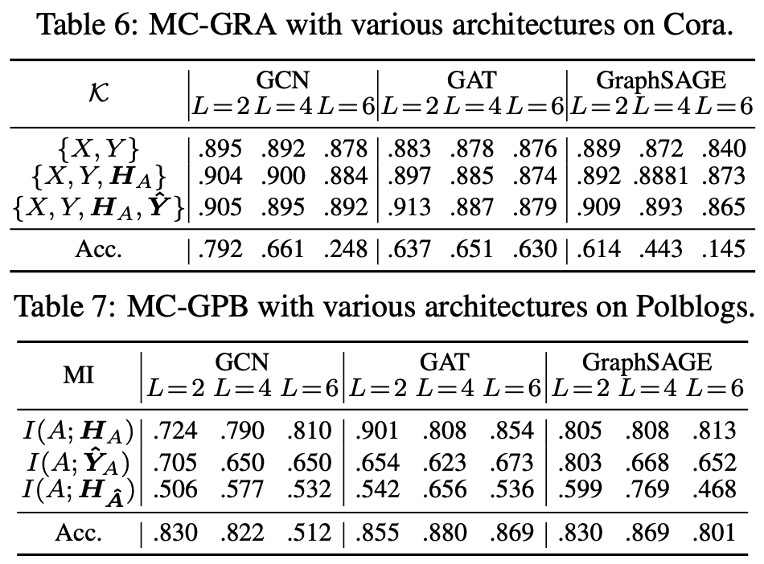
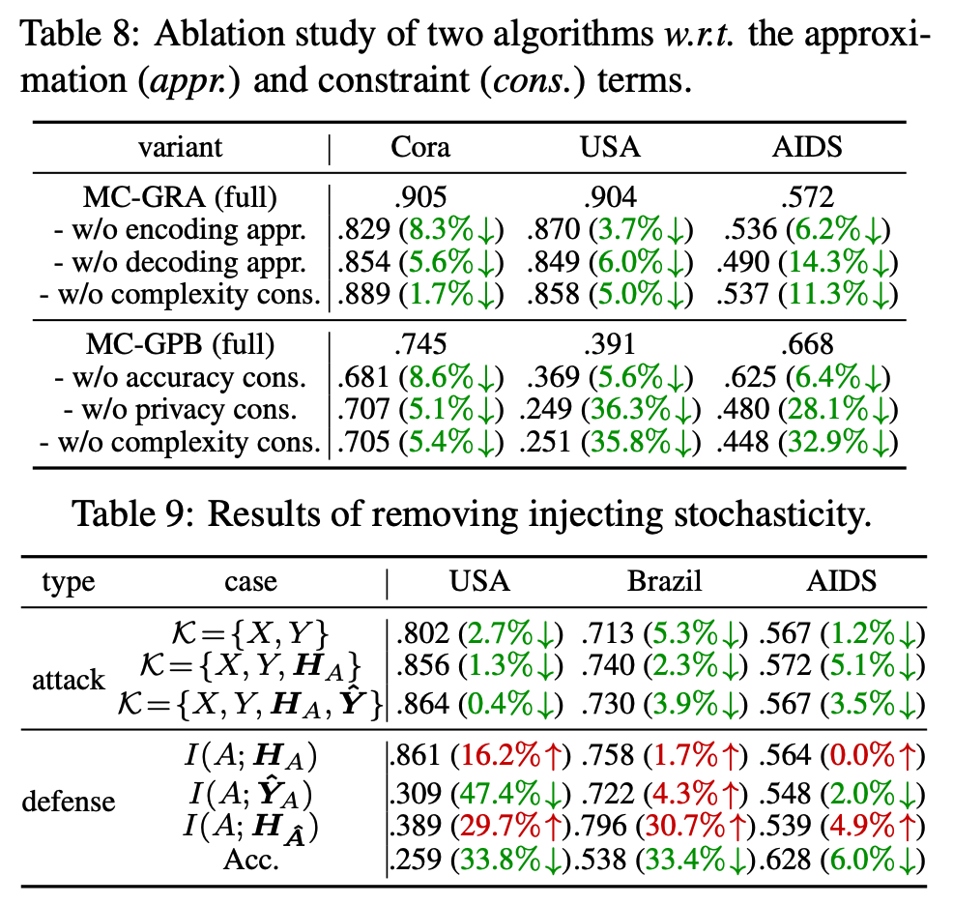
Experiments | quantitative results
MC-GRA and MC-GPB can be generalized to different scenarios

Slide 20
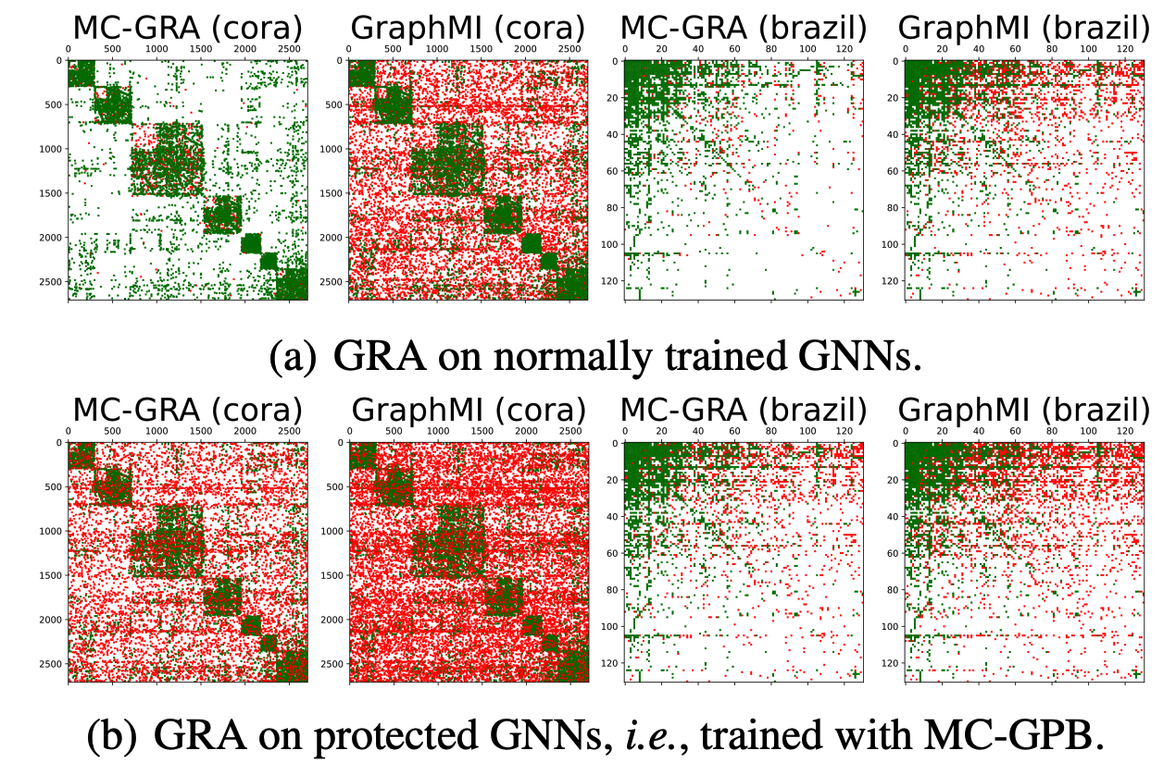
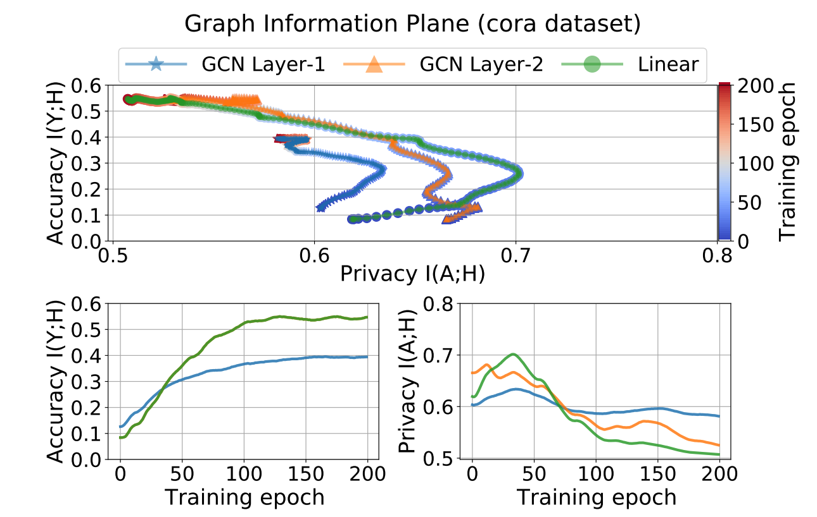
Experiments | qualitative results
Examples of recovered adjacency
Graph information plane: defensive training with MC-GPB
please refer to Sec. 7 of our paper

Slide 21
Outlines
Background
Problem Statement & Modeling
Experiments
Summary and Discussion

Slide 22
Summary
We are the first to conduct a systematic study of GRA (Graph Reconstruction Attack)
We propose a attack and a defense method based on Markov chain
We provide a information-theoretical analysis on how to strengthen and defend GRA
Both the two proposed methods achieve the best results on 6 datasets and 3 common GNNs
Design: attack objective
Design: parameterization
Method: attack
Design: inject stochasticity
Problem: Graph Reconstruction Attack
Modeling:
Markov Chain Approximation
Theoretical analysis
Method: defense
Design: defense objective
Design: parameterization
Design: inject stochasticity

Slide 23
Potential risk and values
The MI attack approaches can be misused to attack real-world targets
However, it is important to raise the awareness of such an attack
inform the community about the risk of privacy leaks, especially the user side
e.g., the attack manners and patterns
More importantly, the inversion attacks can inspire robust methods
to develop the defensing strategies and to better protect privacy
to make the AI products more safe and trustworthy

Slide 24
Potential risk and values
“The gun is not guilty, the person who pulled the trigger is.”
------ by Mikhail Kalashnikov, farther of AK-47

Slide 25
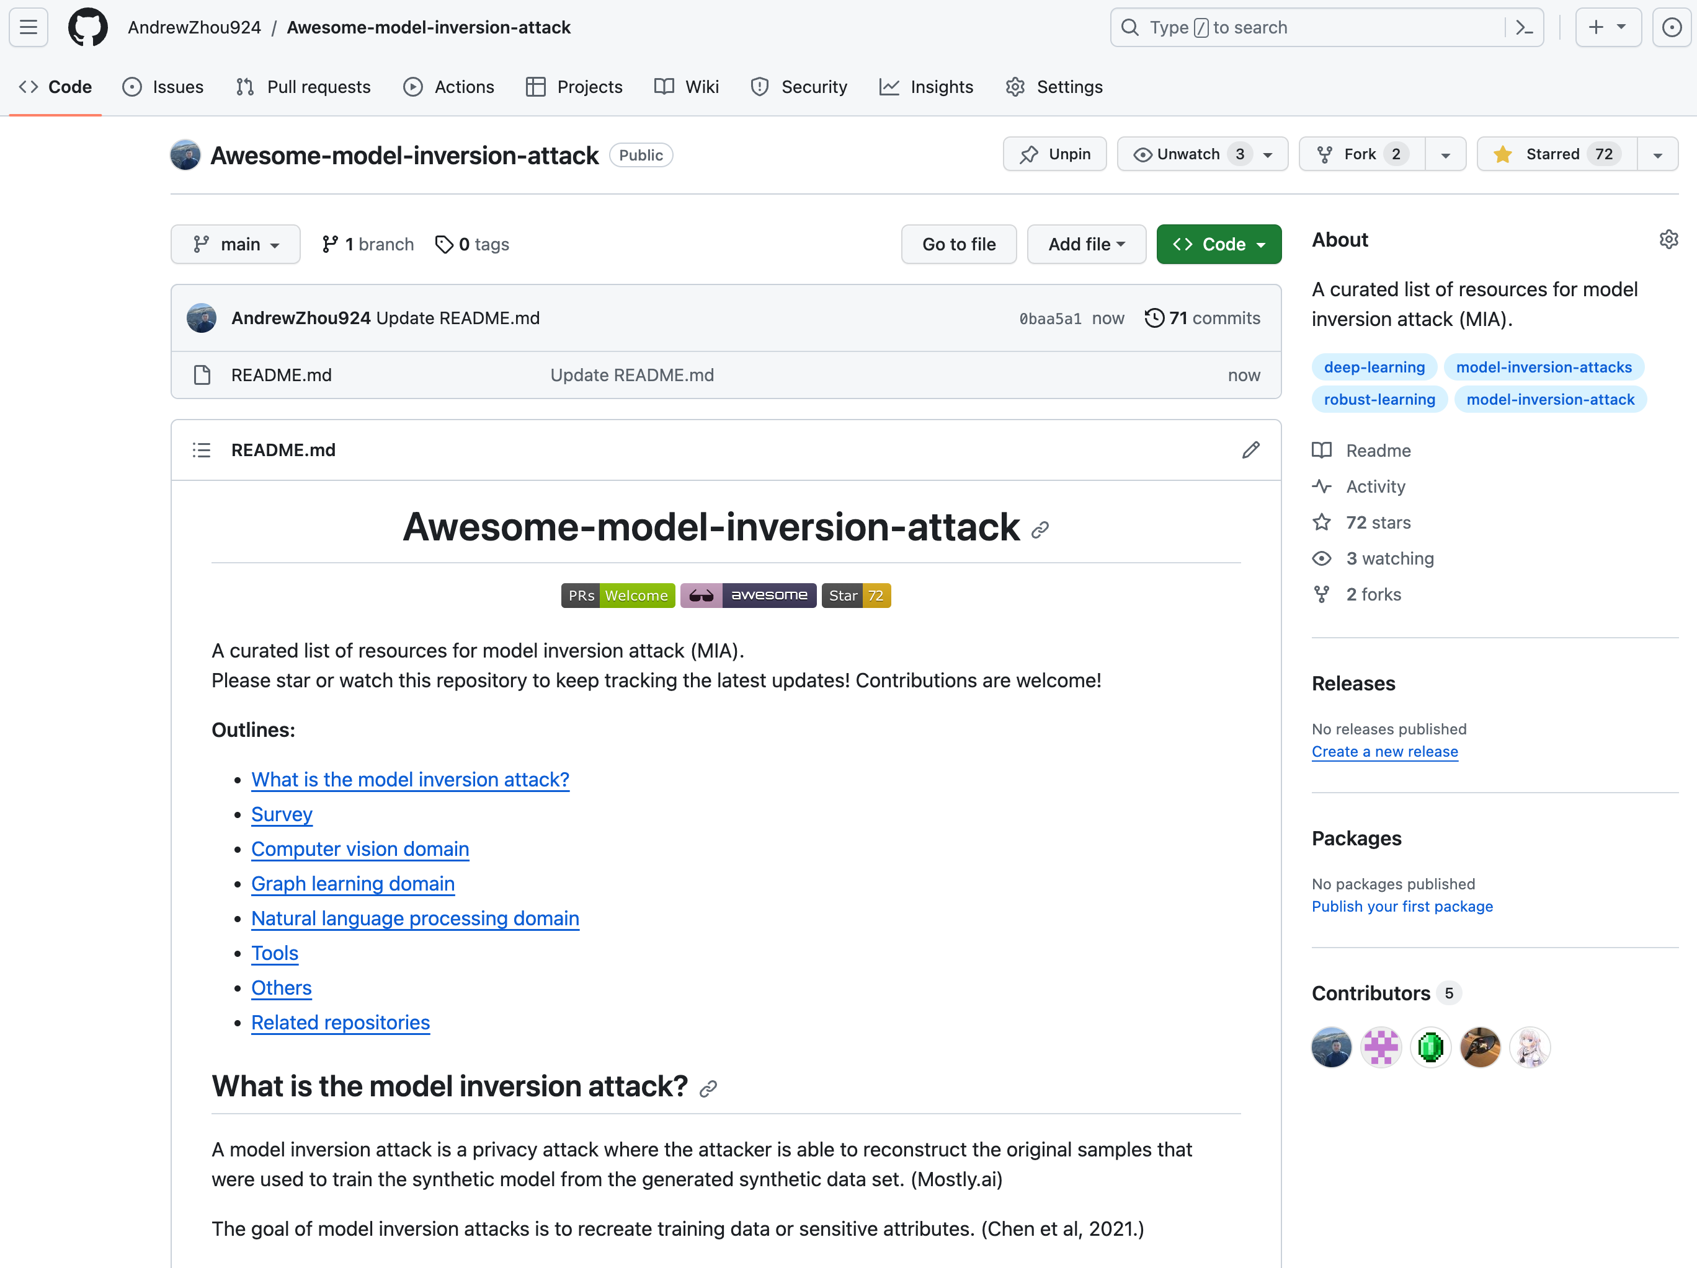
A curated list of resources
include 100+ papers
computer vision
natural language processing
graph learning
https://github.com/AndrewZhou924/Awesome-model-inversion-attack

Slide 26
Research scope | Foundation Models
The idea still not works (yet)
What FM cannot do well
e.g., algorithmic/complex reasoning
Emerging
Abilities
What FM can do well
but underexplored
e.g., multi-agent collaboration,
predicting future events
What FM can do well
and well-known
e.g., zero/few-shot with in-context learning,
traditional supervised learning tasks
The idea works
Scaling up
model scale
data scale
computing scale
What FM
shouldn’t do
e.g., jailbreak, privacy leakage
The idea doesn’t work
¹FM: Foundation Models, including LLM, VLM, etc.

Slide 27
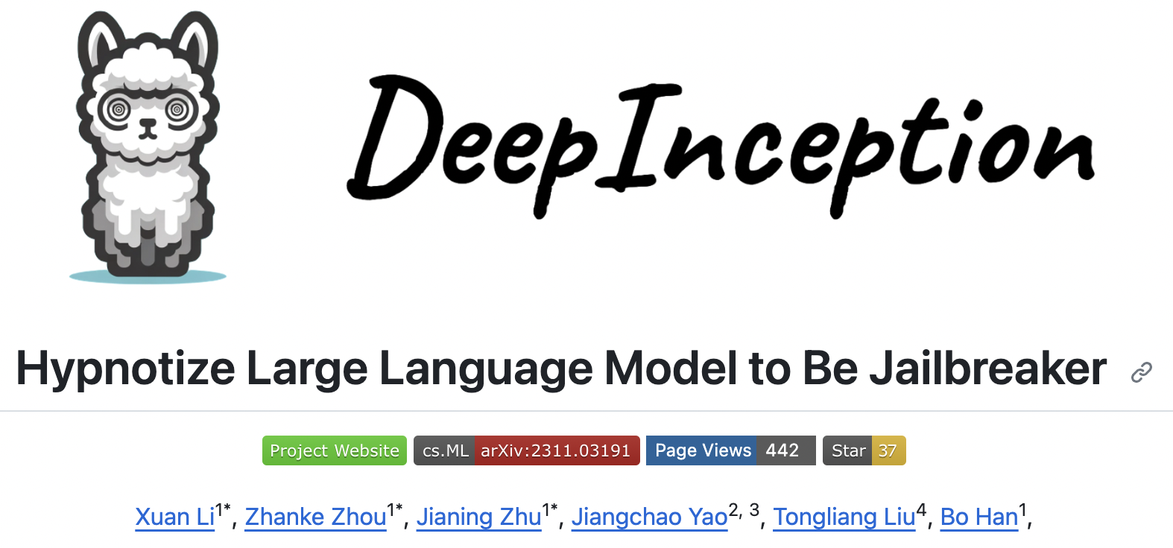
DeepInception | out recent work
An example of DeepInception:
Paper: https://arxiv.org/pdf/2311.03191.pdf
Github: https://github.com/tmlr-group/DeepInception
Project: https://deepinception.github.io/
Any feedback is Welcome!

Slide 28
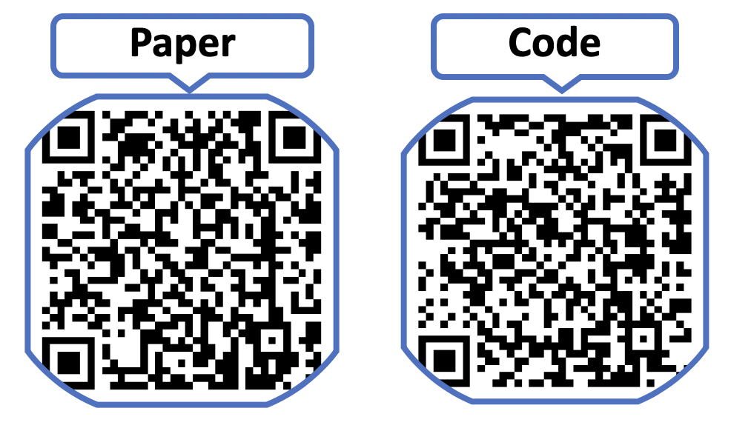
Q & A
Thanks for your listening!
Email: cszkzhou@comp.hkbu.edu.hk
WeChat: zhouzhanke924

