Slide 1
Recent Advances on LLM Reasoning with Graphs
Zhanke Zhou
PhD student @ TMLR Group, HKBU
2023 / 11 / 09
Personal Github: https://github.com/AndrewZhou924 Email: cszkzhou@comp.hkbu.edu.hk Wechat: zhouzhanke924

Slide 2
Outlines
Background
An overview of LLMs & Graphs
paper-1: Can Language Models Solve Graph Problems in Natural Language? 2023/05
paper-2: GraphText: Graph Reasoning in Text Space. 2023/10
paper-3: Large Language Models can Learn Rules. 2023/10
Summary and Discussion

Slide 3
Outlines
Background (Learning on Graphs)
An overview of LLMs & Graphs
paper-1: Can Language Models Solve Graph Problems in Natural Language? 2023/05
paper-2: GraphText: Graph Reasoning in Text Space. 2023/10
paper-3: Large Language Models can Learn Rules. 2023/10
Summary and Discussion

Slide 4
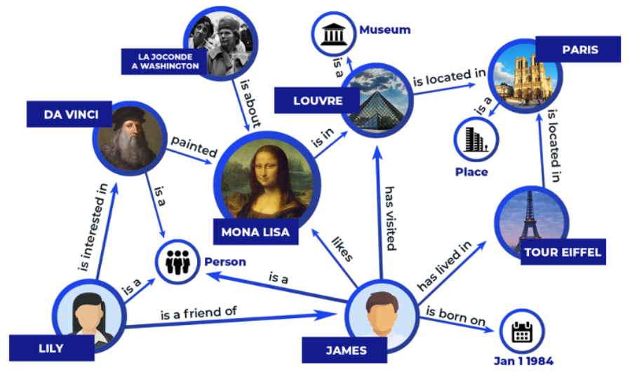
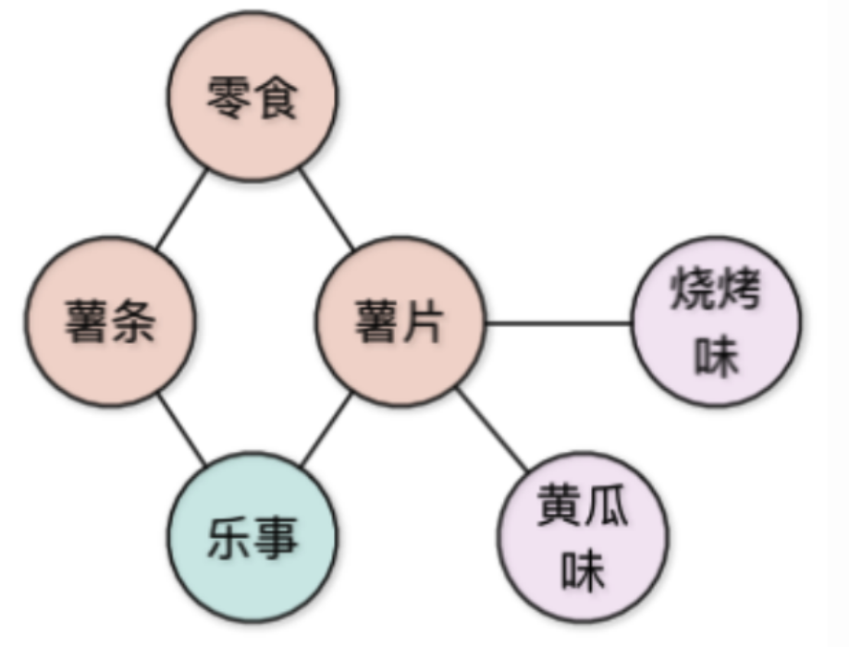
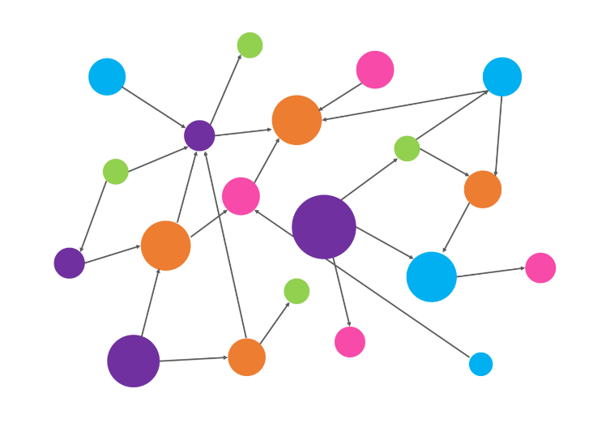
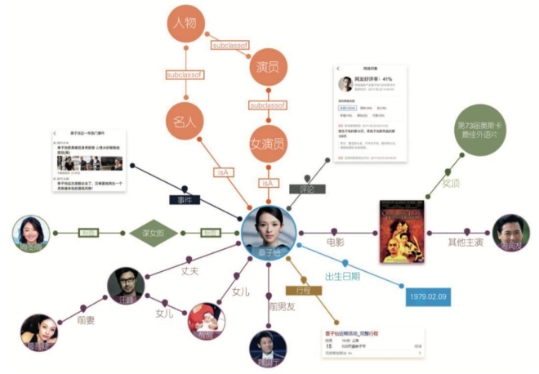
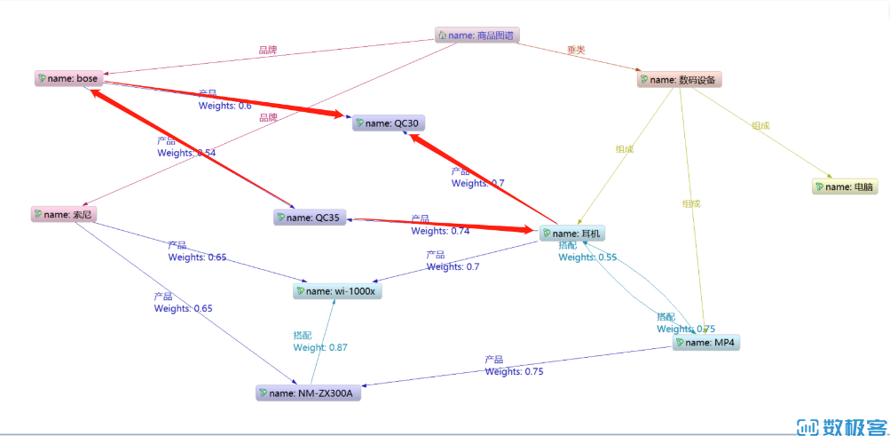
Background
Graph: a general form
of data expression
Notes:
Graph is a general form of data expression, commonly seen in knowledge graph, common sense graph, user-product interaction graph

Slide 5
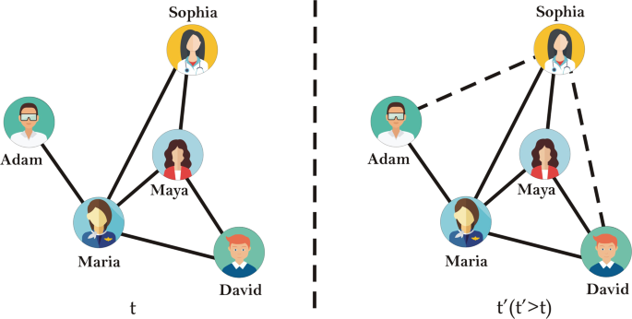
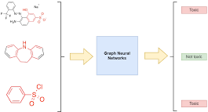
Background
node-level
link-level
graph-level

Slide 6
Background
GNN for learning on graphs
encode: $n_{u}→{h_{u}:ℝ}^{d}$
node
$h_{u}$: node representation
u
$$ℝ^{d}$$
decode: $φ_{uv}=READOUT\left(h_{u},h_{v}\right)→ℝ$
e.g.,
the link-level task
optimization: $ℒ=\sum_{e_{uv}∈ℰ^{train}}{{−y}_{ij}log⁡(φ_{uv})}+\left(1−y_{ij}\right)log⁡(1−φ_{uv})$

Slide 7
Background
node-level
link-level
graph-level
Key challenges (bottlenecks) of graph learning
Generalization (to test-time graphs)
Expressiveness and Data heterogeneity (structural / semantical heterogeneity)
Robustness (to noisy/adversarial examples) / Scalability (prone to the scale of input graph)

Slide 8
Outlines
Background
An overview of LLMs & Graphs
Integrating Graphs with Large Language Models: Methods and Prospects. Arxiv 2023.10.
Exploring the Potential of Large Language Models (LLMs) in Learning on Graphs. Arxiv 2023.08.
paper-1: Can Language Models Solve Graph Problems in Natural Language? 2023/05
paper-2: GraphText: Graph Reasoning in Text Space. 2023/10
paper-3: Large Language Models can Learn Rules. 2023/10
Summary and Discussion

Slide 9
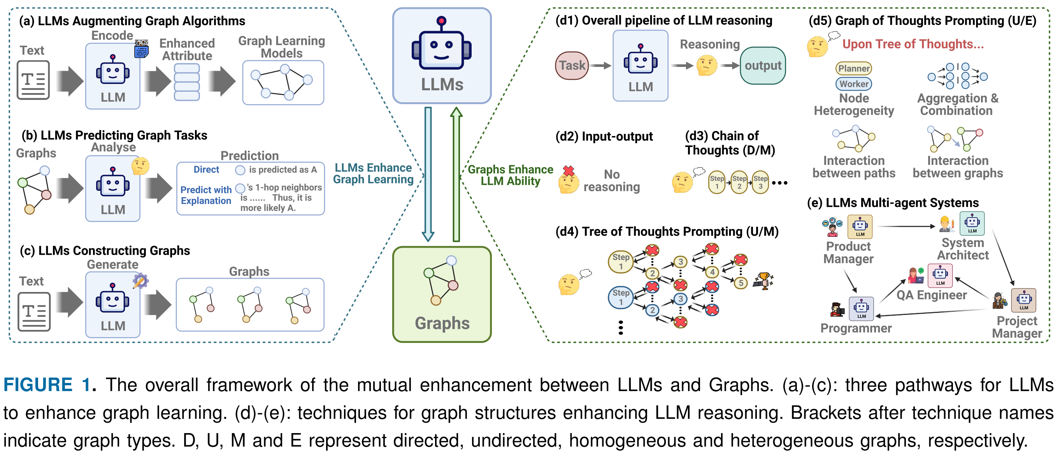
Overview
Integrating Graphs with Large Language Models: Methods and Prospects. Arxiv 2023.10.

Slide 10
Overview | ﻿LLMs Enhancing Graph Learning
LLM-as-Enhancers (of GNNs)
LLM-as-Predictors
Exploring the Potential of Large Language Models (LLMs) in Learning on Graphs. Arxiv 2023.08.
Integrating Graphs with Large Language Models: Methods and Prospects. Arxiv 2023.10.

Slide 11
Overview | ﻿LLMs Enhancing Graph Learning
e.g.,
NLGraph (paper-1)
GRAPHTEXT (paper-2)
Integrating Graphs with Large Language Models: Methods and Prospects. Arxiv 2023.10.

Slide 12
Overview | ﻿﻿Graphs Enhance LLM Ability
e.g.,
Chain-of-thought,
Tree-of-thought,
Graph-of-thought,
Hypotheses-to-Theories (paper-3),
etc.
Integrating Graphs with Large Language Models: Methods and Prospects. Arxiv 2023.10.

Slide 13
Outlines
Background
An overview of LLMs & Graphs
paper-1: Can Language Models Solve Graph Problems in Natural Language? 2023/05
paper-2: GraphText: Graph Reasoning in Text Space. 2023/10
paper-3: Large Language Models can Learn Rules. 2023/10
Summary and Discussion

Slide 14
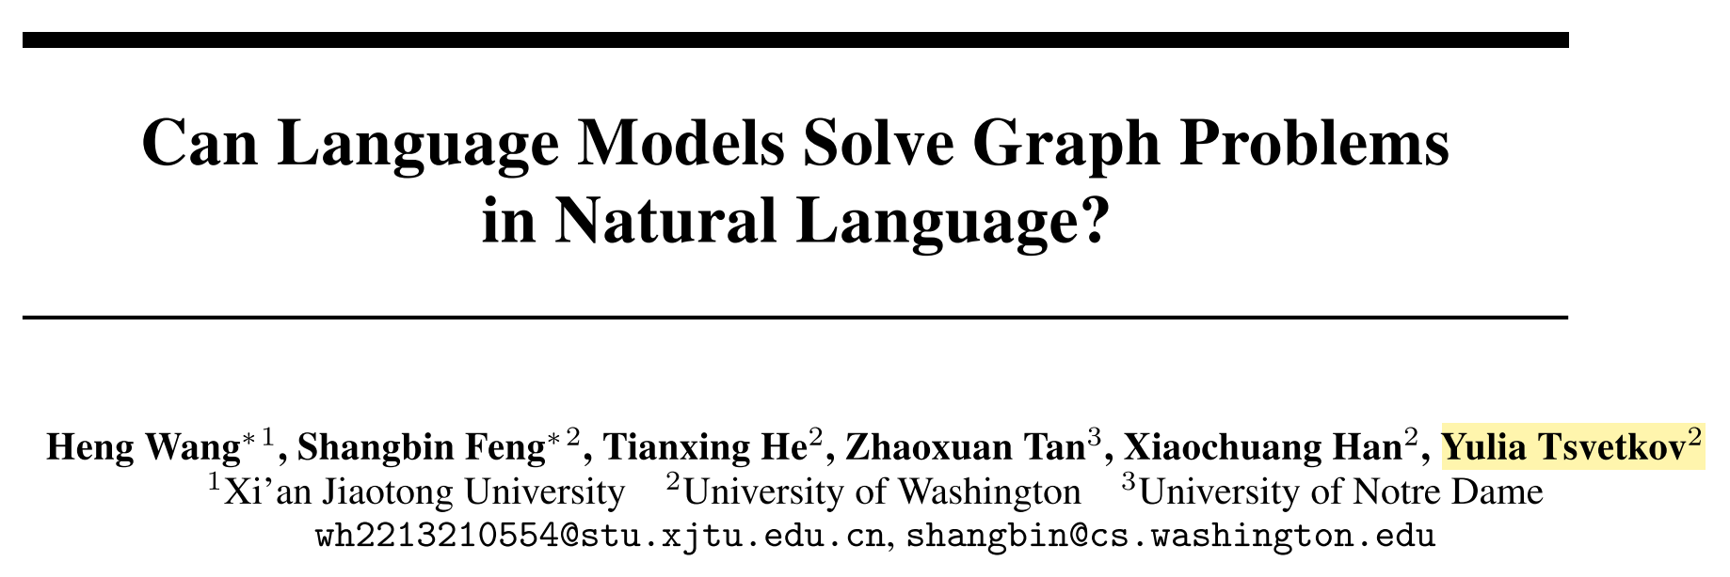
About the paper | NeurIPS 2023 (Spotlight)
The investigated problem:
Can LLMs solve graph algorithm problems in natural language?
NLGraph Benchmark → the base of evaluation
Experiments → evaluating LLMs
Instruction-based Approaches → enhance LLMs

Slide 15
NLGraph Benchmark | overview
NLGraph Benchmark
Experiments
Instruction-based Approaches

Slide 16
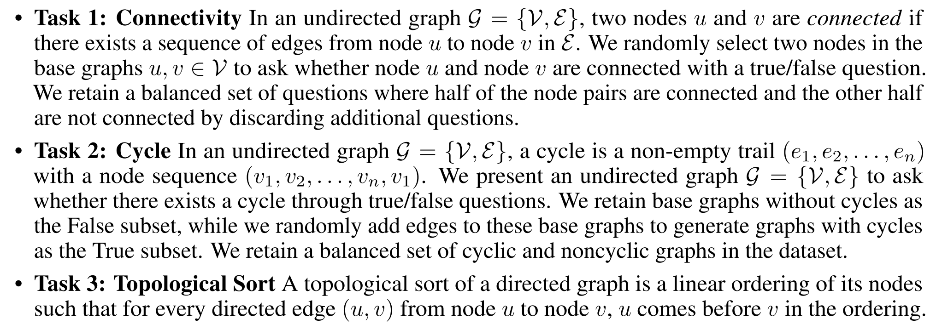
NLGraph Benchmark

Slide 17
NLGraph Benchmark

Slide 18
NLGraph Benchmark

Slide 19
NLGraph Benchmark | data generation
﻿NLGraph benchmark is with
5,902 problems in a standard version
29,370 problems in an extended version
“easy” tasks
“hard” tasks

Slide 20
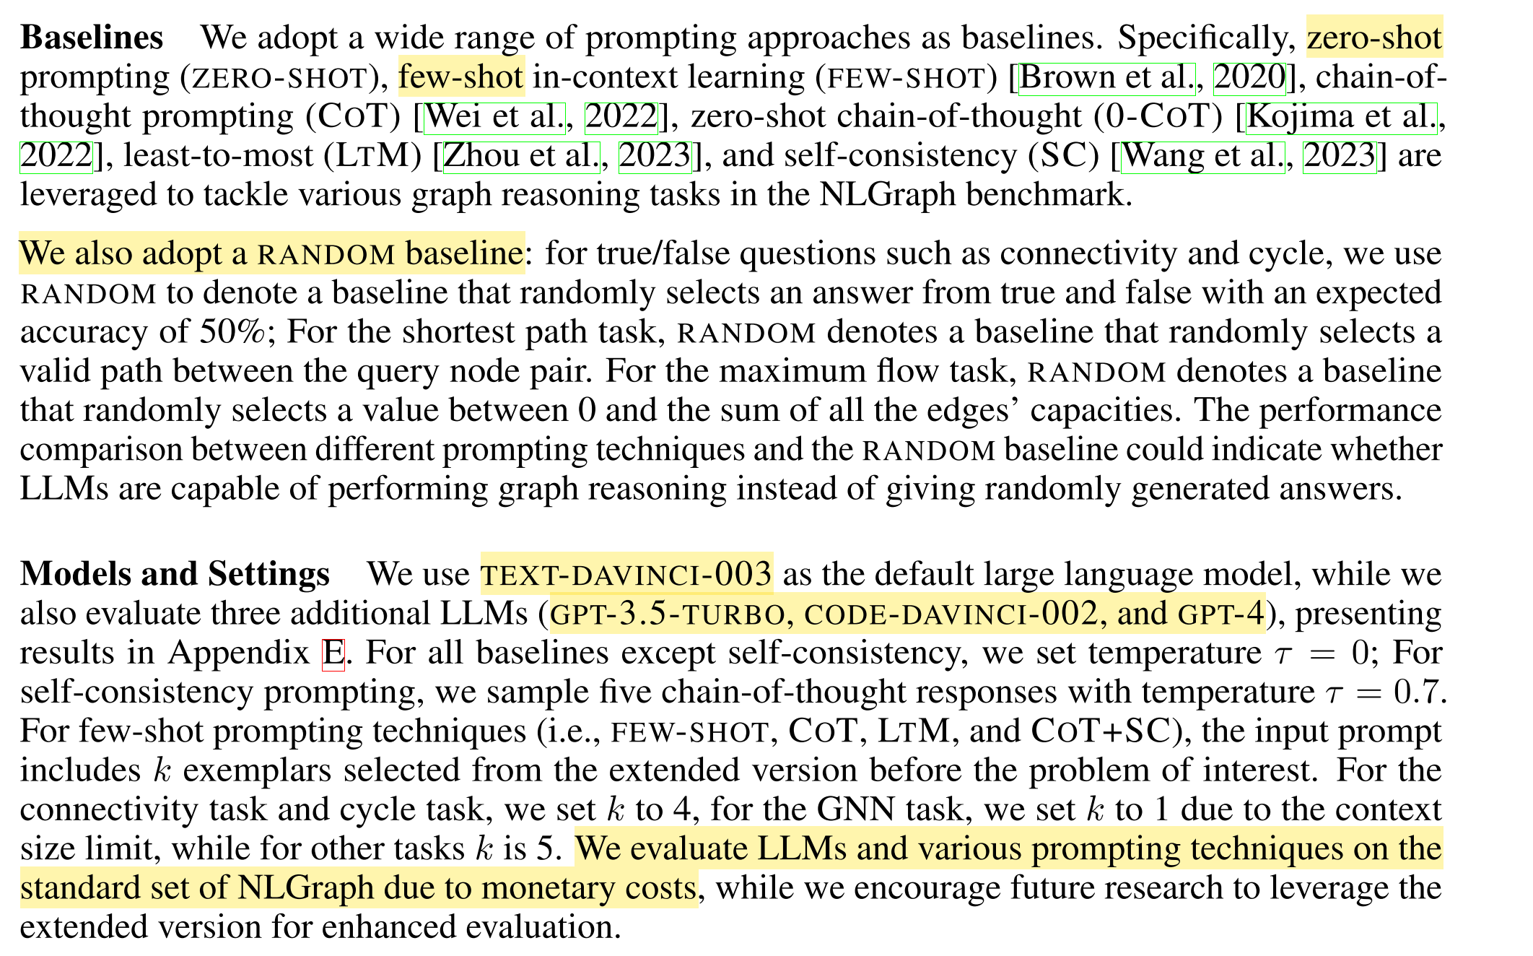
Experiment | Setup
NLGraph Benchmark
Experiments
Instruction-based Approaches

Slide 21
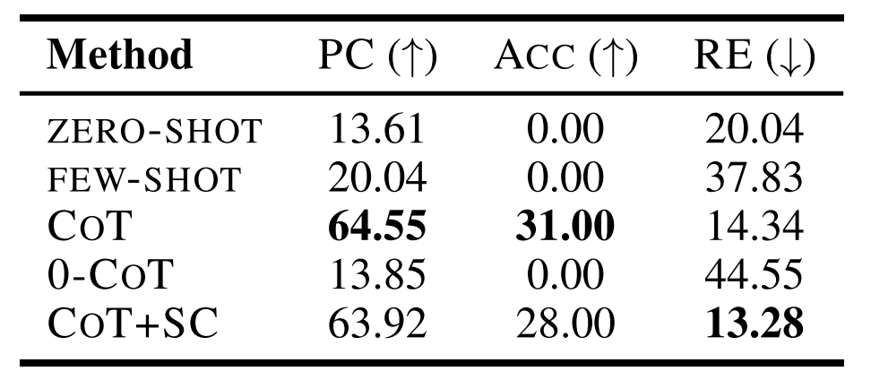
Experiment
Random < Zero-shot < Few-shot < COT
﻿Model performance on the task of simulating graph neural networks.
PC and RE are two ﻿partial credit metrics.
➔ ﻿LLMs Have (Preliminary) Graph Reasoning Abilities

Slide 22
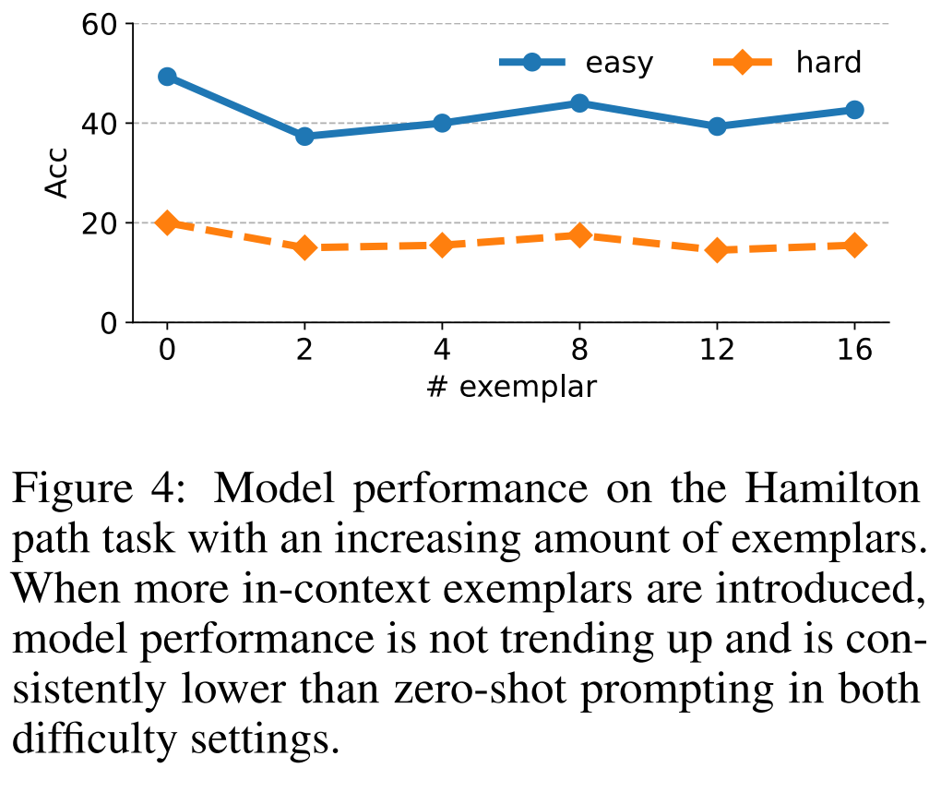
Experiment
﻿In-Context Learning Can be Counterproductive
➔ ﻿LLMs fall short of generating valid intermediate steps to solve the more complex graph reasoning problem

Slide 23
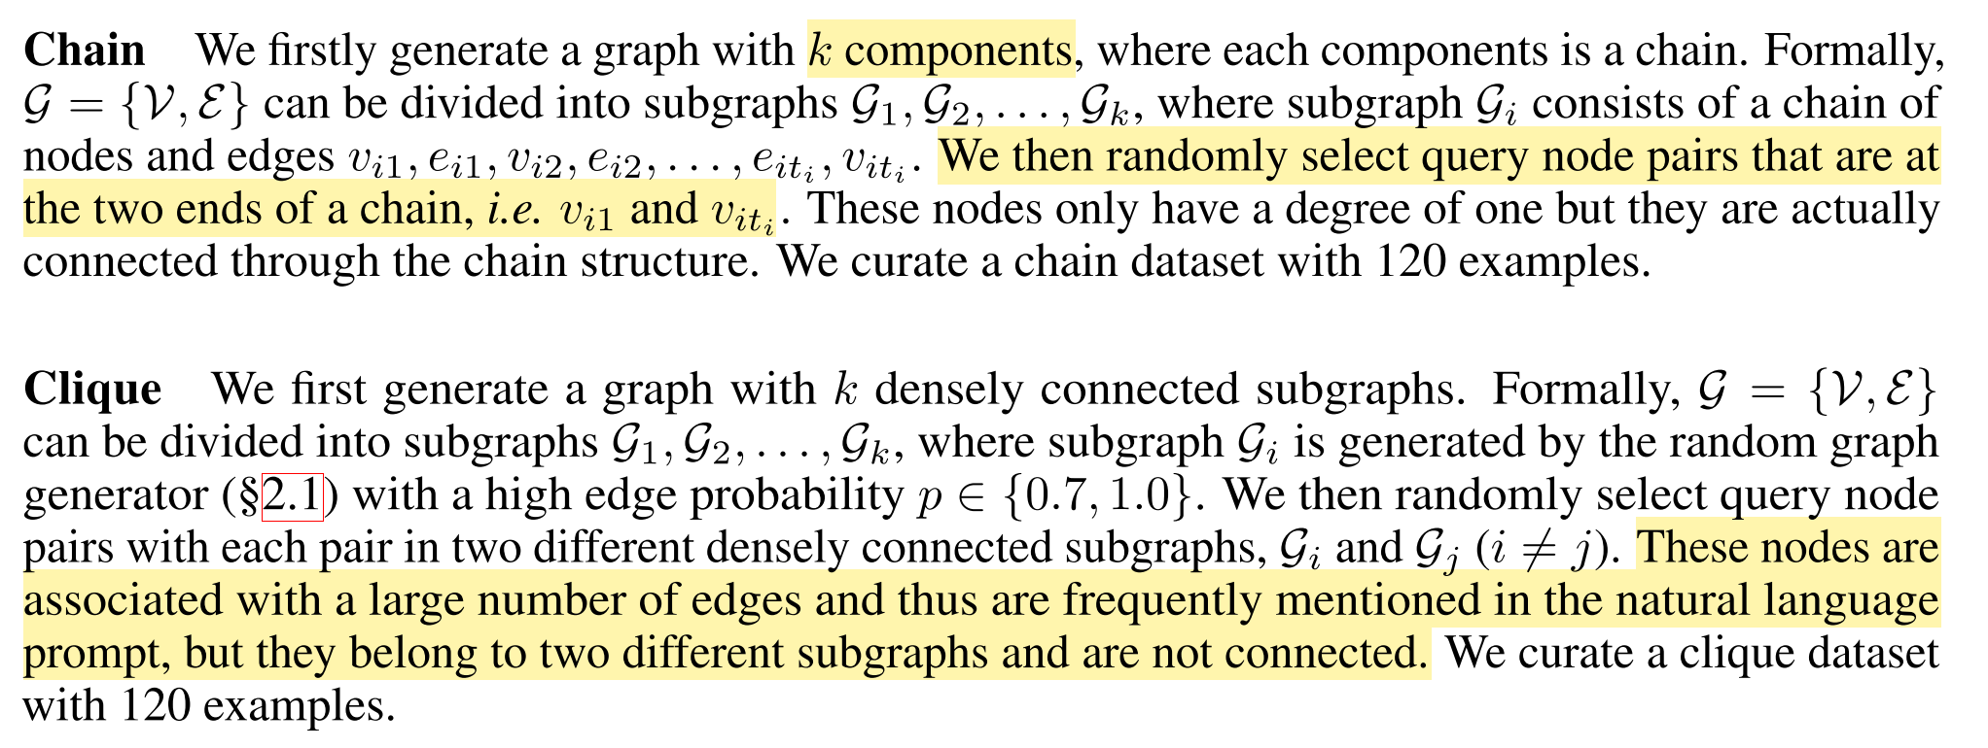
Experiment
Two variant tasks of the connectivity task
﻿LLMs are indeed vulnerable to spurious correlations in structured reasoning
(But, it that real? 🤔)

Slide 24
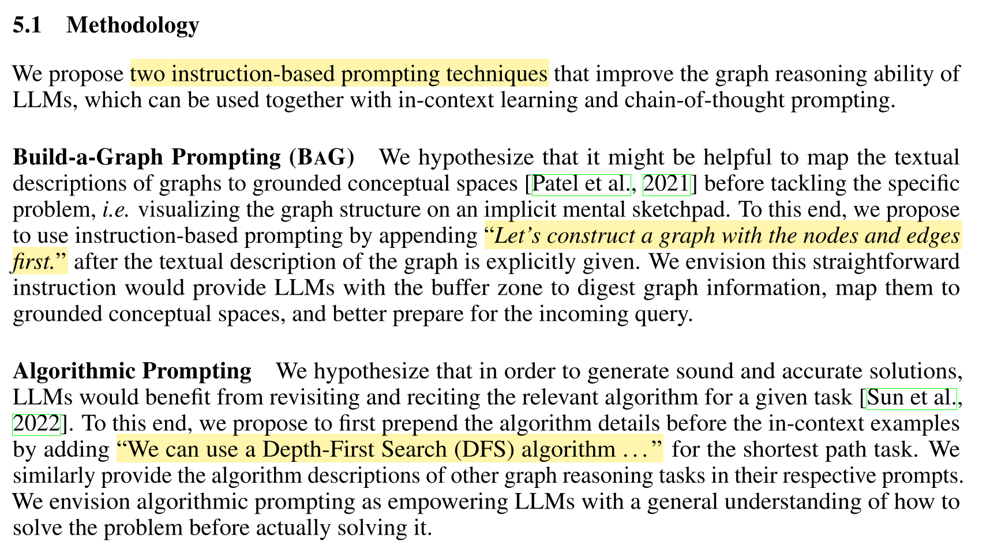
Instruction-based Approaches
NLGraph Benchmark
Experiments
Instruction-based Approaches

Slide 26
Take-home messages (paper-1)
﻿Extensive experiments on the NLGraph benchmark demonstrate that:
LLMs do possess preliminary graph reasoning abilities.
The benefit of advanced prompting methods diminishes with complex problems.
Learning from examples did not happen on complex graph reasoning problems.
LLMs are (un)surprisingly brittle to spurious correlations in problem settings.
Note that the LLMs here
can only rely on the structural information of graphs
previous studies on text-attributed graphs have justified the importance of texts

Slide 27
Outlines
Background
An overview of LLMs & Graphs
paper-1: Can Language Models Solve Graph Problems in Natural Language? 2023/05
paper-2: GraphText: Graph Reasoning in Text Space. 2023/10
paper-3: Large Language Models can Learn Rules. 2023/10
Summary and Discussion

Slide 28
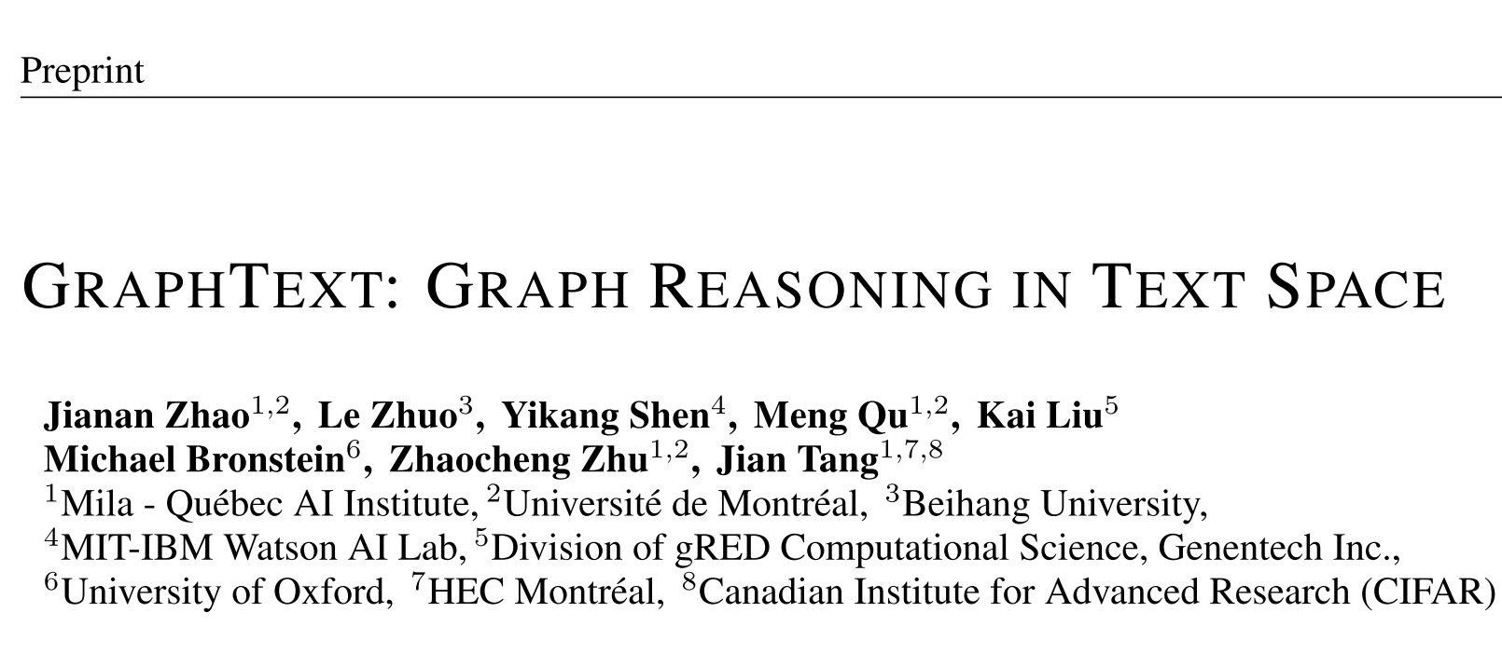
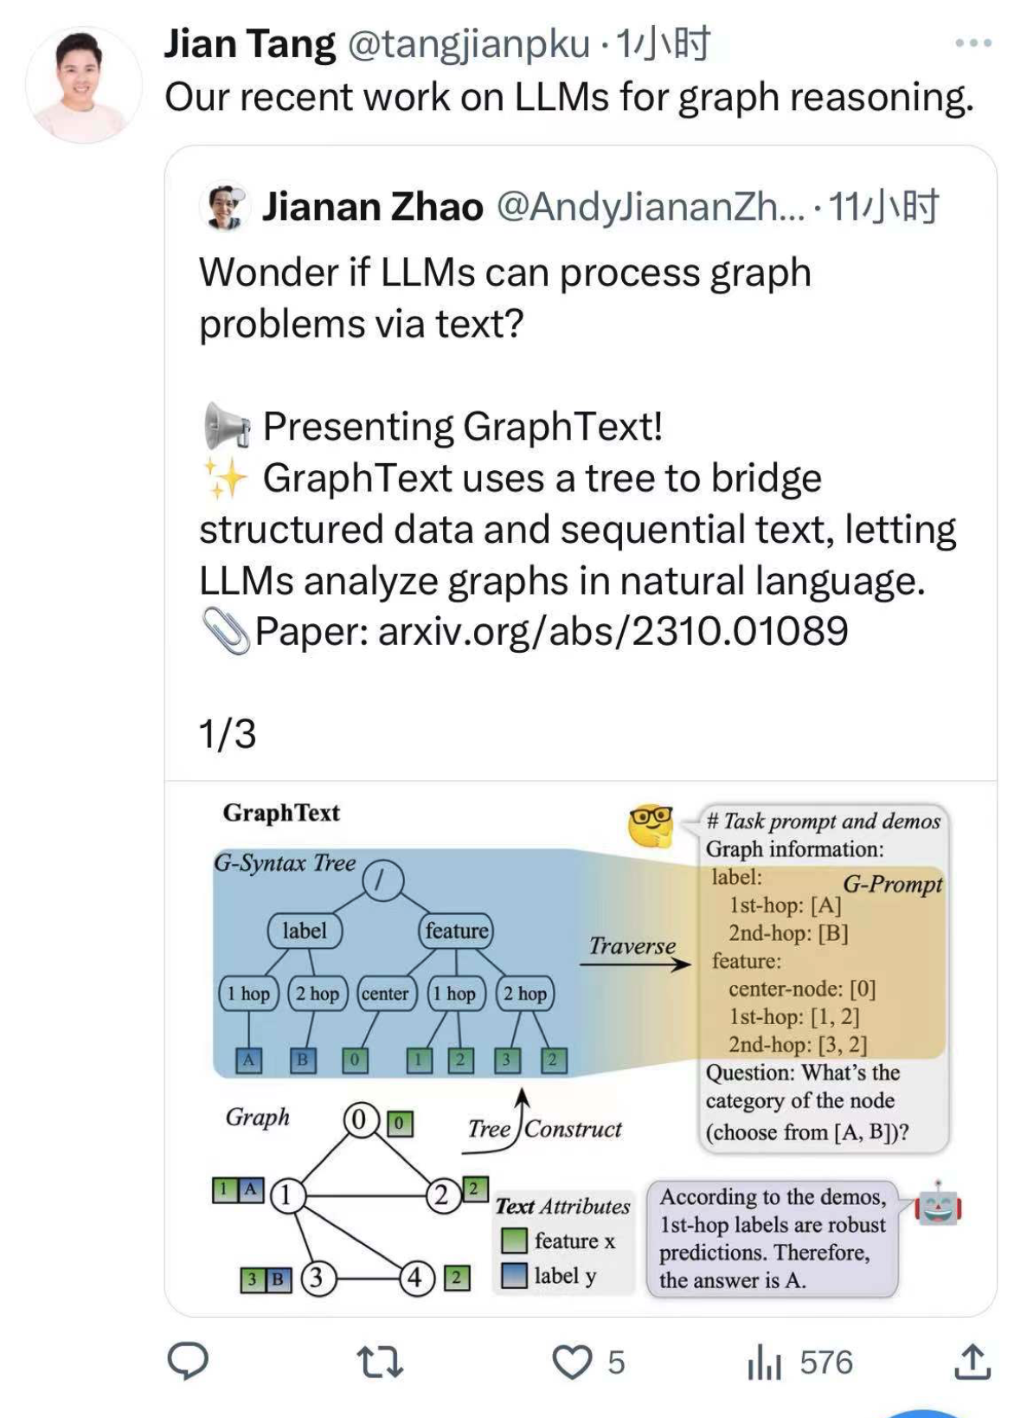
Arxiv 2023/10/02 https://arxiv.org/abs/2310.01089

Slide 29
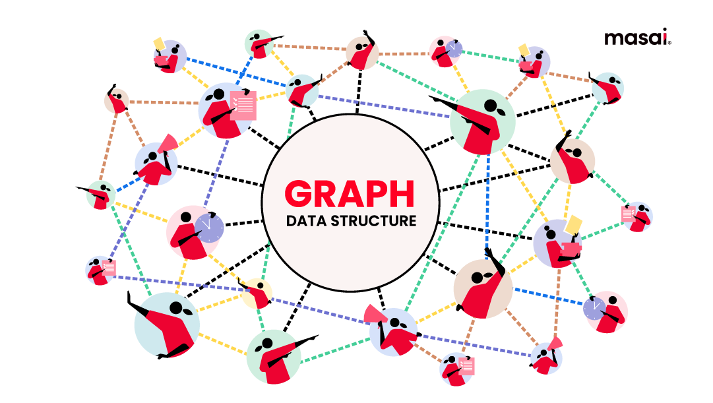
Difficulty of applying LLM to graph learning
➔The modality gap between “graph” and “text”
So, ﻿can we derive a language for graph in natural language? 🤔

Slide 30
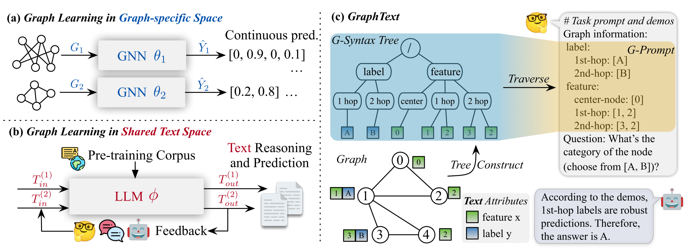
Difficulty of applying LLM to graph learning
GRAPHTEXT: ﻿a graph-syntax tree for each graph that
encapsulates both the node attributes and inter-node relationships
﻿An example of the GRAPHTEXT framework
that classifies node 0:
Given a graph, GRAPHTEXT constructs a graph-syntax tree that contains both node attributes (e.g. feature and label) and relationships (e.g. center-node, 1st-hop, and 2nd-hop).
Then, GRAPHTEXT traverses the graph-syntax tree to obtain a sequential text, i.e. graph prompt, and let LLM perform graph reasoning in text space.

Slide 31
Comparing with GNNs
Advantages compared with GNNs
equipped with commonsense knowledge
handling text features/attributes
generalization to few/zero-shot settings
explainability and human-AI interaction
﻿GNN framework:
different GNNs θ1 θ2 are trained
for different graphs G1 and G2
﻿GRAPHTEXT framework:
﻿encodes the graph information to text
generates text as prediction (reasoning)
leverages a pre-trained LLM
perform training-free graph reasoning
enables human-AI interaction in natural language

Slide 32
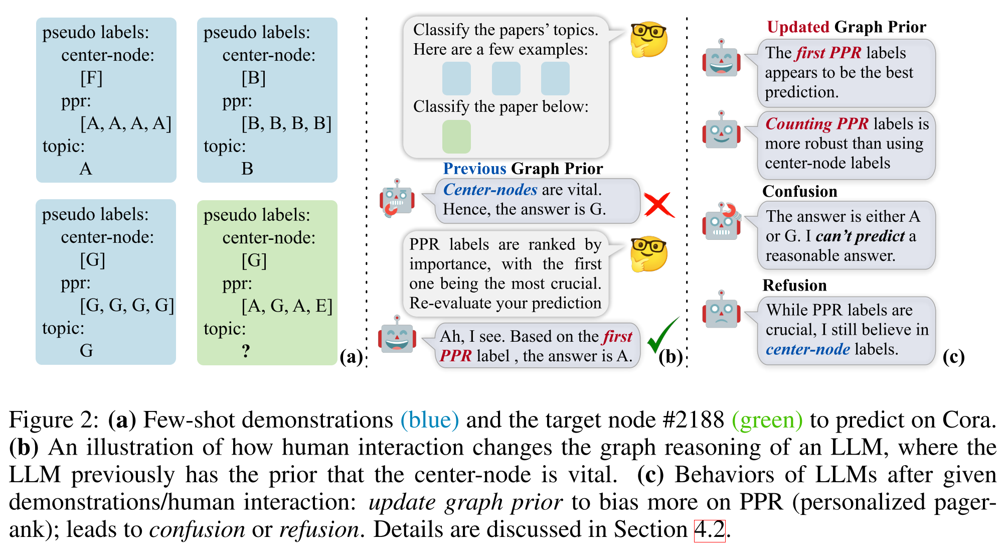
Application: Few-shot reasoning with interaction

Slide 33
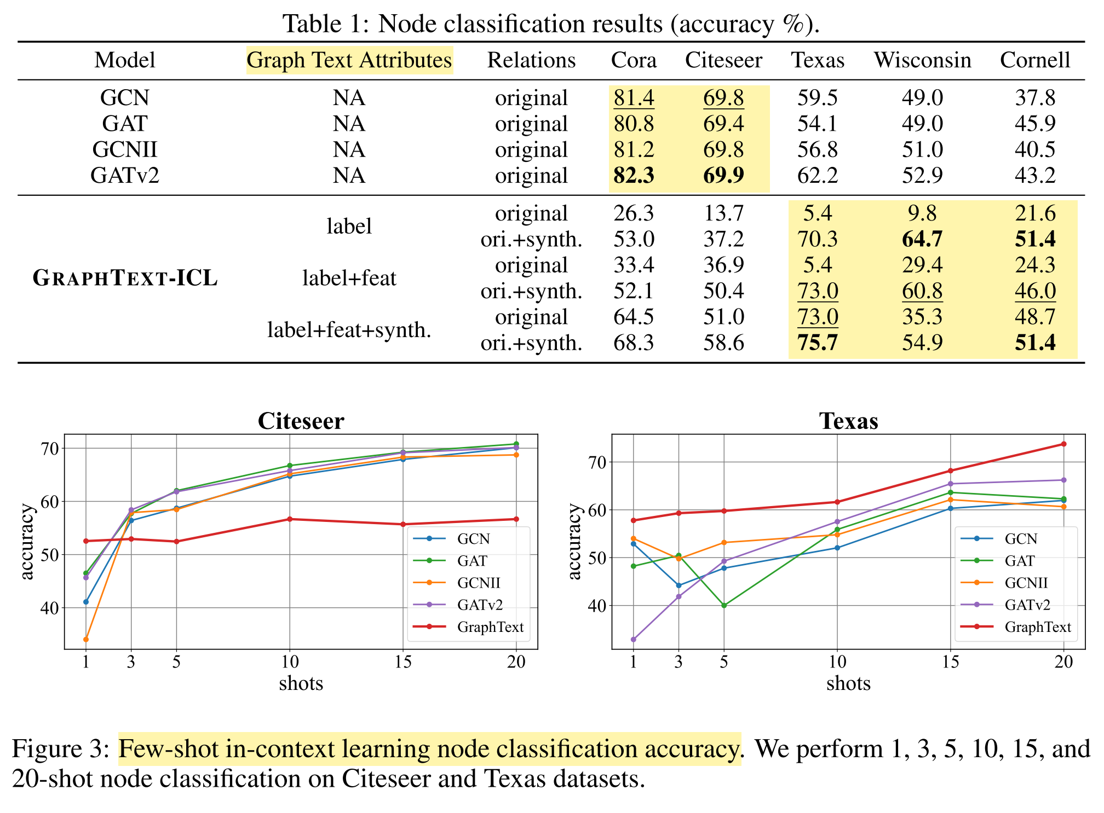
Experiment
➔ GRAPHTEXT can deliver performance on par with, or even surpassing, supervised GNNs through in-context learning.
➔ GRAPHTEXT can out-perform GNNs
in Zero-shot / Few-shot setting.

Slide 34
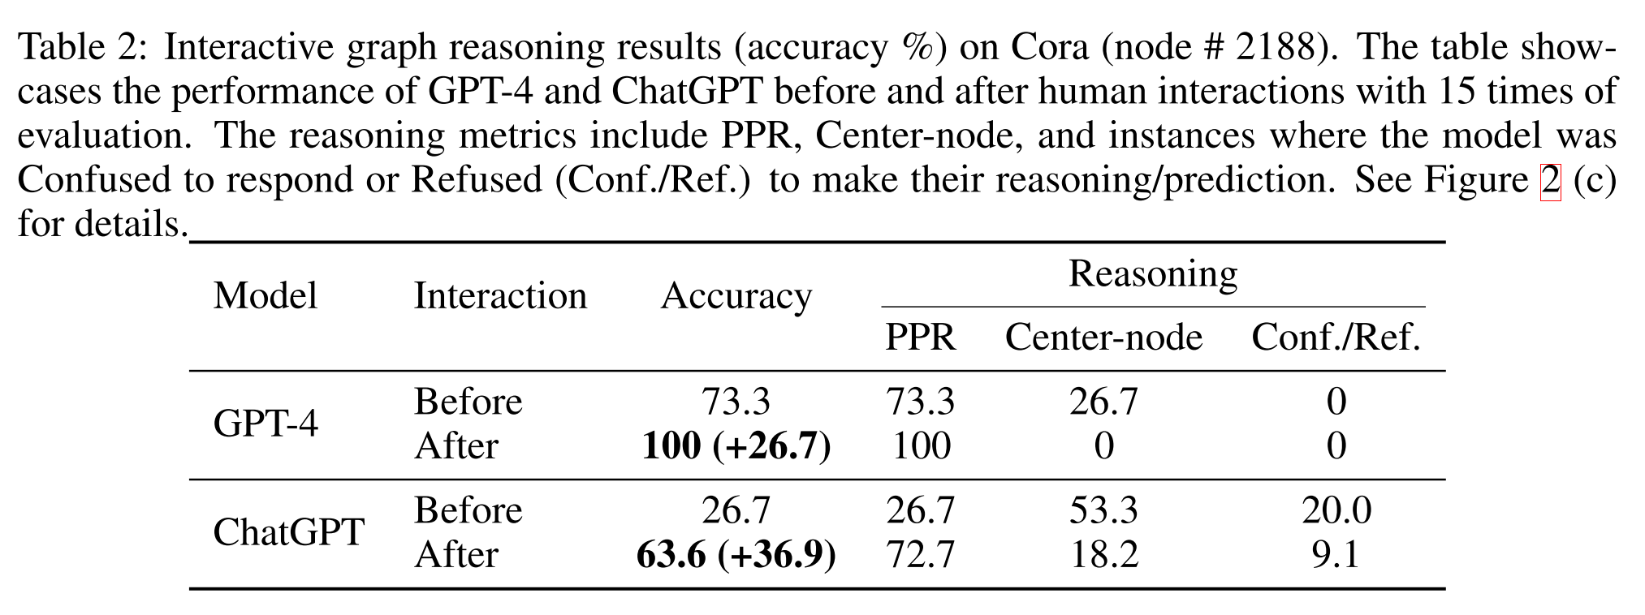
Experiment
➔ The human-LLM interaction is essential.

Slide 35
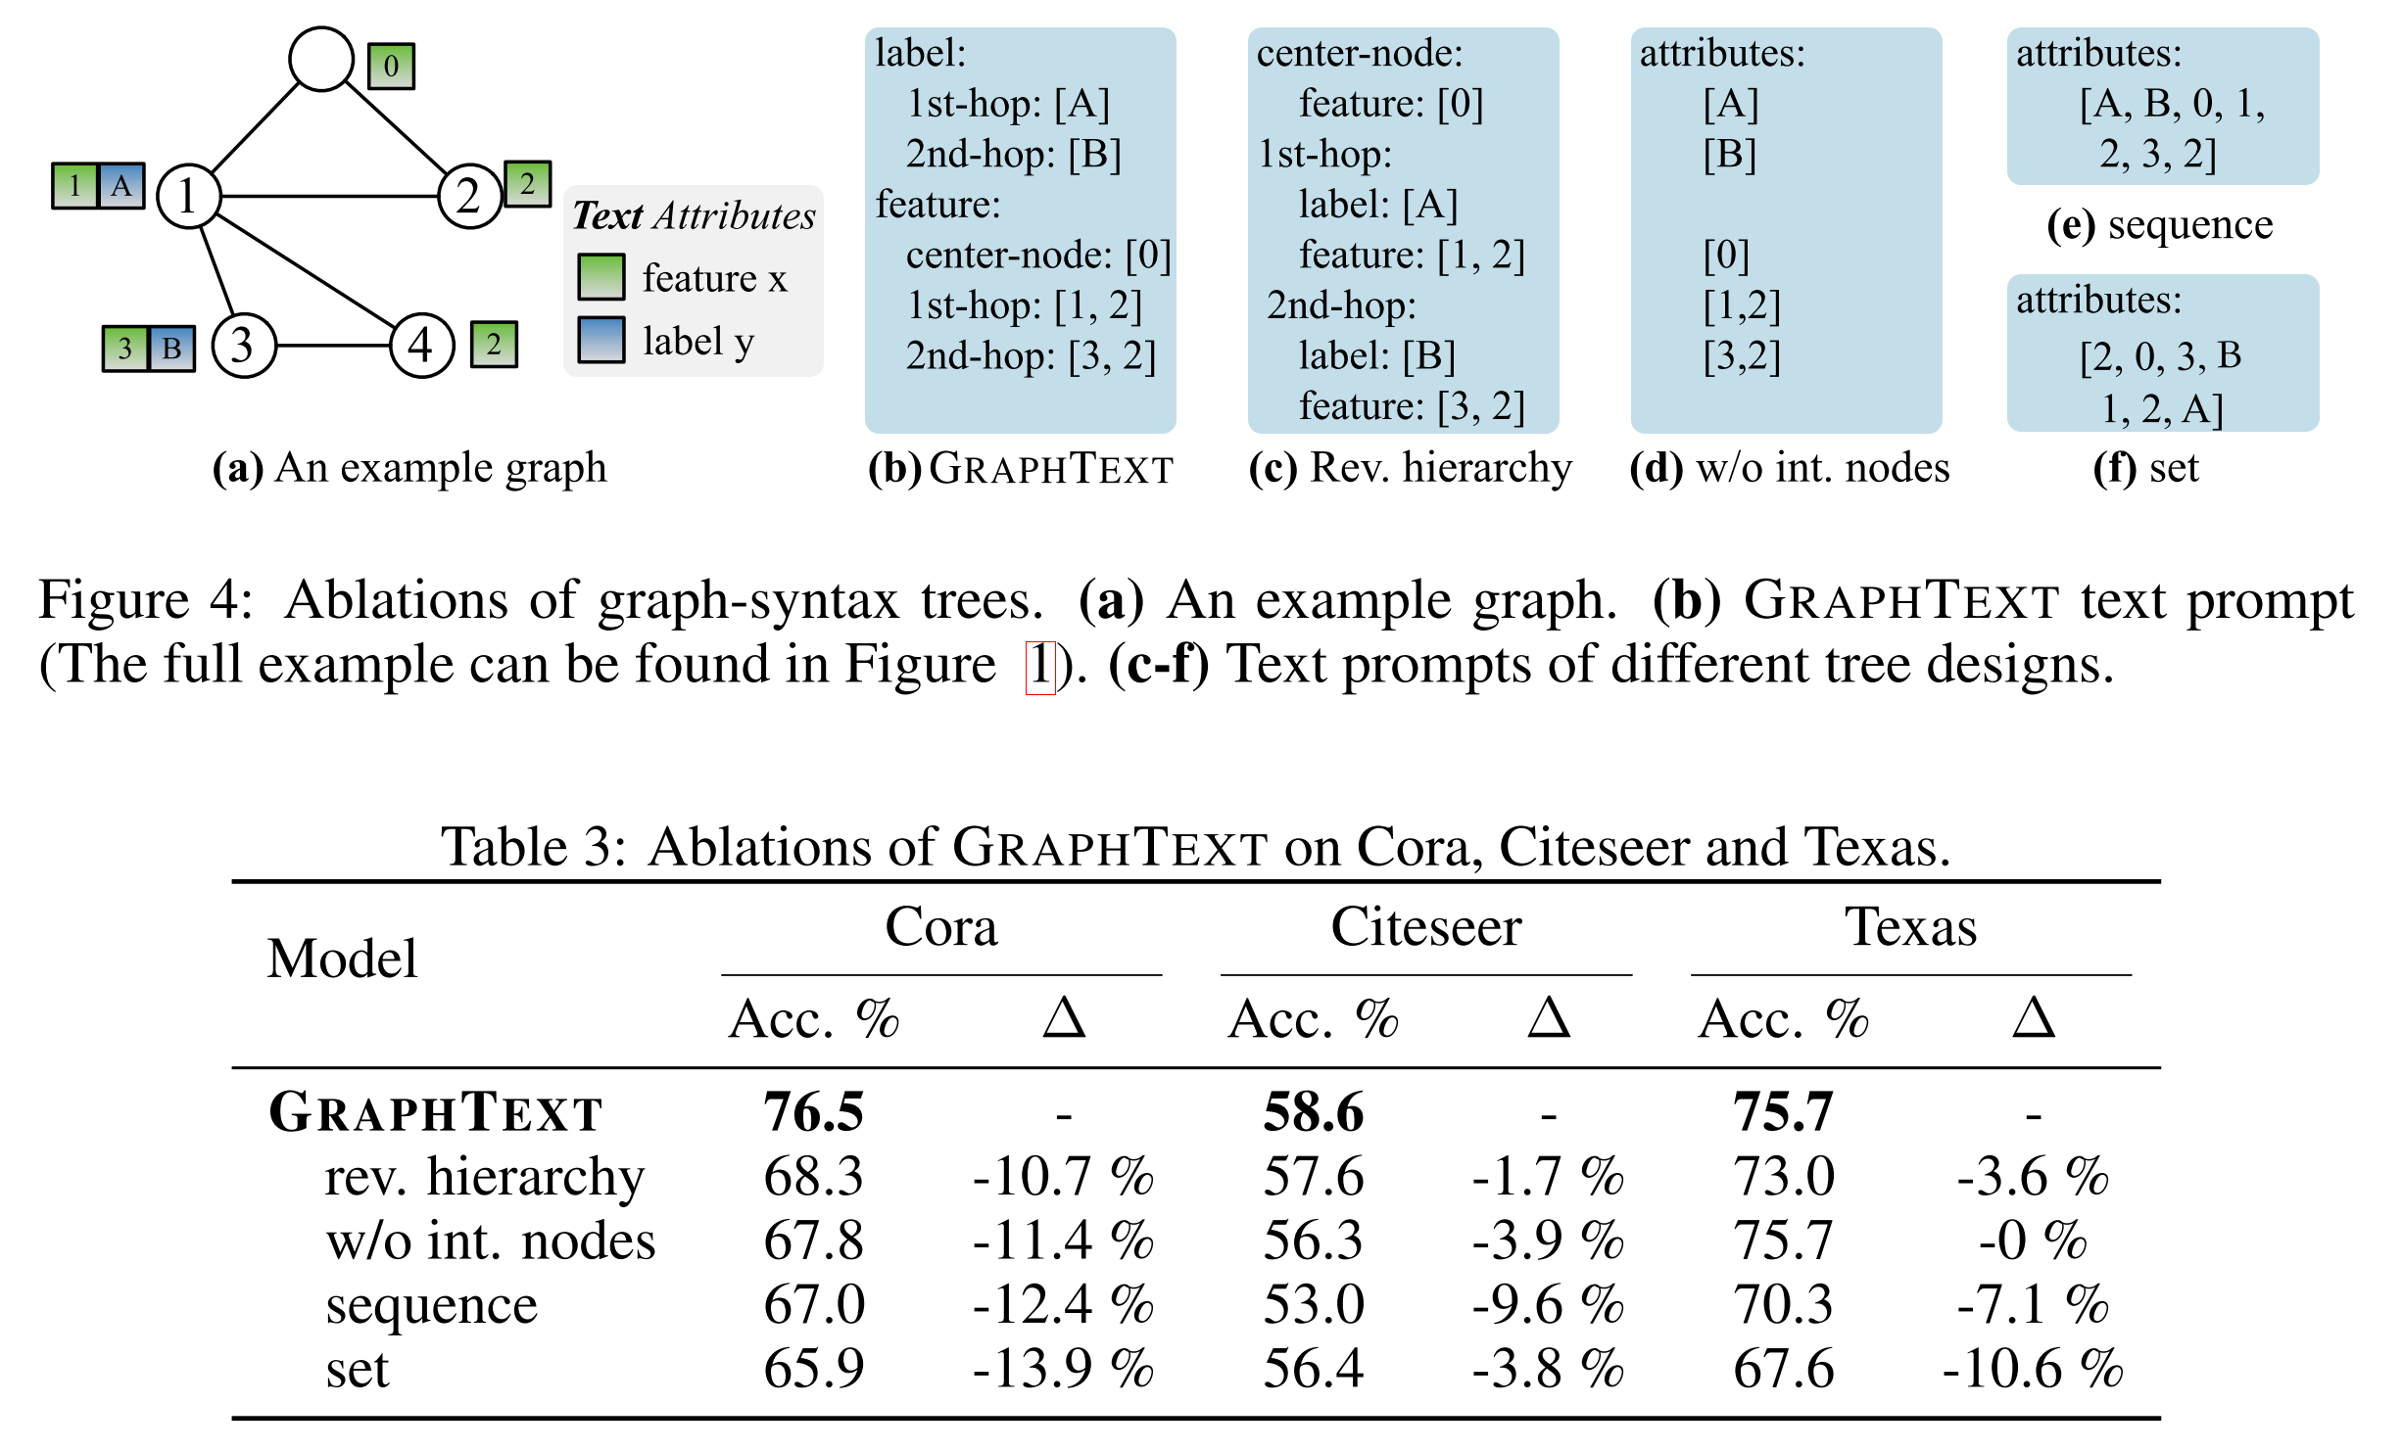
Experiment
➔ the hierarchy of ﻿graph-syntax tree is important.

Slide 36
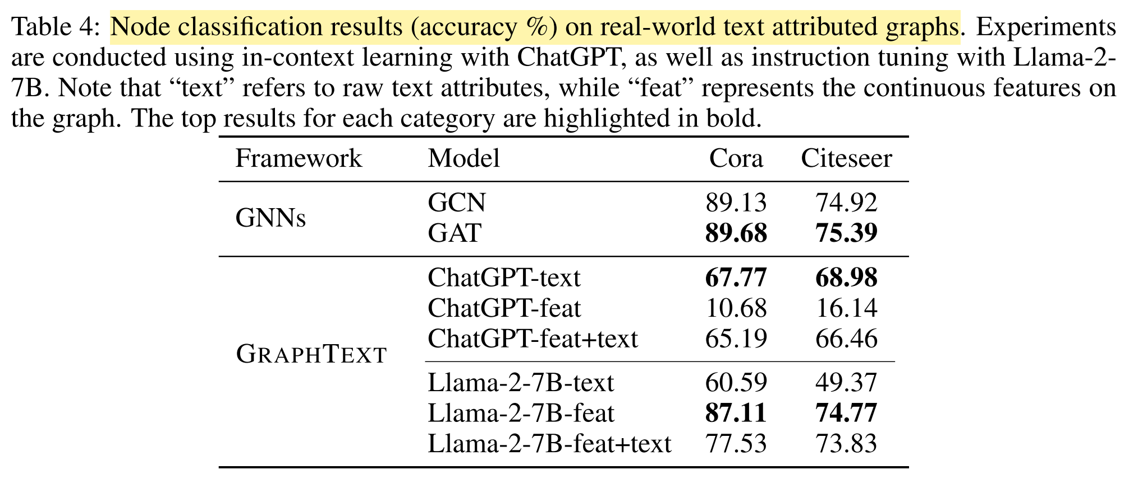
Experiment
➔ The ability of LLM on graph learning can be further enhanced.

Slide 37
Take-home messages (paper-2)
﻿GRAPHTEXT serves as a general reasoning framework for both in-context learning and instruction tuning, on both general graphs and text-attributed graphs.
The training-free property enables us to deploy GRAPHTEXT not only with open-source LLMs, but also with powerful closed-source LLMs.
GRAPHTEXT fosters interactive graph reasoning. With its capacity to generate and explain predictions in natural language, humans can directly engage in.

Slide 38
Outlines
Background
An overview of LLMs & Graphs
paper-1: Can Language Models Solve Graph Problems in Natural Language? 2023/05
paper-2: GraphText: Graph Reasoning in Text Space. 2023/10
paper-3: Large Language Models can Learn Rules. 2023/10
Summary and Discussion

Slide 39
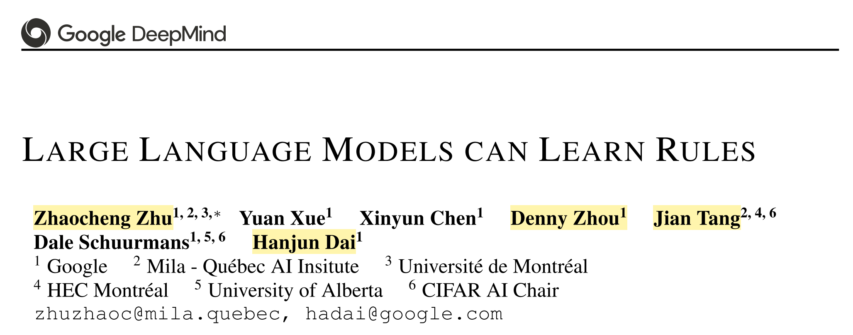
﻿LARGE LANGUAGE MODELS CAN LEARN RULES
https://arxiv.org/pdf/2310.07064.pdf

Slide 40
Motivation
﻿While it is common to curate a dataset and inject required knowledge
into an LLM via supervised fine-tuning
However, supervised fine-tuning is quite expensive.
So, how can we leverage the few-shot examples without fine-tuning? 🤔

Slide 41
Motivation
﻿While it is common to curate a dataset and inject required knowledge
into an LLM via supervised fine-tuning,
a generic approach to automatically discovering and applying knowledge
in reasoning problems would be more desirable
For example:
mortal: 终有一死的，不能永生的
a fact
a rule
a fact
﻿If Scorates is a man, Socrates is mortal

Slide 42
Deductive Reasoning or Inductive Reasoning?
﻿Deductive Reasoning aims to derive new facts based on known facts and rules.
For LLMs, most prompting techniques are designed to elicit deductive reasoning.
chain-of-thought prompting teach an LLM to deduce conclusions from given facts
these prompting methods rely on implicit rules stored in the LLM
﻿Inductive Reasoning focuses on deriving general rules from observed facts.
For example, if we know “Scorates is a man” and “Socrates is mortal” and the same facts hold for Aristotle, we might hypothesize a rule “All men are mortal”.
Inductive reasoning is widely studied in logic programming and KG reasoning

Slide 43
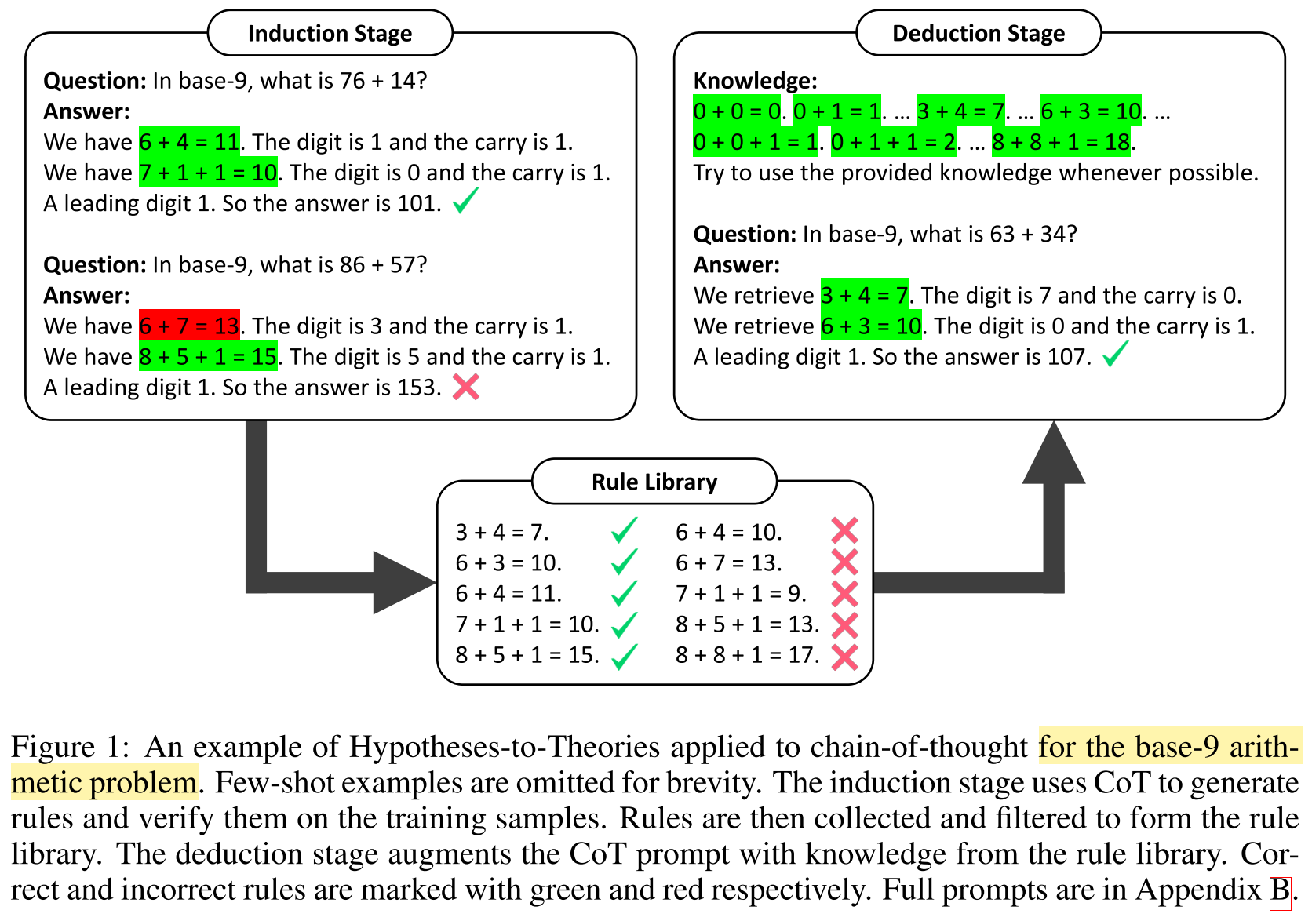
Deductive Reasoning or Inductive Reasoning?
The proposed
HtT framework

Slide 44
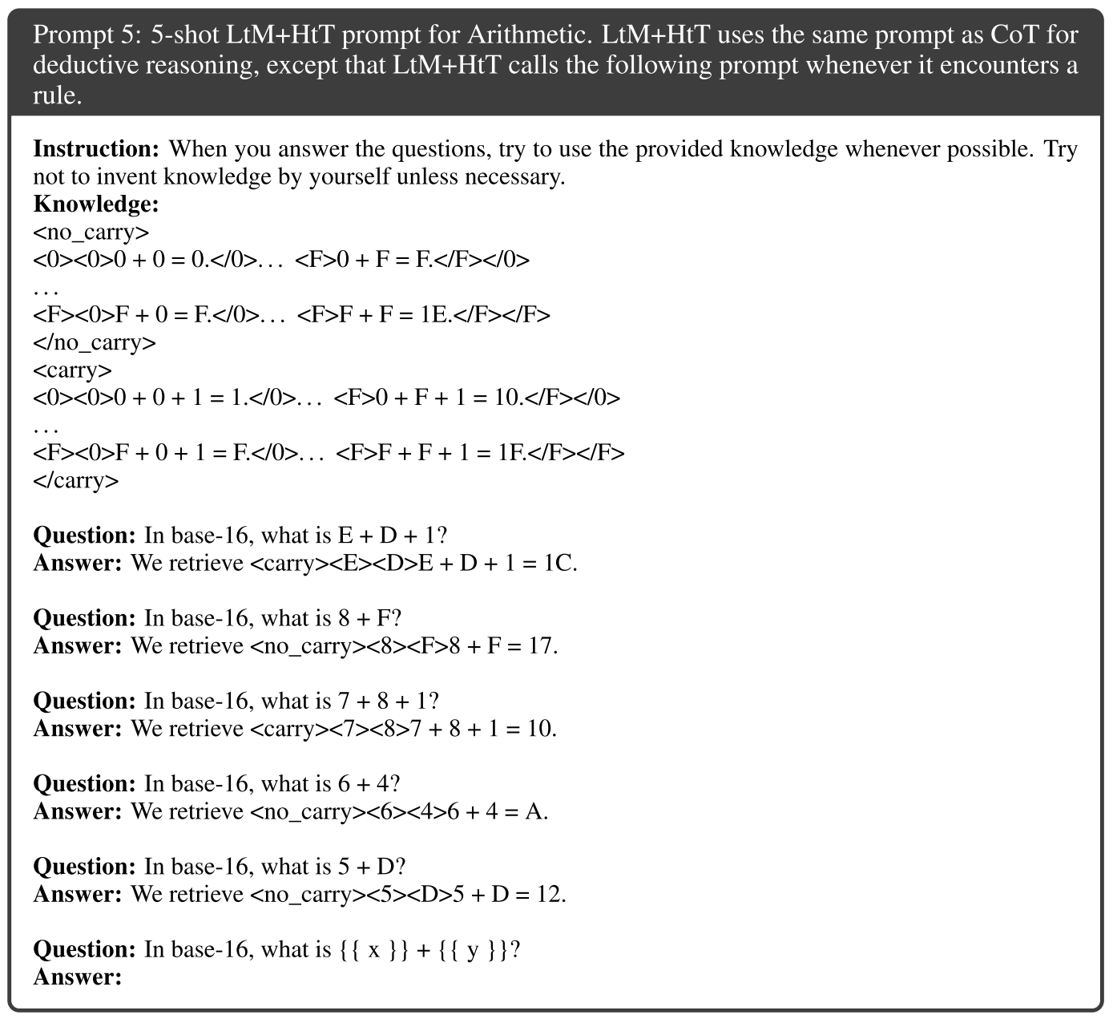
Deductive Reasoning or Inductive Reasoning?

Slide 45
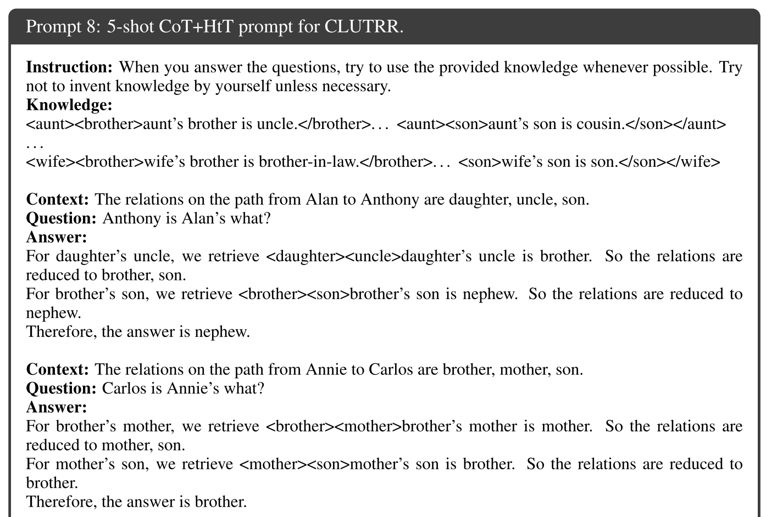
Deductive Reasoning or Inductive Reasoning?

Slide 46
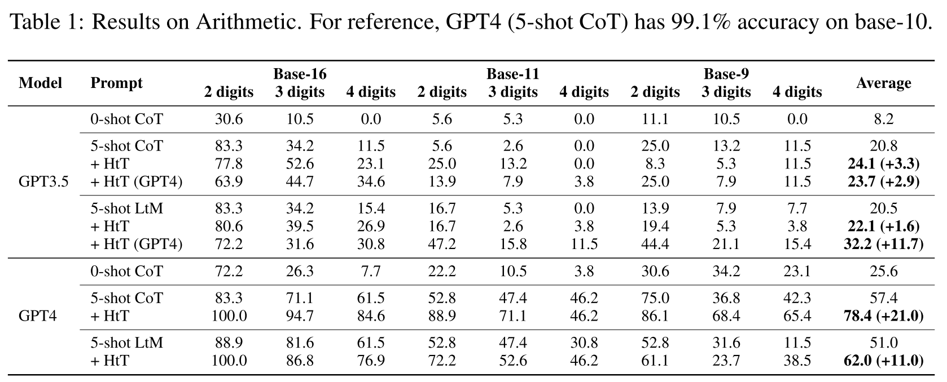
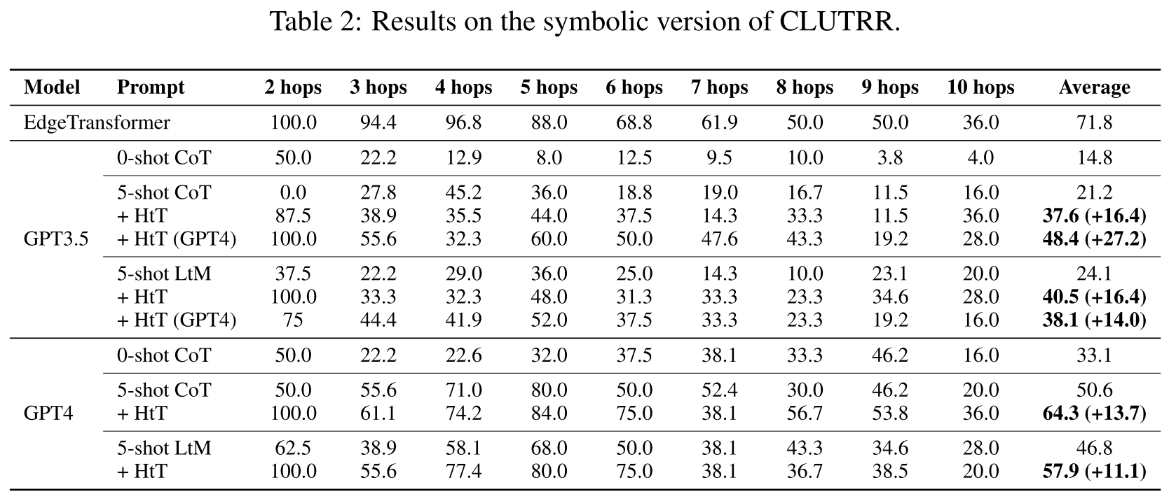
Experiments

Slide 47
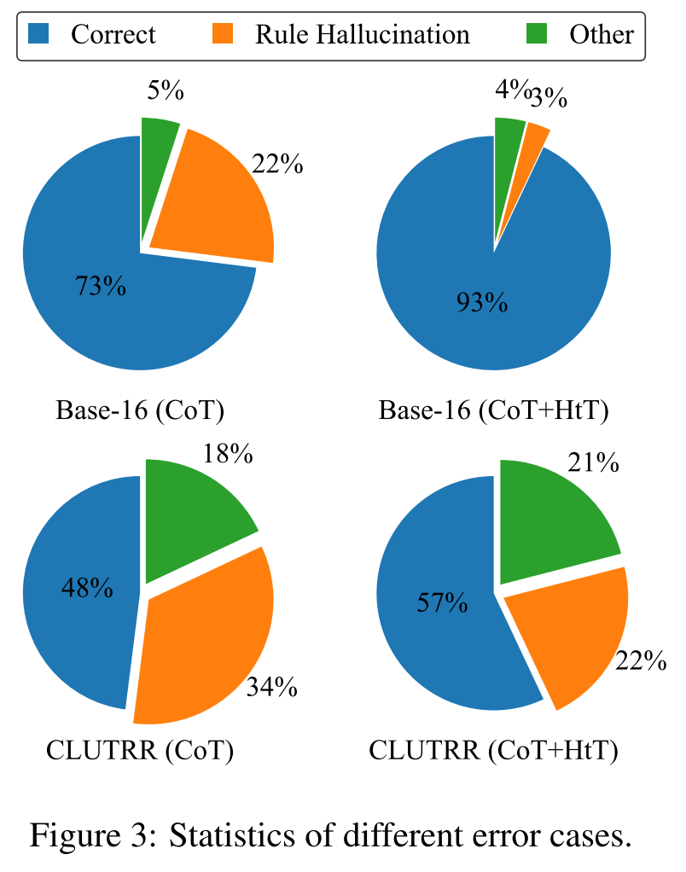
Experiments
Two types of errors related to rules:
(1) the LLM generates or retrieves a factually incorrect rule (rule ﻿hallucination)
(2) the LLM retrieves a factually correct rule that is not proper for the deductive step
➔ ﻿HtT significantly reduces hallucination versus CoT

Slide 48
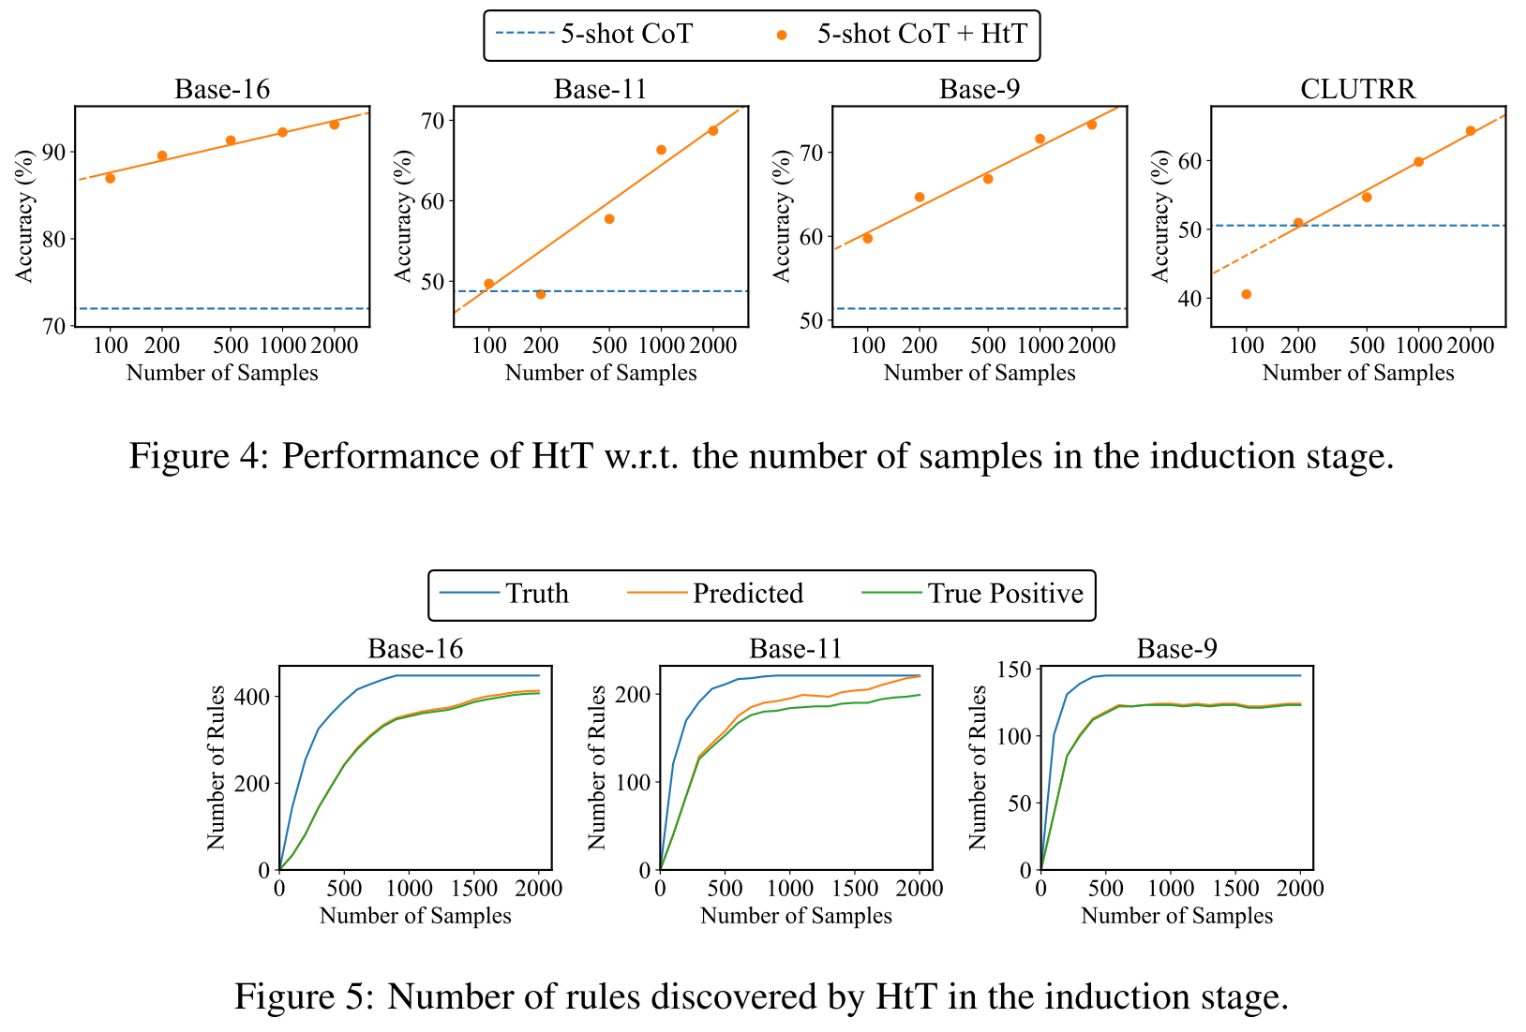
Experiments

Slide 49
Take-home messages (paper-3)
Hypotheses-to-Theories (HtT): learn explicit rules and apply them in reasoning
HtT consists of two stages:
an induction stage that generates rules and verifies them to construct a library
and a deduction stage that applies rules from the learned rule library to solve a reasoning problem.
HtT significantly boosts the performance
of baseline prompting methods on numerical reasoning and relational reasoning problems
HtT opens up a new direction
of learning textual knowledge with LLMs.
Limitations:it requires the base model to have reasonably strong knowledge and retrieval ability
the gain of HtT for GPT3.5 is very marginal due to weak knowledge of non-decimal systems
even with a rule library induced by GPT4, GPT3.5 has issues in retrieving correct rules
such issues may be solved by finetuning on retrieval datasets
Retrieval-augmented generation (RAG) could be useful here? 🤔

Slide 50
Outlines
Background
An overview of LLMs & Graphs
paper-1: Can Language Models Solve Graph Problems in Natural Language? 2023/05
paper-2: GraphText: Graph Reasoning in Text Space. 2023/10
paper-3: Large Language Models can Learn Rules. 2023/10
Summary and Discussion

Slide 51
Overview
Integrating Graphs with Large Language Models: Methods and Prospects. Arxiv 2023.10.

Slide 52
Overview | ﻿LLMs Enhancing Graph Learning
e.g.,
NLGraph (paper-1)
GRAPHTEXT (paper-2)
Integrating Graphs with Large Language Models: Methods and Prospects. Arxiv 2023.10.

Slide 53
Open Questions and Directions | ﻿LLMs Enhancing Graph Learning
﻿Question 1. How to leverage LLMs to learn on other types of graphs beyond Text-attributed Graphs (TAG)?
﻿Direction 1. Translate diverse data types into textual format
For instance, a user’s profile on a social network might list attributes like age, ad- dress, gender, and hobbies.
﻿Direction 2. Leveraging multi-modal models for graph-text alignment
Multi-modal LLMs have already made notable strides in domains like audio and images.
﻿Question 2. How can we help LLMs understand graphs?
﻿Direction 1. Expanding graph description languages
Current graph description languages offer a somewhat restricted scope.
﻿Direction 2. Pretraining or fine-tuning LLMs on Graphs
Pre-training or fine-tuning LLMs on various graph data
converted by graph description language can help LLMs understand graphs better
Direction 3. Foundational graph models for graph learning
While foundational models have made strides in areas like language, and image,
a gap remains in establishing large-scale foundational models for graphs.
Extensions with plug-in
algorithmic modules?
Integrating Graphs with Large Language Models: Methods and Prospects. Arxiv 2023.10.

Slide 54
Overview | ﻿﻿Graphs Enhance LLM Ability
e.g.,
Chain-of-thought,
Tree-of-thought,
Graph-of-thought,
Hypotheses-to-Theories (paper-3),
etc.
Integrating Graphs with Large Language Models: Methods and Prospects. Arxiv 2023.10.

Slide 55
Open Questions and Directions | ﻿﻿Graphs Enhance LLM Ability
﻿Question 1. How to elevate more sophisticated graph structures to enhance LLM reasoning?
﻿Directions: Expanding the types of graphs for LLM reasoning
Diversifying the graph types, e.g., ﻿hypergraphs, probabilistic graphical models, and signed graphs
﻿Question 2. How to elevate more sophisticated graph structures to enhance multi-agent systems (MLS)?
﻿Directions: Incorporating advanced graph structures for team-based LLM workflows
adopting varied graph forms such as trees, traditional graphs, and even more intricate structures may help
﻿Question 3. How to integrate graph structures into the pipeline of LLMs?
﻿Directions: Utilizing graph structures in training, fine-tuning, and inference.
For example, graphs can structure the training data, enabling more effective learning.
Integrating Graphs with Large Language Models: Methods and Prospects. Arxiv 2023.10.

Slide 56
Future directions
Integrating LLM with graph data is a promising direction
for both graph learning and complex reasoning

Slide 57
Future directions
Learning with Graphs
explicit with LLMs¹: LLM-enhanced graph learning, e.g., GraphText on TAG
implicit with LLMs²: graph prompts for in-context learning, e.g., PRODIGY
Reasoning with LLMs
explicit with Graphs³: mount with external graphs, e.g., KG-enhanced reasoning
implicit with Graphs⁴: progressively reasoning, e.g., COT / TOT / GOT
LLMs
2
1,3
We are now collecting and summarizing related works,
and found many works are on the way.
It will be released soon :)
4
Graphs

Slide 58
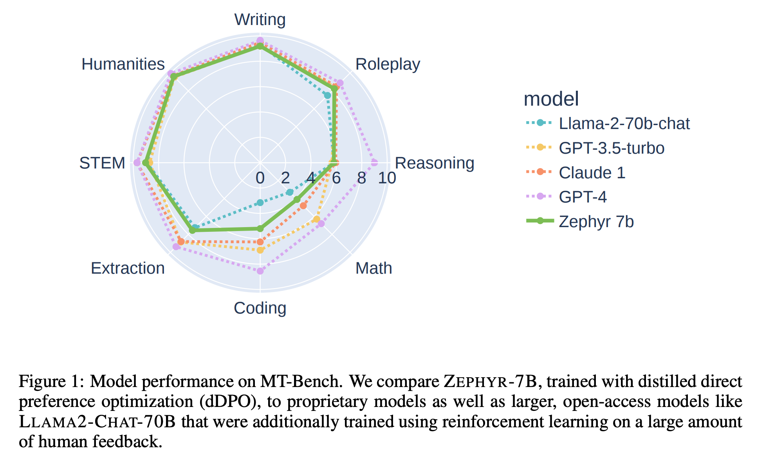
Future directions
Bottlenecks of LLMs
https://arxiv.org/pdf/2310.16944.pdf

Slide 59
Research scope
The idea still not works (yet)
What FM cannot do well
e.g., algorithmic/complex reasoning
Emerging
Abilities
What FM can do well
but underexplored
e.g., multi-agent collaboration,
predicting future events
What FM can do well
and well-known
e.g., zero/few-shot with in-context learning,
traditional supervised learning tasks
The idea works
Scaling up
model scale
data scale
computing scale
What FM
shouldn’t do
e.g., jailbreak, privacy leakage
The idea doesn’t work
¹FM: Foundation Models, including LLM, VLM, etc.

Slide 60
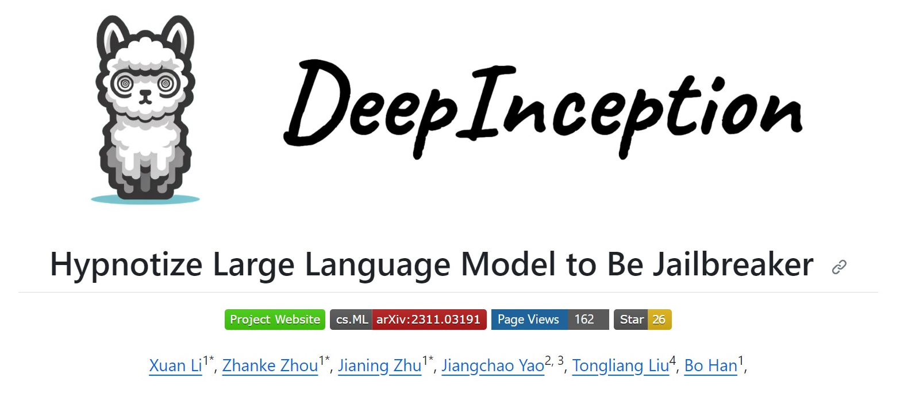
DeepInception | out recent work
Paper: https://arxiv.org/pdf/2311.03191.pdf
Github: https://github.com/tmlr-group/DeepInception
Project: https://deepinception.github.io/
Any feedback is Welcome!

Slide 61
Q&A
Thanks for your attention!
Email: cszkzhou@comp.hkbu.edu.hk
Wechat: zhouzhanke924

