Slide 1
A Data-centric Framework to Endow Graph Neural Networks with Out-Of-Distribution Detection Ability
Presenter: Zhanke Zhou
^{2023. 07. 05}

Slide 2
About the paper
Conference: KDD 2023
Paper: http://shichuan.org/doc/150.pdf
Code: https://github.com/BUPT-GAMMA/AAGOD

Slide 3
Outline
Background
Method
Experiment
Summary

Slide 4
Background | Visual OOD detection
In-distribution Data
(ID data)
Out-of-distribution Data
(OOD data)

Slide 5
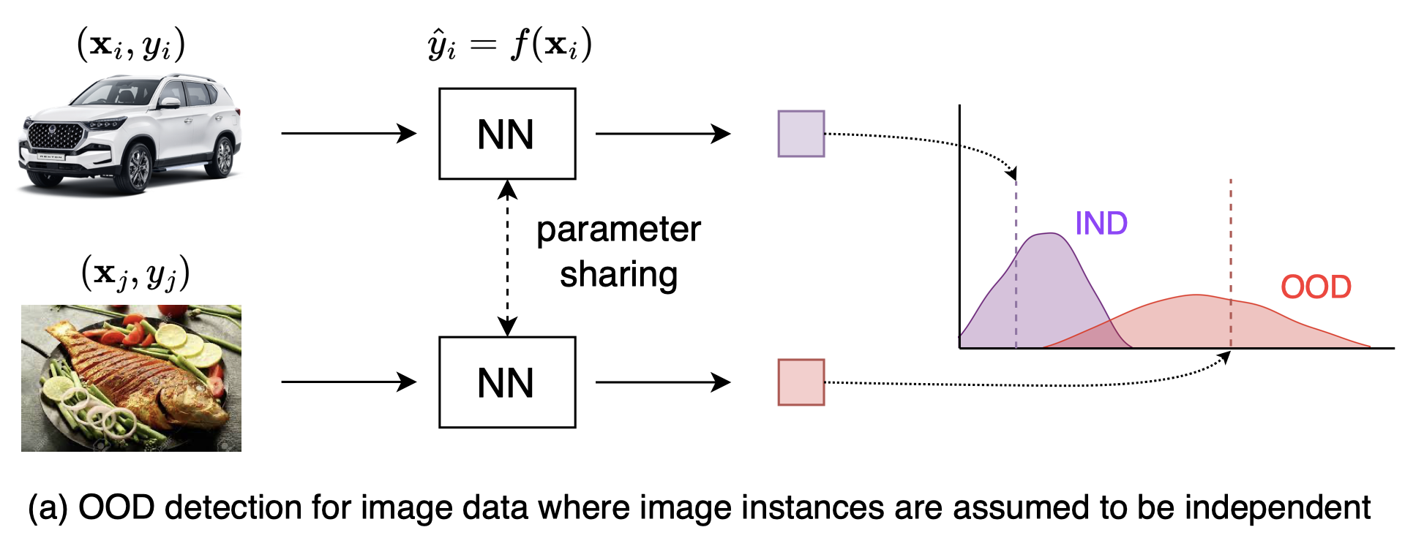
Background | Visual OOD detection
﻿a trustworthy model should
not only perform well on ID samples
but also recognize what they don’t know

Slide 6
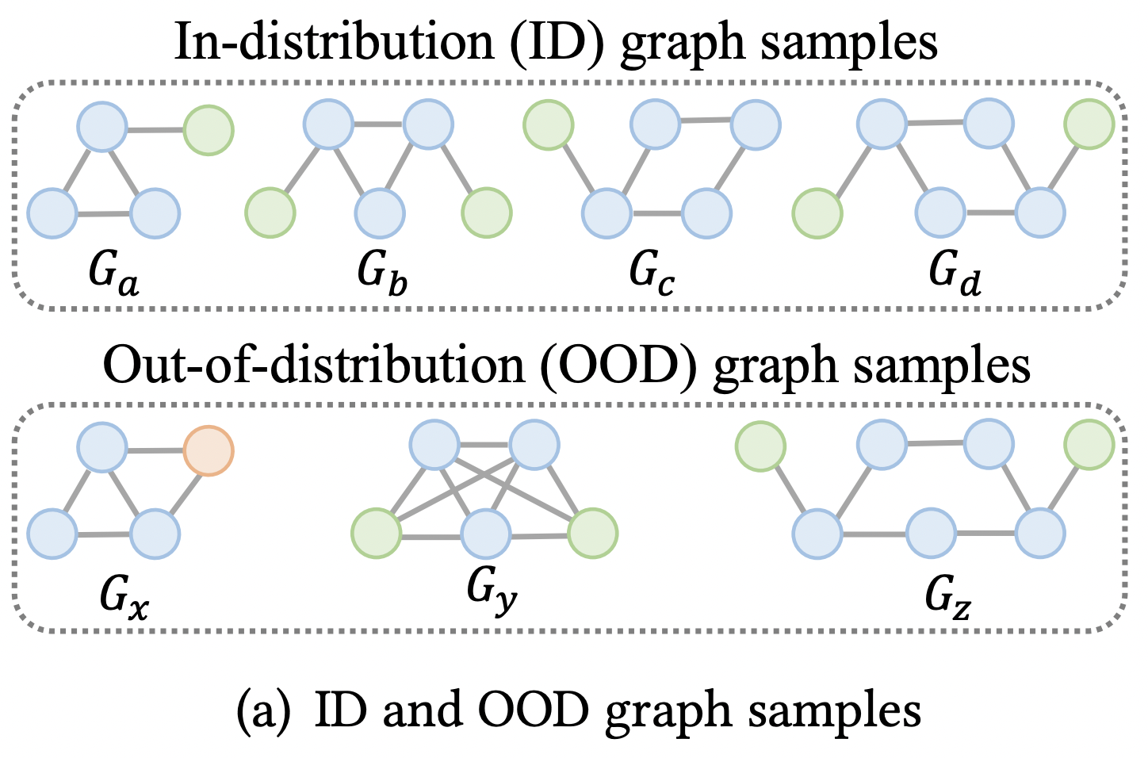
Background | Graph OOD detection

Slide 7
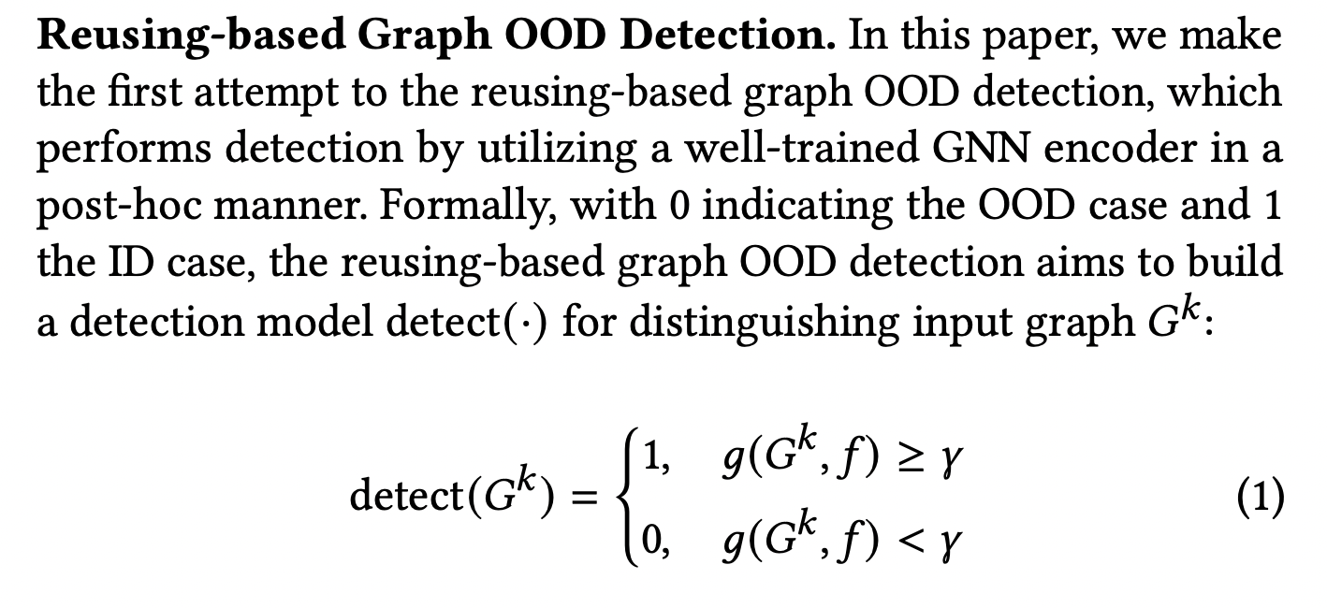
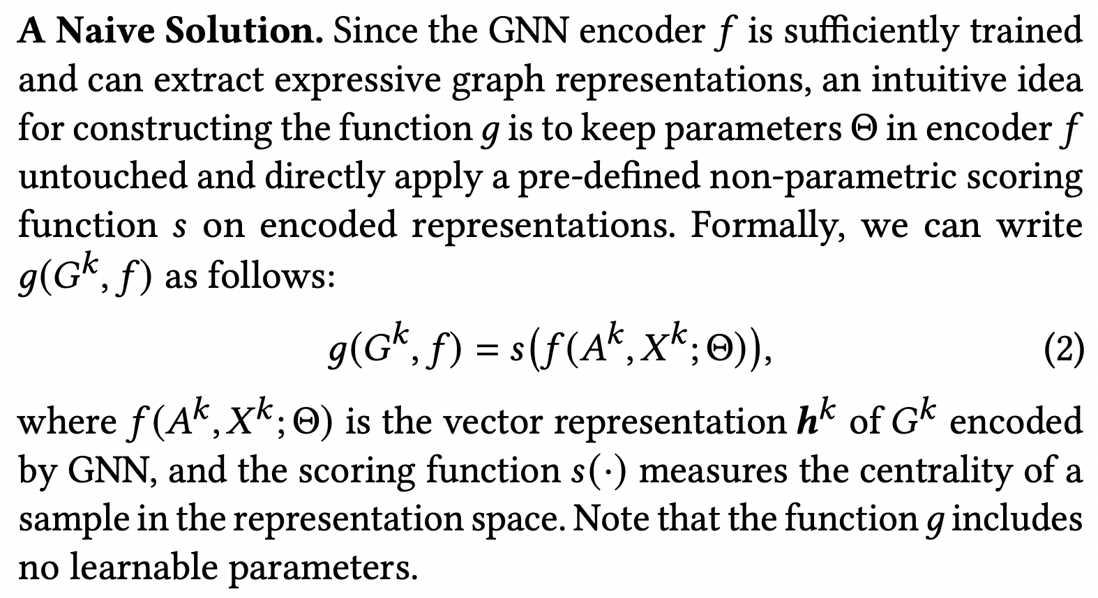
Background | Graph OOD detection

Slide 8
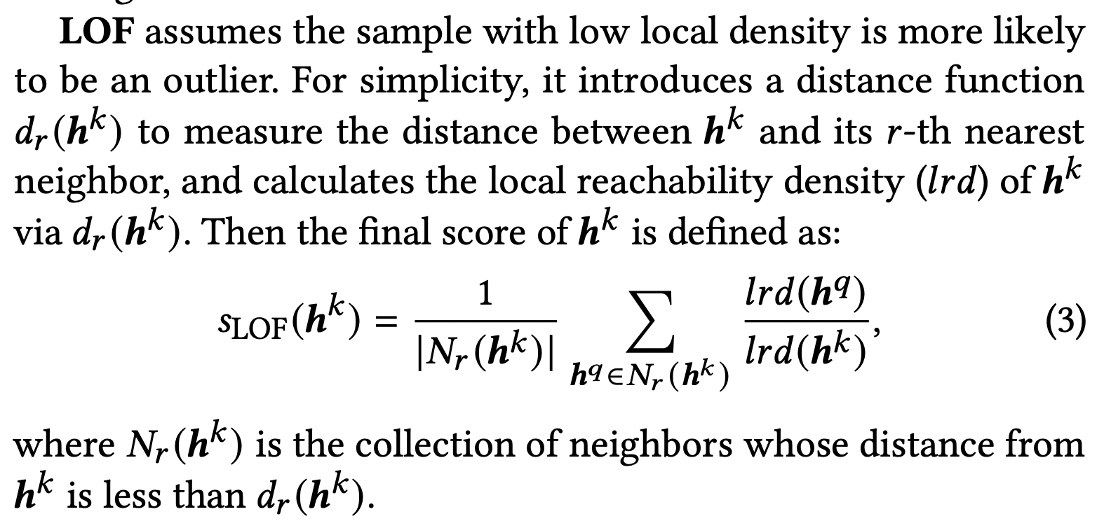
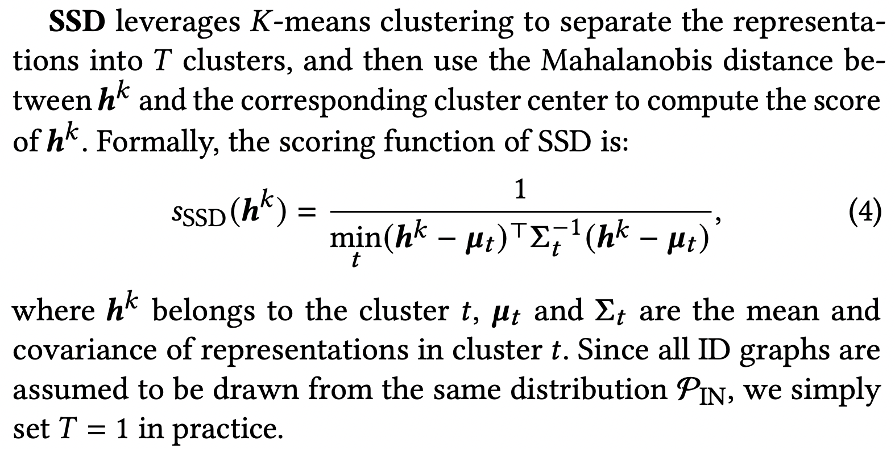
Background | Graph OOD detection
﻿SSD/LOF: two scoring functions

Slide 9
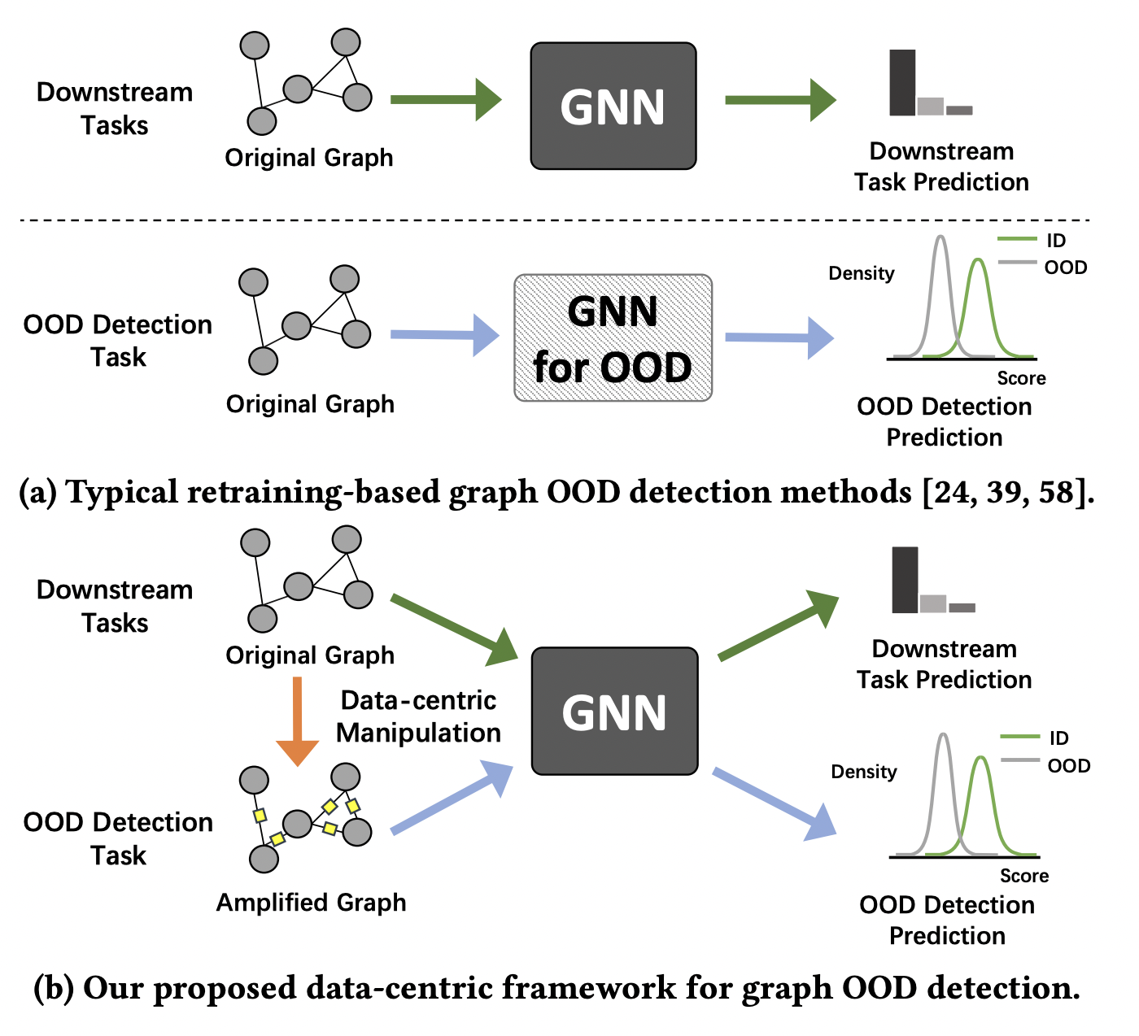
Background | Graph OOD detection
Train-from-scratch pipeline
problem: high computation cost

Slide 10
Background | Graph OOD detection
This work: post-hoc pipeline
﻿endow a well-trained GNN with the OOD detection ability
without modifying its parameters

Slide 11
Outline
Background
Method
Experiment
Summary

Slide 12
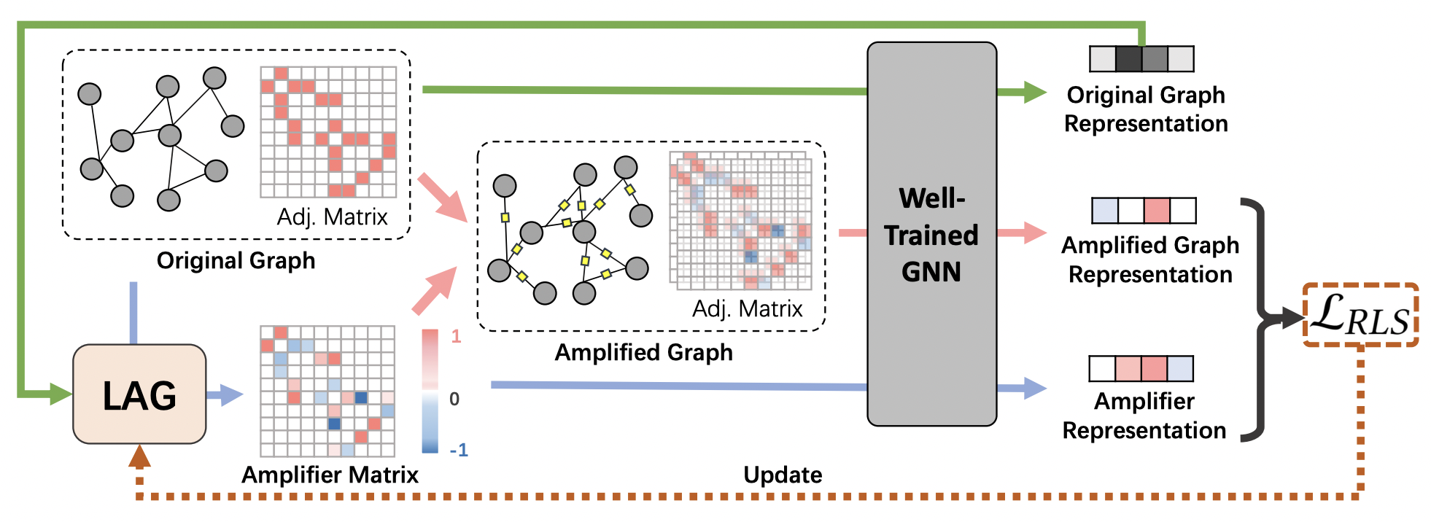
Method
AAGOD: a post-hoc framework with Adaptive Amplifier for Graph OOD Detection
concentrating on data-centric manipulation
﻿help highlight the latent pattern of ID graphs
enlarge the score gap between OOD and ID graphs

Slide 13
Method
AAGOD: a post-hoc framework with Adaptive Amplifier for Graph OOD Detection
concentrating on data-centric manipulation
﻿help highlight the latent pattern of ID graphs
enlarge the score gap between OOD and ID graphs
Difficulties﻿
The number and order of nodes in graph data are uncertain
infeasible to design a global static amplifier suitable for all graphs
OOD graphs are not available during training
hard to design a learning objective for distinguishing ID and OOD data

Slide 14
Method
AAGOD: a post-hoc framework with Adaptive Amplifier for Graph OOD Detection
concentrating on data-centric manipulation
﻿help highlight the latent pattern of ID graphs
enlarge the score gap between OOD and ID graphs
Difficulties﻿
The number and order of nodes in graph data are uncertain
infeasible to design a global static amplifier suitable for all graphs
OOD graphs are not available during training
hard to design a learning objective for distinguishing ID and OOD data
Solutions
﻿a Learnable Amplifier Generator (LAG)
to adaptively generate graph-specific amplifiers
utilize the node representations encoded by the well-trained GNN
to generate weights for the edges in the original graph
a Regularized Learning Strategy (RLS)
encourages high scores for amplified ID graphs
expects low scores when only seeing the amplifiers

Slide 15
Method
original graph representation
“ID graph” representation
“OOD graph” representation

Slide 16
Method
AAGOD: a post-hoc framework with Adaptive Amplifier for Graph OOD Detection
concentrating on data-centric manipulation
﻿help highlight the latent pattern of ID graphs
enlarge the score gap between OOD and ID graphs
Difficulties﻿
The number and order of nodes in graph data are uncertain
infeasible to design a global static amplifier suitable for all graphs
OOD graphs are not available during training
hard to design a learning objective for distinguishing ID and OOD data
Solutions
﻿a Learnable Amplifier Generator (LAG)
to adaptively generate graph-specific amplifiers
utilize the node representations encoded by the well-trained GNN
to generate weights for the edges in the original graph
a Regularized Learning Strategy (RLS)
encourages high scores for amplified ID graphs
expects low scores when only seeing the amplifiers

Slide 17
Method

Slide 18
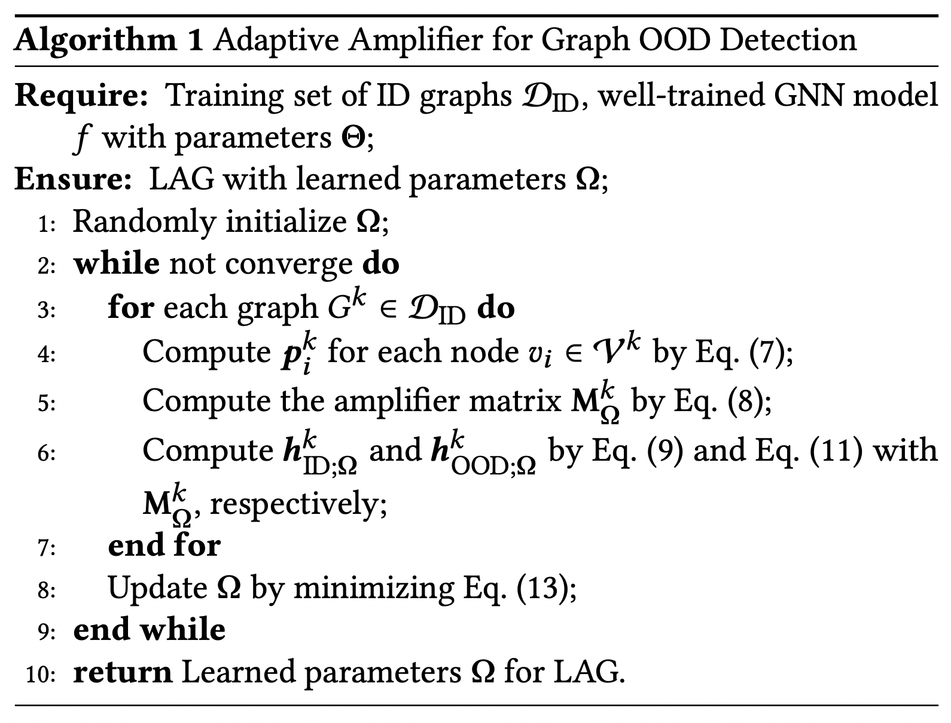
Method
Full algorithm

Slide 19
Outline
Background
Method
Experiment
Summary

Slide 20
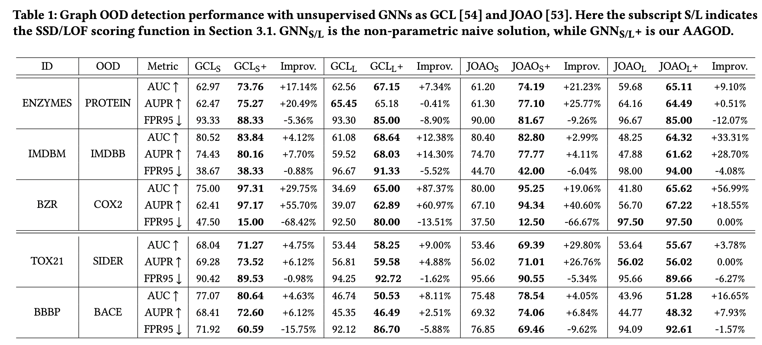
Experiment
﻿6.21% relative enhancement in AUC
a 34 times faster training speed

Slide 21
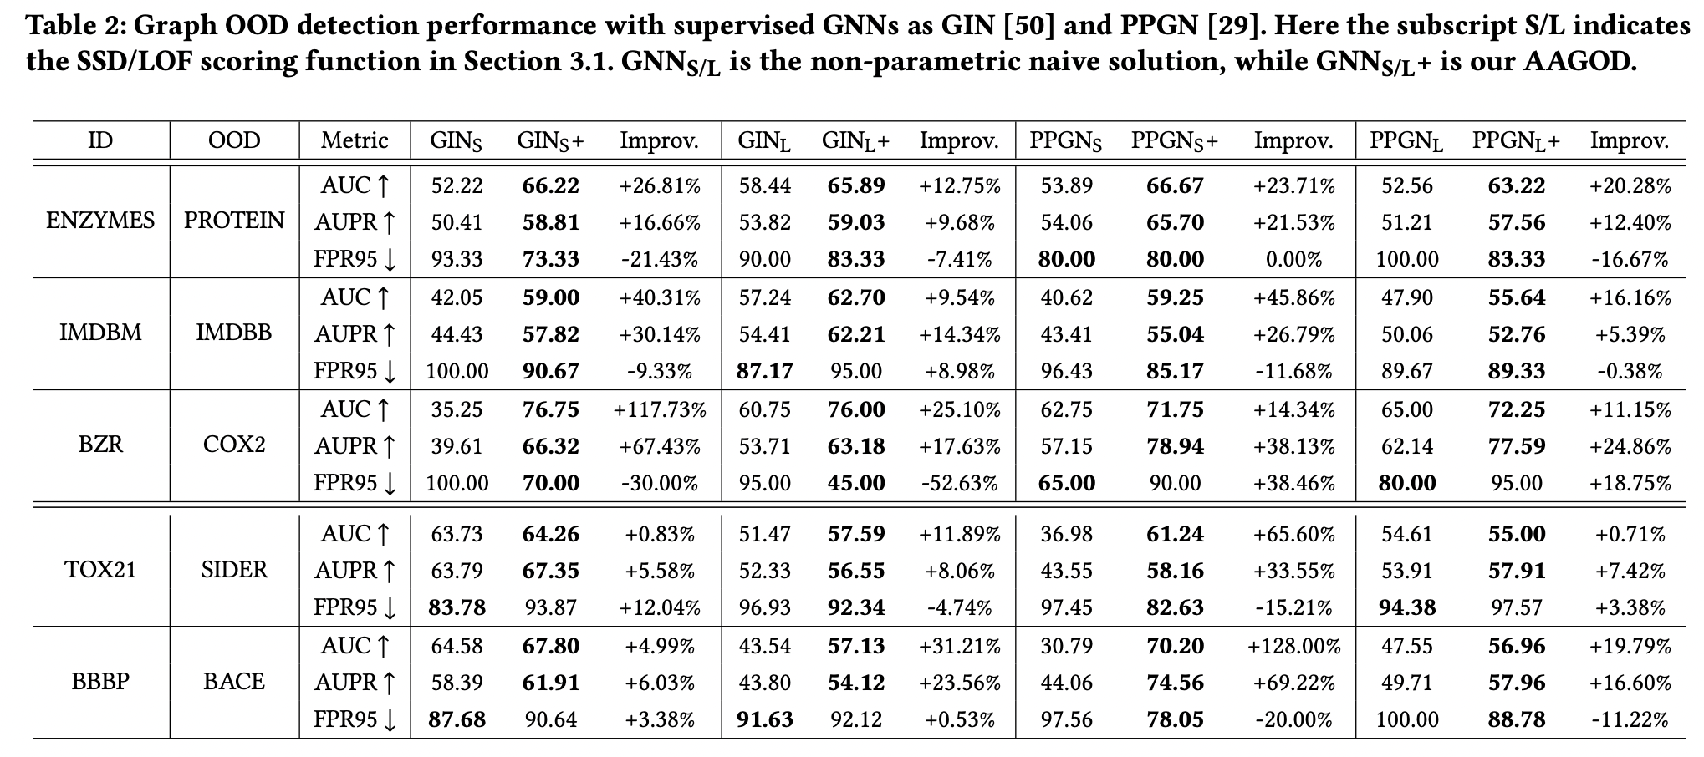
Experiment

Slide 22
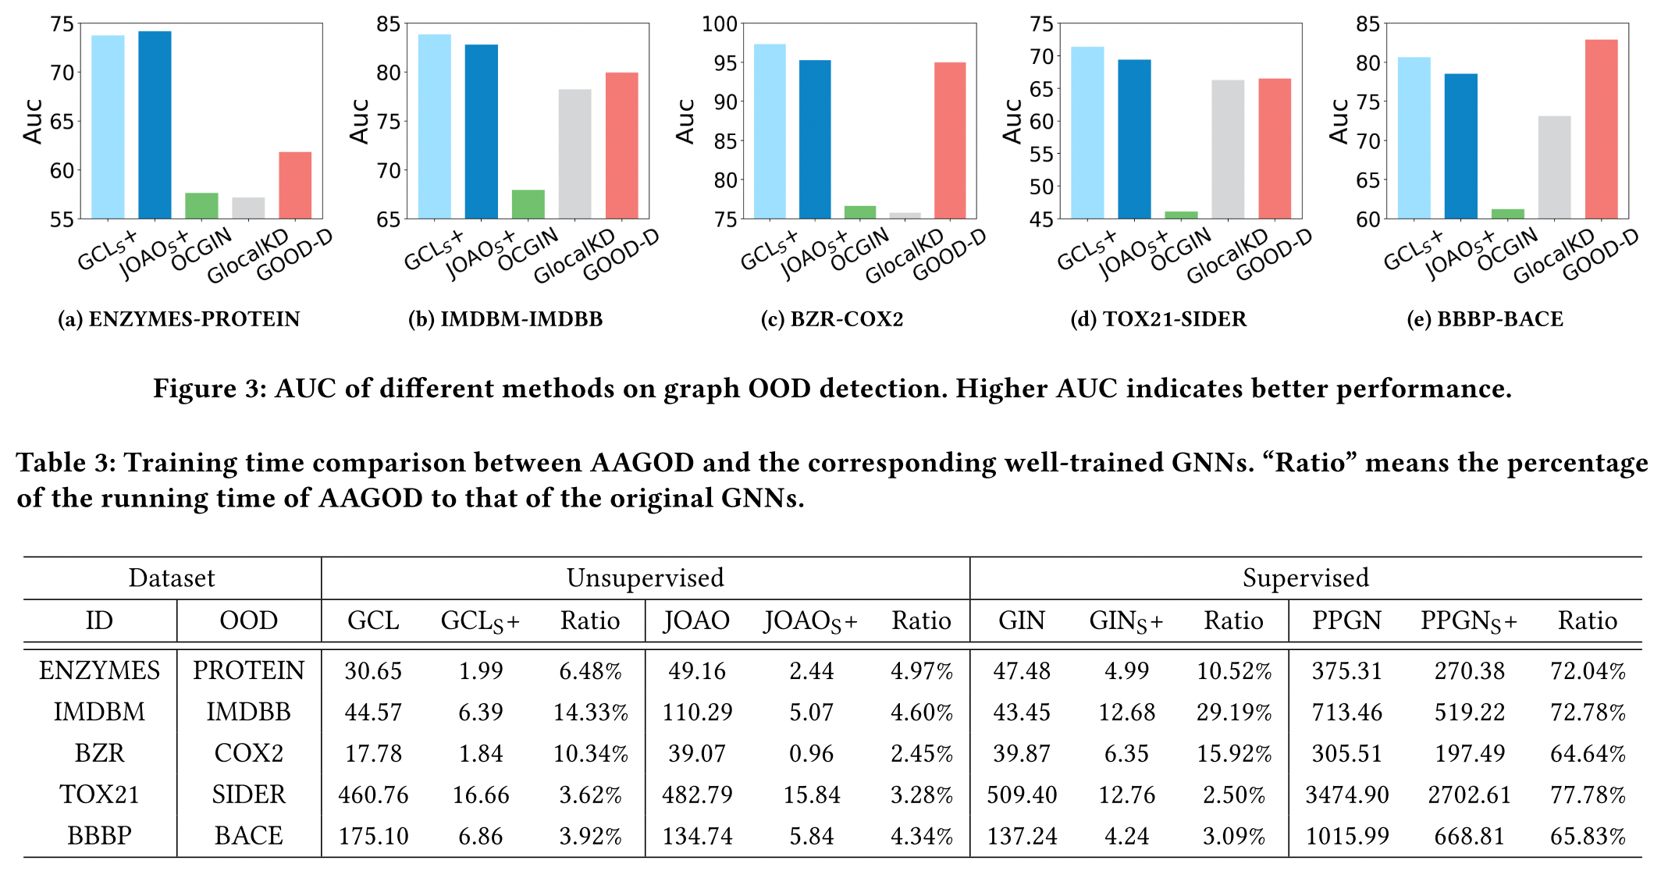
Experiment

Slide 23
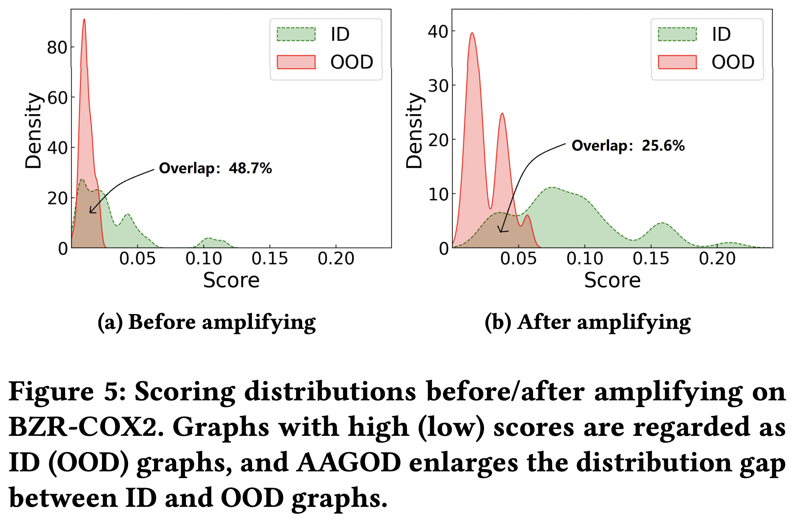
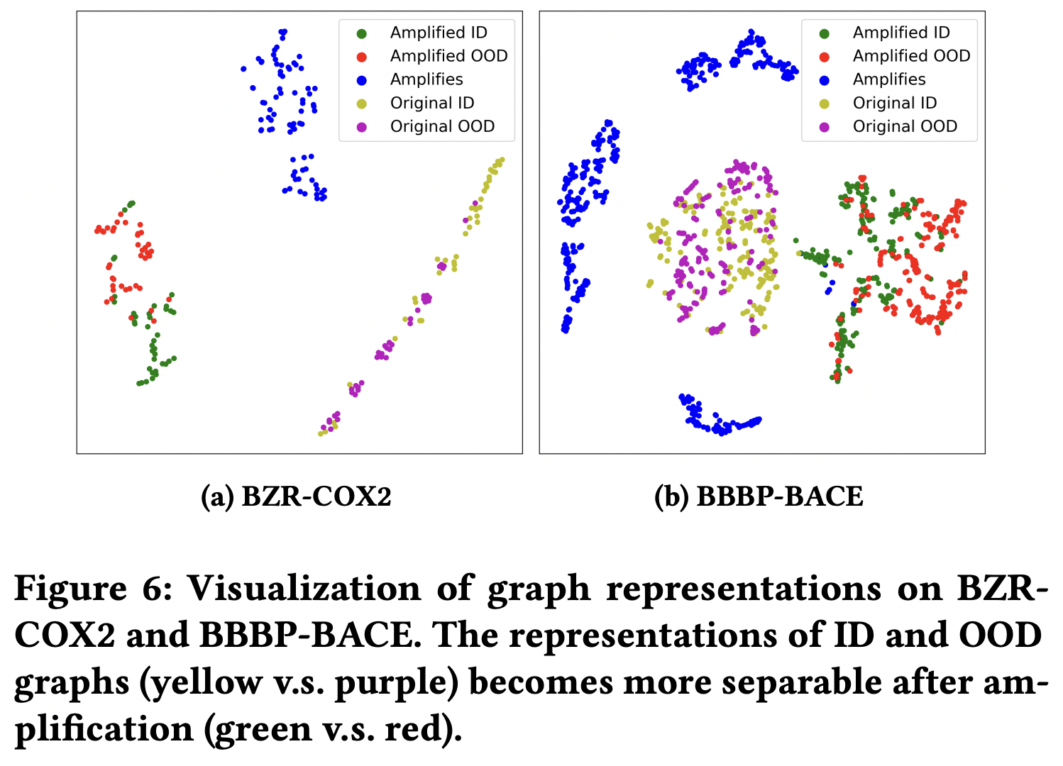
Experiment

Slide 24
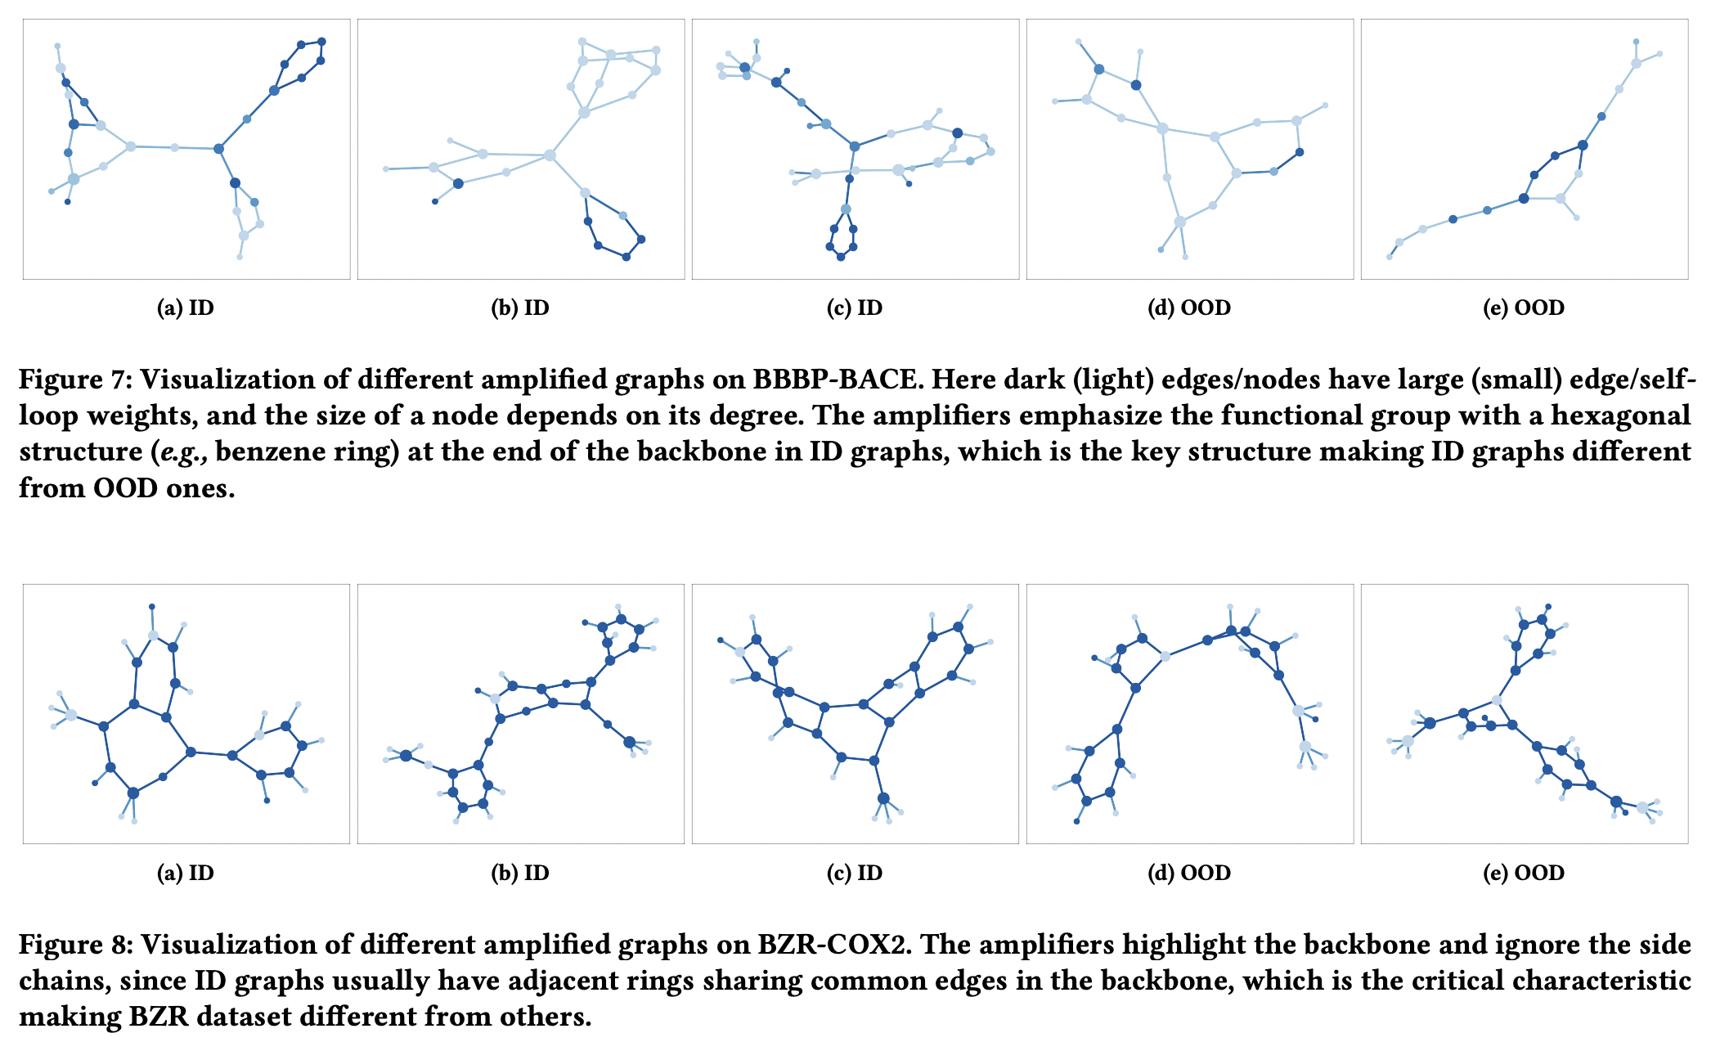
Experiment
﻿The amplifiers emphasize the functional group
with a hexagonal structure (e.g., benzene ring) in ID graphs
which is the key structure making ID graphs different from OOD ones

Slide 25
Outline
Background
Method
Experiment
Summary

Slide 26
Summary
Main contributions:
the first work proposed for reusing-based graph OOD detection problem
endow a well-trained GNN with the OOD detection ability
an effective framework named AAGOD
Learnable Amplifier Generator (LAG) and Regularize Learning Strategy (RLS)
produce graph-specific amplifiers
enlarge the gap between amplified ID and OOD graphs
Extensive experiments on real-world datasets
successfully applied on diverse GNNs
outperforms SOTA baselines in graph OOD detection

Slide 27
Related works | Graph OOD Detection
Graph-level OOD detection
KDD 2023. A Data-centric Framework to Endow Graph Neural Networks with Out-Of-Distribution Detection Ability.
WSDM 2023. GOOD-D: On Unsupervised Graph Out-Of-Distribution Detection
NeurIPS 2022. GraphDE: A Generative Framework for Debiased Learning and Out-of-Distribution Detection on Graphs.
ICML workshop 2022. Towards OOD Detection in Graph Classification from Uncertainty Estimation Perspective.
Node-level OOD detection
ICLR 2023. Energy-based out-of-distribution detection for graph neural networks.
KDD 2022. Learning on Graphs with Out-of-Distribution Nodes.
NeurIPS 2021. Graph Posterior Network: Bayesian Predictive Uncertainty for Node Classification.
NeurIPS 2020. Uncertainty Aware Semi-Supervised Learning on Graph Data.
Anomaly Detection
NeurIPS 2022. Dual-discriminative Graph Neural Network for Imbalanced Graph-level Anomaly Detection.
ICML 2022. Rethinking Graph Neural Networks for Anomaly Detection.

Slide 28
Q&A
Thanks for your attention!

Slide 29
Background | graph learning
$$Graph data D→{GNN f}_{ }→representation Z→ \tilde{Y}⟷Y$$
node
vector
encode
i
$$f:i→ℝ^{d}$$
$$ℝ^{d}$$
node representation $Z_{i}$

