Slide 1
Learning from Counterfactual Links for Link Prediction
Presenter: Zhanke Zhou
^{2023 / 02 / 09}

Slide 2
About the paper
Learning from Counterfactual Links for Link Prediction
affiliation: Department of Computer Science and Engineering, University of Notre Dame
authors: Tong Zhao, Gang Liu, Daheng Wang, Wenhao Yu, Meng Jiang
conference: ICML 2022
paper: https://arxiv.org/pdf/2106.02172.pdf
official codes: https://github.com/DM2-ND/CFLP
official slides: https://icml.cc/media/icml-2022/Slides/16774.pdf

Slide 3
Outline
Background
Methods
Experiment
Summary

Slide 4
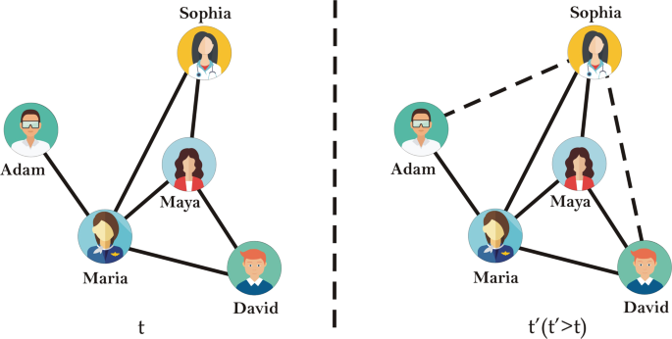
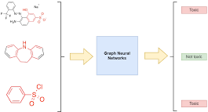
Background | Graph Learning
node-level
link-level
graph-level

Slide 5
Background | Link Prediction
node-level
link-level
graph-level

Slide 6
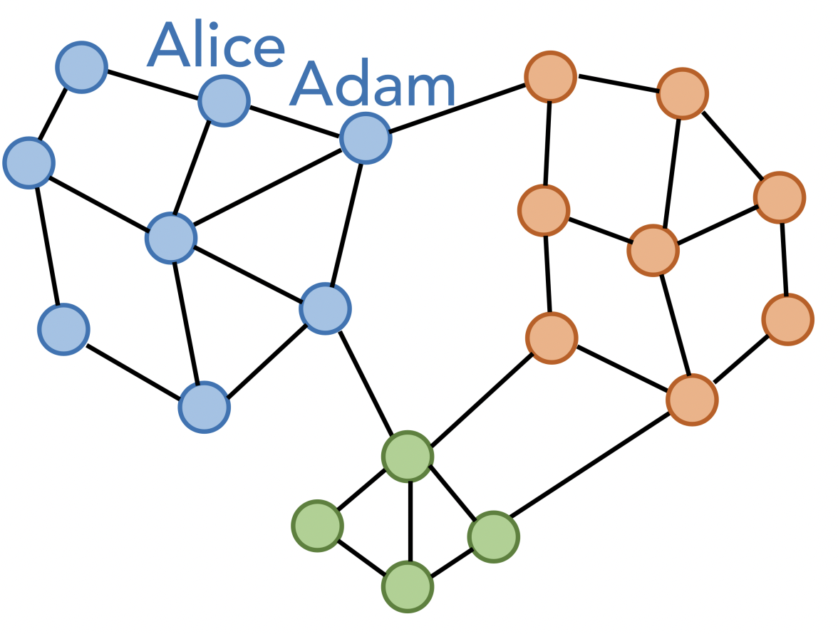
Background | Link Prediction
Given: a graph with adjacency matrix $A∈{\left\{0,1\right\}}^{N×N}$ and raw node features $X∈ℝ^{N×D}$
Learn: low-dimensional node representations $Z∈ℝ^{N×D}$, which can be used for the prediction of link existences
i.e., $f_{GNN}\left(A, X\right)=Z→{\hat{A}↔A}_{GT}$
encode
decode
optimize

Slide 7
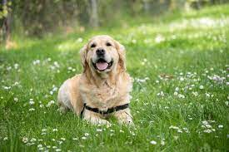
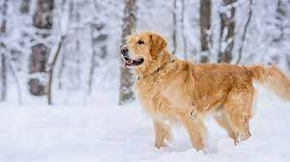
Background | Link Prediction
$$f_{GNN}\left(A, X\right)=Z→\hat{A}$$
A potential problem
existing methods that learn from association
may not capture essential factors to predict missing links
the causal relationship between graph structure and link existence
was largely ignored in previous work
“dog” class

Slide 8
Background | Link Prediction
A potential problem
existing methods that learn from association
may not capture essential factors to predict missing links
the causal relationship between graph structure and link existence
was largely ignored in previous work
an example
Alice and Adam live in the same neighborhood and they are close friends
The association between neighborhood belonging and friendship could be too strong to discover the essential factors of friendship
such as common interests or family relationships (i.e., intrinsic properties)
such factors may be the cause of them living in the same neighborhood

Slide 9
Background | Link Prediction
The counterfactual question:
Would Alice and Adam still be friends if they were not living in the same neighborhood?
?
It is a good question, but how to find
the answer, i.e., the counterfactual link? 🤔

Slide 10
Background | Link Prediction
A counterfactual question
Would Alice and Adam still be friends if they were not living in the same neighborhood?
It is a good question, but how to find
the answer, i.e., the counterfactual link?
?
The binary case is called the treatment (T) ^{[1]}
(T=1) living in the same neighborhood
(T=0) not living in the same neighborhood
Causal modeling
[1]: here, the treatment can be seen as
the topological context of two nodes

Slide 11
Background | Link Prediction
A counterfactual question
Would Alice and Adam still be friends if they were not living in the same neighborhood?
It is a good question, but how to find
the answer, i.e., the counterfactual link?
?
The binary case is called the treatment (T)
(T=1) living in the same neighborhood
(T=0) not living in the same neighborhood
But, in reality, we can only observe the outcome under one particular treatment.
So, how can we find the counterfactual link? 🤔
e.g., effects of a vaccine

Slide 12
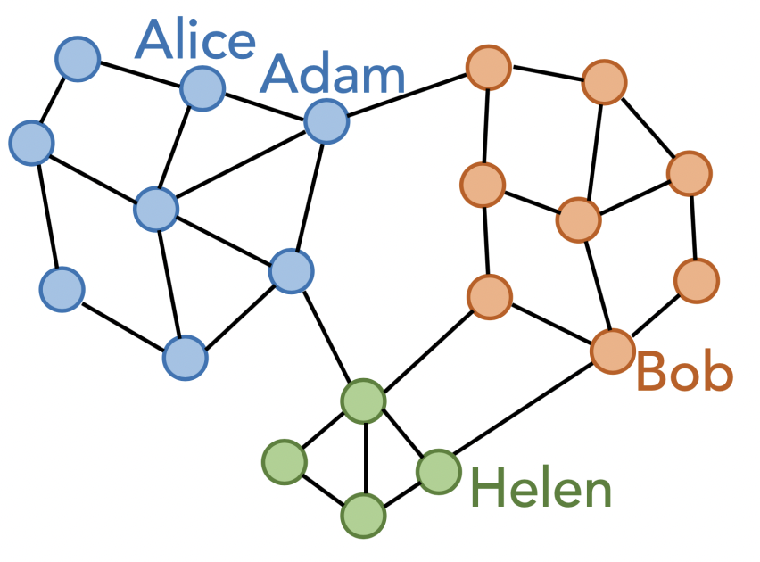
Background | Link Prediction
But, in reality, we can only observe the outcome under one particular treatment.
So, how can we find the counterfactual link? 🤔
➔ Solution:
find the most similar node pair with a different treatment
as the counterfactual link

Slide 13
Background | Link Prediction
But, in reality, we can only observe the outcome under one particular treatment.
So, how can we find the counterfactual link? 🤔
➔ Solution:
find the most similar node pair with a different treatment
as the counterfactual link
➔ core idea: generate counterfactual links to help the model learn better node representations for link prediction.

Slide 14
Background | Link Prediction
➔ core idea: generate counterfactual links to help the model learn better node representations for link prediction.
Logic behind the idea
Generally, the question can be described as “would the link exist or not if the graph structure became different from observation?”
If a model can learn the causal relationship by answering this question, it will improve the prediction with such knowledge.

Slide 15
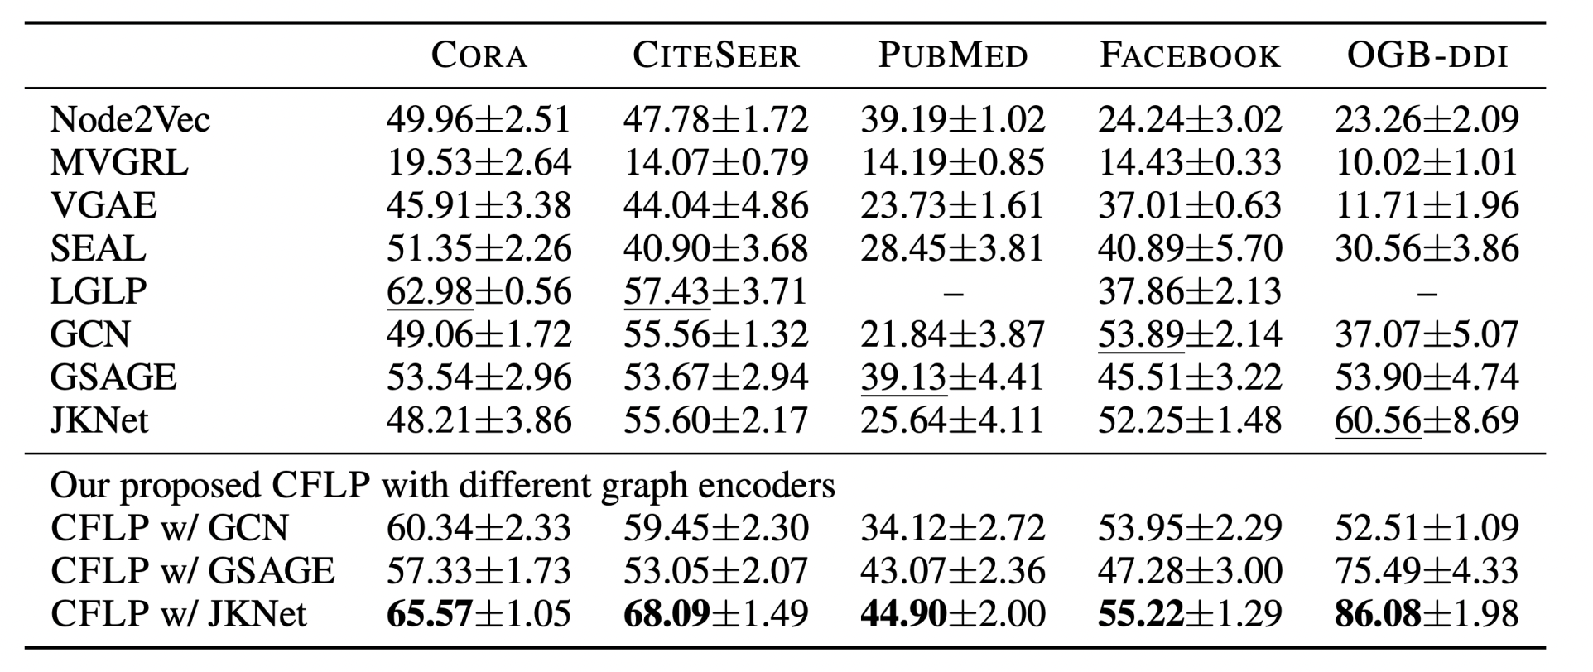
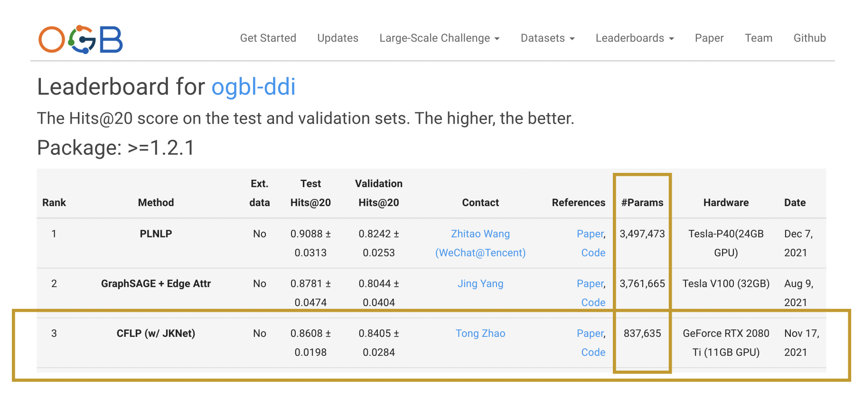
Background | Experiments
Good empirical results

Slide 16
Outline
Background
Methods
Q1: what are the counterfactual links?
Q2: how to generate the counterfactual links?
Q3: how to utilize the counterfactual links?
Experiment
Summary

Slide 17
Method | formulation
3 key factors of a counterfactual question
node representations (Z)
information of node pairs
treatment (T)
global graph structural properties
outcome (Y)
link existence

Slide 18
Method | formulation
3 key factors of a counterfactual question
node representations (Z)
information of node pairs
treatment (T)
global graph structural properties
outcome (Y)
link existence
About the treatment (T)
global graph structural properties
id of community/cluster/neighborhood
or K-core / Louvain / spectral clustering
$T_{ij}=1$ if $c\left(v_{i}\right)=c(v_{j})$ else $T_{ij}=0$
$T_{ij}=1$ means node i and node j
are structurally consistent in one aspect

Slide 19
Method | formulation
Q1: what are the counterfactual links?
that is, the link $A_{ij}^{CF}$that satisfies $T_{ij}^{CF}=1−T_{ij}$
when $T_{ij}^{CF}=1−T_{ij}$, is the link $A_{ij}^{CF}$exist?
3 key factors of a counterfactual question
node representations (Z)
information of node pairs
treatment (T)
global graph structural properties
outcome (Y)
link existence
About the treatment (T)
global graph structural properties
id of community/cluster/neighborhood
or K-core / Louvain / spectral clustering
$T_{ij}=1$ if $c\left(v_{i}\right)=c(v_{j})$ else $T_{ij}=0$
$T_{ij}=1$ means node i and node j
are structurally consistent in one aspect

Slide 20
Method
Q2: How to generate the counterfactual links?
To find the counterfactual link ($v_{a},v_{b}$) of the given link ($v_{i},v_{j}$)
where $h(⋅,⋅)$ is a metric of measuring the distance between a two edges

Slide 21
Method
Q2: How to generate the counterfactual links?
$$O(N^{4})$$
relax
$$O(N^{2})$$

Slide 22
Method
Q2: How to generate the counterfactual links?
➔

Slide 23
Method
Q2: How to generate the counterfactual links?
So far, we obtain $A_{ij}^{CF}, T_{ij}^{CF}$ from $A_{ij}^{ }, T_{ij}^{ }$.
But, how to utilize the $A_{ij}^{CF}, T_{ij}^{CF}$? 🤔

Slide 24
Outline
Background
Methods
Q1: what are the counterfactual links?
Q2: how to generate the counterfactual links?
Q3: how to utilize the counterfactual links?
Experiment
Summary

Slide 25
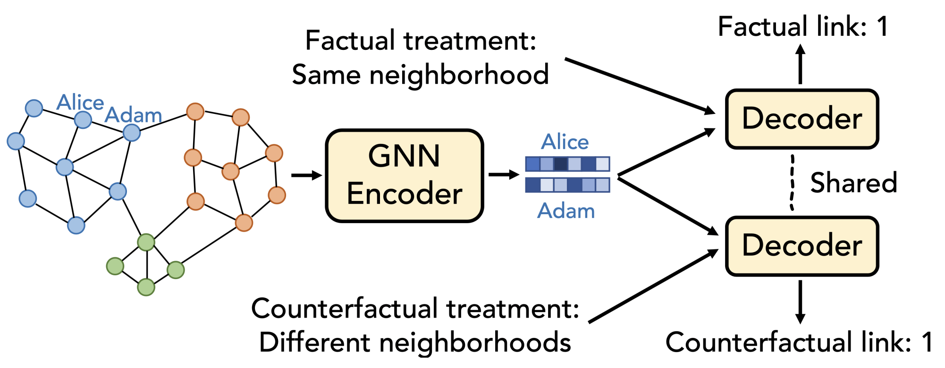
Method
Learning from Counterfactual Links
train a GNN to predict factual links and counterfactual links
given the corresponding treatments

Slide 26
Method
Learning from Counterfactual Links
train a GNN to predict factual links and counterfactual links
given the corresponding treatments
$$T$$
GNN
$$\hat{A}$$
$$A,X$$
$$Z$$
decode
encode
$${\hat{A}}^{CF}$$
$$T^{CF}$$

Slide 27
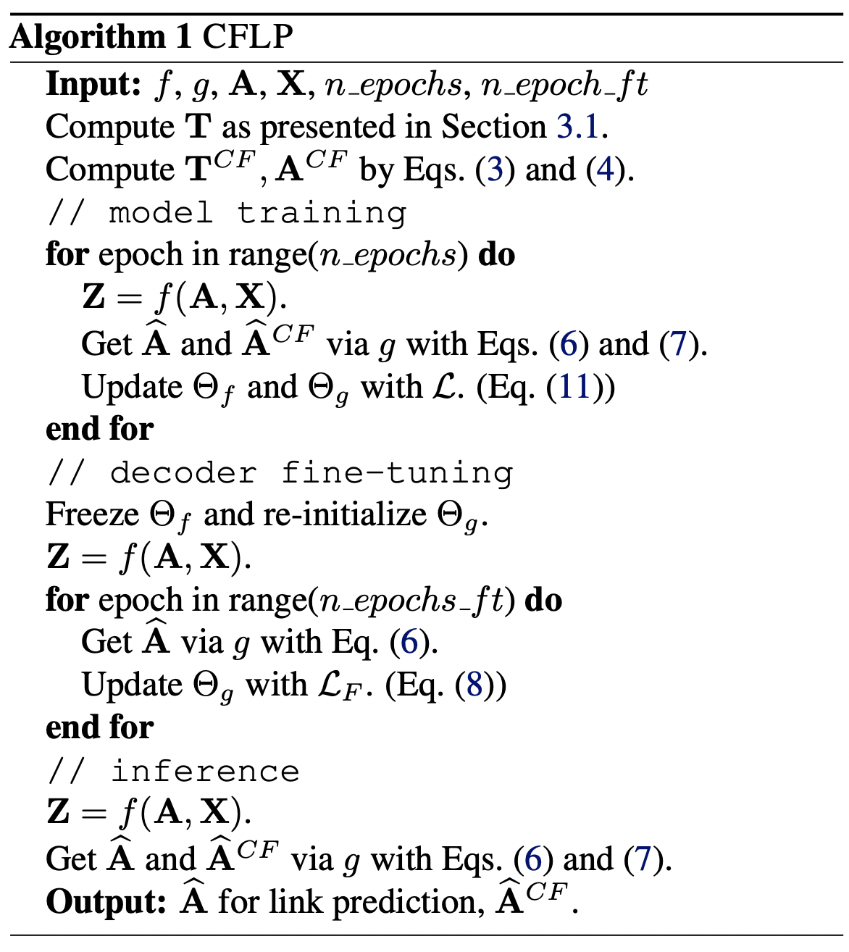
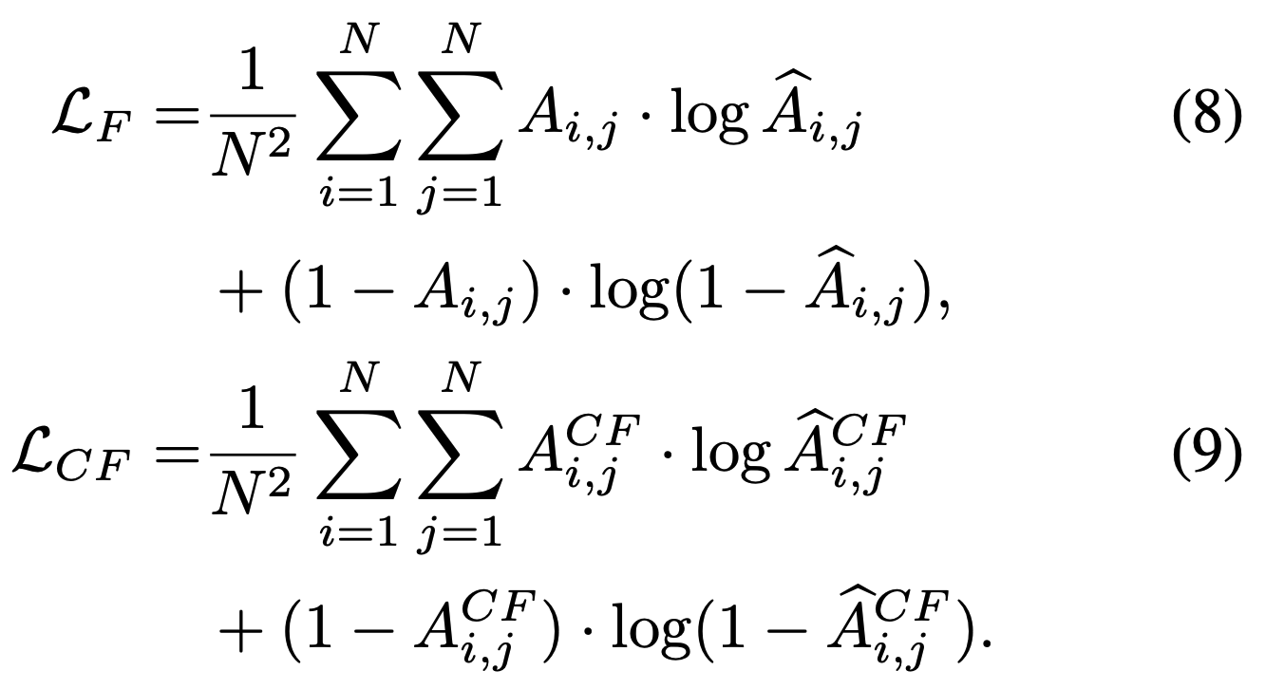
Method
Learning from Counterfactual Links
optimization
1. collect data
2. train
3. fine-tune
4. test

Slide 28
Outline
Background
Methods
Q1: what are the counterfactual links?
Q2: how to generate the counterfactual links?
Q3: how to utilize the counterfactual links?
Experiment
Q4: how helpful are the counterfactual links?
Q5: how to justify the effectiveness of counterfactual links?
Summary

Slide 29
Experiments

Slide 30
Experiments
Link prediction performances measured by Hits@20
Consistent improvement against baselines.

Slide 31
Experiments

Slide 32
Experiments
Q5: how to justify the effectiveness of counterfactual links?
when $T_{ij}=1$ or $T_{ij}=0$,
is the link $A_{ij}$still exist?
The individual treatment effect (ITE) can be used to
quantify the effect of treatment on the outcome.
$$T_{ij}=1$$
$$T_{ij}=0$$
The averaged treatment effect (ATE)
is the expectation of ITE

Slide 33
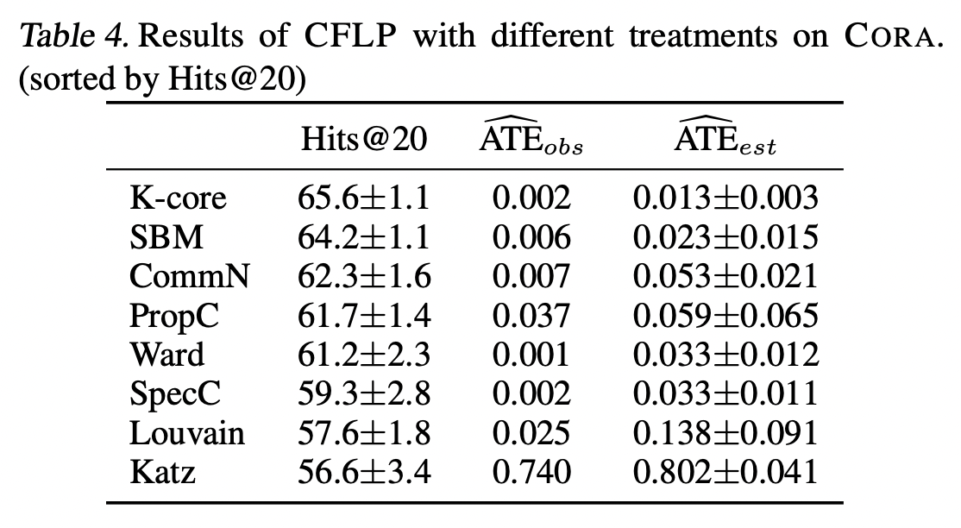
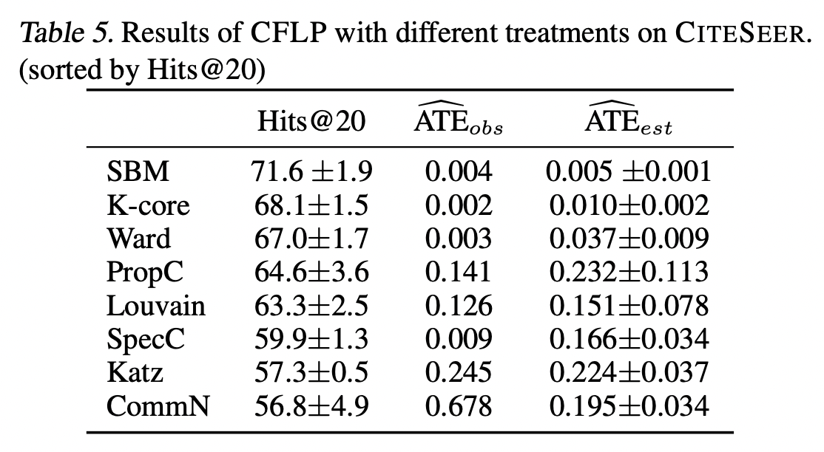
Experiments

Slide 34
Outline
Background
Methods
Experiment
Summary

Slide 35
Summary
Contributions
the first work that aims at improving link prediction by causal inference
introduce CFLP that trains GNNs to predict both factual and counterfactual links
leverage causal relationship to enhance link prediction
CFLP outperforms competitive baselines on several benchmark datasets

Slide 36
Q&A
Thanks for your attention!

