Slide 1
Model Inversion Attack: From Images to Graphs
Presenter: Zhanke Zhou
2023. 02. 07

Slide 2
Outline
Background
Model inversion attacks on images: an overview
Model inversion attack on graphs: recent advances
Summary

Slide 3
Outline
Background
Q1: what is model inversion attack?
Model inversion attacks on images: an overview
Model inversion attack on graphs: recent advances
Summary

Slide 4
Background | Image classification
Training pipeline of a neural network:
input
model
output
A neural network
Cat

Slide 5
Background | Image classification
What if we reverse the pipeline?
output
model
input
A neural network
Cat
Can we recover the cat image from the trained model? 🤔
What if we reverse the process?

Slide 6
Background | Image classification
What if we reverse the pipeline?
output
model
input
A neural network
Cat
Can we recover the cat image from the trained model? 🤔
➔ Yes! we can recover the training data via model inversion attack

Slide 7
Background | Research problem
Training: $f_{θ}\left(x\right)→y$
Inversion attack: $f_{φ}^{−1}\left(y\right)→x$
Definition of model inversion attack (aka MIA, MI attack)
a malicious user attempts to recover the private data
that is used to train a neural network (i.e., the target model)
Image from Variational Model Inversion Attacks. NeurIPS 2021.

Slide 8
Outline
Background
Q1: what is model inversion attack?
An overview of model inversion attacks on images
Q2: how to recover the images used for training?
Model inversion attack on graphs
Summary

Slide 9
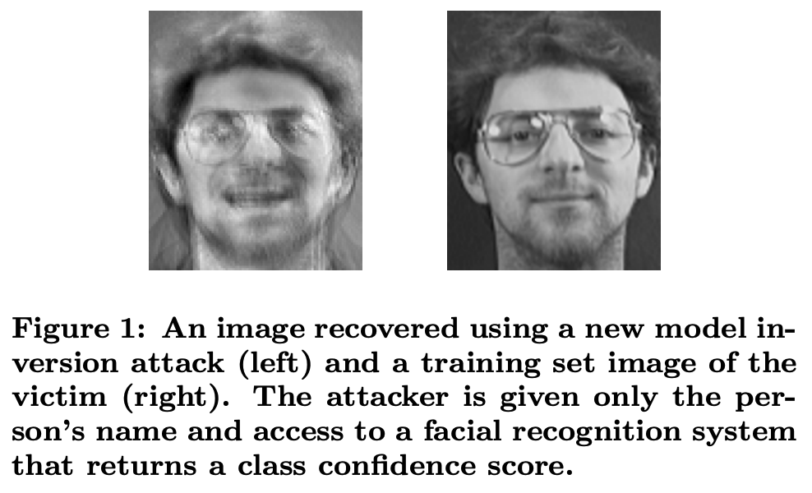
Pioneer works
MI attack with simple models
e.g., linear regression or decision trees
MI attack is feasible
Privacy in Pharmacogenetics: An End-to-End Case Study of Personalized Warfarin Dosing. USENIX Security 2014.
Model Inversion Attacks that Exploit Confidence Information and Basic Countermeasures. CCS 2015.

Slide 10
Pioneer works
MI attack with simple models
e.g., linear regression or decision trees
MI attack is feasible
However
the reconstructed images are unclear
such a method is poor for deep models
Privacy in Pharmacogenetics: An End-to-End Case Study of Personalized Warfarin Dosing. USENIX Security 2014.
Model Inversion Attacks that Exploit Confidence Information and Basic Countermeasures. CCS 2015.

Slide 11
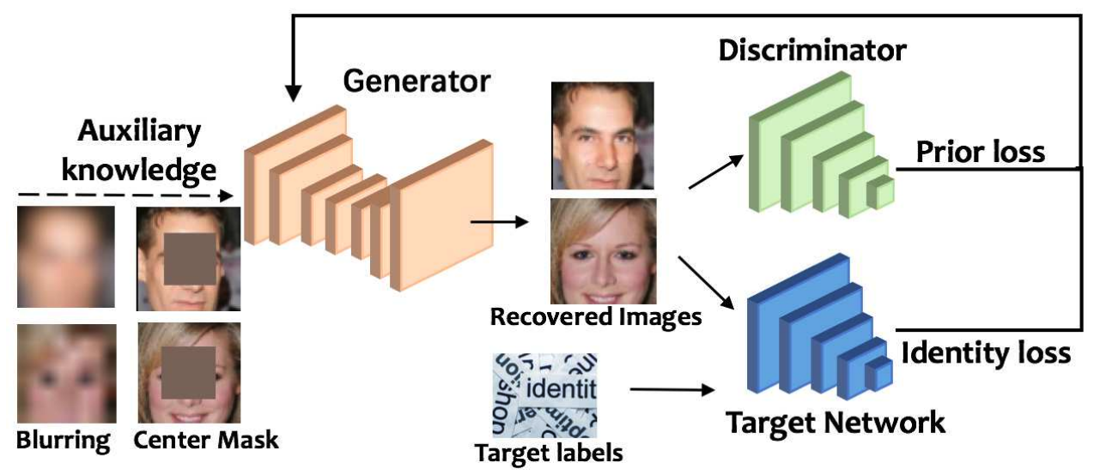
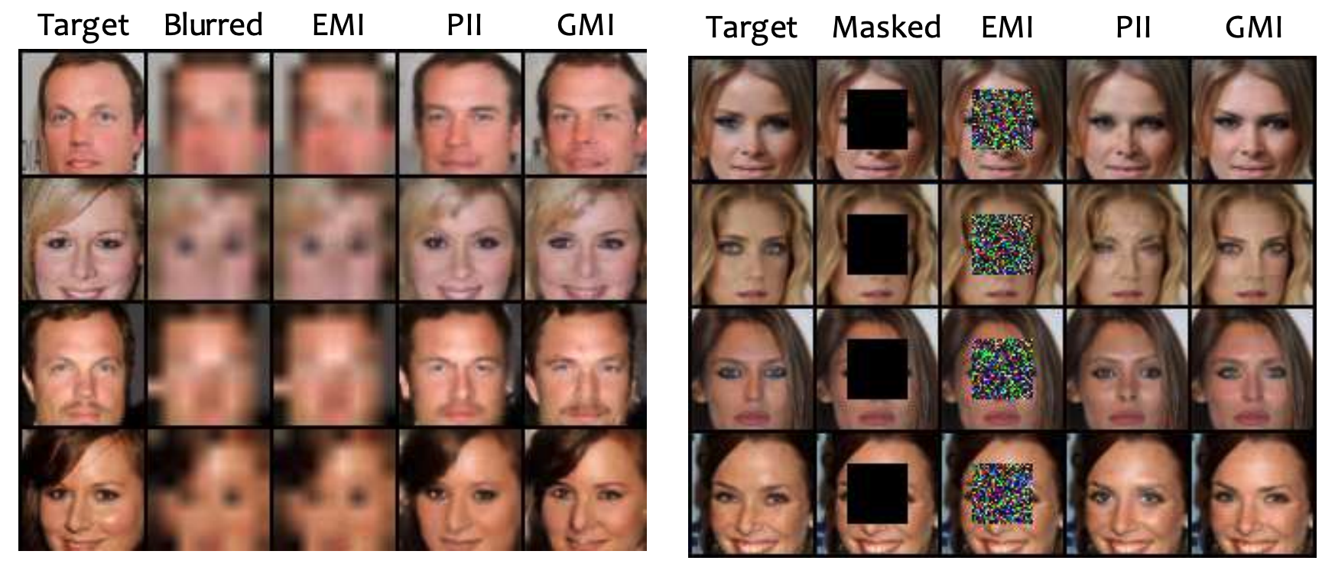
Generative model inversion
the first to conduct MIA on deep models
i.e., the convolution neural networks
the inversion process is guided by a distributional prior
through pretrained a generative adversarial network (GAN)
for obtaining the generic knowledge of human faces.
The Secret Revealer: Generative Model-Inversion Attacks Against Deep Neural Networks. CVPR 2020.

Slide 12
Take a break ☕️
Training: $f_{θ}\left(x\right)→y$
Inversion attack: $f_{φ}^{−1}\left(y\right)→x$
the top-one identification accuracy of face images
inverted from the classifier is only 45%
is it because CNNs do not memorize much about private data
or it is due to the imperfect attack algorithm? 🤔
➔ The target network maybe not be fully utilized

Slide 13
Knowledge-enriched distributional MI
To further distill the useful knowledge from the target model
[design1] utilizes the target model to generate soft labels
for supervising the GAN
[design2] explicitly parameterizes the distribution of private data
proceed MI attacks in a many-to-one way
Step 1. Build an inversion-specific GAN to distill private information
Step 2. Recover the distribution of private domain
Knowledge-Enriched Distributional Model Inversion Attacks. ICCV 2021.

Slide 14
Take a break ☕️
a successful attack should generate realistic and diverse samples
so, how can we generate the more diverse samples? 🤔

Slide 15
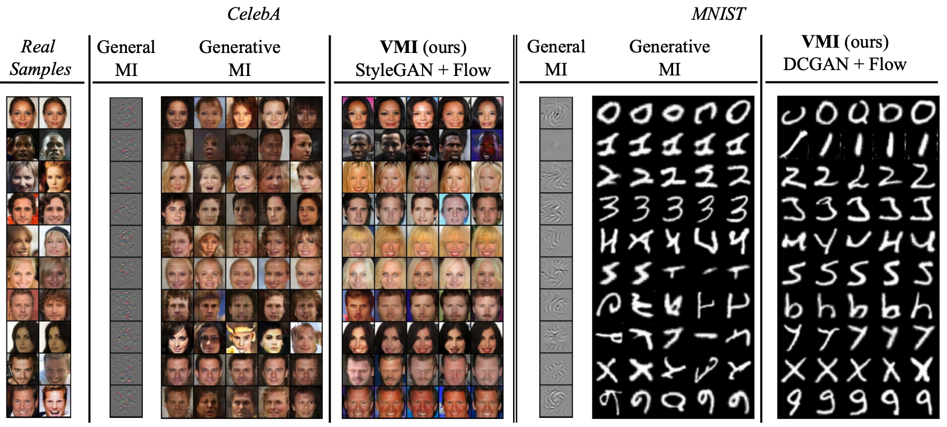
Variation model inversion
formulate a variational objective for both diversity and accuracy
Variational Model Inversion Attacks. NeurIPS 2021.

Slide 16
A short summary
model inversion attack
A well-defined research problem
Effective objectives and mechanisms
State-of-the-arts solutions
utilize prior knowledge (public data)
extract knowledge from target model
generate more realistic samples
generate more diverse samples
generative model inversion
knowledge-enriched distributional MI
variation model inversion

Slide 17
Outline
Background
Q1: what is model inversion attack?
Model inversion attacks on images: an overview
Q2: how to recover the images used for training?
Model inversion attack on graphs: recent advances
Q3: what can be attacked for graph data?
Q4: how to conduct such an attack on graph data?
Summary

Slide 18
MI attack | from images to graphs
“human faces”
but, what about “graphs”?

Slide 19
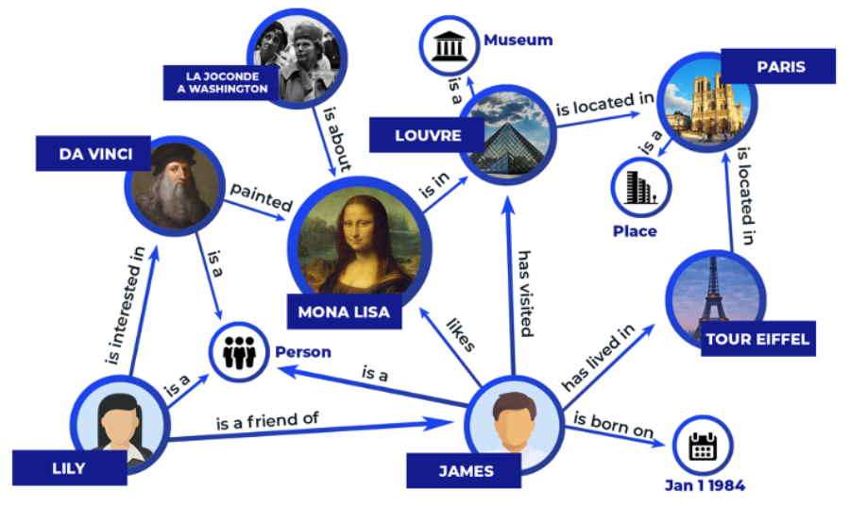
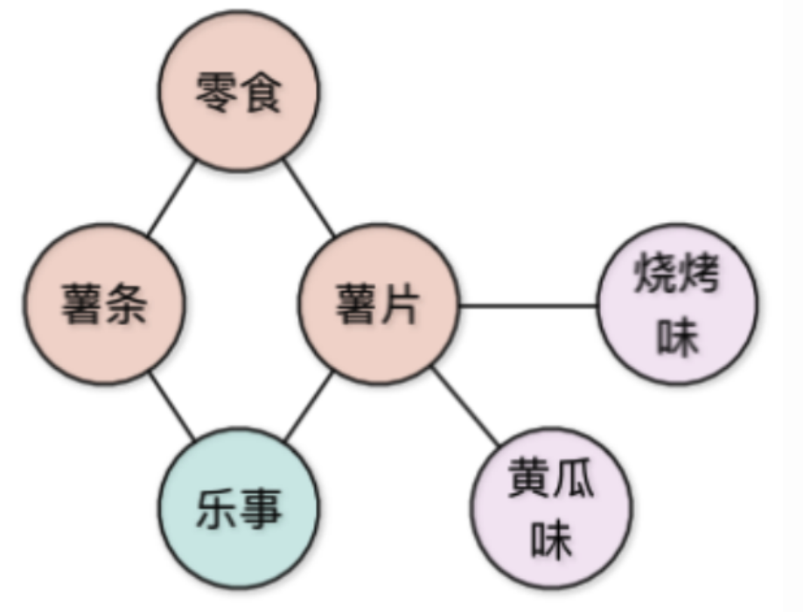
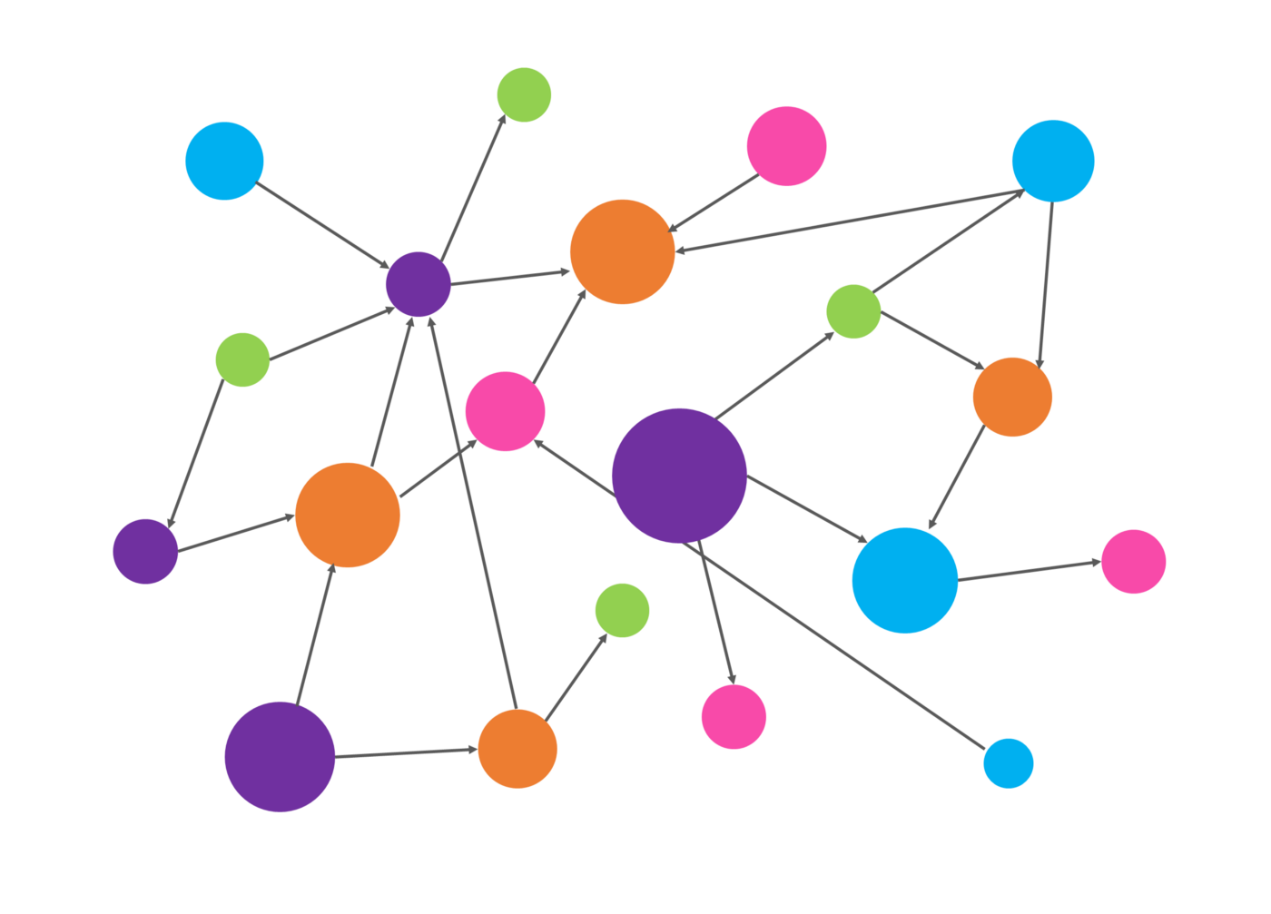
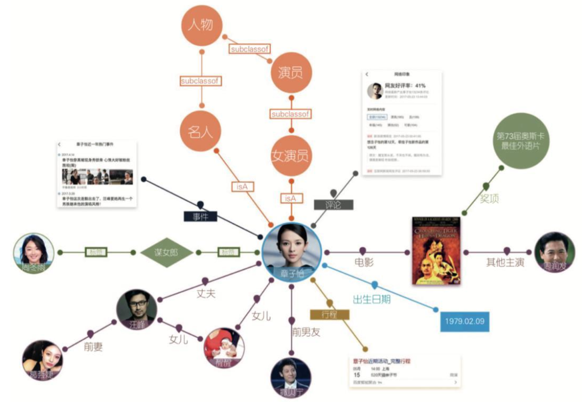
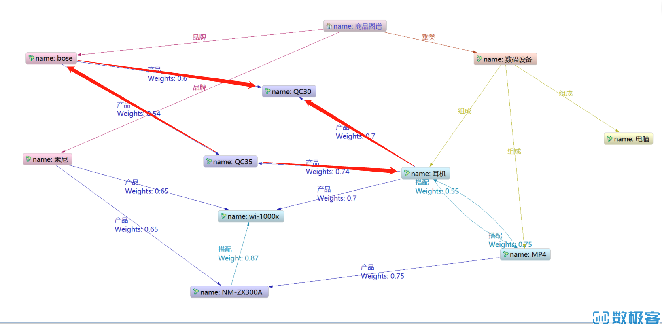
MI attack | from images to graphs
Graph is a general form of data expression
diverse and domain-specific
molecules
social networks
citation networks

Slide 20
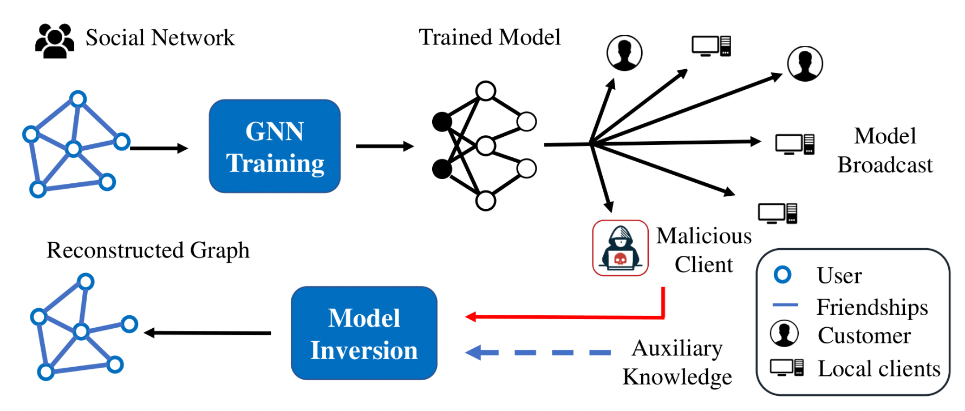
MI attack on graphs | motivation
Why Graph Reconstruction Attack?
inferring links leads to a severe privacy threat when the links represent sensitive information
e.g., the relationship between users in social networks
it may also leak the model owner’s intellectual property
GraphMI: Extracting Private Graph Data from Graph Neural Networks. IJCAI 2021.

Slide 21
MI attack on graphs | challenges
Key challenges
Lack of domain knowledge as the priors
graphs are less intuitive than images
the domain knowledge can be diverse
The discrete nature of graph structure
hard to optimize in a differentiable way
the nodes and edges cannot be resized to the same shape

Slide 22
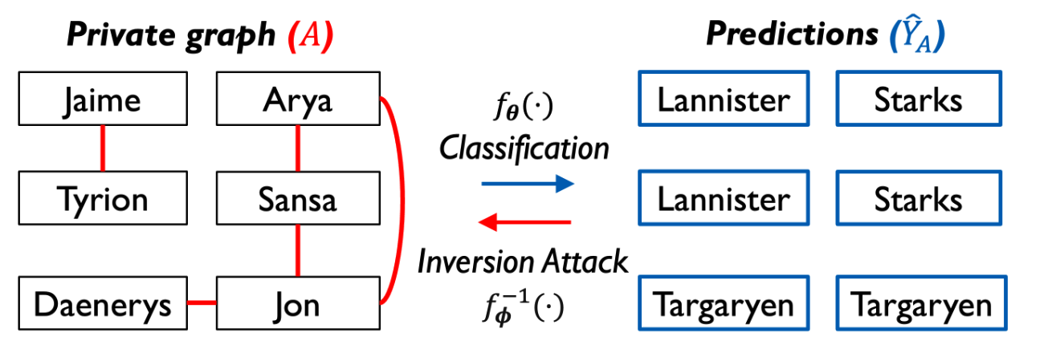
MI attack on graphs | an example
Graph Reconstruction Attack (GRA): a kind of MI attack on graphs
the forward inference is to predict the node category ${\hat{Y}}_{A}$
i.e., family of each person
the backward attack is to recover the adjacency $A$
i.e., kinship among the persons

Slide 23
MI attack on graphs | definition
Graph Reconstruction Attack (GRA):
given a set of prior knowledge $𝒦$ and a trained GNN $f_{θ}\left(⋅\right)$
the GRA aims to recover the adjacency ${\hat{A}}^{ }$of the training graph $\left(A,X\right)$
$${ \hat{A}}^{∗}={argmax}_{\hat{A}}ℙ (\hat{A}|𝒦)$$
${\hat{A}}^{∗}$ is the recovered adjacency
$𝒦$: set of prior knowledge
$𝒦⊆\{f_{θ}\left(⋅\right), X, H,\hat{Y},Y,D_{aux}\}$
where $D_{aux}$ is an auxiliary data
$ℙ(⋅)$: attack method to generate $\hat{A}$
training with $f_{θ}:\left(A,X\right)→…→H→\hat{Y}↔Y$
reconstruction attack with $f_{φ}^{−1}:𝒦→\hat{A}↔A$

Slide 24
Outline
Background
Q1: what is model inversion attack?
Model inversion attacks on images: an overview
Q2: how to recover the images used for training?
Model inversion attack on graphs: recent advances
Q3: what can be attacked for graph data?
Q4: how to conduct such an attack on graph data?
Summary

Slide 25
MI attack on graphs | existing works
training with $f_{θ}:\left(A,X\right)→…→H→\hat{Y}↔Y$
reconstruction attack with $f_{φ}^{−1}:𝒦→\hat{A}↔A$
A taxonomy
Class1: non-learnable attacks with single dataset
$𝒦=\{H,\hat{Y}\}$ (model’s outputs)
Class2: learnable attacks with single dataset
$𝒦=\left\{f_{θ}\left(⋅\right),X, Y\right\}$ (model + data)
Class3: learnable attacks with dual datasets
$𝒦=\{H,D_{aux}\}$ (model’s outputs + auxiliary data)
$${\hat{A}}^{∗}={argmax}_{\hat{A}}ℙ (\hat{A}|𝒦)$$
${\hat{A}}^{∗}$ is the recovered adjacency
$𝒦$: set of prior knowledge
$𝒦⊆\{f_{θ}\left(⋅\right), X, H,\hat{Y},Y,D_{aux}\}$
where $D_{aux}$ is an auxiliary data
$ℙ(⋅)$: attack method to generate $\hat{A}$
Basically, Class1 < Class2 < Class3 (in attack effectiveness)

Slide 26
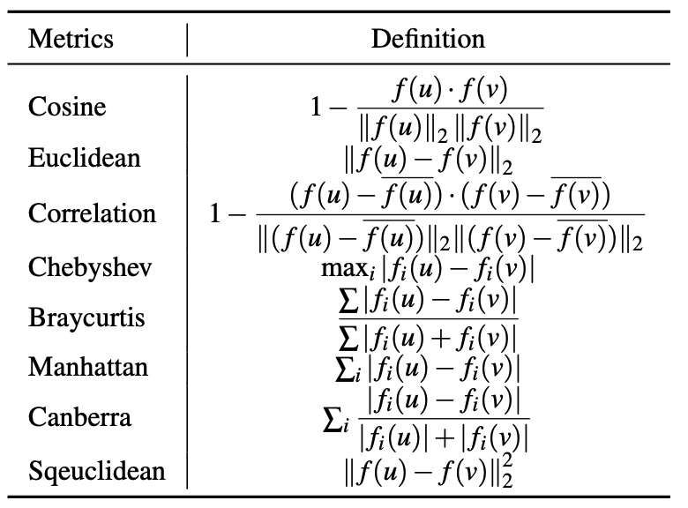
MI attack on graphs | Class1: non-learnable attacks
Non-learnable attacks with single dataset
$𝒦=\{H,\hat{Y}\}$ (model’s outputs)
key: similarity between nodes
$\hat{A}=distance(H)$
where ${\hat{A}}_{ij}=distance(h_{i},h_{j})$
Stealing Links from Graph Neural Networks. USENIX Security 2020.

Slide 27
MI attack on graphs | Class2: learnable attacks with single dataset
Learnable attacks with single dataset
$𝒦=\left\{f_{θ}\left(⋅\right),X, Y\right\}$
key: minimize the classification error
${\hat{A}}^{∗}={argmin}_{\hat{A}}ℒ_{cls}(f_{θ}\left(X,\hat{A}\right),Y)$
GraphMI: Extracting Private Graph Data from Graph Neural Networks. IJCAI 2021.

Slide 28
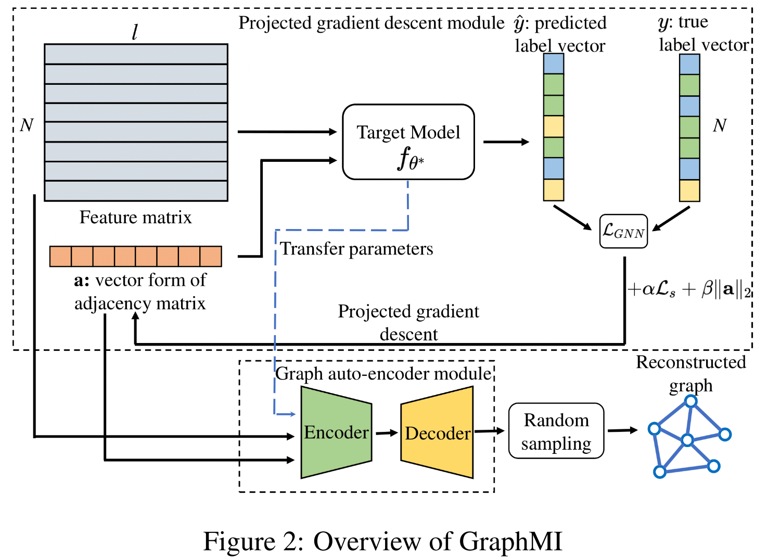
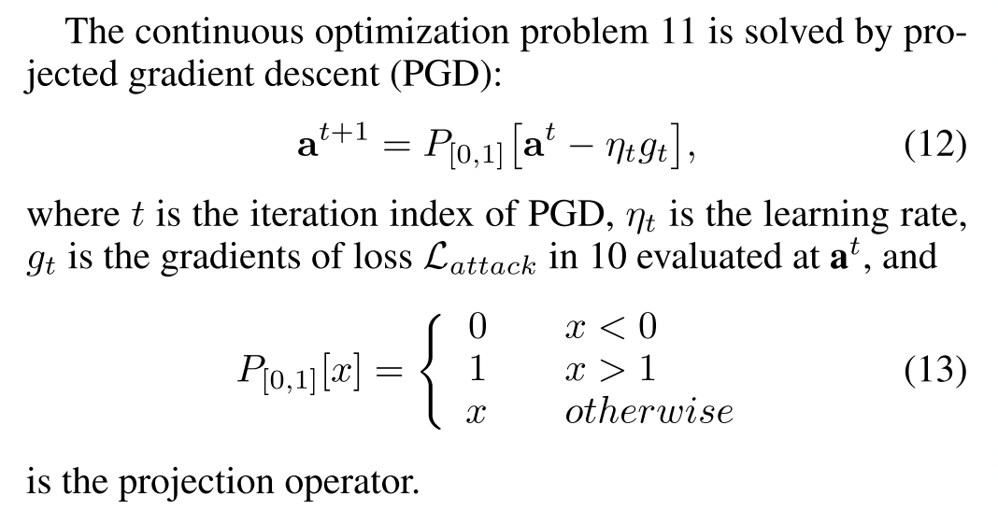
MI attack on graphs | Class2: learnable attacks with single dataset
Objective:
minimize ﻿the loss between true y and predicted y
added with feature smoothness (homophily)
and regularization on A
GraphMI: Extracting Private Graph Data from Graph Neural Networks. IJCAI 2021.

Slide 29
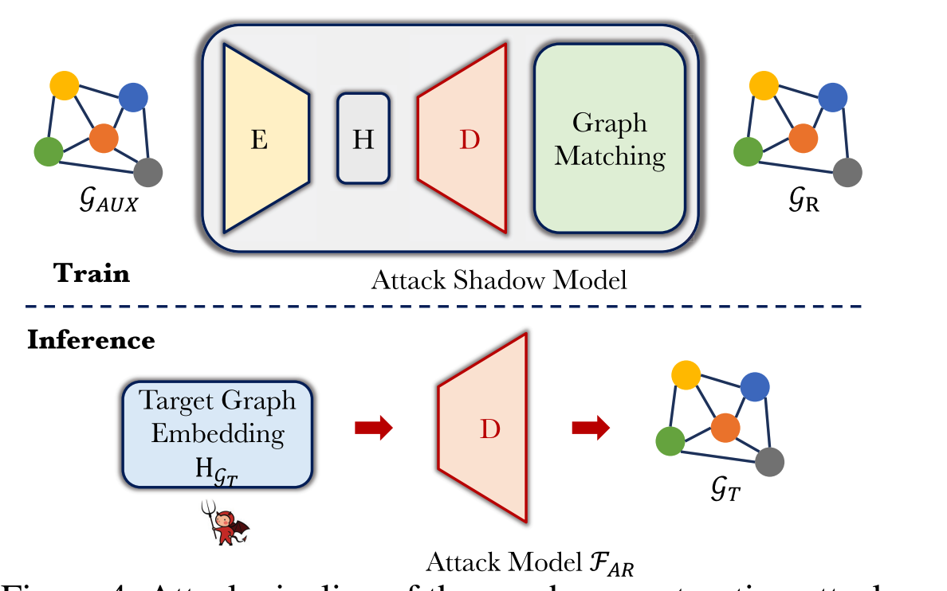
MI attack on graphs | Class3: transferable attacks with dual datasets
Learnable attacks with dual datasets
$𝒦=\{H,D_{aux}\}$
key: use $D_{aux}$ to train a encoder-decoder $f_{φ}^{ }$
$D_{aux}=\left(A_{aux},X_{aux}\right)$
$f_{φ}^{ }:\left(A_{aux},X_{aux}\right)→H_{aux}→A_{aux}$
then, directly apply $f_{φ}^{ }$ on $H$
$\hat{A}=f_{φ}^{dec} (H)$

Slide 30
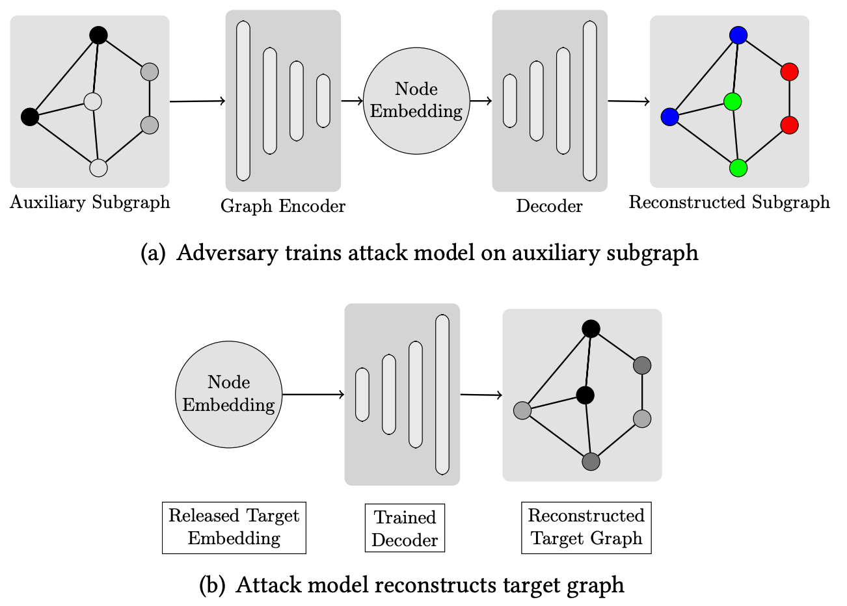
MI attack on graphs | Class3: transferable attacks with dual datasets
[1]
[2]
[1] Quantifying Privacy Leakage in Graph Embedding. MobiQuitous 2020.
[2] Inference Attacks Against Graph Neural Networks. USENIX Security 2022.

Slide 31
MI attack on graphs | Effectiveness
Finding MNEMON: Reviving Memories of Node Embeddings. CCS 2022.

Slide 32
MI attack on graphs | Effectiveness
Stealing Links from Graph Neural Networks. USENIX Security 2020.

Slide 33
Outline
Background
Q1: what is model inversion attack?
Model inversion attacks on images: an overview
Q2: how to recover the images used for training?
Model inversion attack on graphs: recent advances
Q3: what can be attacked for graph data?
Q4: how to conduct such an attack on graph data?
Summary

Slide 34
Take home messages
Model inversion attack from images to graphs
Q1: what is model inversion attack
➔ recover the private dataset from the target model
Q2: how to recover the images used for training
➔ utilize prior knowledge from public data and extract knowledge from target model
Q3: what can be attacked for graph data?
➔ to reconstruct the adjacency of the training graph
Q4: how to conduct reconstruction attack on graph data?
➔ utilize the prior knowledge and conduct learnable/non-learnable attack

Slide 35
Future directions
Directions
utilize more prior knowledge (if available)
inspecting the recovered graph’s properties
robust methods for defending against the attack
General principles
to attack, you must extract more
to defense, you must forget more

Slide 36
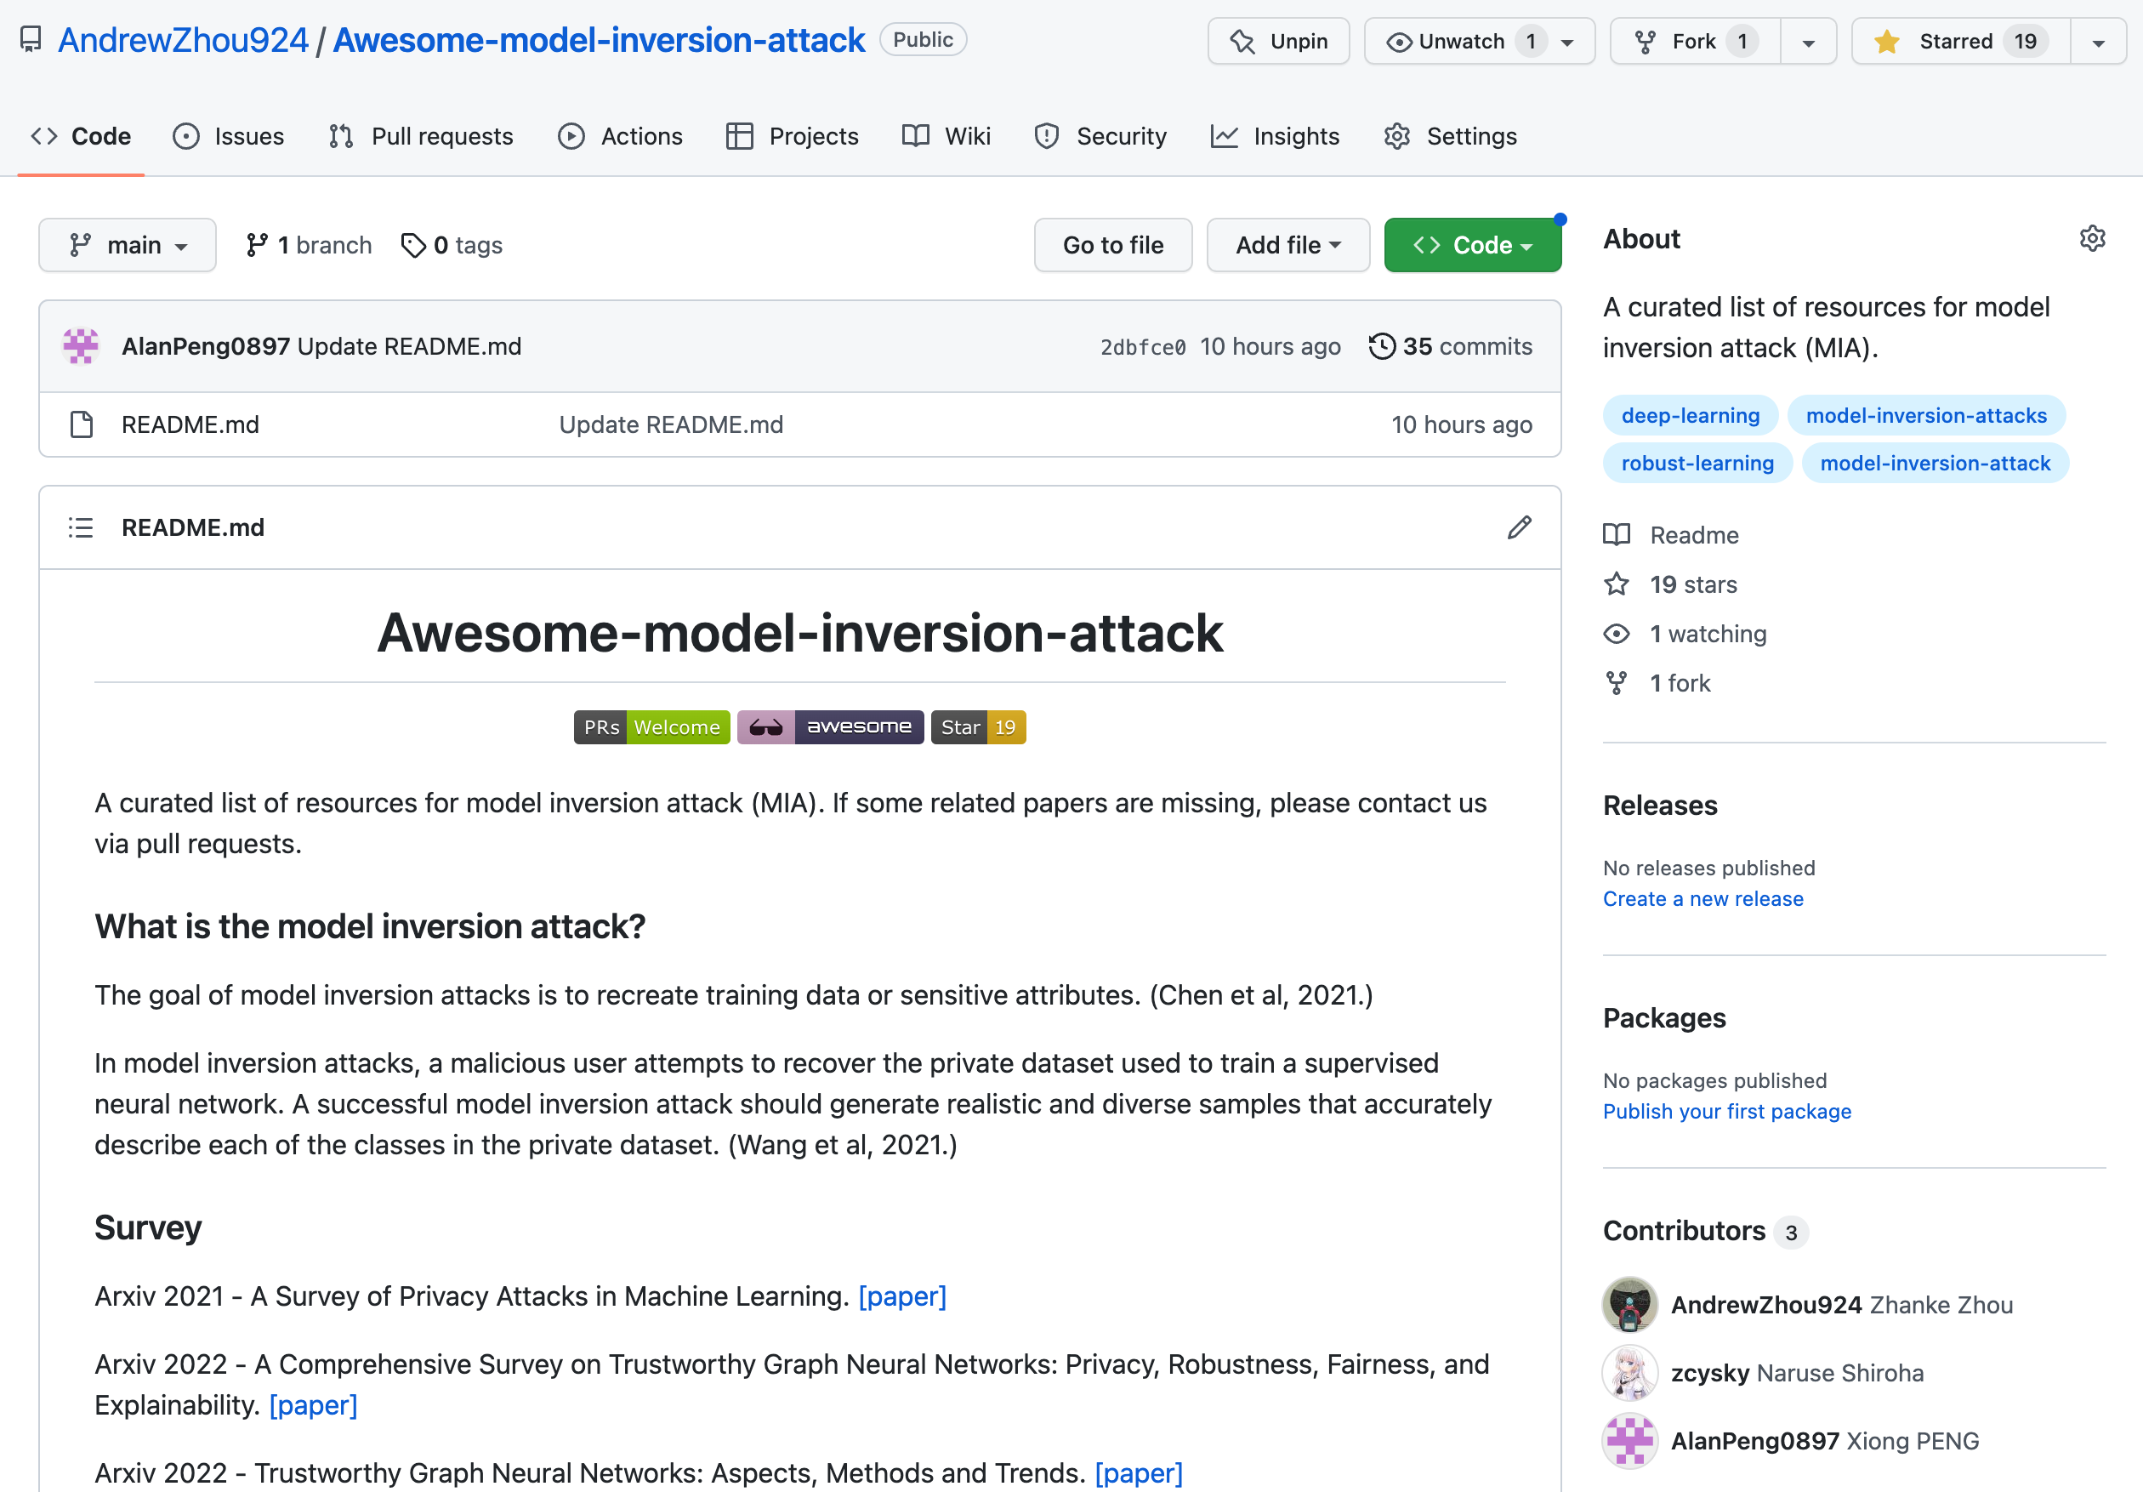
A curated list of resources
include 60+ paper of 3 domains
computer vision
natural language processing
graph learning
https://github.com/AndrewZhou924/Awesome-model-inversion-attack

Slide 37
Q&A
Thanks for your attention!

Slide 38
Potential risk and values
The MI attack approaches can be misused to attack real-world targets
However, it is important to raise the awareness of such an attack
inform the community about the risk of privacy leaks, especially the user side
e.g., the attack manners and patterns
More importantly, use the MI attacks to inspire the robust method
to develop the defensing strategies and to better protect privacy
to make the AI products more safe and trustworthy

Slide 39
Potential risk and values
“The gun is not guilty, the person who pulled the trigger is.”
------ by Mikhail Kalashnikov, farther of AK-47

Slide 40
Appendix: evaluation metrics
Inference Attacks Against Graph Neural Networks. USENIX Security 2022.

Slide 41
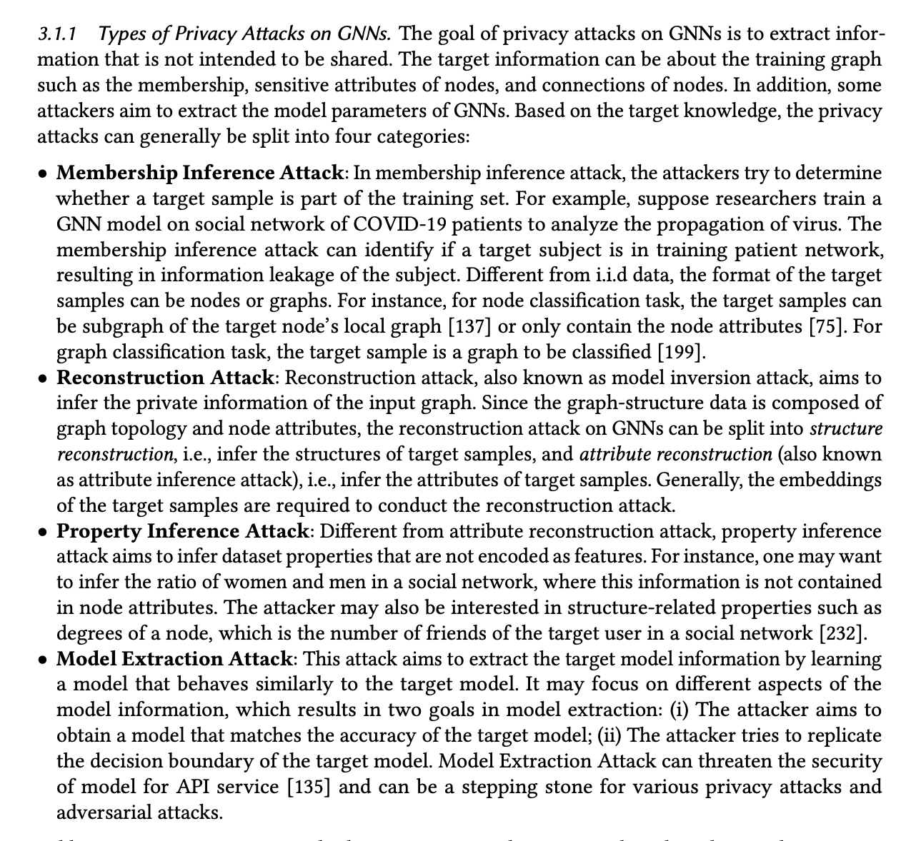
Appendix: privacy attack on graph
https://arxiv.org/pdf/2204.08570.pdf

Slide 42
Appendix: evaluation metrics
Target Accuracy
how many generated images can be classified as the target class
Sample Realism
how real are the generated images
Sample Diversity
how many images of the same class are recovered
Variational Model Inversion Attacks. NeurIPS 2021.

Slide 43
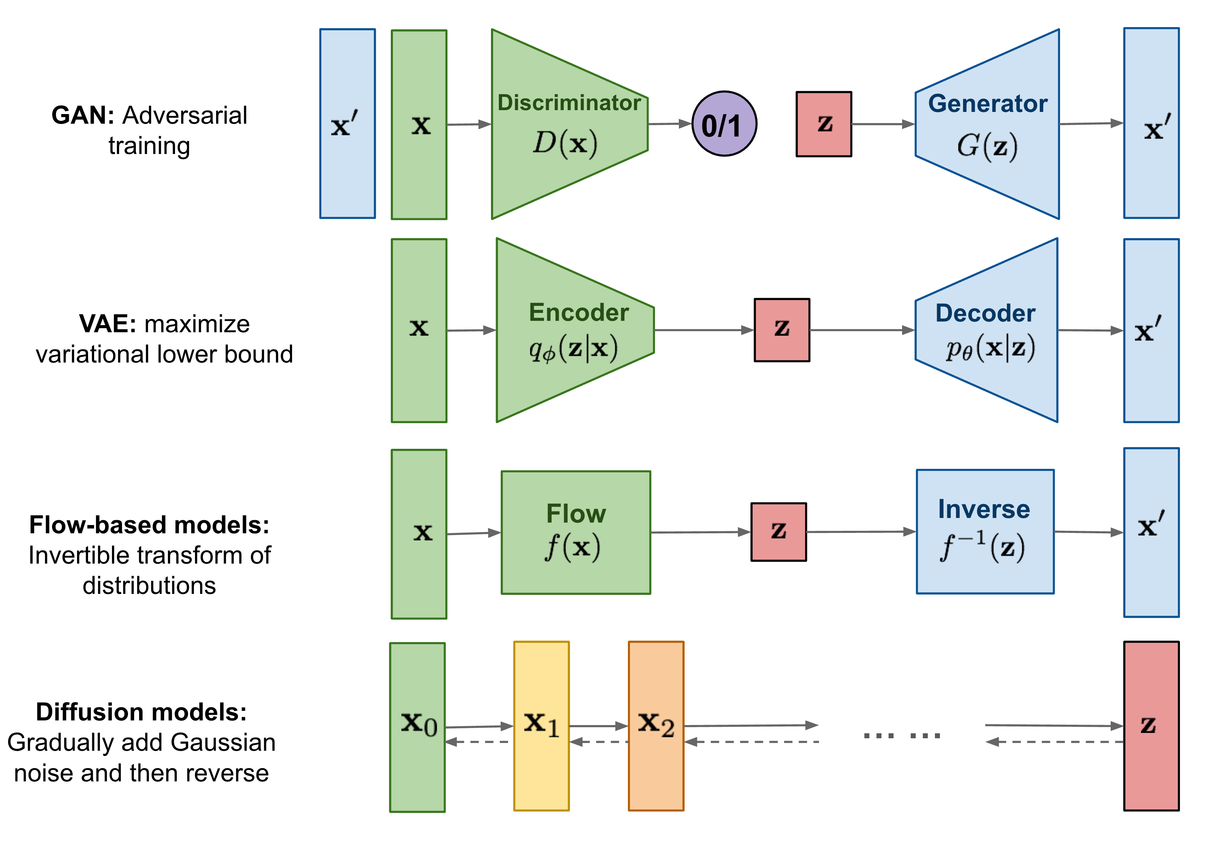
Appendix: generative models
https://lilianweng.github.io/posts/2021-07-11-diffusion-models/

Slide 44
Appendix: diffusion probabilistic model
GEODIFF: A GEOMETRIC DIFFUSION MODEL FOR MOLECULAR CONFORMATION GENERATION. ICLR 2022

