Slide 1
A review of GNN explanation methods
Presenter: Zhanke Zhou
^{2022. 10. 28}

Slide 2
Outline
Background
A review of existing methods
Recent advances that go beyond the post-hoc manner
Summary

Slide 3
Outline
Background
from graph learning to explainable graph learning
A review of existing methods
Recent advances that go beyond the post-hoc manner
Summary

Slide 4
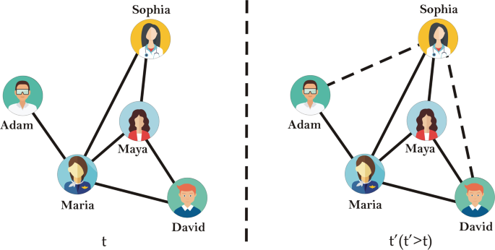
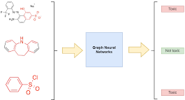
Background | graph learning
node-level
link-level
graph-level

Slide 5
Background | graph learning
$$Graph data D=(A,X)→{GNN f}_{ }→representation Z→ \tilde{Y}⟷Y$$
node
vector
encode
i
$$f:i→ℝ^{d}$$
$$ℝ^{d}$$
node representation $Z_{i}$
However, only powerful is not enough
explainability is also important

Slide 6
Background | explainable graph learning
However, the mere predictive power of the graph classifier is of limited interest to the neuroscientists, which have plenty of tools for the diagnosis of specific mental disorders. What matters is the interpretation of the model, as it can provide novel insights and new hypotheses. ^{[1]}
[1]: Counterfactual Graphs for Explainable Classification of Brain Networks. KDD 2021

Slide 7
Background | explainable graph learning
$$Graph data D=(A,X)→{GNN f}_{ }→prediction \tilde{Y}⟷ground truth Y$$
Powerful
explainable
i.e., to approximate $Y$ by $\tilde{Y}$
i.e., to determine which parts in $D$contribute to $\tilde{Y}$
the learned representation and graph data are usually highly entangled
an important property to trustworthy ML
e.g. ﻿identifying the functional groups in a molecule
Core problem: how to provide better explanations?

Slide 8
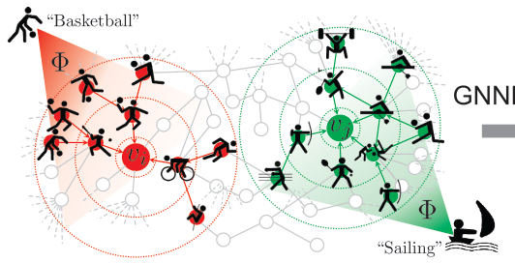
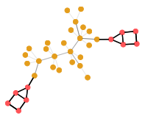
Background | explainable graph learning
node-level task: requires relevant nodes
e.g., node classification
graph-level task: requires relevant subgraphs
e.g., graph classification
link-level task: requires relevant paths
e.g., link prediction
To interpret the prediction of a GNN,
i.e., to identify a subgraph that
contributes most to the prediction.

Slide 9
Background | challenges
Discrete nature of graph structure
hard to optimize in a differentiable way
nodes and edges in a graph cannot be resized to the same shape
Lack of fine-grind annotations
e.g., node-level / motif-level annotations are blank for graph-level tasks
we need a suitable objective to train and metric to evaluate the explanation method
Lack of domain knowledge
e.g., ﻿molecules, social networks, and citation networks
graph data are less ﻿intuitive than images or texts

Slide 10
Outline
Background
A review of existing methods
Taxonomy
Metrics and evaluation
Recent advances that go beyond the post-hoc manner
Summary

Slide 11
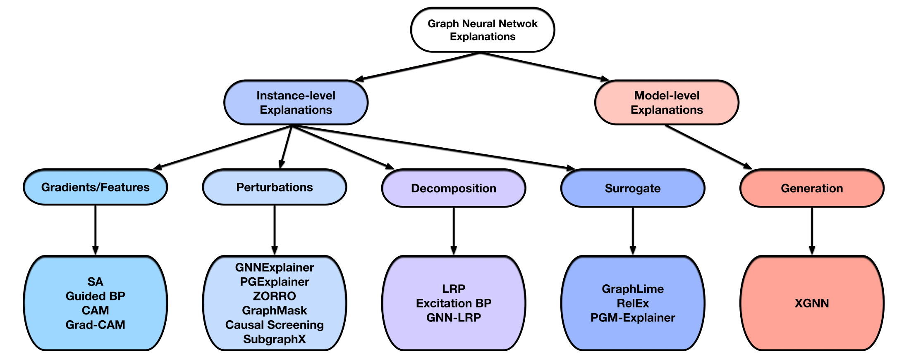
Taxonomy
﻿Instance-level Explanations
﻿Gradients/Features
﻿Perturbations (we will focus on)
﻿GNNExplainer
﻿PGExplainer
SubgraphX
﻿Decomposition
﻿Surrogate
Model-level Explanations
XGNN (the only one)
Explainability in Graph Neural Networks: A Taxonomic Survey. TPAMI 2022.

Slide 12
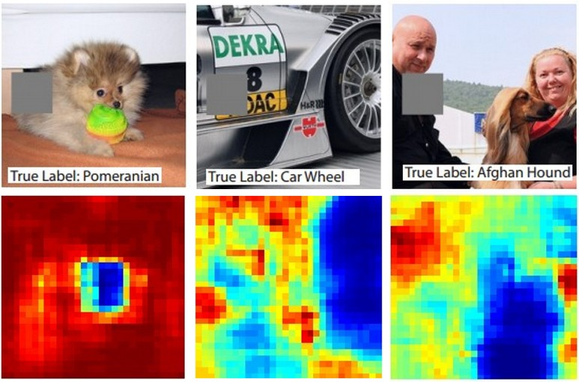
Class1: ﻿Gradients/Features-Based Methods
Class1: ﻿Gradients/Features-Based Methods
Class2: ﻿Perturbation-Based Methods
Class3: Surrogate-based methods
Class4: Decomposition-based methods
use the gradients or feature map values as the approximations of input importance
Visualizing and Understanding Convolutional Networks. 2013
https://cs231n.github.io/understanding-cnn/

Slide 13
Class1: ﻿Gradients/Features-Based Methods
Class1: ﻿Gradients/Features-Based Methods
Class2: ﻿Perturbation-Based Methods
Class3: Surrogate-based methods
Class4: Decomposition-based methods
[key idea] use the gradients/features to approximate input importance
[option1] get gradients of target prediction w.r.t. input by back-propagation
[option2] map the hidden features to the input space via interpolation
generally, larger gradients or feature values indicate higher importance
4 representative
methods
no extra learning procedures
not originally designed for graphs

Slide 14
Class2: ﻿Perturbation-Based Methods
Class1: ﻿Gradients/Features-Based Methods
Class2: ﻿Perturbation-Based Methods
Class3: Surrogate-based methods
Class4: Decomposition-based methods
[key idea] to study the output variations w.r.t input perturbations
intuitively,
when important input information is retained, the outputs should be similar to the original ones
when important input information is removed, the outputs should change greatly
➔ “house”
➔ “house” √
➔ “tree” ×
with mask $M_{A}$
with mask $（{1−M}_{A}）$

Slide 15
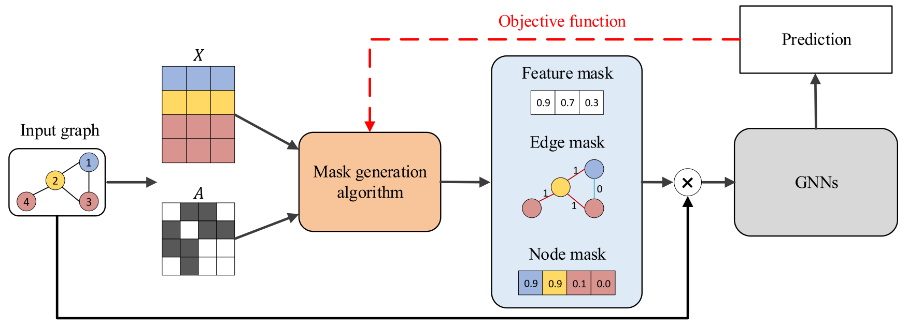
Class2: ﻿Perturbation-Based Methods
A general framework:
The $A⋅M_{A}$ here is a subgraph
Three key aspects here
﻿the mask generation algorithm
the type of masks
the objective function
$$M_{A}^{∗}=\min_{M_{A}}{Distance\left(f^{∗}\left(A\right), { f}^{∗}\left(A⋅M_{A}\right)\right)}$$
$$s.t. f^{∗}=\min_{f}{L_{cls}\left(f\left(A\right), Y\right)}$$
in a bi-level form

Slide 16
Class2: ﻿Perturbation-Based Methods
※
※
※
representative
methods
need extra learning procedures
originally designed for graphs

Slide 17
Class2 | GNNExplainer
Class2: ﻿Perturbation-Based Methods
GNNExplainer
PGExplainer
SubgraphX
﻿Given a trained GNN and its prediction yi=Basketball for node vi,
GNNExplainer identifies a small subgraph of the input graph that are most influential for yi
$$M_{A}^{∗}=\min_{M_{A}}{Distance\left(f^{∗}\left(A\right), { f}^{∗}\left(A⋅M_{A}\right)\right)}$$
$$s.t. f^{∗}=\min_{f}{L_{cls}\left(f\left(A\right), Y\right)}$$
learn a mask for each node vi,vj…
GNNExplainer: Generating Explanations for Graph Neural Networks. NeurIPS 2019.

Slide 18
Class2 | GNNExplainer
﻿the first general, model-agnostic approach for providing explanations
﻿to learn soft masks for edges and features, treats masks as trainable variables
➔
➔
the masks are optimized by maximizing the mutual information between the predictions of the original graph and the predictions of the sampled graph

Slide 19
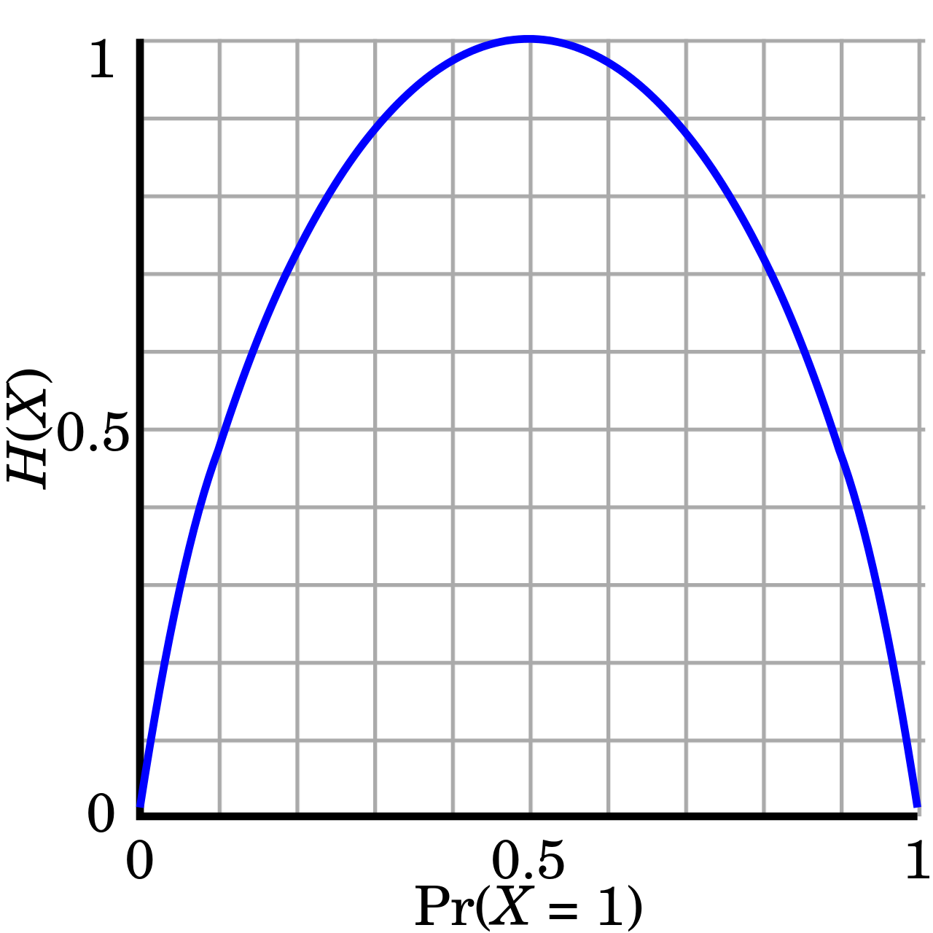
Class2 | GNNExplainer
$$H\left(x\right)=−xlog_{2}(x)$$
To avoid trivial solutions, constraints on the mask are necessary.
(entropy constraint) element-wise entropy to encourage the mask to be discrete.
(size constraint) size penalty as the sum of all elements in a mask.
(implicit connectivity constraint) get the largest connected subgraph as the explanation.

Slide 20
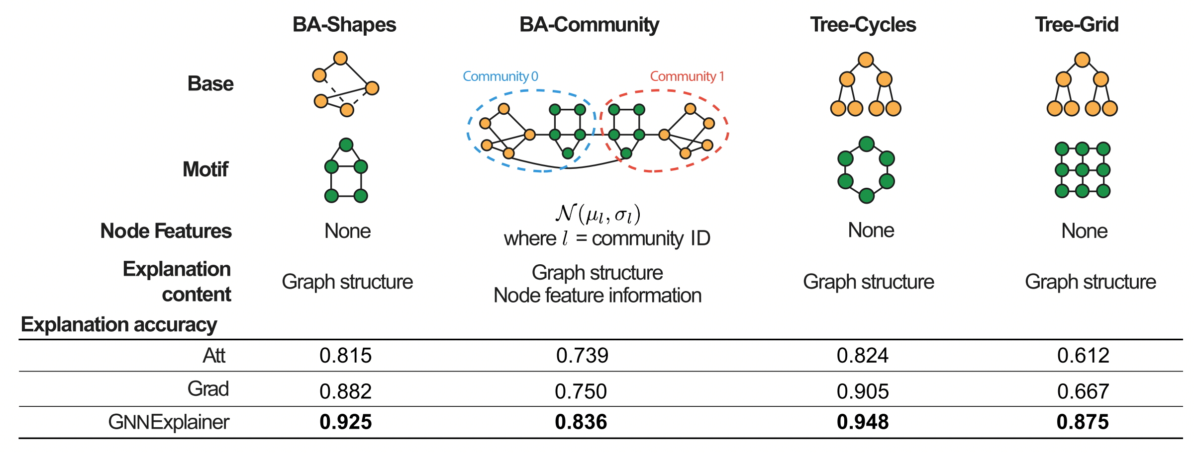
Class2 | GNNExplainer
GNNExplainer is better than
attention/gradient-based methods.

Slide 21
Take a break ☕️
However, do we really need to
explain each prediction by learning its mask individually? 🤔

Slide 22
Class2 | PGExplainer
Class2: ﻿Perturbation-Based Methods
GNNExplainer
PGExplainer
SubgraphX
A shared explainer
for all graphs
﻿PGExplainer emphasize the collective and inductive nature of this problem
the explanations can provide a global understanding of the trained GNNs
Parameterized explainer for graph neural network. NeurIPS 2020.

Slide 23
Class2 | PGExplainer
[training details]
Given an input graph,
1. it first obtains the embeddings for each edge by concatenating the corresponding node embeddings
2. uses the edge embeddings to predict the importance of each edge
3. the discrete masks are sampled via the reparameterization trick
4. Finally, the mask predictor is trained by maximizing the mutual information between the original predictions and new predictions

Slide 24
Class2 | PGExplainer
Constraints
In addition to the aforementioned entropy/size constraint,
PGExplainer also adopts a explicit connectivity constraint.
Reason: in many real-life scenarios, determinant motifs are expected to be connected.
This constraint is implemented with the cross-entropy of adjacent edges connecting to the same node.
e.g., node j and node k both connected to the node i.
If edge (i, j) is selected in the the explanatory graph, then adjacent edge (i, k) should also be included

Slide 25
Class2 | PGExplainer
PGExplainer is better than GNNExplainer.

Slide 26
Take a break ☕️
Connected subgraphs are more intuitive and human-intelligible.
However, the learned subgraphs by GNNExplainer/PGExplainer
are not always connected.
Is there a better way to extract connected subgraphs? 🤔

Slide 27
Class2 | SubgraphX
Class2: ﻿Perturbation-Based Methods
GNNExplainer
PGExplainer
SubgraphX
﻿to explore subgraph-level explanations for GNNs
use Monte Carlo Tree Search to explore different subgraphs via node pruning
select the most important subgraph w.r.t. the Shapley value as the explanation
Monte Carlo Tree Search ➔
(the search algorithm)
=
Shapley value ➔
(the score function)
On Explainability of Graph Neural Networks via Subgraph Explorations. ICML 2021.

Slide 28
Class2 | SubgraphX
SubgraphX is better than
GNNExplainer and PGExplainer.
On Explainability of Graph Neural Networks via Subgraph Explorations. ICML 2021.

Slide 29
Outline
Background
A review of existing methods
Taxonomy
Class1: ﻿Gradients/Features-Based Methods
Class2: ﻿Perturbation-Based Methods
Class3: Surrogate-based methods
Class4: Decomposition-based methods
Metrics and evaluation
A brief summary
Recent advances that go beyond the post-hoc manner
Summary

Slide 30
Class3: Surrogate-based methods
Class1: ﻿Gradients/Features-Based Methods
Class2: ﻿Perturbation-Based Methods
Class3: Surrogate-based methods
Class4: Decomposition-based methods
[key idea] ﻿employ a simple and interpretable surrogate model
to approximate the predictions of the complex deep model
﻿the explanations from the interpretable model are regarded as the explanations of the GNN
Learning procedures:
x
GNN
y
x
surrogate
y
x
surrogate
explanations
x
y
step1. collecting data
step2. fitting
step3. explaining
representative
methods
﻿key differences
how to obtain the local dataset (x,y pairs)
what interpretable surrogate model to use

Slide 31
Class3 | PGM-Explainer
to build a probabilistic graphical model to provide instance-level explanations
an interpretable Bayesian network is employed to fit the local dataset
then to explain the predictions of the original GNN model
﻿e.g., estimate the probability that node E has the predicted role given other nodes
PGM-Explainer: Probabilistic Graphical Model Explanations for Graph Neural Networks. NeurIPS 2020.

Slide 32
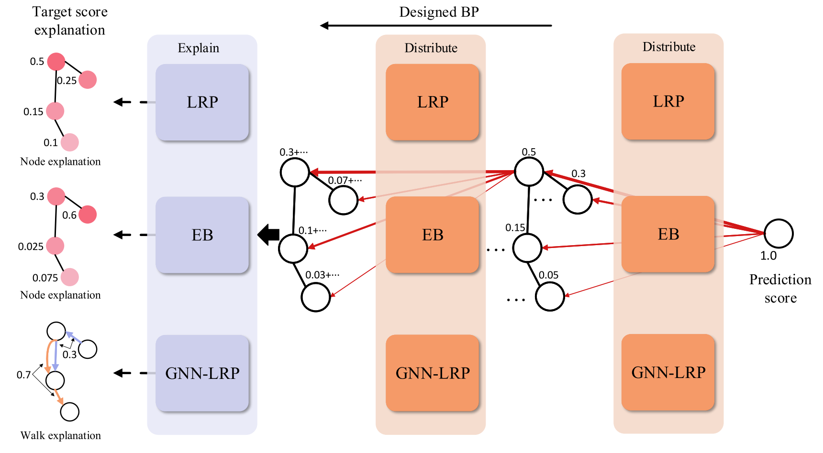
Class4: Decomposition-based methods
Class1: ﻿Gradients/Features-Based Methods
Class2: ﻿Perturbation-Based Methods
Class3: Surrogate-based methods
Class4: Decomposition-based methods
[key idea]
to ﻿measure the importance of input features by decomposing the original model predictions into several terms.
It can only study the importance of different nodes but not the graph structures.

Slide 33
Take a break ☕️
So far, we have reviewed the explanation methods of 4 classes.
How can we evaluate these methods? 🤔

Slide 34
Metrics and evaluation | Fidelity
Good explanations should be faithful to the model.
﻿if the identified mask are discriminative to the model
when the mask is removed, the prediction should change significantly ➔ higher Fidelity+
when the mask is retained, the prediction should be similar ➔ lower Fidelity-
$$¬A →¬B$$
(necessity)
$$A →B$$
(sufficiency)

Slide 35
Metrics and evaluation | Sparsity
﻿Good explanations should be sparse and compact.
➔ capture the most important input features and ignore the irrelevant ones
A fair comparison can be conducted under the same level of sparsity

Slide 36
Metrics and evaluation | Stability & Accuracy
﻿Good explanations should be stable.
﻿when small changes are applied to the input without affecting the predictions
the explanations should remain similar
﻿Good explanations should be accurate.
compare the explanations with such ground truths
the closer to ground truths, the better explanations
specific metrics here can be accuracy, F1 score, ROC-AUC score.
however, the Accuracy metric cannot be applied to real-world datasets due to the lack of ground truths.

Slide 37
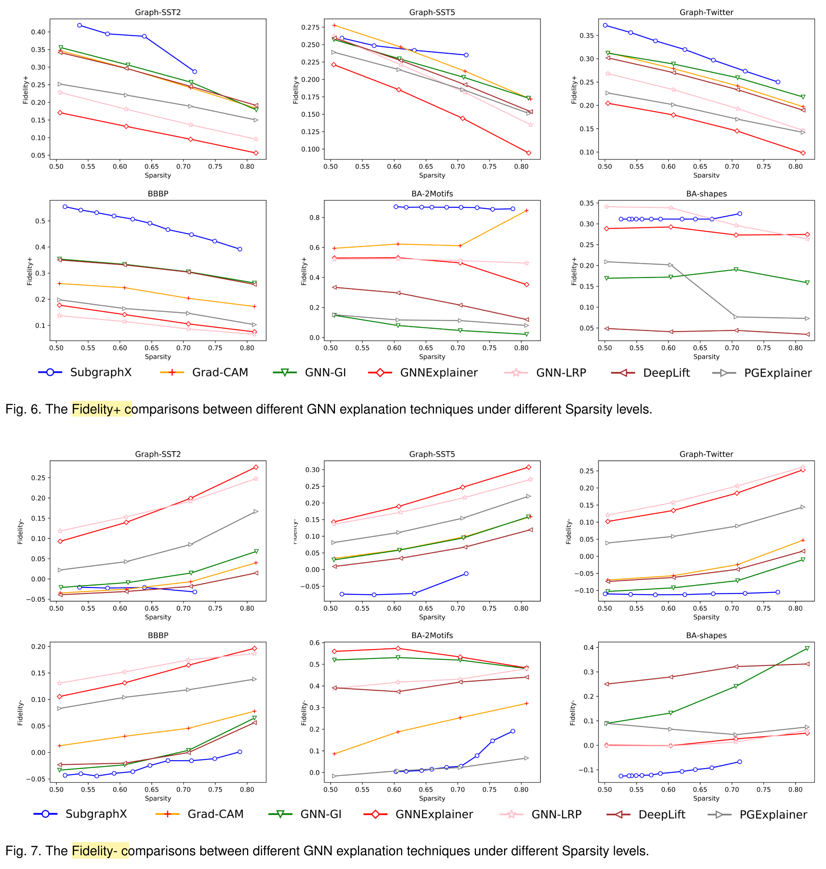
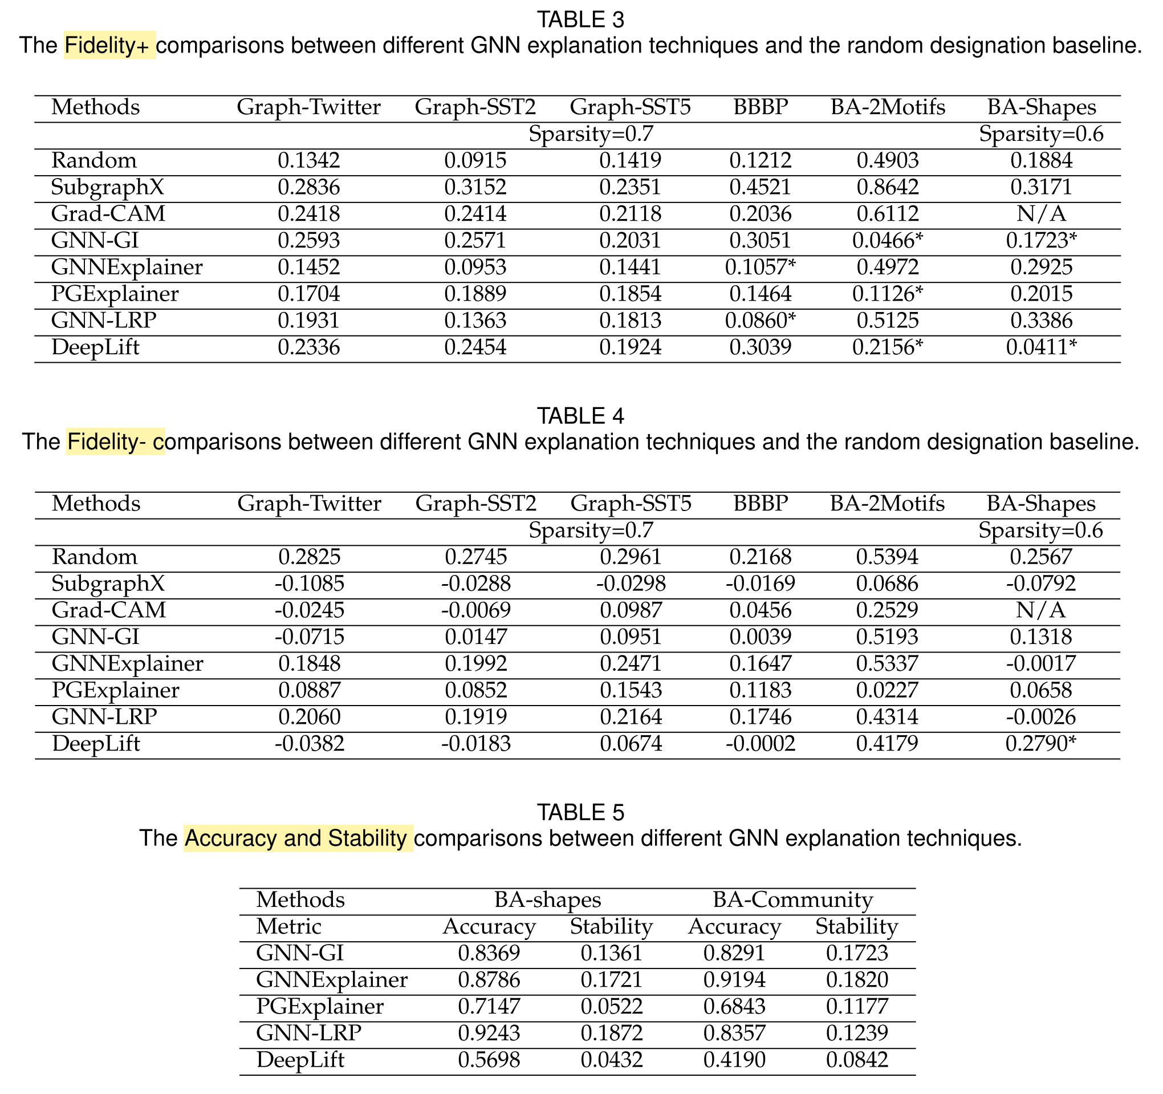
Metrics and evaluation
SubgraphX is the best method here
higher Fidelity+ 👍🏻
lower Fidelity- 👍🏻

Slide 38
Outline
Background
A review of existing methods
Taxonomy
Metrics and evaluation
A brief summary
Recent advances that go beyond the post-hoc manner
Summary

Slide 39
Taxonomy | summary
Class1: ﻿Gradients/Features-Based Methods
Class2: ﻿Perturbation-Based Methods
Class3: Surrogate-based methods
Class4: Decomposition-based methods
The post-hoc methods are popular
$$f_{\tilde{θ}}$$
step1: ﻿obtain the model parameter $\tilde{θ}$
i.e., train the predictor
$$G$$
$$\tilde{Y}$$
$$Y$$
fixed
step2: ﻿optimize the subgraph extractor $\tilde{φ}$
approximate the MI: $I\left(G_{s};\tilde{Y}\right)−I\left(G;\tilde{Y}\right)→0$
usually with constraints (e.g., size, connectivity)
$$g_{\tilde{φ}}$$
$$f_{\tilde{θ}}$$
$$G$$
$$G_{s}$$
$$\tilde{Y}$$
$$Y$$
$f_{\tilde{θ}}∘g_{\tilde{φ}}$ is the interpretating system
As ${\text{A}\text{ccuracy}(f}_{\tilde{θ}})<{\text{Accuracy}(f_{\tilde{θ}}∘g_{\tilde{φ}})}_{ }$is usual,
can we provide interpretation without sacrificing the accuracy? 🤔

Slide 40
Take a break ☕️
$$f_{\tilde{θ}}∘g_{\tilde{φ}}$$
$$g_{\tilde{φ}}$$
$$f_{\tilde{θ}}$$
$$G$$
$$G_{s}$$
$$\tilde{Y}$$
$$Y$$
a joint training of $f_{\tilde{θ}}∘g_{\tilde{φ}}$ might be better? 🤔

Slide 41
Outline
Background
A review of existing methods
Recent advances that go beyond the post-hoc manner
Summary

Slide 42
GSAT | method
use information constraint to select label-relevant subgraph
inspired by the Graph Information Bottleneck (GIB)
form a joint learning framework of $f_{\tilde{θ}}$ and $g_{\tilde{φ}}$
$$g_{\tilde{φ}}$$
$$G$$
$$G_{s}$$
$$\tilde{Y}$$
$$Y$$
$$I(G_{s};G)↓$$
$$I(G_{s};Y)↑$$
do ﻿not impose any potentially biased constraints
e.g., graph size or connectivity
Interpretable and Generalizable Graph Learning via Stochastic Attention Mechanism. ICML 2022.

Slide 43
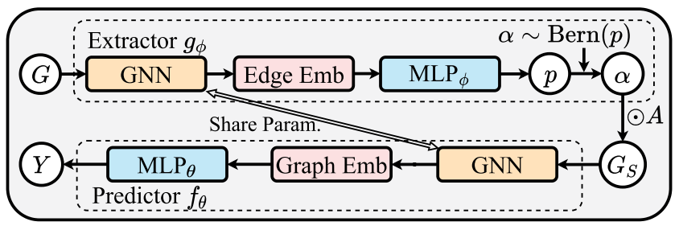
GSAT | method
$$G$$
$$g_{φ}$$
joint training
$$g_{φ}$$
$$f_{θ}$$
$$G$$
$$G_{s}$$
$$\tilde{Y}$$
$$Y$$
$$\tilde{Y}$$
$$f_{θ}$$
$$G_{s}$$

Slide 44
GSAT | Full learning objective
joint training
$$g_{φ}$$
$$f_{θ}$$
$$G$$
$$G_{s}$$
$$\tilde{Y}$$
$$Y$$
$$\left(g_{\tilde{φ}}\right)$$
$$\left(f_{\tilde{θ}}\right)$$

Slide 45
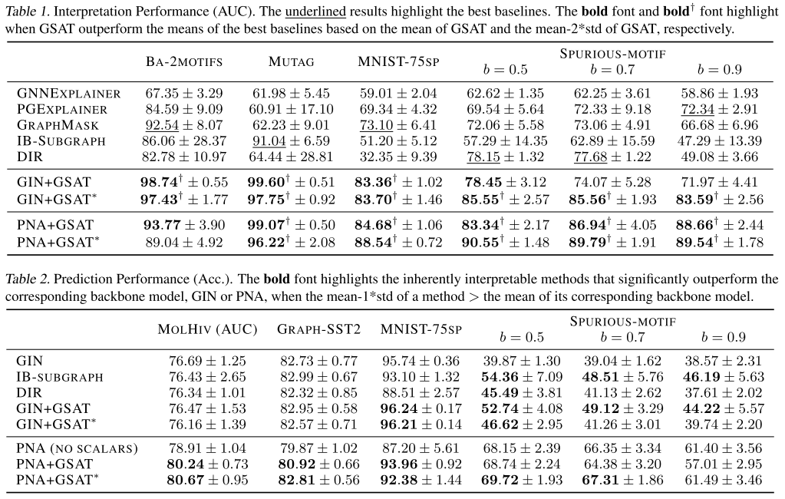
GSAT | Experiment
Interpretation 👍🏻
Prediction 👍🏻

Slide 46
GSAT | Experiment
since the GSAT dose not make any assumptions on the selected subgraphs,
the improvement of GSAT can be even more
if the true subgraph are dis-connected or vary in sizes.

Slide 47
Outline
Background
A review of existing methods
Recent advances that go beyond the post-hoc manner
Summary

Slide 48
Summary
A review of 4-class explanation methods
Class1: ﻿Gradients/Features-Based Methods
Class2: ﻿Perturbation-Based Methods
Class3: Surrogate-based methods
Class4: Decomposition-based methods
Future directions
go beyond the post-hoc manner
model-level explanation
explain for KG reasoners and corresponding analysis

Slide 49
Related works | interpretating GNN
Most Influential
Explainability in graph neural networks: A taxonomic survey. Yuan Hao, Yu Haiyang, Gui Shurui, Ji Shuiwang. ARXIV 2020. paper
Gnnexplainer: Generating explanations for graph neural networks. Ying Rex, Bourgeois Dylan, You Jiaxuan, Zitnik Marinka, Leskovec Jure. NeurIPS 2019. paper code
Explainability methods for graph convolutional neural networks. Pope Phillip E, Kolouri Soheil, Rostami Mohammad, Martin Charles E, Hoffmann Heiko. CVPR 2019.paper
Parameterized Explainer for Graph Neural Network. Luo Dongsheng, Cheng Wei, Xu Dongkuan, Yu Wenchao, Zong Bo, Chen Haifeng, Zhang Xiang. NeurIPS 2020. paper code
Xgnn: Towards model-level explanations of graph neural networks. Yuan Hao, Tang Jiliang, Hu Xia, Ji Shuiwang. KDD 2020. paper.
Evaluating Attribution for Graph Neural Networks. Sanchez-Lengeling Benjamin, Wei Jennifer, Lee Brian, Reif Emily, Wang Peter, Qian Wesley, McCloskey Kevin, Colwell Lucy, Wiltschko Alexander. NeurIPS 2020.paper
PGM-Explainer: Probabilistic Graphical Model Explanations for Graph Neural Networks. Vu Minh, Thai My T.. NeurIPS 2020.paper
Explanation-based Weakly-supervised Learning of Visual Relations with Graph Networks. Federico Baldassarre and Kevin Smith and Josephine Sullivan and Hossein Azizpour. ECCV 2020.paper
GCAN: Graph-aware Co-Attention Networks for Explainable Fake News Detection on Social Media. Lu, Yi-Ju and Li, Cheng-Te. ACL 2020.paper
On Explainability of Graph Neural Networks via Subgraph Explorations. Yuan Hao, Yu Haiyang, Wang Jie, Li Kang, Ji Shuiwang. ICML 2021.paper
Recent SOTA
Quantifying Explainers of Graph Neural Networks in Computational Pathology. Jaume Guillaume, Pati Pushpak, Bozorgtabar Behzad, Foncubierta Antonio, Anniciello Anna Maria, Feroce Florinda, Rau Tilman, Thiran Jean-Philippe, Gabrani Maria, Goksel Orcun. Proceedings of the IEEECVF Conference on Computer Vision and Pattern Recognition CVPR 2021.paper
Counterfactual Supporting Facts Extraction for Explainable Medical Record Based Diagnosis with Graph Network. Wu Haoran, Chen Wei, Xu Shuang, Xu Bo. NAACL 2021. paper
When Comparing to Ground Truth is Wrong: On Evaluating GNN Explanation Methods. Faber Lukas, K. Moghaddam Amin, Wattenhofer Roger. KDD 2021. paper
Counterfactual Graphs for Explainable Classification of Brain Networks. Abrate Carlo, Bonchi Francesco. Proceedings of the th ACM SIGKDD Conference on Knowledge Discovery Data Mining KDD 2021. paper
Explainable Subgraph Reasoning for Forecasting on Temporal Knowledge Graphs. Zhen Han, Peng Chen, Yunpu Ma, Volker Tresp. International Conference on Learning Representations ICLR 2021.paper
Generative Causal Explanations for Graph Neural Networks. Lin Wanyu, Lan Hao, Li Baochun. Proceedings of the th International Conference on Machine Learning ICML 2021.paper
Improving Molecular Graph Neural Network Explainability with Orthonormalization and Induced Sparsity. Henderson Ryan, Clevert Djork-Arné, Montanari Floriane. Proceedings of the th International Conference on Machine Learning ICML 2021.paper
Explainable Automated Graph Representation Learning with Hyperparameter Importance. Wang Xin, Fan Shuyi, Kuang Kun, Zhu Wenwu. Proceedings of the th International Conference on Machine Learning ICML 2021.paper
Higher-order explanations of graph neural networks via relevant walks. Schnake Thomas, Eberle Oliver, Lederer Jonas, Nakajima Shinichi, Schütt Kristof T, Müller Klaus-Robert, Montavon Grégoire. arXiv preprint arXiv:2006.03589 2020. paper
HENIN: Learning Heterogeneous Neural Interaction Networks for Explainable Cyberbullying Detection on Social Media. Chen, Hsin-Yu and Li, Cheng-Te. EMNLP 2020. paper
https://github.com/THUDM/cogdl/blob/master/gnn_papers.md#explainability

Slide 50
Q&A
Thanks for your attention!

Slide 51
interpretable v.s. explainable
﻿We consider a model to be “interpretable” if the model itself can provide humanly understandable interpretations of its predictions
Note that such a model is no longer a black box to some extent.
For example, a decision tree model is an “interpretable” one.
Meanwhile, an “explainable” model implies that model is still a black box
its predictions could potentially be understood by post-hoc techniques.
Explainability in Graph Neural Networks: A Taxonomic Survey. TPAMI 2022.

Slide 52
Taxonomy
Explainability in Graph Neural Networks: A Taxonomic Survey. TPAMI 2022.

Slide 53
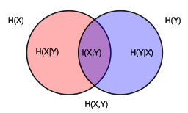
﻿Preliminaries | ﻿mutual information
the mutual information (MI) of two random variables
is a measure of the mutual dependence between the two variables.
$I\left(X;Y\right)=H\left(X\right)−H\left(X | Y\right)$
$I\left(X;Y\right)=H\left(Y\right)−H\left(Y | X\right)$
$I\left(X;Y\right)=H\left(X\right)+H\left(Y\right)−H(X,Y)$
https://en.wikipedia.org/wiki/Mutual_information

Slide 54
﻿Preliminaries | ﻿mutual information
the mutual information (MI) of two random variables
is a measure of the mutual dependence between the two variables.
definition: $I\left(X;Y\right)=I\left(Y;X\right)=D_{KL}(p\left(x,y\right)||p\left(x\right)⨂p(y))$
discrete variables: $I\left(X;Y\right)=\sum_{y∈Y}{\sum_{x∈X}{p\left(x,y\right)log⁡(\frac{p\left(x,y\right)}{p\left(x\right)p(y)})}}$
continuous variables: $I\left(X;Y\right)=\int_{Y}^{ }{\int_{X}^{ }{p\left(x,y\right)log⁡(\frac{p\left(x,y\right)}{p\left(x\right)p(y)}})}$
https://en.wikipedia.org/wiki/Mutual_information

Slide 55
﻿Preliminaries | ﻿mutual information
$I\left(X;Y\right)=H\left(X\right)−H\left(X | Y\right)$
$I\left(X;Y\right)=H\left(Y\right)−H\left(Y | X\right)$
$I\left(X;Y\right)=H\left(X\right)+H\left(Y\right)−H(X,Y)$
$$H\left(x\right)=−xlog_{2}(x)$$

Slide 56
The existing post-hoc methods | problems
﻿Post-hoc methods just perform one-step projection
to the information-constrained space (Ω)
cons
always suboptimal (low accuracy)
sensitive to the pre-trained model (high variance)
the pretrain model
the learned projection

Slide 57
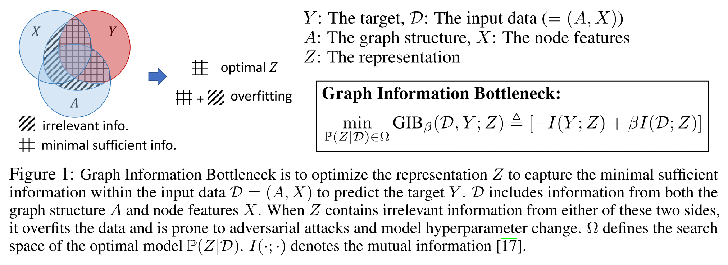
Graph information bottleneck (GIB)
D=(X,A) → (GNN) → Z ↔ Y
Graph Information Bottleneck. NeurIPS 2020.

Slide 58
The proposed method | extractor
$$G$$
$$g_{φ}$$
1. obtain the node embeddings (representation)
$$GNN\left(G\right)→H∈ ℝ^{N×D}$$
2. obtain the edge embeddings
$$H_{edge}=\{\left[h_{i},h_{j}\right]:e_{ij}∈ℇ\}$$
3. obtain the edge probabilities (importance)
$$P_{edge}=MLP(H_{edge})$$
4. obtain the sampled graph $G_{s}$ with random noise
$$α_{ij} \sim {\text{Bernoulli}(p}_{ij}+u)$$
$$A_{s}=α⨀A∈ ℝ^{N×N}$$
$$G_{s}=(A_{s},X)$$
$$G_{s}$$
$$g_{φ}$$
$$f_{θ}$$
$$G$$
$$G_{s}$$
$$\tilde{Y}$$
$$Y$$

Slide 59
The proposed method | extractor
$$G$$
$$g_{φ}$$
$$G_{s}$$
$$g_{φ}$$
$$f_{θ}$$
$$G$$
$$G_{s}$$
$$\tilde{Y}$$
$$Y$$

Slide 60
The proposed method | predictor
$$G$$
$$g_{φ}$$
$$\tilde{Y}$$
$$f_{θ}$$
$$G_{s}$$
classification loss, e.g., cross entropy
$$g_{φ}$$
$$f_{θ}$$
$$G$$
$$G_{s}$$
$$\tilde{Y}$$
$$Y$$

Slide 61
Experiment
graph information bottleneck (GIB) 👍🏻
stochasticity (gumbel trick) 👍🏻

Slide 62
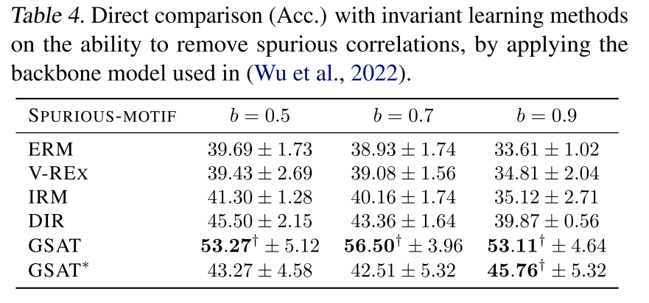
Experiment
﻿GSAT can remove spurious correlations in the training data 👍🏻
mainly due to the injecting stochasticity

