Slide 1
I Know What You Do Not Know: Knowledge Graph Embedding via Co-distillation Learning
Presenter: Zhanke Zhou
^{2022. 10. 19}

Slide 2
About the paper
I Know What You Do Not Know: Knowledge Graph Embedding via Co-distillation Learning
Authors: ﻿﻿Yang Liu, Zequn Sun, Guangyao Li, Wei Hu
Conference: CIKM 2022
Affiliation: ﻿ Nanjing University
Paper: https://arxiv.org/pdf/2208.09828.pdf
Code: https://github.com/nju-websoft/CoLE
Notes:
Wei Hu

Slide 3
Outline
Background
The proposed method
Experiment
Summary and discussion

Slide 4
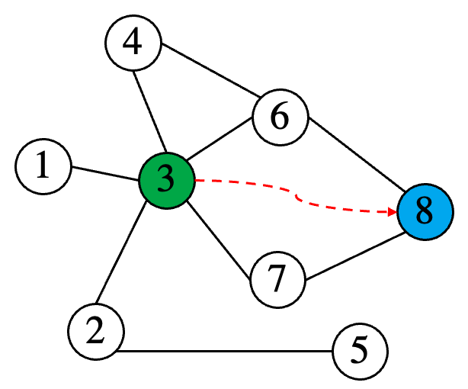
Background | link prediction on KG
Link prediction task in knowledge graph
give a query ${(e}_{q},r_{q},?)$, to find the target entity $e_{a}$
based on observed (known) edges, to predict the latent (unknown) edges
query = ${(e}_{q},r_{q},?)$
$e_{q}$ $←$ ③, $r_{q}$ $←$ $r_{1},e_{a}$ $←$ ⑧
KG

Slide 5
Background | existing KG learning models
(SLMs) Structure learning models: learn from the KG structure
triple-based (implicit structure learning)
${p(e}_{q},r_{q},e_{a})$ is measured by a scoring function, utilizing the representations $e_{q},r_{q},e_{a}$
path-based (explicit structure learning)
learn the sequential order of structures by leveraging the relational paths between $e_{q}$and $e_{a}$
graph-based (explicit structure learning)
directly use the (sub-)graph structure for reasoning, capturing more complex semantics
triple-based path-based graph-based
→[0,1]

Slide 6
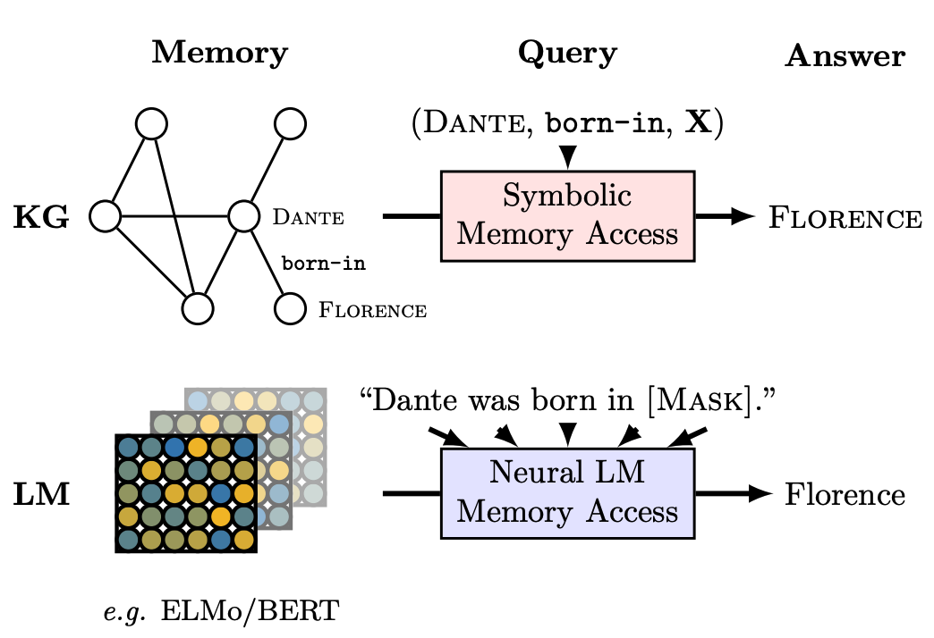
Background | using PLMs as “soft” knowledge bases
(PLMs) Pretrained language models
for the relational knowledge
Usage
asking PLMs to fill in masked tokens in sequences
e.g., “Dante was born in [Mask]”
building such sequences is essential for query
Advantages
support an open set of queries
can be applied in the inductive setting
Language Models as Knowledge Bases? EMNLP 2019.

Slide 7
Background | motivation
SLMs (grey line) ﻿ HittER uses Transformer in a GNN manner
PLMs (orange lines) KNN-KGE/LAMA that are based on BERT
Observations
For long-tail entities, PLM is better than SLM
﻿because it can benefit from the external knowledge
﻿For entities with rich edges, SLM is better than PLM
﻿these popular entities can be found in many texts
The noise, homonym, and ambiguity issues in such texts hinder PLM

Slide 8
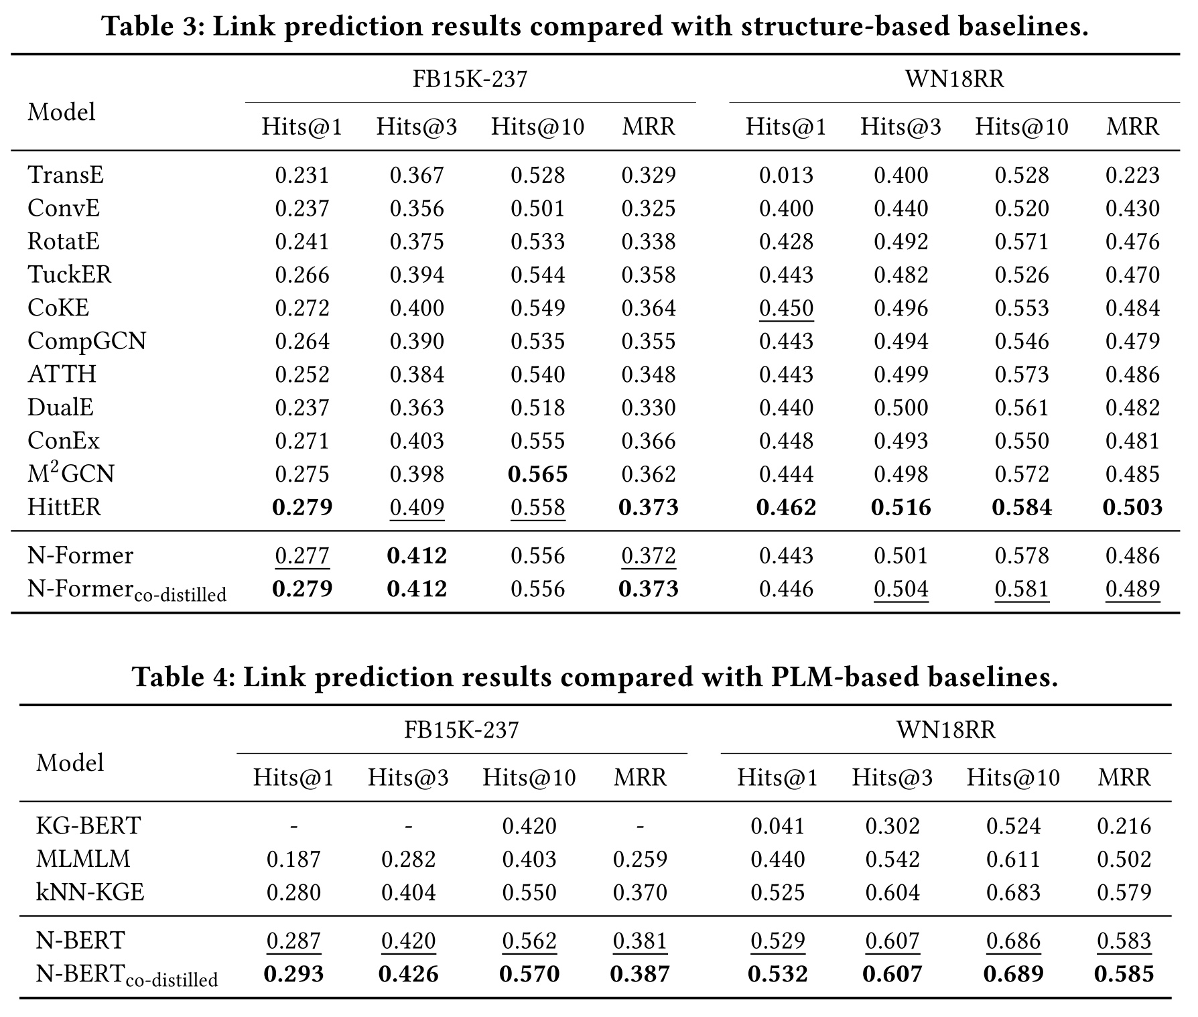
Background | motivation
Two lines of KG learning models
(1) Structure-based models
(2) Pretrained language model
These two lines are studied separately.
So, can they be complementary?
can they help each other and boost performances?
➔ Yes, we can achieve it by knowledge distillation

Slide 9
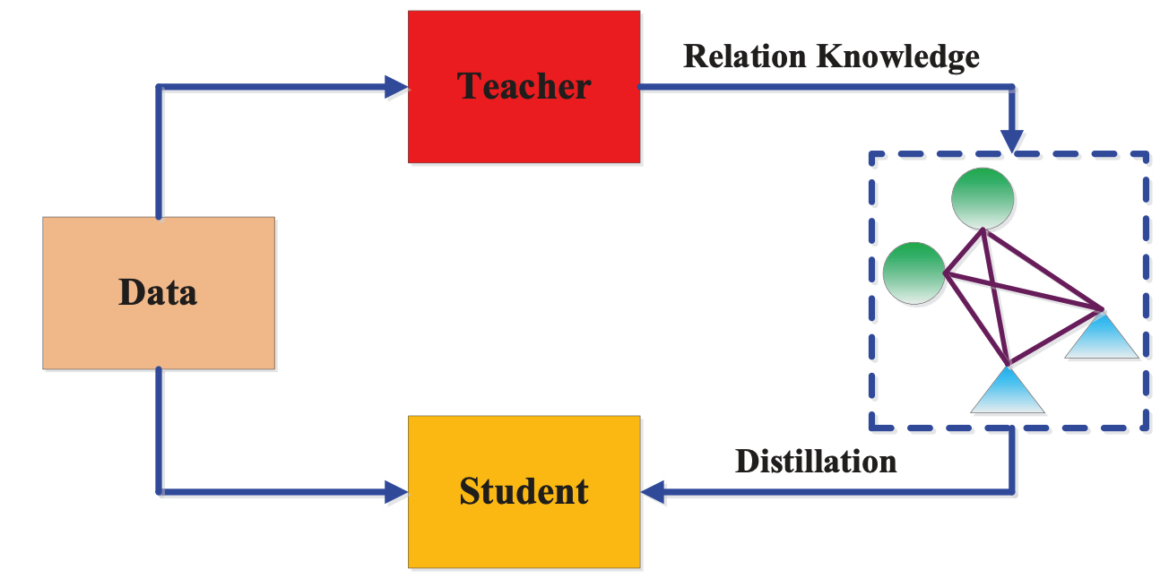
Background | motivation
Knowledge distillation
in short, knowledge distillation is the process of
transferring knowledge from teacher model to student model
loss function for the student model
classification loss
behave like the teacher

Slide 10
Outline
Background
The proposed method
Experiment
Summary and discussion

Slide 11
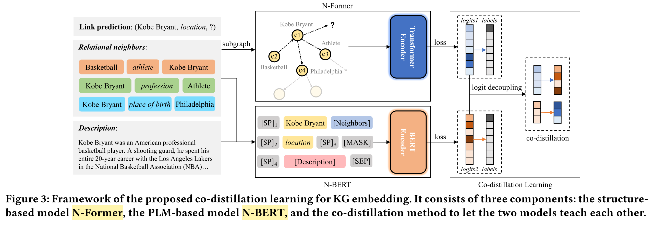
Method | framework
﻿The objective is to predict the missing entity in an incomplete triplet
such as (Kobe Bryant, location, ?) in FB15K-237
Three major components:
one SLM, one PLM, and one distillation module
SLM
distillation module
PLM

Slide 12
Method | framework
Constructing the input of models
﻿The available information to support this prediction includes
relational neighbors
textual descriptions
of Kobe Bryant

Slide 13
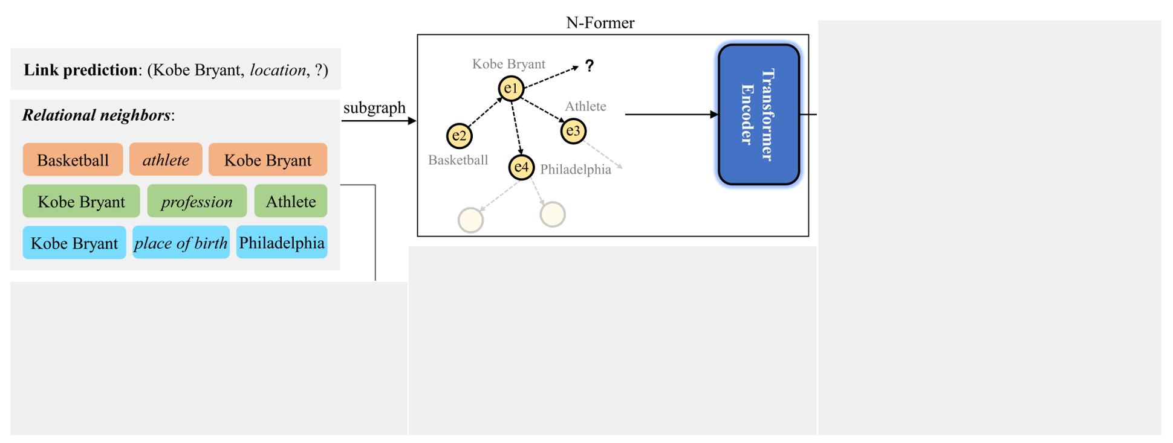
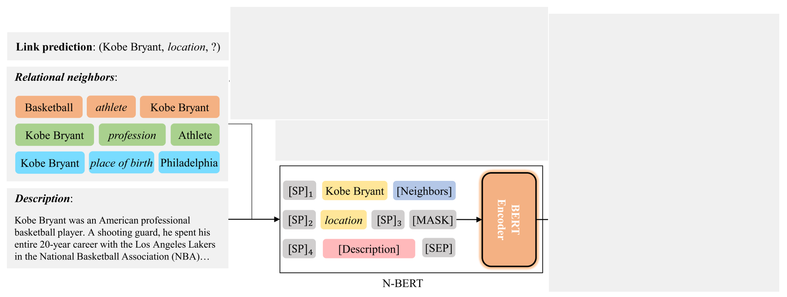
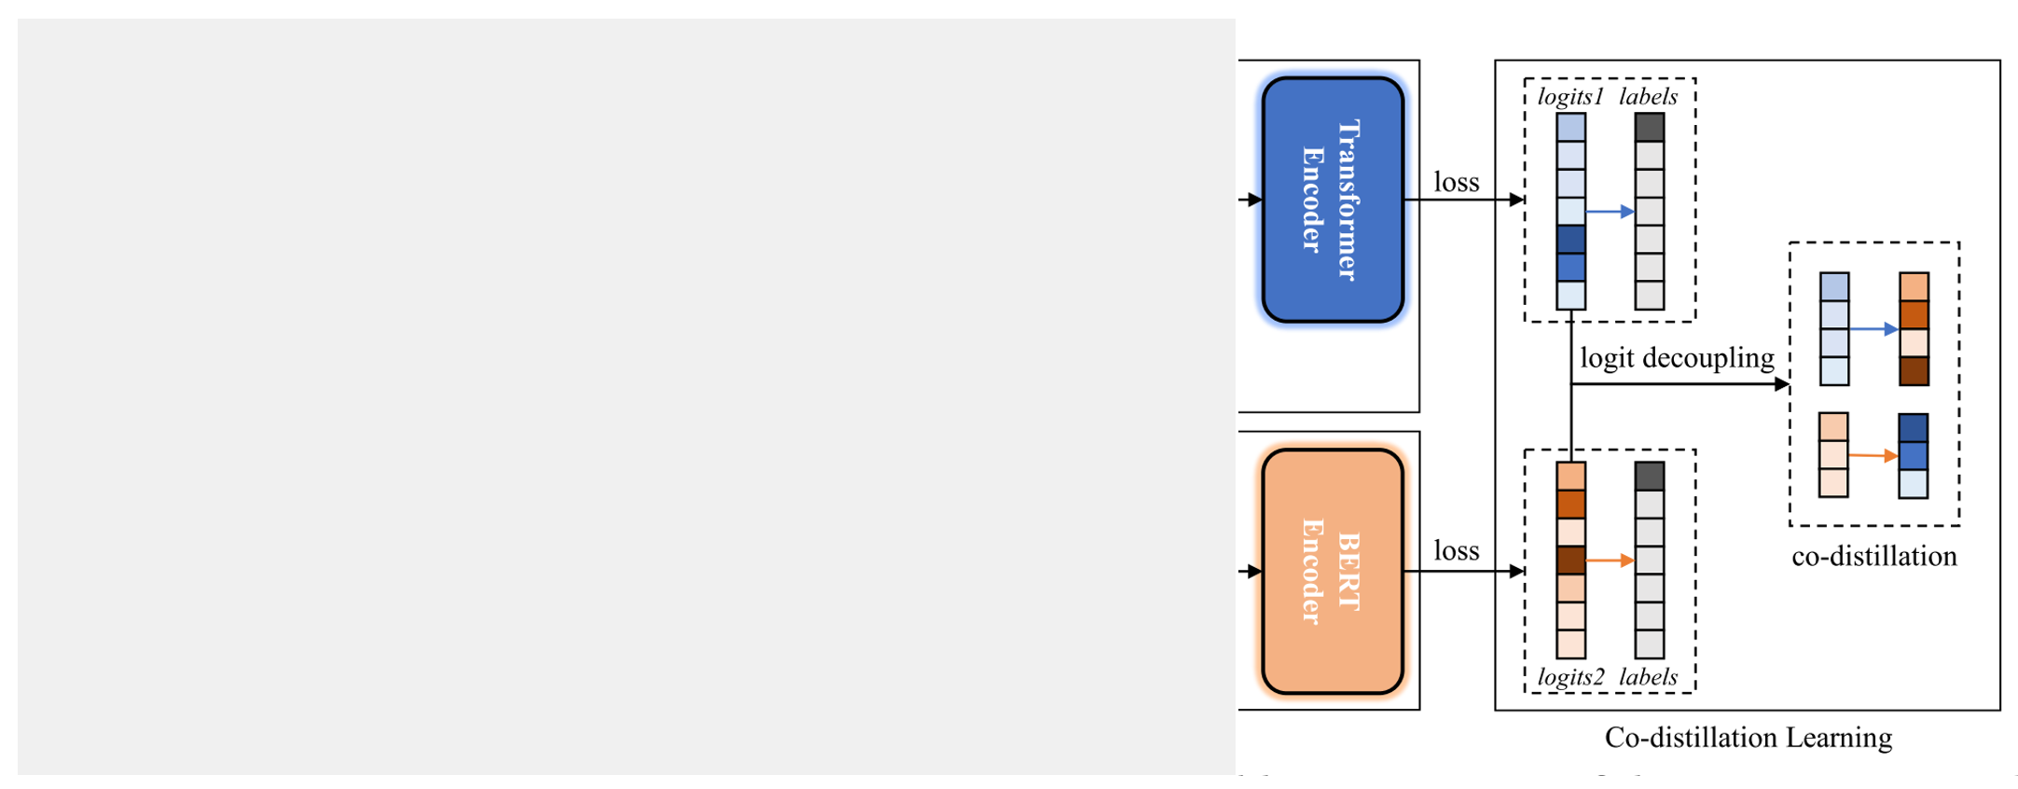
Method | framework
SLM
PLM
distillation
module

Slide 14
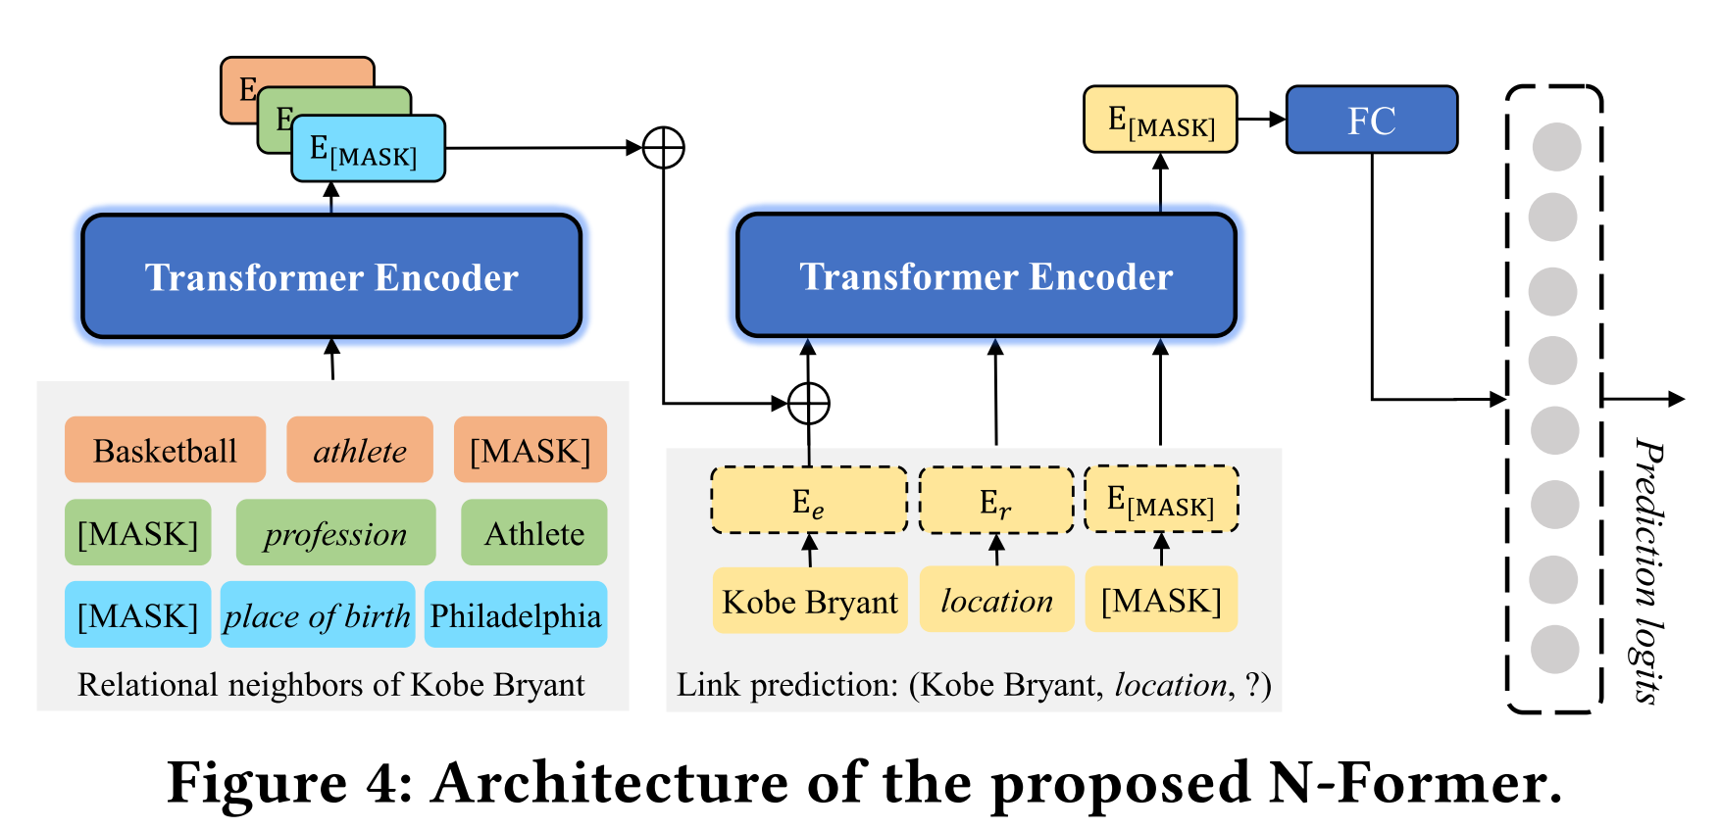
Method | part1 N-Former
step 1. The N-Former first takes as input the subgraph to reconstruct a representation for Kobe Bryant.
step 2. subgraph representation together with initial embedding and relation location are fed into N-Former
to reconstruct a representation for the missing entity denoted as a special placeholder “[MASK]”.
step 3. The output “[MASK]” ﻿representation is used to compute the prediction logits.
step 1
step 3
step 2

Slide 15
Method | part1 N-Former
Optimization objectives

Slide 16
Method | framework
SLM
2. PLM
distillation
module

Slide 17
Method | part2 N-BERT
﻿The key challenge for PLM-based link prediction
is how to retrieve the relevant knowledge from PLMs
﻿Given an incomplete triplet (h, r, [MASK]),
a typical solution is to introduce the textual description
of the entity for constructing a sentence-like prompt
﻿For an incomplete triplet (h, r, [MASK]),
its prompt sentence is denoted by prompt(h, r)
[CLS]: classification
[SEP]: separation
[SP]: soft prompt

Slide 18
Method | part2 N-BERT
The PLM-based model N-BERT constructs a prompt from the descriptions, neighbors and names of entities as the input.
﻿The prompt sentences would be fed into a BERT to get the representation of [MASK] w.r.t. the missing entity.
The output representation of BERT for “[MASK]” is used to predict the missing entity.
$$\left(h,r\right)→prompt(h,r)$$
$$f\left(E_{\left[MASK\right]}\right)→logits$$

Slide 19
Method | part2 N-BERT
Some further details of N-BERT
﻿To make prompts more expressive and take full advantage of the PLMs

Slide 20
Method | part2 N-BERT
Optimization objectives
For a training triple (h, r, t)
Head prediction (?, r, t)
Tail prediction (h, r, ?)
$$⇒$$

Slide 21
Method | framework
SLM
PLM
3. distillation
module

Slide 22
Method | part3 distillation
(picked from the paper):
﻿For our N-Former and N-BERT, we empirically find that the scores for target entities both become higher in the training process.
However, the scores for non-target entities are varying obviously.
Given that N-Former is a structure-based model while N-BERT is a PLM-based model, we think that the scores for non-target entities are also important to quantize the knowledge of models.
Therefore, the key point for co-distillation is to transfer the predicted probabilities of non-target entities mutually, rather than only to deliver the probabilities of target entities.
A knowledge co-distillation method
assume two models are complementary, they should teach each other what they are good at
Co-distillation:
a model can be the teacher
and the student at the same time

Slide 23
Method | part3 distillation
Co-distillation
1. divide the logits into two parts,
one concerning the high-confidence predictions of N-Former
and the other for N-BERT.
2. enable bidirectional knowledge transfer
by minimizing the KL divergence
of the partial logits from the two models.

Slide 24
Method | part3 distillation
logits
sorted logits
bottom
$$\hat{P_{ }^{S1}}$$
N-Former
(teacher)
$$P_{ }^{S}$$
top
$$P_{ }^{S1}$$
select entities
with top scores
$${KL(P_{ }^{S1} \text{||} P}_{ }^{T1})$$
top
$$P_{ }^{T1}$$
N-BERT
(student)
$$P_{ }^{T}$$
$${KL(\hat{P_{ }^{S1}} || }_{ }^{ }\hat{P_{ }^{T1}})$$
bottom
$$\hat{P_{ }^{T1}}$$

Slide 25
Method | part3 distillation
Co-distillation
﻿select half entities with higher scores and then compare via KL:
objectives for N-BERT and N-Former:

Slide 26
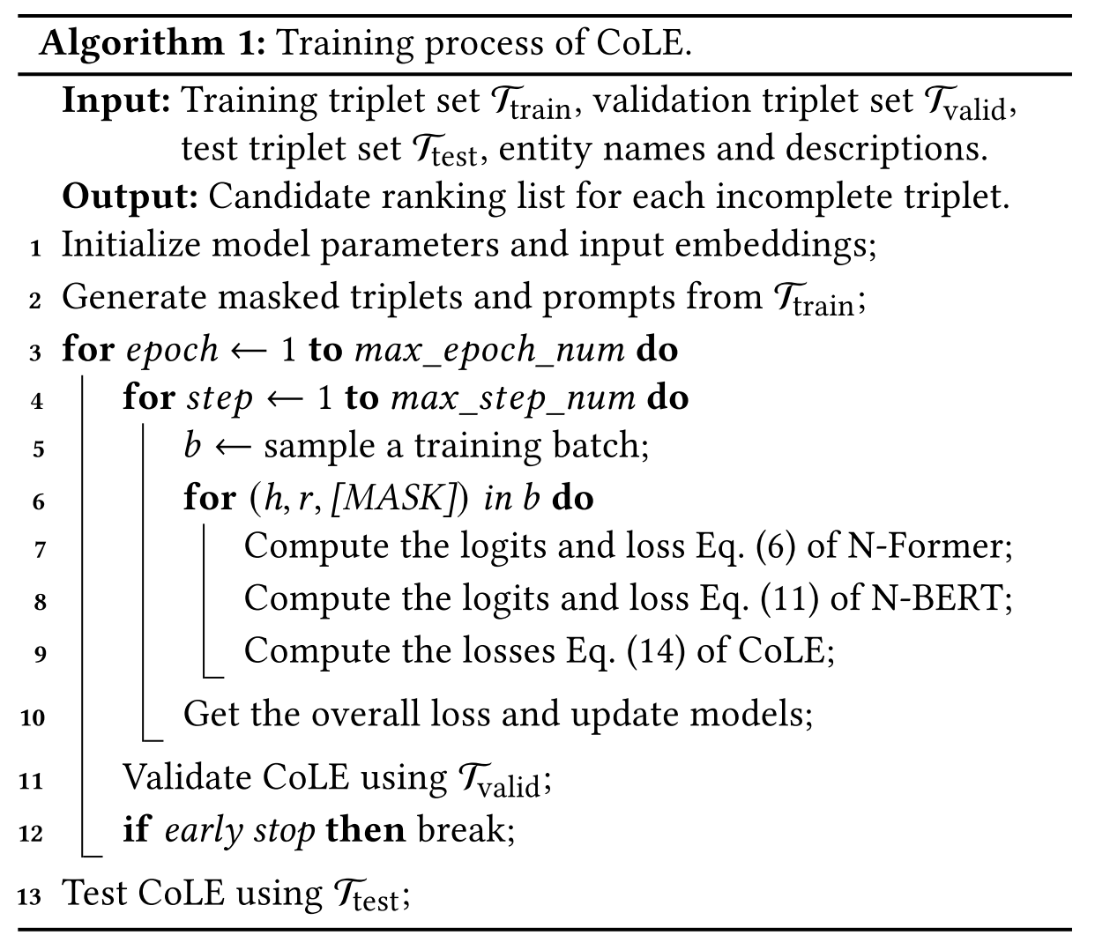
Method | full algorithm
Eq. (6):
Eq. (11):
Eq. (14):

Slide 27
Outline
Background
The proposed method
Experiment
Summary and discussion

Slide 28
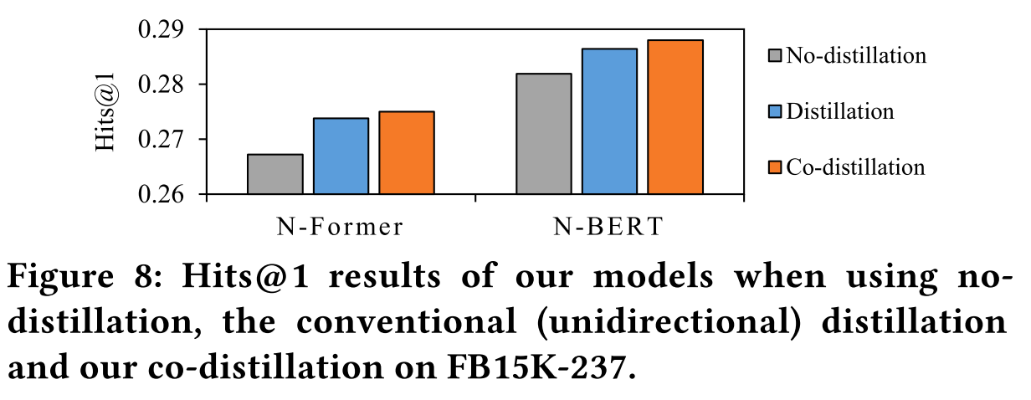
Experiment
Co-distillation can boost
both N-Former and N-BERT,
result in higher individual performances

Slide 29
Experiment
Ensemble N-Former and N-BERT
can be better
The proposed designs
for N-Former / N-BERT
are effective

Slide 30
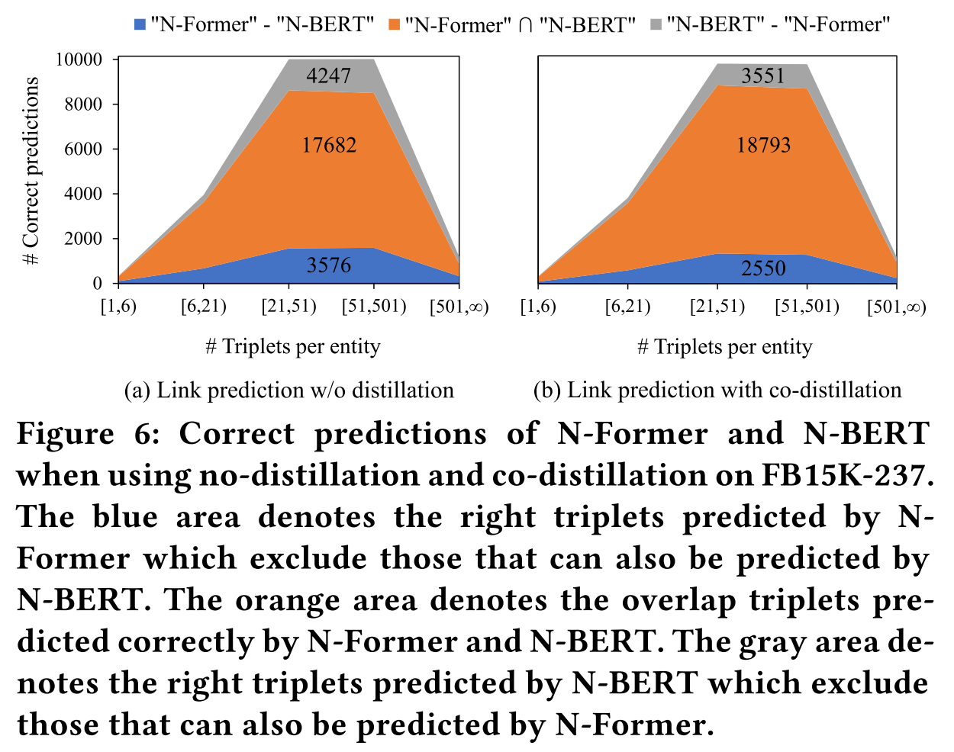
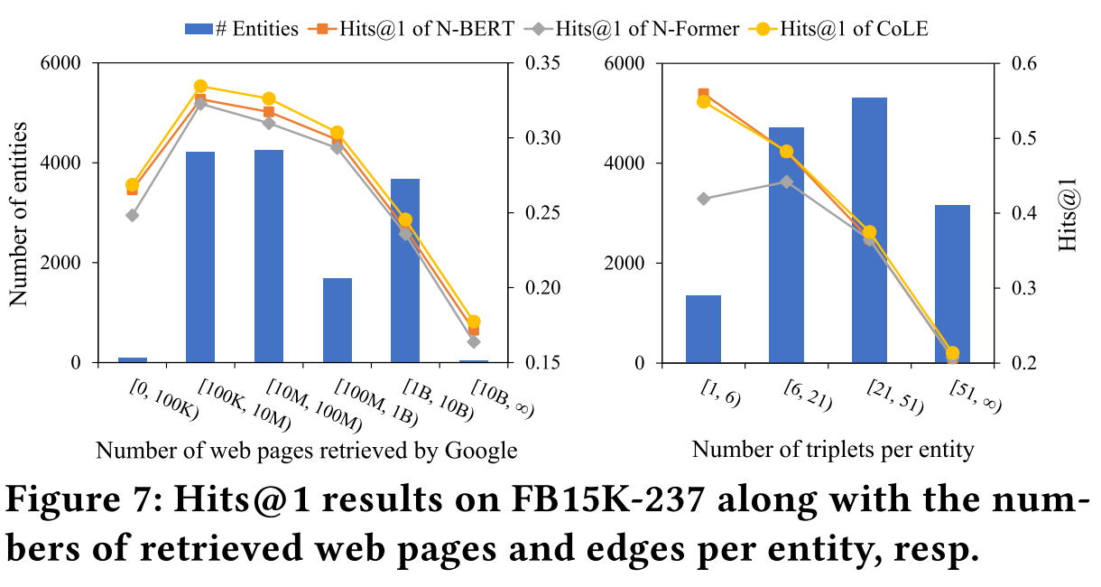
Experiment
﻿Co-distillation leverages the complementarity and
transfers the unique knowledge of each model mutually,
thus benefiting them.

Slide 31
Outline
Background
The proposed method
Experiment
Summary and discussion

Slide 32
Summary
(methodology) reveal that PLMs and SLMs can be complementary.
(model) adopt PLMs and SLMs for KG reasoning with adaptive designs, especially the construction of model input that is dependent on the specific query.
(optimization) a co-distillation method for transferring knowledge among PLMs and SLMs.
(experiment) good performances on WN18RR/FB15k-237.

Slide 33
Potential directions
(model design): information injecting and utilizing
1. The idea and adaptive designs of “query-dependent”
(learning paradigm): knowledge transferring
2. Knowledge distillation of PLMs and SLMs
(interpretability): knowledge representing
3. Interpreting SLMs via PLMs

Slide 34
Potential directions | “query-dependent”
The high-level idea of “query-dependent” and the corresponding adaptive designs
current query-dependent SLMs/PLMs may not fully utilize the graph structure
in SLMs like RED-GNN or NBFNet,
only the head entity is assigned effective embedding before propagation
However,
its propagation is strongly-correlated with the location of head entity
in PLMs like N-BERT or KG-BERT,
the prompt templates are specially designed w.r.t. queries and the graph structure
However,
the input templates are manually designed and fixed for each query
the neighboring information is compressed to a fixed-size embedding of token
$$f_{\tilde{θ}}$$
$$A$$
$$X$$
$$\tilde{Y}$$
$$f_{\tilde{θ}}$$
$$A$$
$$X$$
$$\tilde{Y}$$

Slide 35
Potential directions | “query-dependent”
So, is there a better way to a KG reasoning model? 🤔
in addition to utilizing the local information in KG
SLMs → long-range information (internal of KG)
PLMs → context information (external of KG)
Maybe, we can consider a query-dependent transformer?
jump out of the local area of head entity
can potentially explore the full KG
injecting the token embeddings of PLMs as inputs
as initial entity embeddings that are also inductive
$$f_{\tilde{θ}}$$
$$A$$
$$X$$
$$\tilde{Y}$$

Slide 36
Potential directions | “query-dependent”
Refining the observed graph
dataset | # train triples | # validate triples | # test triples
WN18RR | 17368 | 5562 | 5716
FB15k237 | 54424 | 20112 | 22850
NELL995 | 29936 | 802 | 3639
$$f_{\tilde{θ}}$$
$$A$$
$$X$$
$$\tilde{Y}$$
dataset | setting | Test MRR | Test H@1 | Test H@10
WN18RR | w/o validate triples | 0.5649 | 0.4992 | 0.6793
 | add validate triples | 0.5856 | 0.5230 | 0.6961
FB15k237 | w/o validate triples | 0.4177 | 0.3315 | 0.5852
 | add validate triples | 0.4044 | 0.3186 | 0.5685
NELL995 | w/o validate triples | 0.5651 | 0.5012 | 0.6686
 | add validate triples | 0.5659 | 0.5023 | 0.6702

Slide 37
Potential directions | “knowledge”
Extract and transfer the knowledge among PLMs and SLMs
the large-scale PLMs are informative and the GNN-based SLMs are powerful
however, they are complex and expensive whether in training or inference
so, can their knowledge be extracted and stored in the more efficient model?
e.g., embedding models
however, embedding models can not explicitly utilize the KG structure
So, can we ensemble all their advantages in one model? 🤔
➔ The knowledge distillation technique is a natural solution here.

Slide 38
Potential directions | “knowledge”
$$Performance$$
$$Performance$$
Graph-based
SLMs
target
target
Graph-based
SLMs
PLMs
PLMs
embedding-based
SLMs
embedding-based
SLMs
$$Inference$$
$$Complexity$$
$$\#params$$
However, existing distillation works are mainly for models of similar architectures
e.g., distillate a 18-layer resnet from a 101-layer resnet
distillation across different models is still under-explored 🤔

Slide 39
Potential directions | “interpretable”
KG
SLMs
query triple

Slide 40
Potential directions | “interpretable”
SLMs
“I think 2792 is the brother of 2973
because their father is 2785,
their mother is 2791,
and they are sons of 2785 as well as 2791.”
PLMs
➔ Can we use PLMs to generate sentences for interpreting? 🤔

Slide 41
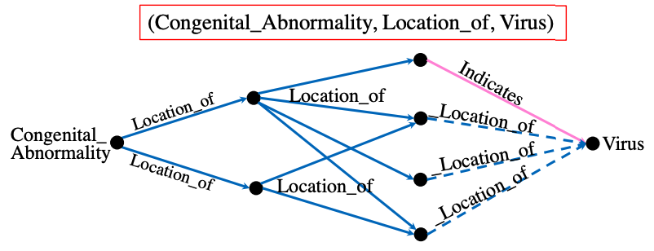
Potential directions | “interpretable”
The latest methods for interpreting the SLMs
can tell which triples are most important for a query (SIGMOD’22)
in a post-hoc manner for interpreting embedding models
or subgraphs for GNN-based model (WWW’21)
but the subgraph size is hard to control
But, the weighted triples/subgraphs might still not easy to be understood
understanding the underneath correlation among them is hard for human
especially when important triples are quite a lot
So, can we utilize the PLMs for interpreting the SLMs with natural languages?
i.e., watch the weighted triples (or subgraphs), and summarize them into sentences.
i.e., 看“图”说“话”

Slide 42
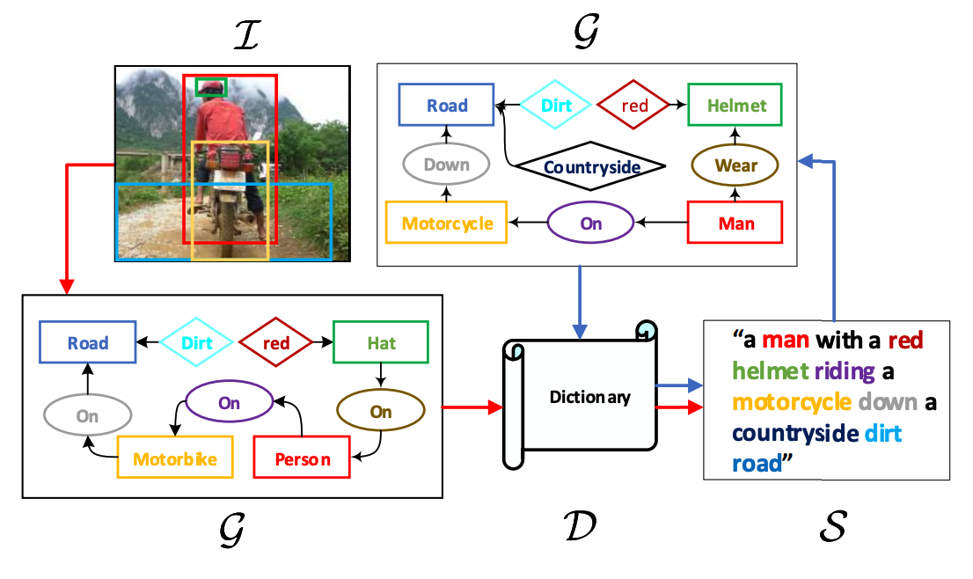
Potential directions | “interpretable”
Scene graph captioning
Auto-Encoding Scene Graphs for Image Captioning. 2018

Slide 43
Potential directions | summary
$$Reward$$
KG interpreter
KG model
KG distillation
$$Risk$$

Slide 44
Related works | PLMs for KG learning
Language Models as Knowledge Bases? EMNLP 2019.
Pretrain-KGE: Learning Knowledge Representation from Pretrained Language Models. EMNLP 2020.
KG-BERT: BERT for Knowledge Graph Completion. AAAI 2020.
Scientific Language Models for Biomedical Knowledge Base Completion: An Empirical Study. AKBC 2020.
MLMLM: Link Prediction with Mean Likelihood Masked Language Model. ACL-IJCNLP 2021.
Domain-Specific Language Model Pretraining for Biomedical Natural Language Processing. ACM Transactions on Computing for Healthcare 2021.
I Know What You Do Not Know: Knowledge Graph Embedding via Co-distillation Learning. CIKM 2022.
Structure-Augmented Text Representation Learning for Efficient Knowledge Graph Completion. WWW 2021.
Do Pre-trained Models Benefit Knowledge Graph Completion? A Reliable Evaluation and a Reasonable Approach. ACL 2022.
SimKGC: Simple Contrastive Knowledge Graph Completion with Pre-trained Language Models. ACL 2022.
Reasoning Through Memorization: Nearest Neighbor Knowledge Graph Embeddings. Arxiv 2022.

Slide 45
Q&A
Thanks for your attention!

