Slide 1
Inductive Relation Prediction by Subgraph Reasoning
Presenter: Zhanke Zhou
^{2021. 11. 12}

Slide 2
Background – About the paper
Title: Inductive Relation Prediction by Subgraph Reasoning
Authors: ﻿Komal K. Teru, Etienne Denis, William L. Hamilton
Conference: ICML’20
Affiliation: ﻿McGill University, Mila
Paper: http://proceedings.mlr.press/v119/teru20a/teru20a.pdf
Code: https://github.com/kkteru/grail

Slide 3
Outline
Background
The proposed framework: GraIL
Key takeaways and research directions

Slide 4
Outline
Background
Knowledge graph embedding (KGE)
Two learning paradigms in KGE
The proposed framework: GraIL
Key takeaways and research directions

Slide 5
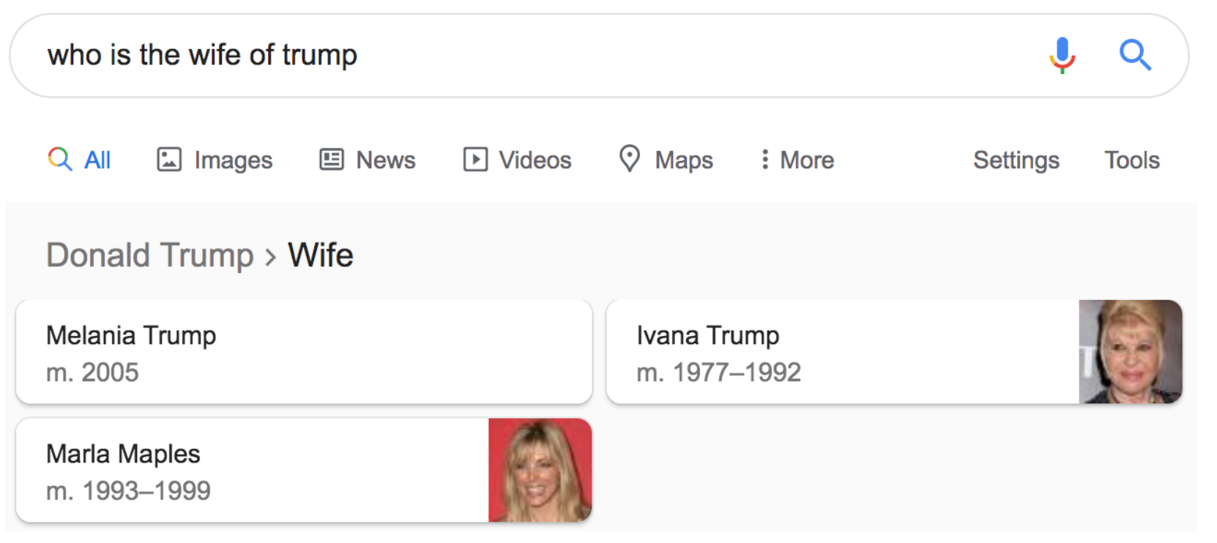
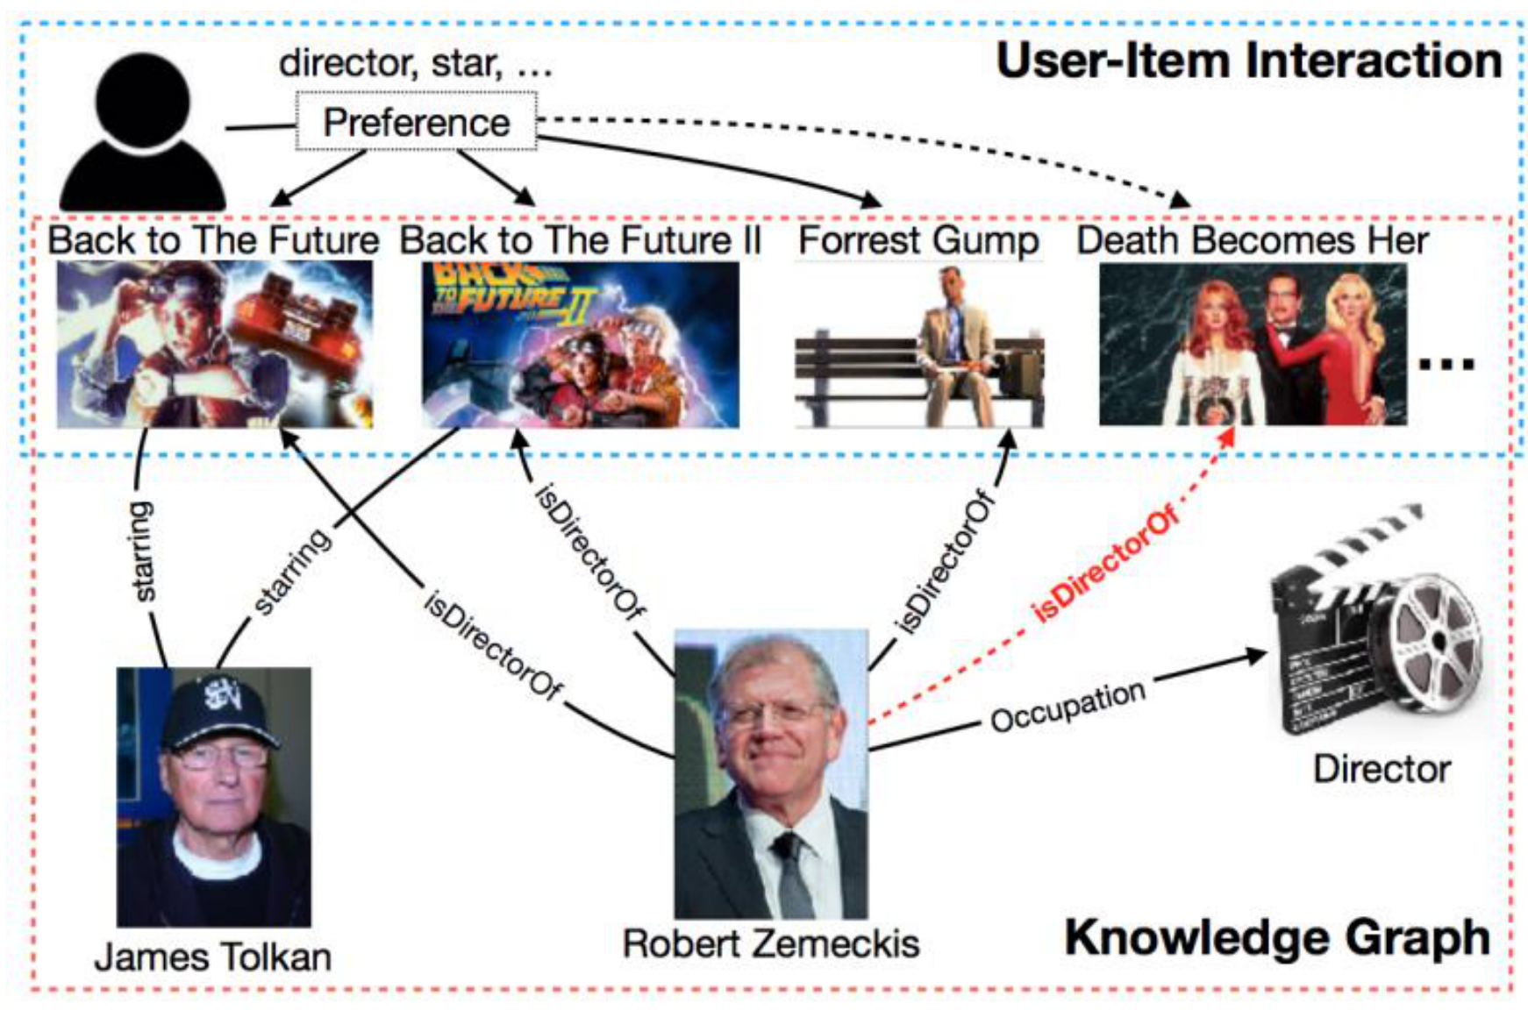
Background – Knowledge Graph (KG)
A knowledge graph
Mainly describe real world entities and relations, organized in a graph
Allows potentially interacting arbitrary entities with each other
Preliminaries
Graph representation:$𝒢=(ℰ, ℛ, ℱ)$
Entities $ℰ$
real world objects or concepts
Relations $ℛ$
interactions between entities
Facts$ℱ$
the basic unit in form of $(s,r,o)$
(subject entity, relation, object entity)
Applications
KGQA:
Recommendation:

Slide 6
Background – Knowledge Graph Embedding (KGE)
Knowledge Graph Embedding
Encode entities and relations in KG into low-dimensional vectors space
while capturing nodes’ and edges’ connection properties
Most KGE models based on embeddings define a scoring function $φ$to estimate the plausibility of any fact $(s,r,o)$ using their embeddings:
Two kinds of information
Semantical
Topological
vectorize
entities & relations
$$φ(s,r,o)$$

Slide 7
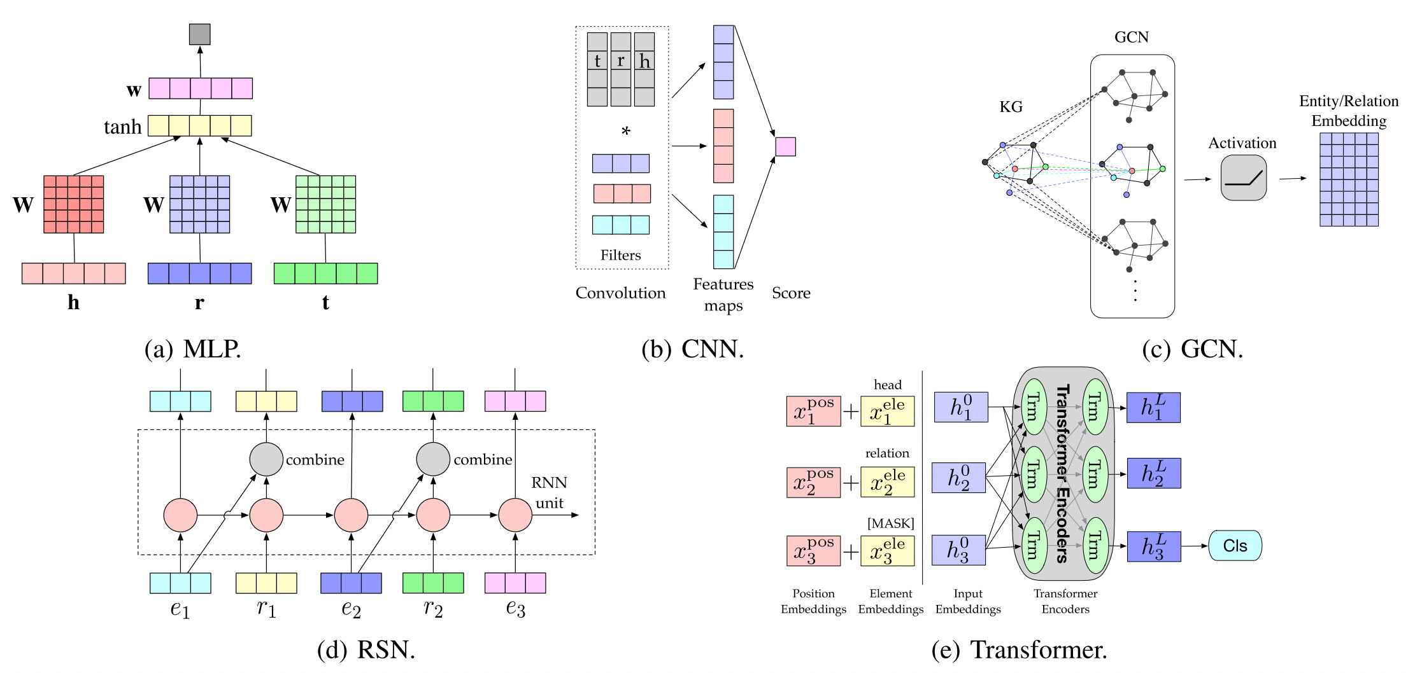
Background – Knowledge Graph Embedding (KGE)
Main Challenge:
How to extract and utilize
the semantical / topological information
in the original KG ?
$$φ(s,r,o)$$

Slide 8
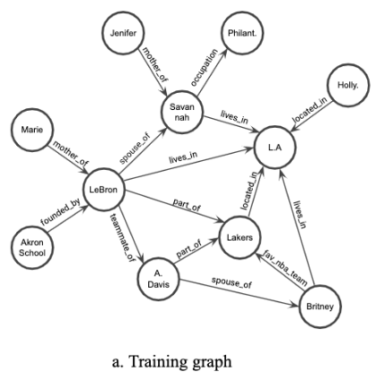
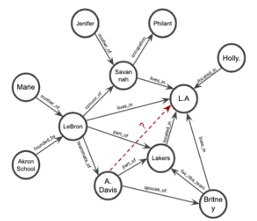
Background – Knowledge Graph Embedding (KGE)
Transductive learning | Popular learning paradigm in KGE
Training data
Testing data
Query (s,r,o)?
transductive
setting
The same set of entities (nodes)
for the training and testing data

Slide 9
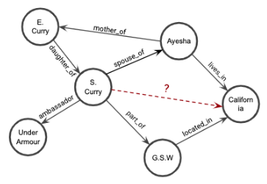
Two learning paradigms: Inductive and transductive
Training data
Testing data
The same set of entities (nodes) as the training data
transductive
Inductive
Different set of entities to the training data
e.g.,
﻿new users and products on e-commerce platforms
new molecules in biomedical KG
No matching node

Slide 10
Two learning paradigms: Inductive and transductive
Inductive learning
is how AI systems attempt to use a generalized rule to carry out observations ^{[1]}
e.g., to find symbolic descriptions expressed in high-level terms that people can understand ^{[2]}
[1] https://towardsdatascience.com/introduction-to-inductive-learning-in-artificial-intelligence-dafc2796405b#:~:text=Inductive%20Learning%2C%20also%20known%20as,If%20this%20then%20that%E2%80%9D%20format.
[2] Applying inductive learning to enhance knowledge-based expert systems. MJ Shaw. 1987
[3] https://towardsdatascience.com/inductive-vs-transductive-learning-e608e786f7d

Slide 11
Two learning paradigms: Inductive and transductive
LA
Query = (A. Davis, lives in, LA) ?
transductive
Semantic node embedding of [Davis] / [lives in] / [LA]
LA
A. Davis
Inductive
A. Davis
Query = (S. Curry, lives in, CA) ?
S. Curry
﻿(X, spouse of, Y) ∧ (Y, lives in, Z) → (X, lives in, Z)
CA
﻿(X, part of, Y) ∧ (Y, located in, Z) → (X, lives in, Z)

Slide 12
Two learning paradigms: Inductive and transductive
Query = (A. Davis, lives in, LA) ?
LA
Semantic embedding of [Davis] / [lives in] / [LA]
Representatives
TransE
RotatE
ComplEx
DistMult
transductive
Embedding models
$\text{✓}$ semantics
$?$ topologies
LA
A. Davis
Query = (S. Curry, lives in, CA) ?
Inductive
A. Davis
﻿(X, spouse of, Y) ∧ (Y, lives in, Z) → (X, lives in, Z)
S. Curry
Rule mining models
$?$ semantics
$\text{✓}$ topologies
Representatives
Neural LP
DRUM
RuleN
CA

Slide 13
Rethink existing works
Embedding models
Pros
simple, powerful, and popular
can be enhanced by other models (e.g., RNN, GNN)
Cons
the learned embedding is not understandable to human
do not explicitly capture the compositional logical rules
limited to the transductive setting
Rule mining models (structure learning models)
﻿Pros
more explainable, easier to understand
Cons
more difficult to train and optimize
suffer from scalability issues
LA
A. Davis

Slide 14
Outline
Background
The proposed framework: GraIL
Overview
Technical details
Experiments
Key takeaways and research directions

Slide 15
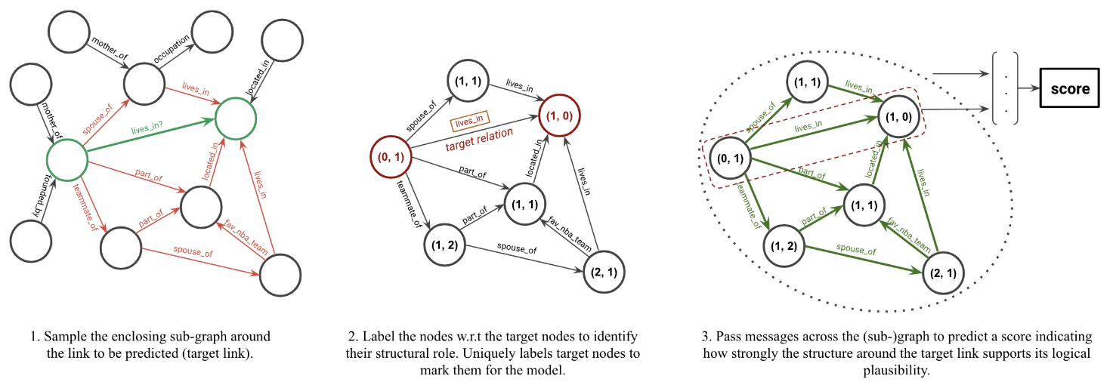
﻿Graph Inductive Learning (GraIL)
Overview
﻿a GNN-based relation prediction framework
reasons over local subgraph structures
has the inductive bias to learn entity-independent relational semantics
﻿can generalize to unseen entities and graphs after training
Step 1: subgraph generation
2: labeling
3: scoring
Two key components
subgraph preparing (step1 & 2)
subgraph scoring (step 3)

Slide 16
Outline
Background
The proposed framework: GraIL
Overview
Technical details
step1: subgraph generation
step2: subgraph labeling
step3: subgraph scoring
Experiments
Key takeaways and research directions

Slide 17
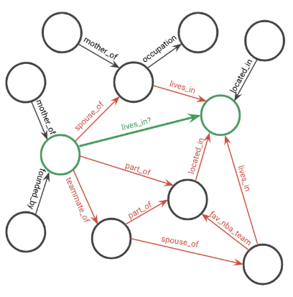
GraIL | Technical details
Step 1: Subgraph generation
﻿Assumption
local graph neighborhood of a particular triplet in the KG contains the logical evidence
Subgraph generation
﻿enclosing subgraph: the graph induced by all the nodes that occur on a path between u and v. (﻿by taking the intersection, $𝒩_{k}\left(u\right)∩𝒩_{k}\left(v\right)$ )
query
generate
subgraph
k=2 here

Slide 18
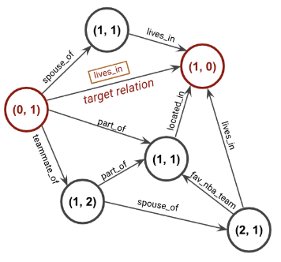
GraIL | Technical details
Two key components
subgraph preparing (step1 & 2)
subgraph scoring (step 3)
Step 2: Subgraph labeling
aims to give entity-independent node feature
each node i ﻿is labeled with (d(i, u), d(i, v))
﻿d(i, u) denotes the shortest distance between nodes i and u
counted by ﻿Dijkstras algorithm
The node features are [one-hot(d(i, u)) ⊕ one-hot(d(i, v))]
step1
step2

Slide 19
GraIL | Technical details
Two key components
subgraph preparing (step1 & 2)
subgraph scoring (step 3)
Step 3: Subgraph scoring
step1
step2
step3
scoring
$$Score∈[0,1]$$

Slide 20
GraIL | Technical details
Step 3: Subgraph scoring
step1
step2
step3
scoring
$$Score∈[0,1]$$
$$h_{4}^{k−1}$$
$$h_{4}^{k}$$
$$h_{6}^{k−1}$$
GNN
$$h_{6}^{k}$$
$$h_{1}^{k−1}$$
$$h_{1}^{k}$$
$$h_{3}^{k−1}$$
Message passing
$$h_{3}^{k}$$
$$h_{2}^{k−1}$$
$$h_{5}^{k−1}$$
$$h_{2}^{k}$$
$$h_{5}^{k}$$

Slide 21
GraIL | Technical details
Step 3: Subgraph encoding and scoring
$h_{t}^{k−1}$ : representation of node t at layer (k-1)
$h_{t}^{k}$ : representation of node t at layer k
$$h_{4}^{k−1}$$
$$h_{4}^{k}$$
$$h_{6}^{k−1}$$
$$h_{6}^{k}$$
$$h_{1}^{k−1}$$
$$h_{1}^{k}$$
$$h_{3}^{k−1}$$
$$h_{3}^{k}$$
$$h_{5}^{k−1}$$
Message passing
$$h_{5}^{k}$$
$$h_{2}^{k−1}$$
$$h_{2}^{k}$$

Slide 22
GraIL | Technical details
Design space for GNN. NeurIPS’20
Step 3: Subgraph encoding and scoring
$$h_{4}^{k−1}$$
$$h_{6}^{k−1}$$
$$h_{1}^{k−1}$$
s
s
$$a_{t}^{k}$$
$$h_{3}^{k−1}$$
t
$$h_{t}^{k−1}$$
t
s
s
s
s
$$h_{2}^{k−1}$$
$$h_{5}^{k−1}$$
$$h_{s}^{k−1}$$
Aggregated message at k th layer (for node t)

Slide 23
GraIL | Technical details
Step 3: Subgraph encoding and scoring
Aggregate operation
$$h_{4}^{k−1}$$
$$h_{6}^{k−1}$$
$$h_{1}^{k−1}$$
s
s
$$a_{t}^{k}$$
$$h_{3}^{k−1}$$
t
t
s
s
s
s
$$h_{2}^{k−1}$$
$$h_{5}^{k−1}$$
Aggregated message at k th layer (for node t)
Learnable parameters

Slide 24
GraIL | Technical details
Step 3: Subgraph encoding and scoring
s
t
$$h_{t}^{k−1}$$
$$a_{t}^{k}$$
t
$$h_{t}^{k}$$
t
s
s

Slide 25
GraIL | Technical details
Step 3: Subgraph encoding and scoring
$$h_{4}^{0}$$
$$h_{4}^{L}$$
$$h_{6}^{0}$$
$$h_{6}^{L}$$
readout
$$h_{1}^{0}$$
$$h_{1}^{L}$$
$$Score$$
$$h_{3}^{0}$$
L layers message passing
$$h_{3}^{k}$$
$$h_{5}^{0}$$
$$h_{2}^{L}$$
$$h_{5}^{L}$$
$$h_{2}^{0}$$

Slide 26
GraIL | Technical details
Step 3: Subgraph encoding and scoring
$$h_{4}^{0}$$
$$h_{4}^{L}$$
$$h_{6}^{0}$$
v
$$h_{6}^{L}$$
$$h_{1}^{0}$$
$$h_{1}^{L}$$
u
$$h_{3}^{0}$$
L layers message passing
$$h_{3}^{k}$$
$$h_{2}^{0}$$
$$h_{5}^{0}$$
$$h_{2}^{L}$$
$$h_{5}^{L}$$
Get global information:
Compute the final score:

Slide 27
GraIL | Technical details
Optimization
sample a negative triplet by replacing the head (or tail)
train the model to score positive triplets higher than negative triplets
Live in?
Live in?

Slide 28
Outline
Background
The proposed framework: GraIL
Overview
Technical details
Experiments
Key takeaways and research directions

Slide 29
GraIL | Experiments
Three major parts
Inductive relation prediction
﻿Q: How does GraIL perform in comparison to existing methods?
Transductive relation prediction
Q: ﻿Can the complementary inductive bias improve existing KGE methods?
Ablation study
Q: ﻿How important are the various components?

Slide 30
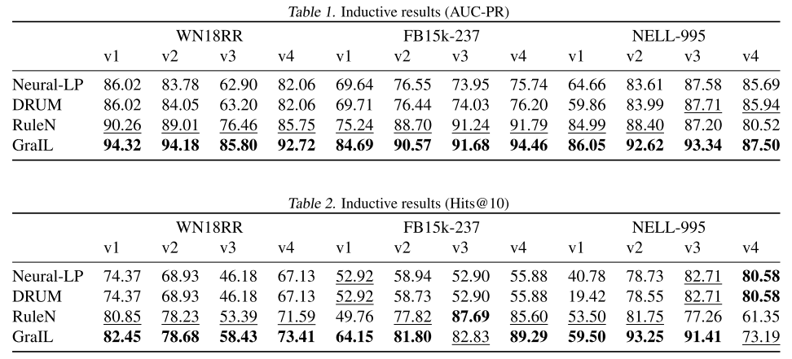
GraIL | Experiments
Part1 | Inductive relation prediction
Observation
﻿GraIL significantly outperforms the inductive baselines across all datasets
Variant KGs for inductive setting

Slide 31
GraIL | Experiments
Part2 | ﻿Transductive relation prediction
Observation
﻿GraIL is not SOTA for transductive prediction
optimized for the inductive setting
significant gains obtained by ensembling GraIL with various KGE methods
Late fusion
Early fusion

Slide 32
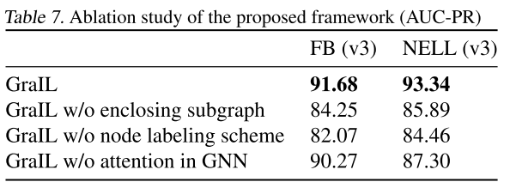
GraIL | Experiments
Part3 | ﻿Ablation study
Observation
the three components are all effective to GraIL
components of subgraph generation are more important
Subgraph generation
Subgraph scoring

Slide 33
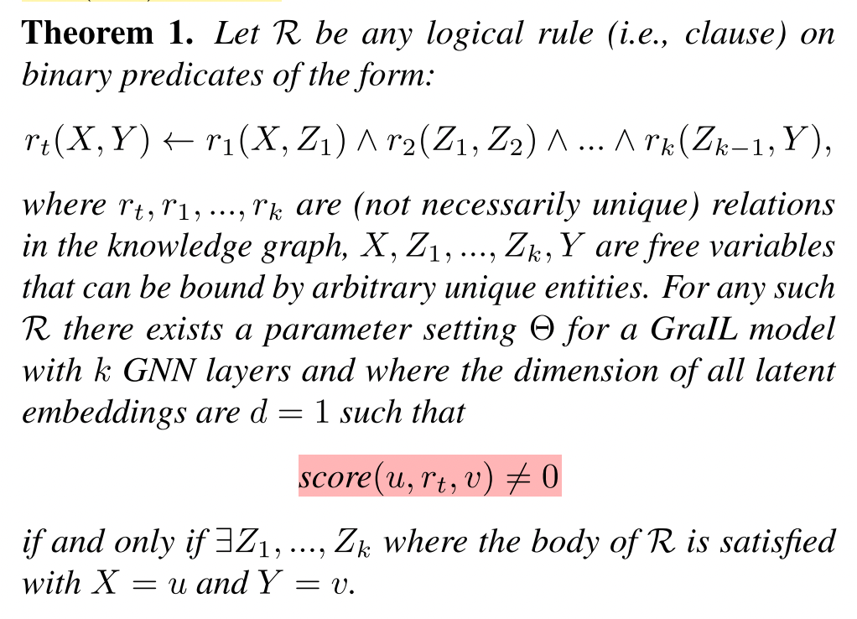
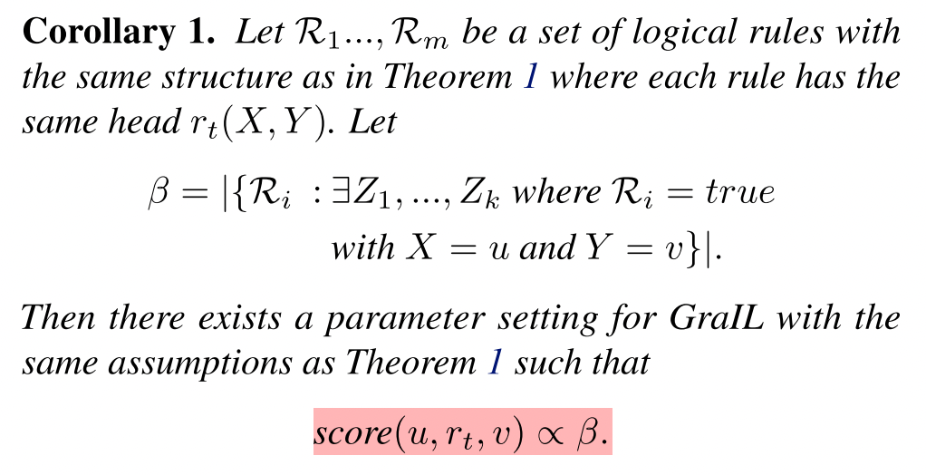
GraIL | Theoretical analysis
GraIL can represent a useful subset of first-order logic
Rules discovered by other rule-mining methods

Slide 34
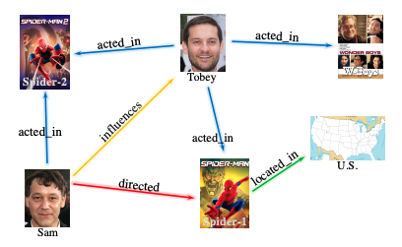
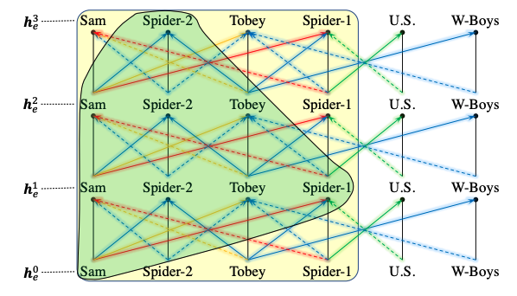
GraIL | Disadvantages
Efficiency $𝒪(\log\left(𝒱\right)ℰ+ℛdk)$
Time-consuming node labeling
Effectiveness
The information flow inside the enclosing subgraph is mixed
(making it hard to learn the dependency among relations)
Not interpretable or traceable
Knowledge Graph Reasoning with Relational Directed Graph. Arxiv 2021.

Slide 35
Outline
Background
The proposed framework: GraIL
Key takeaways and research directions

Slide 36
Key takeaways and Research directions
Summary of GraIL
﻿Presents a GNN framework that has a strong inductive bias to learn entity-independent relational semantics.
Introduces a series of benchmark tasks for the inductive relation prediction problem.
Empirically justify the effectiveness of the proposed method in both of transductive and inductive settings.
Main contributions
GNN + inductive for KG reasoning
Variant KGs for inductive setting
SOTA in inductive setting
Following works:
[1] Graph meta learning via local subgraphs. 2020.
[2] Inductive Learning on Commonsense Knowledge Graph Completion. 2021.
[3] Standing on the Shoulders of Predecessors: Meta-Knowledge Transfer for Knowledge Graphs. 2021.

Slide 37
Direction: Decoupling of structure generation and scoring
Summary of existing works
Structure Generation
Structure Scoring
Path
using RL agent to pick up next edge
select path with max length [PathCon]
Subgraph
enclosing subgraph from h to t [GraIL]
relation di-graph [RED-GNN]
generalized Bellman-Ford algorithm [NBFNet]
RNN / (MLP)
used as policy network in RL agent → ﻿encodes the state (i.e., history of the walked path) and then take action (decode)
GNN
uniquely label nodes and pass messages to obtain final score [GraIL]
assign an independent embedding s_{p} for each path P ∈ P_{h→t} , combine context presentation with message passing [PathCon]
local+global with {indicator + message + aggregate} functions [NBFNet]
Forward
Inference
RL agent (sparse reward / slow convergence)
BFS + Monte-Carlo policy gradient (REINFORCE)
EM algorithm
generate rules from a pre-defined distribution
to select good generated rules and then optimize the rule generator [RNNLogic]
EM + pure embedding model [pLogicNet]
RNN
GNN
[negative sampling] sampled a negative triple and minimize a MR loss [GraIL]
1/k vs all training
Backward
Optimization

Slide 38
Direction: Decoupling of structure generation and scoring
1. From the aspect of structure generation:
Knowledge Graph Reasoning with Relational Directed Graph. Arxiv 2021.

Slide 39
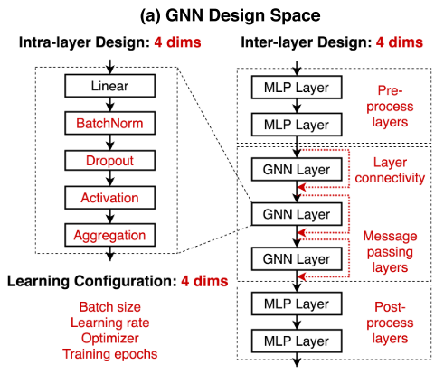
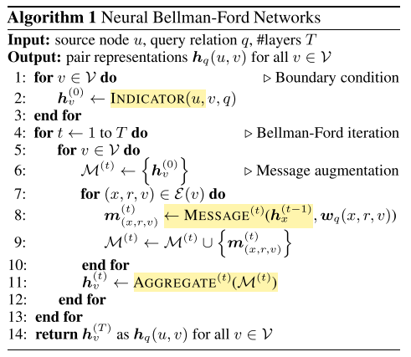
Direction: Decoupling of structure generation and scoring
2. From the aspect of structure scoring:
[1]
[2]
[1] Design Space for Graph Neural Networks
[2] Neural Bellman-Ford Networks: A General Graph Neural Network Framework for Link Prediction

Slide 40
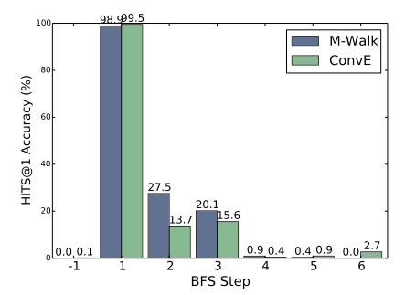
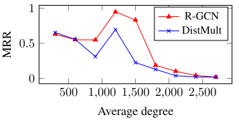
Direction: Decoupling of structure generation and scoring
Potential advantages for structure learning models
more robust and effective to distant triplets (e.g., hop>1)
﻿performs better for nodes with high degree (where contextual information is abundant).
Good enough
Can be better
poor
[1]
[2]
[1] M-Walk: Learning to Walk over Graphs using Monte Carlo Tree Search. 2018.
[2] Modeling Relational Data with Graph Convolutional Networks. 2017.

Slide 41
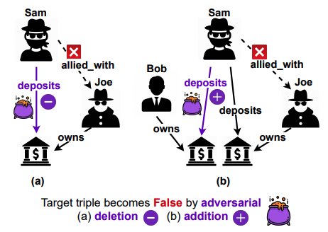
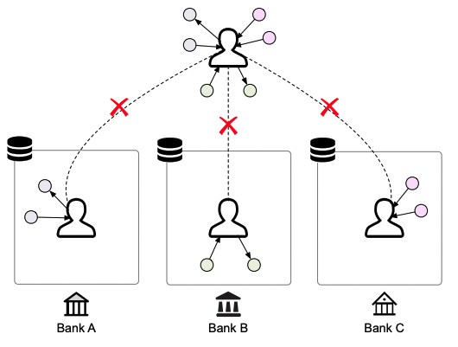
Direction: Decoupling of structure generation and scoring
3. From the aspect of task:
Adversarial attack on KG
Transfer / federated learning with KG
[1]
[2]
[1] Adversarial Attacks on Knowledge Graph Embeddings via Instance Attribution Methods. EMNLP 2021.
[2] FedE: Embedding Knowledge Graphs in Federated Setting. Arxiv 2020.

Slide 42
Q&A
Thanks for your attention!

Slide 43
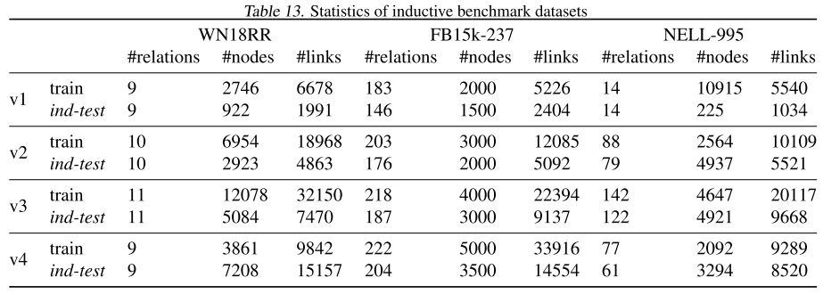
Appendix: data statistics

Slide 44
Appendix: ﻿readout function

Slide 45
Appendix: ﻿introduction
[1] INDUCTIVE MATRIX COMPLETION BASED ON GRAPH NEURAL NETWORKS. ICLR 2020.

Slide 46
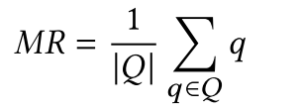
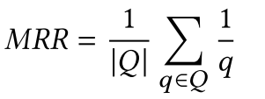
Appendix: KGE training and testing
Training
$S^{+}:positive samples S^{−}:negative samples$
Objectives: $\max{φ^{+}(S^{+}) }$+ $φ^{−}(S^{−})$
Prediction
For link prediction, given an incomplete triple $(h, r,?)$
the missing tail is inferred as the entity that results in the highest score:
Evaluation
Three common metrics
q: the rank of correct entity

Slide 47
Appendix: KGE training and testing
For obtaining embeddings of entities and relations, and finishing KGE task (e.g., predict potential facts)
the scoring function $f$ is expected to discriminate positive/negative factual triples
a sampling scheme is needed to generate negative samples $S^{−}$
a loss function $L$ and regularization $r$ are required for defining learning problem
a optimization strategy is needed for convergence procedure
Considering the above 5 factors,
we can formulate the KGE learning framework as:

Slide 48
Appendix: KGE training and testing
5 KGE components:
Component | Role | Inputs | Outputs | Example
Scoring function $f( )$ | Plausibility estimation | Factual triples | Scores for each triple | TransE / CP
Loss function $L( )$ | Learning problem definition | Scores and labels | Loss value | BCE / CE
Negative sampling | Budget tradeoff | Positive samples $S^{+}$ | Negative samples $S^{−}$ | Uniform
Regularization $r( )$ | Avoid overfitting | Learnable parameters | Regularization value | L2 / N3
Optimization | Convergence control | - | - | -

