Slide 1
KGBench: Towards Understanding and Benchmarking Model Search for Knowledge Graph Embedding
Presenter: Zhanke Zhou
Advisors: Yongqi Zhang and Quanming Yao
2021. 07. 09

Slide 2
Outline
Background
Motivation
Understanding of KGE components
Searching experiments
Key takeaway

Slide 3
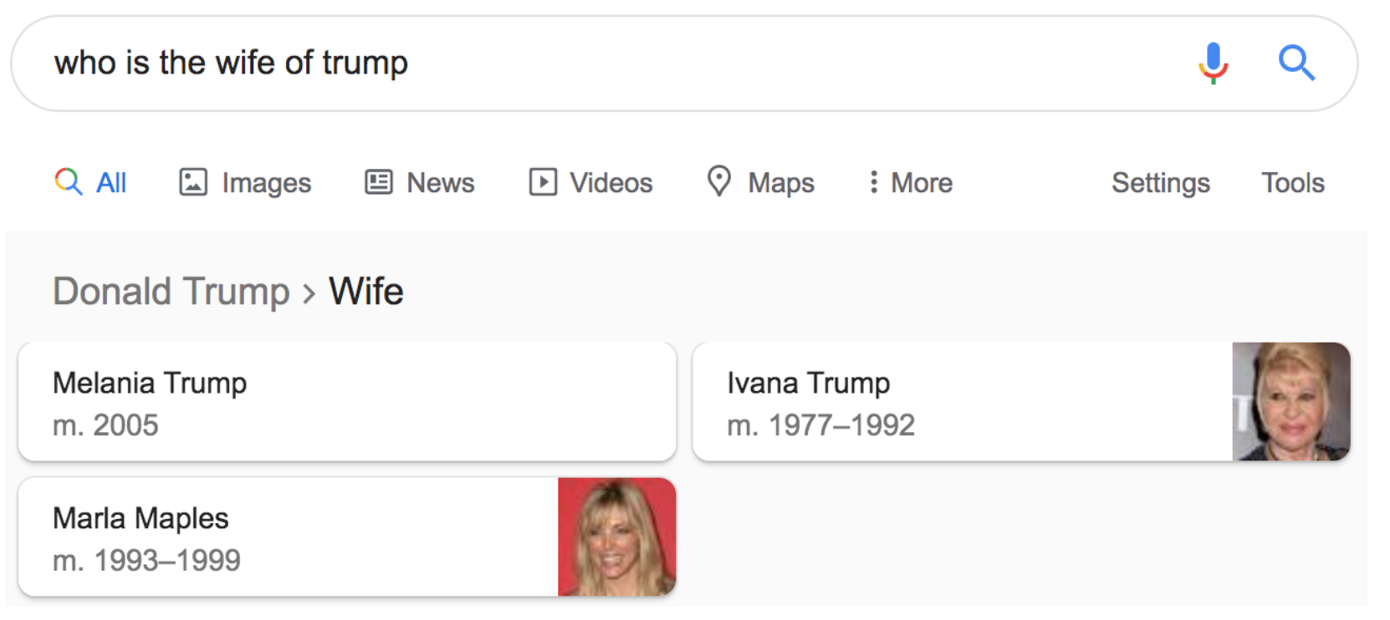
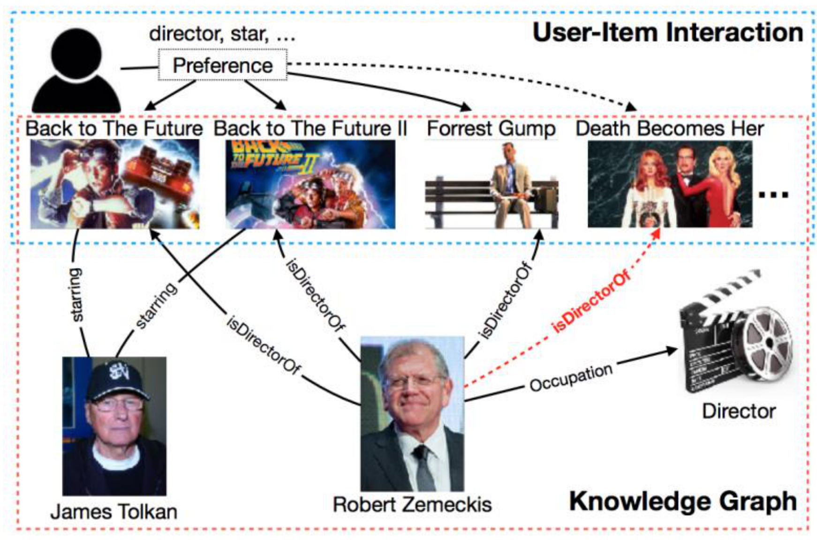
Background – Knowledge Graph (KG)
A knowledge graph
Mainly describe real world entities and relations, organized in a graph
Allows potentially interacting entities with each other
Preliminaries
Graph representation:$𝒢=(ℰ, ℛ, ℱ)$
Entities $ℰ$
real world objects or concepts
Relations $ℛ$
interactions between entities
Facts$ℱ$
the basic unit in form of $(h,r,t)$
(head entity, relation, tail entity)
Applications
KGQA:
Recommendation:

Slide 4
Background – Knowledge Graph Embedding (KGE)
Knowledge Graph Embedding (KGE)
Encode entities and relations in KG into low-dimensional vectors space
while capturing nodes’ and edges’ connection properties
Most KGE models define a scoring function $f$to estimate the plausibility of any fact $(h, r,t)$ using their embeddings: $f(h,r,t)$
embedding
original KG
continuous space

Slide 5
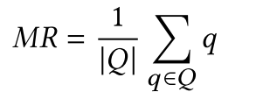
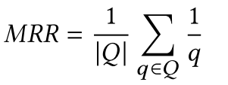
Background – Knowledge Graph Embedding (KGE)
Training
$S^{+}:\text{positive} \text{samples} S^{−}:\text{negative} \text{samples}$
Objectives: $\max{f(S^{+})}$ and $\min{f(S^{−})}$
Inference
head/tail prediction $\left(?, r,t\right)/(h, r,?)$
the missing tail is inferred as the entity that results in the highest score:
Evaluation metrics
q: the rank of correct entity
$$f$$

Slide 6
Machine learning on Knowledge Graph
For obtaining embeddings of entities and relations, and finishing KGE task (e.g., predict potential facts)
the scoring function $f$ is expected to discriminate positive/negative factual triples
a sampling scheme is needed to generate negative samples $S^{−}$
a loss function $L$ and regularization $r$ are required for defining learning problem
a optimization strategy is needed for convergence procedure
Considering the above 5 factors,
we can formulate the KGE learning framework as:

Slide 7
Learning Framework of KGE
5 KGE components:
Component | Role | Inputs | Outputs | Example
Scoring function $f( )$ | Plausibility estimation | Factual triples | Scores for each triple | TransE / CP
Loss function $L( )$ | Learning problem definition | Scores and labels | Loss value | BCE / CE
Negative sampling | Budget tradeoff | Positive samples $S^{+}$ | Negative samples $S^{−}$ | Uniform
Regularization $r( )$ | Avoid overfitting | Learnable parameters | Regularization value | L2 / N3
Optimization | Convergence control | - | - | -

Slide 8
Learning Framework of KGE
Learning objective:
Training procedure of knowledge graph embedding
Input data: training triples $S_{tra}$
step1: initialize learnable parameters $w$ (embeddings / model weights)
step2: sample negative triples ${\tilde{S}}_{(h,r,t)}$ $(S^{−})$ for each positive triple $\left(h,r,t\right)∈S_{tra} (S^{+})$
step3: $f( )$ forward inference to obtain $Scores$ for triples in $\left\{\left(h,r,t\right)\right\}∪$ ${\tilde{S}}_{(h,r,t)}$
step4: compute loss and regularization term w.r.t. $L( )$ and $r( )$
step5: backward propagation, and update $w$
Output: $w$
repeat
mini-batch training
until convergence

Slide 9
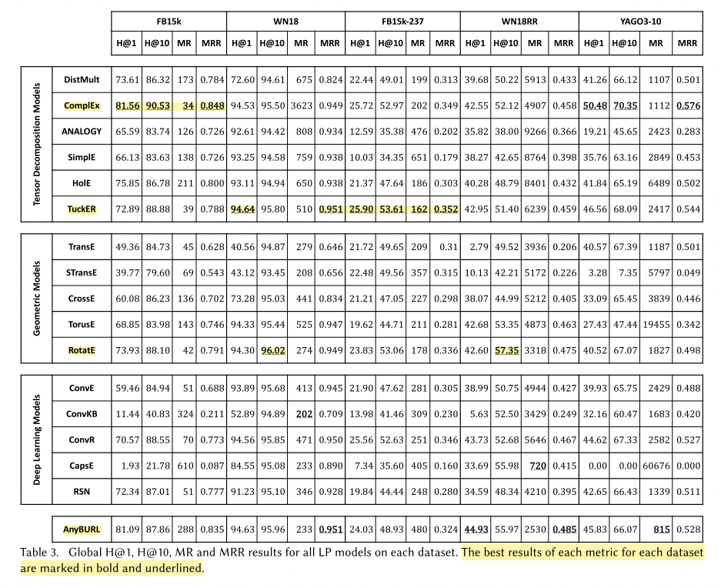
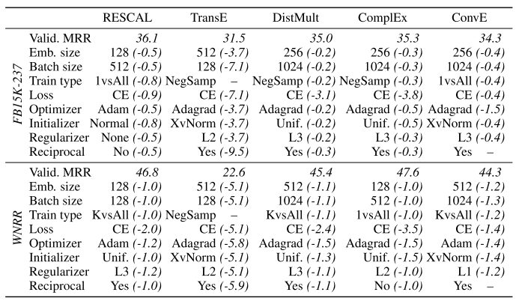
Review of Current KGE Models
[1]
[2]
No best models 🤔
No best configurations 🤔

Slide 10
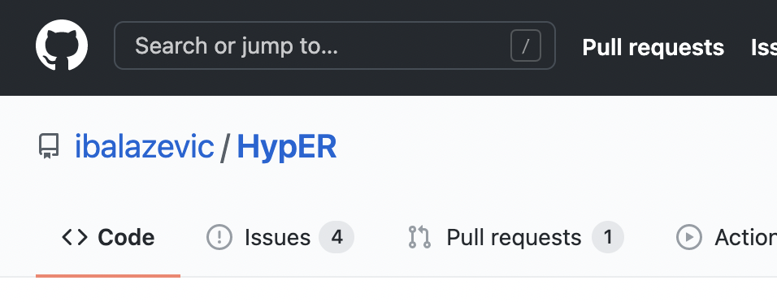
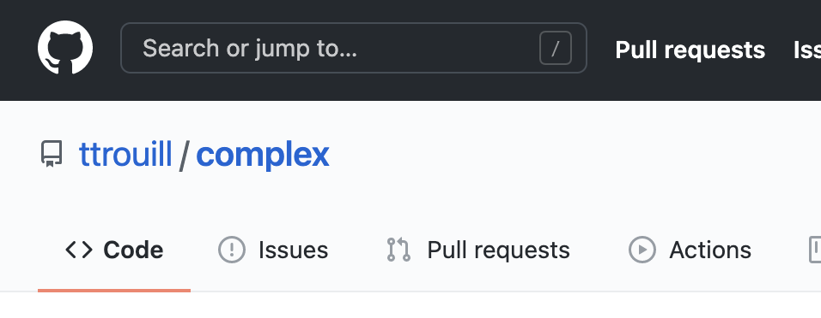
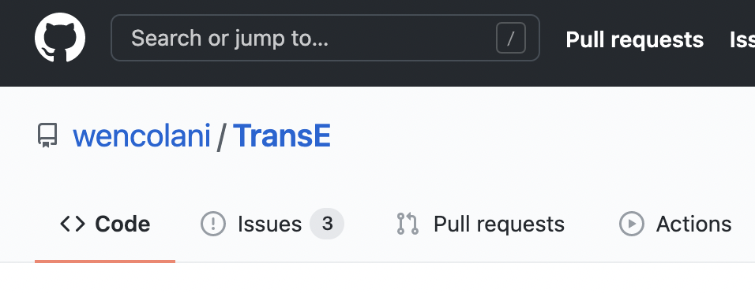
Motivation and Objective
Difficulties and Challenges
The choice of KGE model and configuration
usually in a time-consuming trial-and-error way
A fair comparison of model or strategy
﻿due to the heterogeneity in implementation, training, and evaluation
Lacking understanding of KGE components
interaction, importance, and tunability are unclear
…
Ultimate objective of KGbench:
Design an AutoML approach,
for any given dataset,
with requirements and limited budget,
to search for the optimal KGE model and configuration

Slide 11
Comparing with related works
^{[1]} Link prediction analysis:
additional evaluation
Evaluation
^{[11]} Bringing light into the dark:
large-scale reproduction
Training
^{[5]} Re-evaluation:
tie policy
^{[2]} Old dog new tricks
search hyper-parameters
KGE Models
Diagnosis for
more insightful evaluation
Reproduction for
better training strategy
KGbench
Design space(s) for KGE: model (configuration) / dataset / task
Deep insights and theoretical analysis of KGE components
Efficient automatic search for optimal model and configuration

Slide 12
Outline
Background
Motivation
Understanding of KGE components
Part1: Scoring Function $f( )$
Part2: Loss Function $L( )$
Part3: Negative Sampling $S^{−}$
…
Searching experiments
Key takeaway

Slide 13
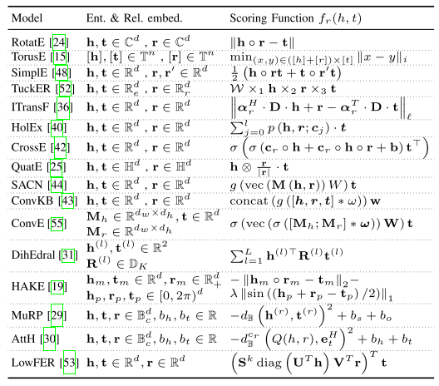
Part1: Scoring Function $f( )$
Learning Objective:
Category
Triple-based (focus point)
geometric models → need additional constraints
tensor decomposition models → expressive
neural network models → more prone to overfitting
Path / (Sub) Graph-based
utilize observable topological features
Rule-based
logical rule mining
[3]
[3]

Slide 14
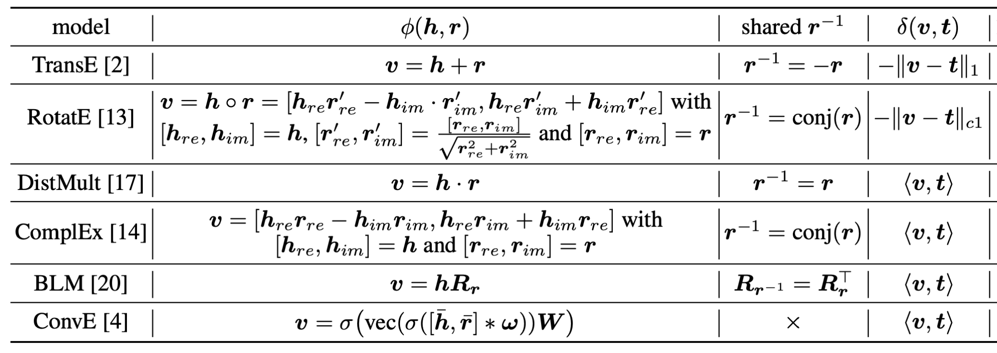
Part1: Scoring Function $f( )$
﻿Questions to answer for developing a novel $f$
which representation space to choose
which encoding model to use for modeling relational interactions (encoder)
how to measure the plausibility of triplets in a specific space (decoder)
whether to utilize auxiliary information
KGbench: $f(h,r,t)=δ(φ(h,r), t)$
decoupling and re-combination of existing $f$
Real/complex vector space
$f$is the combination of candidate $φ$ and $δ$
Not requiring additional information
[3]
In progress

Slide 15
Part2: Loss Function $L( )$
Learning Objective:
Category
Point-wise
Pair-wise
Set-wise
Comparison scope | #positive samples | #negative samples | Representatives
Point-wise | 1 (0) | 0 (1) | BCE / MSE
Pair-wise | 1 | 1 | MR
Set-wise | All (including peers) | All | CE / NLL / Adversarial

Slide 16
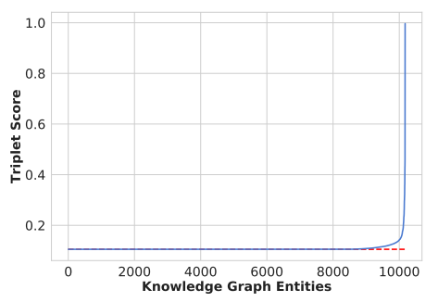
Part3: Negative Sampling $S^{−}$
Learning Objective:
$$positive \left(h,r,t\right)→negative \left(\tilde{h},r,t\right) \text{or} \left(h,r,\tilde{t}\right)$$
Methods
Uniform / Bernoulli sampling
GAN-based (with additional parameters to learn)
Cache(score)-based (NSCaching ICDE 2019)
Bias/variance-based (SRNS NeurIPS 2020)
Efficient
Importance weighting:
[4]
Effective
Self-contrast approximation:
[7]
[4]
﻿negative triples with large scores are rare.
﻿around 58.5% negative triples obtain the exact same score
as the valid one (in NN model)
﻿Both false and hard negative instances have large scores,
false negative instances have lower prediction variance
[5]
[6]

Slide 17
Outline
Background
Motivation
Understanding of KGE components
…
Part4: Regularization $r\left( \right)$ [NeurIPS 2020]
Part5: Optimization
Searching experiments
Key takeaway

Slide 18
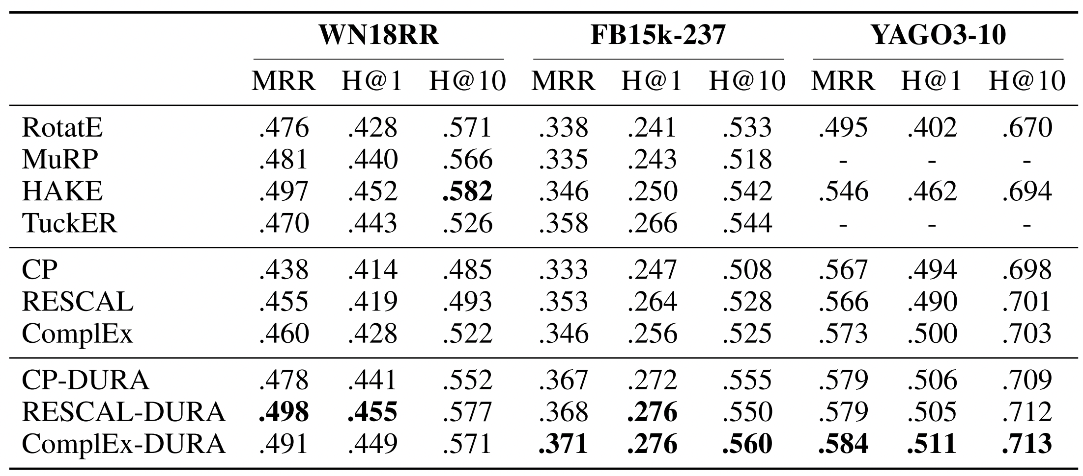
Part4: Regularization $r( )$
Learning Objective:
$r\left( \right)$: to avoid overfitting in KGE
trade off between expressiveness and complexity
No general & promising regularization schemes
squared frobenius norm (L2 norm)
tensor nuclear 3-norm (N3 norm)
designed for CP-like tensor decomposition models
$$r_{FRO}={\left\|H\right\|}_{F}^{2}+{\left\|T\right\|}_{F}^{2}+\sum_{j=1}^{|R|}{{\left\|R_{j}\right\|}_{F}^{2}}$$
$$r_{N3}=\sum_{d=1}^{|D|}{{(\left\|h_{:d}\right\|}_{3}^{3}+{\left\|r_{:d}\right\|}_{3}^{3}+{\left\|t_{:d}\right\|}_{3}^{3}})$$
[8]
[9]
Even worse performance when equipped with FRO regularizer

Slide 19
Part4: Regularization $r( )$
Duality-induced regularizer (DURA^{[9]}, NeurIPS 2020)
for an existing tensor factorization based model (primal),
there is often another distance based model (dual) closely associated with it.
Tensor factorization based (TFB): $f_{TFB}\left(h_{i},{r_{j}, t}_{k}\right)=Re\left({\overline{h}}_{i}R_{j}t_{k}\right)=Re(\left\langle h_{i}{\overline{R}}_{j}, t_{k}\right\rangle )$
Distance based (DB):${ f}_{DB}\left(h_{i},{r_{j}, t}_{k}\right)=−{\left\|h_{i}{\overline{R}}_{j}{− t}_{k}\right\|}_{2}^{2}$
$$f_{DB}\left(h_{i},{r_{j}, t}_{k}\right)=2Re\left(h_{i}{\overline{R}}_{j}t_{k}\right)−{\left\|h_{i}{\overline{R}}_{j}\right\|}_{2}^{2}−{\left\|{ t}_{k}\right\|}_{2}^{2}$$
$$=2f_{TFB}−{\left\|h_{i}{\overline{R}}_{j}\right\|}_{2}^{2}−{\left\|{ t}_{k}\right\|}_{2}^{2}$$
Notice that
Such that
$$\max{f_{DB}=\min{{−f}_{DB}}}=\min{(−2f_{TFB}+{\left\|h_{i}{\overline{R}}_{j}\right\|}_{2}^{2}+{\left\|{ t}_{k}\right\|}_{2}^{2})}$$
$$r_{B_DURA}=\sum_{(h_{i},{r_{j}, t}_{k})∈S}{{(\left\|h_{i}{\overline{R}}_{j}\right\|}_{2}^{2}+{\left\|t_{k}\right\|}_{2}^{2}})$$
Derive the Basic DURA:

Slide 20
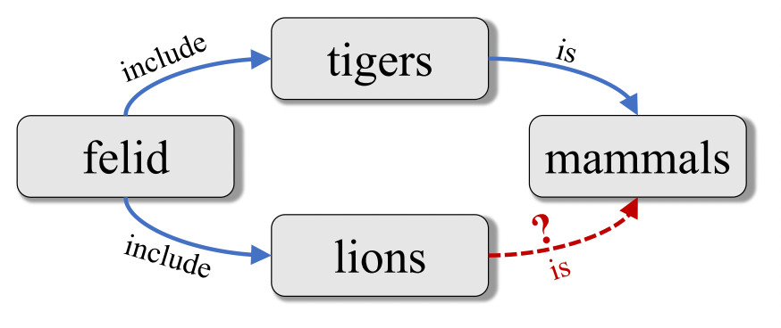
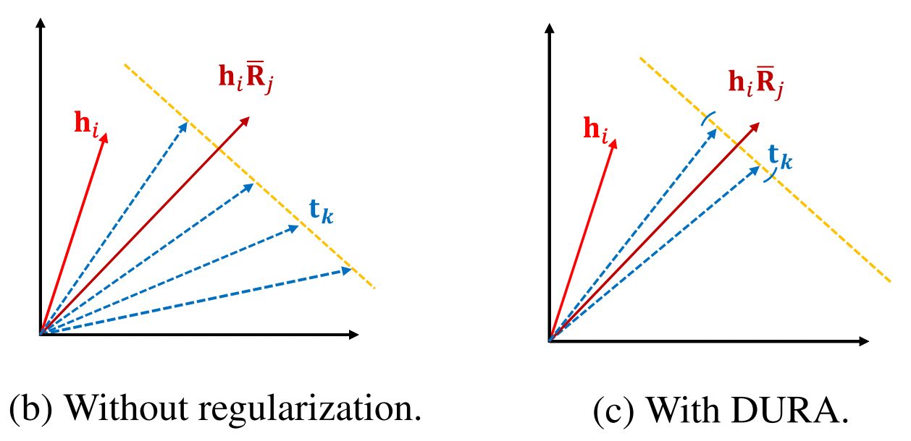
Part4: Regularization $r( )$
Explanation of basic DURA
(felid, include, tigers)
(felid, include, lions)
→ representation of tigers and lions should be similar
(tigers, is, mammals)
to predict (lions, is, mammals)?
Basic DURA → DURA
act on tails → heads and tails
$$f_{TFB}\left(h_{i},{r_{j}, t}_{k}\right)=Re\left({\overline{h}}_{i}R_{j}t_{k}^{T}\right)$$
$$f_{TFB}\left(h_{i},{r_{j}, t}_{k}\right)=Re\left({\overline{t}}_{k}{R_{j}^{T}h}_{i}^{T}\right)$$
$${ f}_{DB}\left(h_{i},{r_{j}, t}_{k}\right)=−{\left\|h_{i}{\overline{R}}_{j}{− t}_{k}\right\|}_{2}^{2}$$
$${ f}_{DB}\left(h_{i},{r_{j}, t}_{k}\right)=−{\left\|{t_{k}R}_{j}^{T}−h_{i}\right\|}_{2}^{2}$$
$$r=\sum_{(h_{i},{r_{j}, t}_{k})∈S}{{(\left\|h_{i}{\overline{R}}_{j}\right\|}_{2}^{2}+{\left\|t_{k}\right\|}_{2}^{2}})$$
$$r=\sum_{(h_{i},{r_{j}, t}_{k})∈S}{{(\left\|{t_{k}R}_{j}^{T}\right\|}_{2}^{2}+{\left\|h_{i}\right\|}_{2}^{2}})$$
Basic DURA:
$$r_{B_DURA}=\sum_{(h_{i},{r_{j}, t}_{k})∈S}{{(\left\|h_{i}{\overline{R}}_{j}\right\|}_{2}^{2}+{\left\|t_{k}\right\|}_{2}^{2}})$$
DURA:
$$r_{DURA}=\sum_{(h_{i},{r_{j}, t}_{k})∈S}{{(\left\|h_{i}{\overline{R}}_{j}\right\|}_{2}^{2}+{\left\|t_{k}\right\|}_{2}^{2}}+{\left\|t_{k}R_{j}^{T}\right\|}_{2}^{2}+{\left\|h_{i}\right\|}_{2}^{2})$$

Slide 21
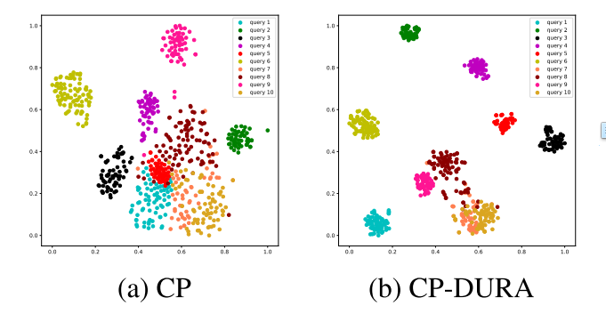
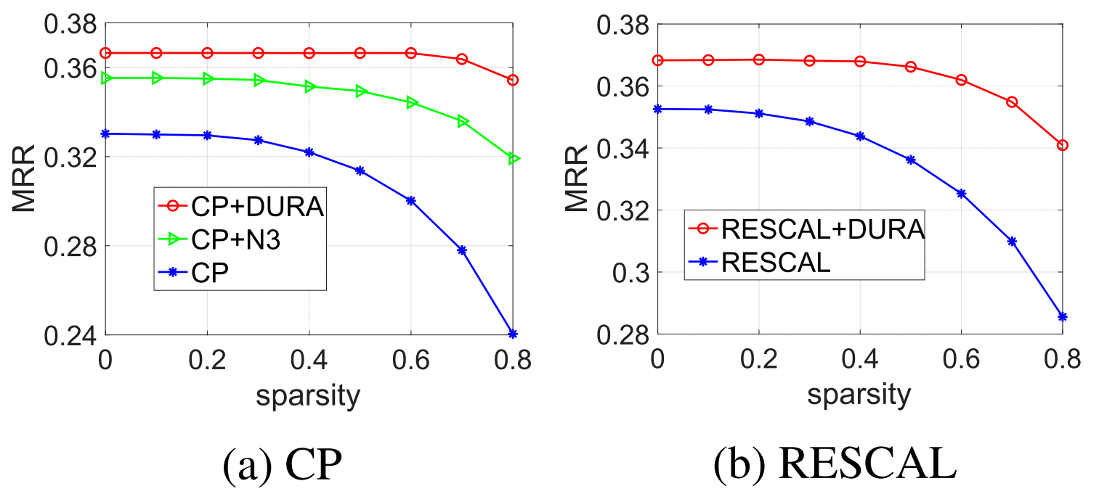
Part4: Regularization $r( )$
T-SNE visualization:
the same query $φ\left(h,r\right)$are assigned
more similar representation
Practical usage (in a weighted form)
Smaller dataset scale, larger improvement
Sparsity analysis:
DURA can reduce the storage usage
KG → TKG (ICLR 2020)^{[10]}

Slide 22
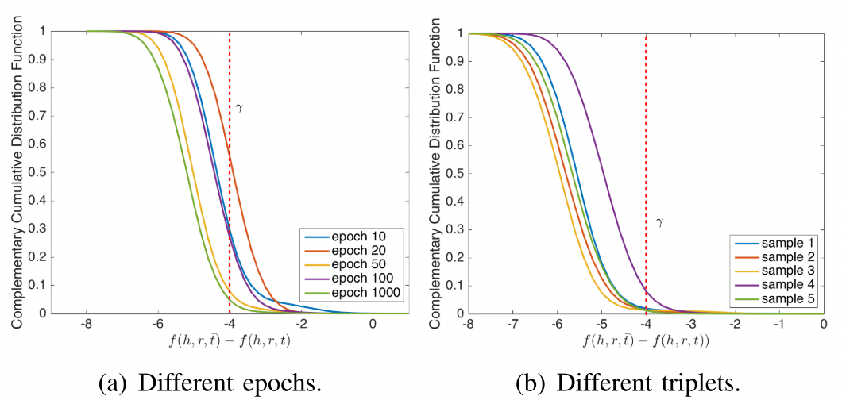
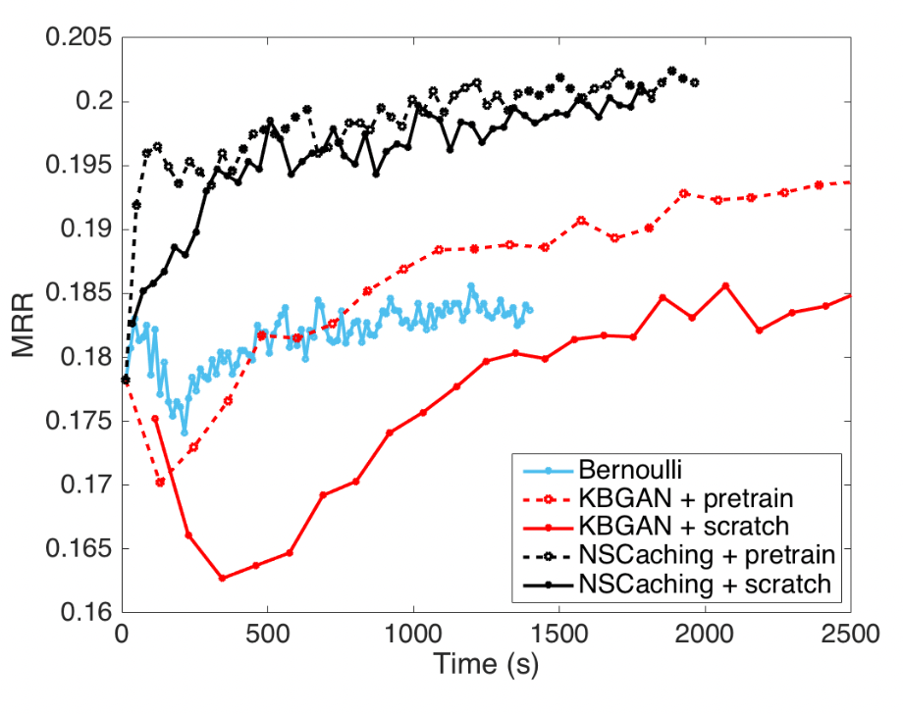
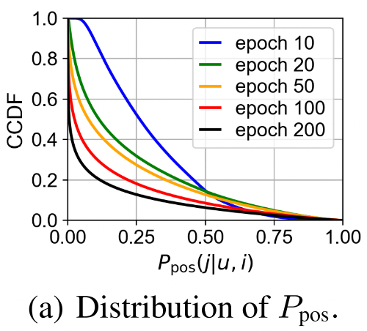
Part5: Optimization
Monitoring and control of convergence procedure
interact with other 4 KGE components
with plenty of hyper-parameters to tune
e.g., optimizer / initializer / learning rate / batch size
[4]
[6]
[4]

Slide 23
Review the Learning Objective
Summary
Scoring function $f( )$
simple bi-linear models reach SOTA performance
complex models are not often promising but more likely to overfitting
trend: pure KGE model → GNN-based / Path-based model
Negative sampling $S^{−}$
tradeoff between efficiency and effectiveness
false negative and hard samples play essential roles
Loss function $L( )$
likelihood losses are empirically better than ranking losses
lacking theoretical analysis and deep insights
Regularization $r( )$
can be derived from associating scoring functions
queries ($φ\left(h,r\right) / φ(t,r)$) and targets ($t/h$) can be closer
Optimization
closely interact with other components
with plenty of hyper-parameters to tune
Five core components
Scoring function $f( )$
Negative sampling $S^{−}$
Loss function $L( )$
Regularization $r( )$
Optimization
What can be conducted with AutoML? 🤔

Slide 24
Outline
Background
Motivation
Understanding of KGE components
Searching experiments
Configuration Space of KGE
Searching on original KG
Searching on sampled KG
Key takeaway

Slide 25
Configuration Space of KGE
Training procedure
Input data: training triples $S_{tra}$
step1: initialize learnable parameters $w$ (embeddings / model weights)
step2: sample negative triples ${\tilde{S}}_{(h,r,t)}$ $(S^{−})$ for each positive triple $\left(h,r,t\right)∈S_{tra} (S^{+})$
step3: $f( )$ forward inference to obtain $Scores$ for triples in $\left\{\left(h,r,t\right)\right\}∪$ ${\tilde{S}}_{(h,r,t)}$
step4: compute loss and regularization term w.r.t. $L( )$ and $r( )$
step5: backward propagation, and update $w$ & optimizer
Output: $w$
step1: 3 HP
step2: 3 HP
step3: 1 HP
step4: 6 HP
step5: 2 HP
No. | Hyper-parameter | Range
1 | L2 norm regularization | 0, 10⁻⁸, 10⁻⁶, 10⁻⁴
2 | L3 norm regularization | 0, 10⁻⁸, 10⁻⁶, 10⁻⁴
3 | Gamma | 10, 50, 200
4 | Embedding dimension | 100, 200, 500, 1000, 2000
5 | #negative samples | 1, 8, 32, 128, 512, 2048
6 | Self-adversarial rate | 0.5, 1.0, 2.0
7 | Training mode | negSamp, 1vs All, k vs All
8 | Filtering false negative samples | True, False
9 | Initialization mode | Uniform, xavier_norm
10 | Loss function | MR, BCE, BCE_adv, CE
11 | Learning rate | 10⁻², 10⁻³, 10⁻⁴
12 | Batch size | 128, 512, 2048
Any patterns in searching configuration?

Slide 26
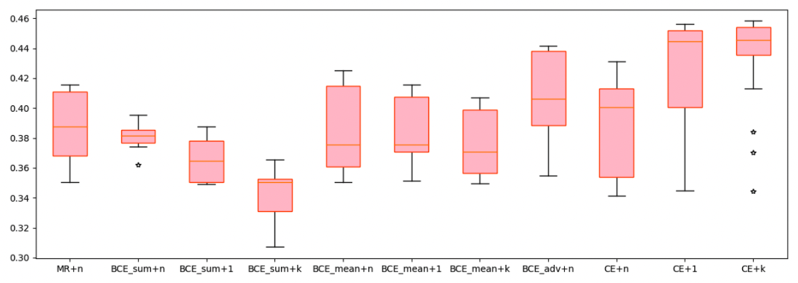
Experiments: searching on original KG
Old dog new tricks [ICLR 2020]^{[2]}
Experiment settings
Dataset: WN18RR
Model: ComplEx
Searching by {loss function + training method}
Observations
CE + 1/ CE + k are generally better
BCE_adv performs best with negative sampling
MRR
training methods
n: negative sampling
1: 1 vs all
k: k vs all
loss function + training method

Slide 27
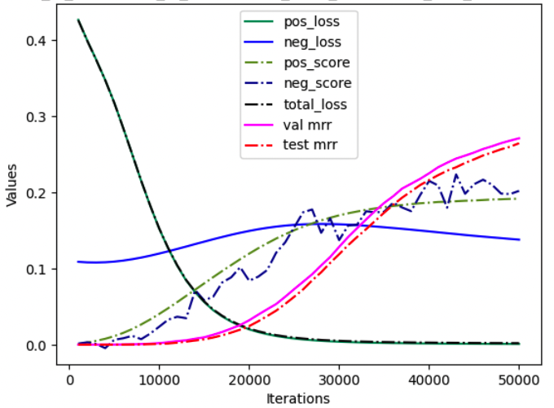
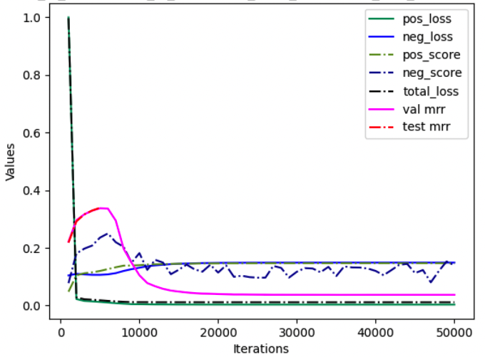
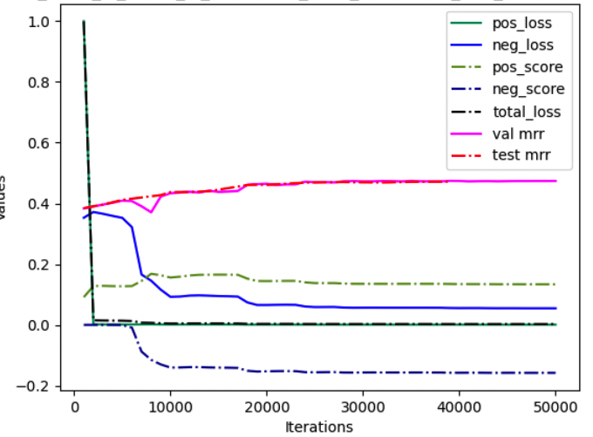
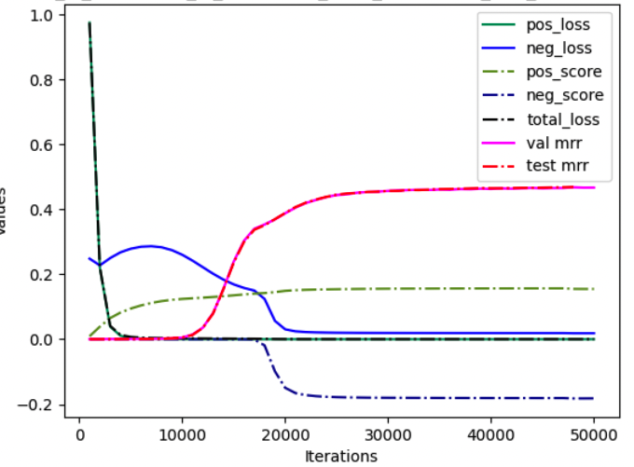
Experiments: searching on original KG
Visualization of training process
No obvious patterns found
Configurations with poor performances:
Model | dataset | original MRR | KGbench MRR | Promotion
ComplEx | WN18RR | 0.440 | 0.474 | +0.034
ComplEx | FB15K237 | 0.247 | 0.339 | +0.092
DistMult | WN18RR | 0.430 | 0.444 | +0.014
DistMult | FB15K237 | 0.241 | 0.337 | +0.096
RESCAL | WN18RR | 0.420 | 0.462 | +0.042
RESCAL | FB15K237 | 0.270 | 0.338 | +0.068
Configurations with good performances

Slide 28
Pipeline for KG sampling analysis
Searching on original KG is too time-consuming
How can boost the searching speed?
What about searching on sampled KGs?
Difference:
Static Graph Features
Difference:
Dynamic Learning Features
Random
Generator
KGE
Model
params1
$$𝒢_{rand}$$
$$𝒫_{rand}$$
Problem:
Over-fitting
params2
Random
Walker
$$𝒢_{samp}$$
$$𝒫_{samp}$$
Performance distribution
$$𝒢_{ori}$$
$$𝒢_{ori}$$
$$𝒫_{ori}$$

Slide 29
Experiments: searching via KG sampling
Data statistics
smaller subgraph → denser
obtain multi-scale KGs via sampling
dataset | wn18rr | wn18rr | wn18rr | wn18rr
sample ratio | 0.01 | 0.1 | 0.3 | Full
min sparsity | 2.22E-04 | 2.22E-05 | 7.40E-06 | 5.00E-06
max sparsity | 4.78E-04 | 4.08E-05 | 1.60E-05
dataset | FB15k-237 | FB15k-237 | FB15k-237 | FB15k-237
sample ratio | 0.01 | 0.1 | 0.3 | Full
min sparsity | 2.90E-05 | 2.90E-06 | 9.67E-07 | 6.20E-06
max sparsity | 3.81E-04 | 5.11E-05 | 2.24E-05
$$sparsity = \frac{\#triple}{(\#entity ∗ \#entity ∗ \#relation)}$$
dataset | FB15k-237 | FB15k-237 | FB15k-237 | FB15k-237
sample ratio | 0.2 | 0.5 | 0.8 | Full
#entity | 2908 | 7270 | 11632 | 14541
#relation | 236 | 237 | 237 | 237
#triples | 57.9k | 182.4k | 283.0k | 310.1k
sparsity | 5.81e-05 | 2.91e-05 | 1.77e-05 | 1.24e-05
validate depth distribution (1-7) | 28.9 - 51.5 - 19.4 - 0.0 - 0.0 - 0.0 - 0.03 | 31.1 - 52.8 - 15.9 - 0.03 - 0.0 - 0.0 - 0.01 | 31.9 - 52.7 - 15.2 - 0.02 - 0.0 - 0.0 - 0.00 | 0.51 - 73.2 - 26.0 - 0.09 - 0.00 - 0.0 - 0.05
mean validate depth | 1.90 | 1.84 | 1.83 | 2.26
test depth distribution (1-7) | 27.3 - 51.3 - 21.2 - 0.0 - 0.0 - 0.03 - 0.03 | 31.1 - 52.5 - 16.1 - 0.03 - 0.0 - 0.0 - 0.02 | 32.0 - 52.5 - 15.3 - 0.02 - 0.0 - 0.0 - 0.00 | 0.44 - 73.4 - 25.8 - 0.17 - 0.00 - 0.0 - 0.13
mean test depth | 1.94 | 1.85 | 1.83 | 2.26
mean inDegree | 19.9 | 25.0 | 24.3 | 21.3
inDegree distribution (0/1/2/3/3+) | 5.74 - 5.15 - 5.57 - 5.43 - 78.0 | 4.64 - 3.45 - 3.64 - 4.41 - 83.8 | 4.61 - 4.10 - 4.01 - 4.74 - 82.5 | 7.13 - 5.59 - 5.22 - 5.79 - 76.2
mean outDegree | 19.9 | 25.0 | 24.3 | 21.3
outDegree distribution (0/1/2/3/3+) | 3.85 - 2.37 - 1.92 - 2.33 - 89.5 | 3.86 - 2.11 - 1.40 - 1.63 - 90.9 | 2.77 - 2.32 - 1.97 - 2.07 - 90.8 | 4.47 - 4.59 - 3.23 - 3.12 - 84.5

Slide 30
Outline
Background
Motivation
Understanding of KGE components
Searching experiments
Searching on original KG
Searching on sampled KG
Correlation across sampling ratios (scales)
Correlation across computing budgets
Efficiency analysis
Broader correlation
Key takeaway

Slide 31
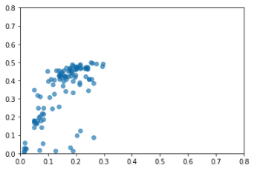
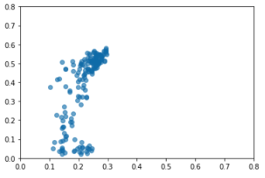
Experiments: searching via KG sampling
Correlation across sampling ratios (scales)
0.01 → sample ratio = 0.01 (of keeping nodes)
Observation:
Acceptable correlation between original KG and sampled KG
Well-performed configurations can be selected
No. | X axis | Y axis | Spearman | Pearson
1 | NELL-995 | NELL-995 0.01 | 0.6738 | 0.6680
2 | FB15k-237 | FB15k-237 0.01 | 0.7674 | 0.6624
x: NELL-995 (20w iterations)
y: NELL-995 0.01 (1w iterations)
x: FB15k-237
y: FB15k-237 0.01

Slide 32
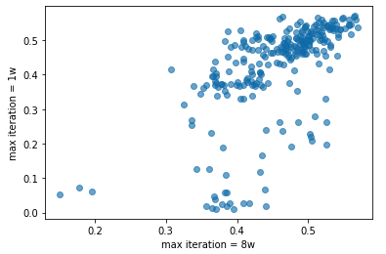
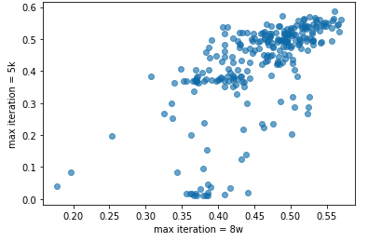
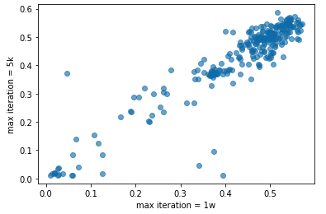
Experiments: searching via KG sampling
Correlation across computing budgets
Dataset: WN18RR 0.01
Searching by max #iterations: 8w / 1w / 5k / 2k
No. | X #iteration | Y #iteration | Spearman | Pearson
1 | 8w | 1w | 0.6863 | 0.6140
2 | 8w | 5k | 0.7076 | 0.6467
3 | 8w | 2k | 0.5846 | 0.5714
Observation:
Less training time, weaker correlation
x: MRR of 8w iters
y: MRR of 1w iters
x: MRR of 8w iters
y: MRR of 5k iters
x: MRR of 8w iters
y: MRR of 2k iters

Slide 33
Experiments: searching via KG sampling
Efficiency Analysis
Full KG: ${iter}_{full} \text{=}\text{ \#}\text{C} \text{×} {iter}_{max1}$
Sampled KG: ${iter}_{sample}\text{ = \#}\text{C} \text{×} {iter}_{max2} \text{+ }\text{K} \text{×} {iter}_{max1}$
Two-stage speed-up ratio: $R=\frac{{iter}_{full}}{{iter}_{sample}}$
First stage: comparison of convergence speed
Observation:
6-10X acceleration for the whole two-stage pipeline
To fully cover top-k configurations of original KG
Mean iterations | Original KG | Sampled KG | Ratio_{stage1}
NELL-995 v.s. sample 0.01 | 85.8k | 5.1k | 16.6 X
FB15k-237 v.s. sample 0.01 | 85.8k | 7.4k | 11.5 X
FB15k-237 v.s. sample 0.05 | 76.5k | 7.1k | 10.7 X
FB15k-237 | FB15k-237 0.01
Top5 | Top20
Top10 | Top70
Top20 | Top70
Top30 | Top100
Top50 | Top100

Slide 34
Experiments: searching via KG sampling
Correlation across models
with the same configuration
Correlation across datasets
for certain model with the same configuration
No. | X axis | Y axis | Spearman | Pearson
1 | ComplEx | RotatE | 0.2096 | 0.5842
2 | ComplEx | DistMult | 0.7097 | 0.6818
3 | RotatE | DistMult | 0.3153 | 0.5343
Observation:
Stronger correlation between models of the same type
Good correlation across sampled KGs
No. | X axis | Y axis | Spearman | Pearson
1 | WN18RR 0.01 | NELL-995 0.01 | 0.7597 | 0.7716
2 | WN18RR 0.01 | FB15k-237 0.01 | 0.7106 | 0.7726
3 | NELL-995 0.01 | FB15k-237 0.01 | 0.8022 | 0.9297

Slide 35
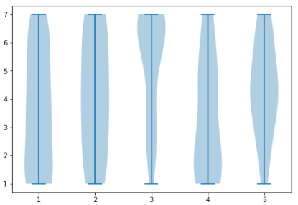
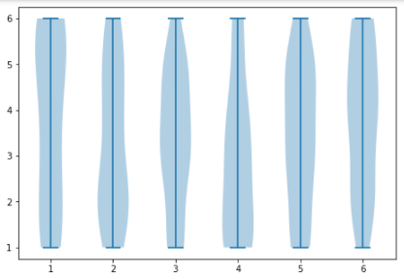
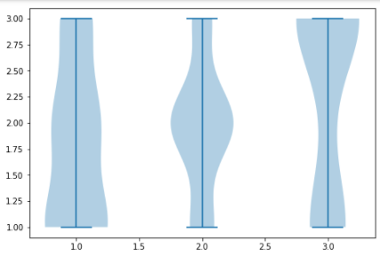
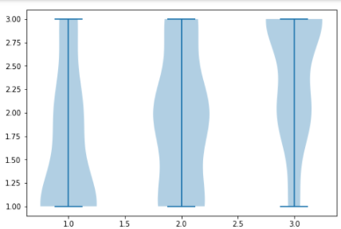
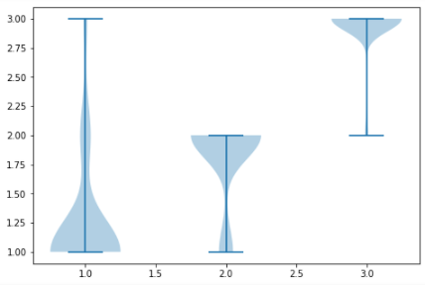
Experiments: searching via KG sampling
loss function
MR, BCE_mean, BCE_sum, CE, BCE_adv
#negative samples
1, 8, 32, 128, 512, 2048
No. | Hyper-parameter
1 | L2 norm regularization
2 | L3 norm regularization
3 | Gamma
4 | Embedding dimension
5 | #negative samples
6 | Self-adversarial rate
10 | Training mode
11 | Filtering false negative samples
12 | Initialization mode
13 | Loss function
14 | Learning rate
15 | Batch size
✗ lower
rankings
✓ higher
rankings
Learning rate
10⁻⁴ ,10⁻³, 10⁻²,
Batchsize
128, 512, 2048
Gamma
10, 50, 200

Slide 36
Experiments
Summary
directly search on full data is quite slow
good correlation across scale/model/dataset
two-step searching might be more practical
sample subgraph and proceed searching
transfer to full data and finetune
TODO experiments
Importance/sensitivity estimation
General model search
Transfer to original KG
Transfer to other datasets
Transfer to other KGE tasks
Potential two-step configuration searching for knowledge graph embedding
Inputs: KG $𝒢$, KGE model $M$
step1: sample configurations $Θ$and train on $𝒢_{samp}$, $ℳ_{Θ}←\{ℳ\left(θ\right), ∀θ∈Θ\}$
step2: get top-k1 configurations $Θ_{k1}$ w.r.t. $ℳ_{Θ}$
step3: compute dataset similarity by comparing $ℳ_{Θ}$ and $ℳ_{Θ}^{′}$, and recommend configurations $Θ_{k2}$
step4: finetune $Θ^{′}←Θ_{k1}∪Θ_{k2}$ on $𝒢$, get optimal $θ^{∗}←\operatorname{argmax}{ℳ_{Θ^{′}}}$
Output: $θ^{∗}$

Slide 37
Outline
Background
Motivation
Understanding of KGE components
Searching experiments
Key takeaway

Slide 38
Key takeaways
Recall the difficulties
﻿The choice of KGE model and configuration
A fair comparison of model and strategy
Lacking understanding of KGE components
KGbench
Automated configuration search
Benchmarking for fair comparison
Study the principle and interaction of KGE components
TODO List
Experiment-driven → comprehensive experiments
Deep insights + theoretical analysis
Summary and refine key novelty

Slide 39
Reference
[1] Rossi, Andrea, et al. "Knowledge graph embedding for link prediction: A comparative analysis." ACM Transactions on Knowledge Discovery from Data (TKDD) 15.2 (2021): 1-49.
[2] Ruffinelli, Daniel, Samuel Broscheit, and Rainer Gemulla. "You can teach an old dog new tricks! on training knowledge graph embeddings." International Conference on Learning Representations. 2019.
[3] Ji, Shaoxiong, et al. "A survey on knowledge graphs: Representation, acquisition, and applications." IEEE Transactions on Neural Networks and Learning Systems (2021).
[4] Zhang, Yongqi, et al. "NSCaching: simple and efficient negative sampling for knowledge graph embedding." 2019 IEEE 35th International Conference on Data Engineering (ICDE). IEEE, 2019.
[5] Sun, Zhiqing, et al. "A Re-evaluation of Knowledge Graph Completion Methods." Proceedings of the 58th Annual Meeting of the Association for Computational Linguistics. 2020.
[6] Ding, Jingtao, et al. "Simplify and Robustify Negative Sampling for Implicit Collaborative Filtering." arXiv preprint arXiv:2009.03376 (2020).
[7] Yang, Zhen, et al. "Understanding negative sampling in graph representation learning." Proceedings of the 26th ACM SIGKDD International Conference on Knowledge Discovery & Data Mining. 2020.
[8] Wang, Quan, et al. "Knowledge graph embedding: A survey of approaches and applications." IEEE Transactions on Knowledge and Data Engineering 29.12 (2017): 2724-2743.
[9] Zhang, Zhanqiu, Jianyu Cai, and Jie Wang. "Duality-Induced Regularizer for Tensor Factorization Based Knowledge Graph Completion." Advances in Neural Information Processing Systems 33 (2020).
[10] Lacroix, Timothée, Guillaume Obozinski, and Nicolas Usunier. "Tensor decompositions for temporal knowledge base completion." arXiv preprint arXiv:2004.04926 (2020).
[11] Ali, Mehdi, et al. "Bringing light into the dark: A large-scale evaluation of knowledge graph embedding models under a unified framework." arXiv preprint arXiv:2006.13365 (2020).

Slide 40
Q&A
Thanks for your attention!

Slide 41
