Slide 1
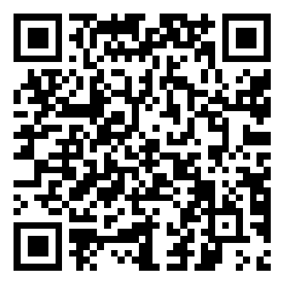
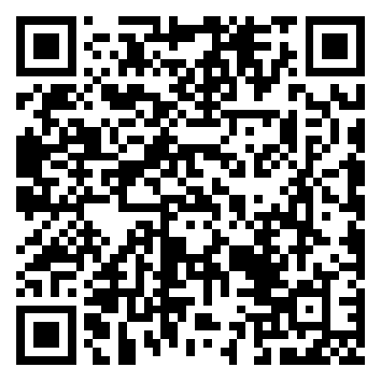
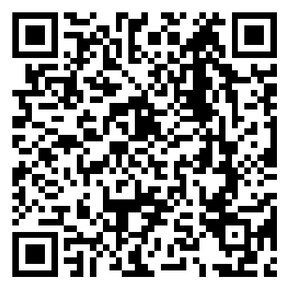
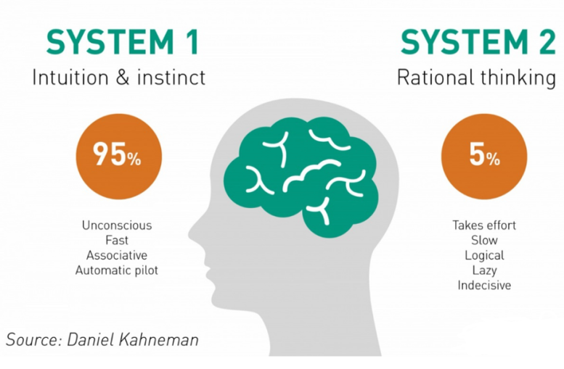
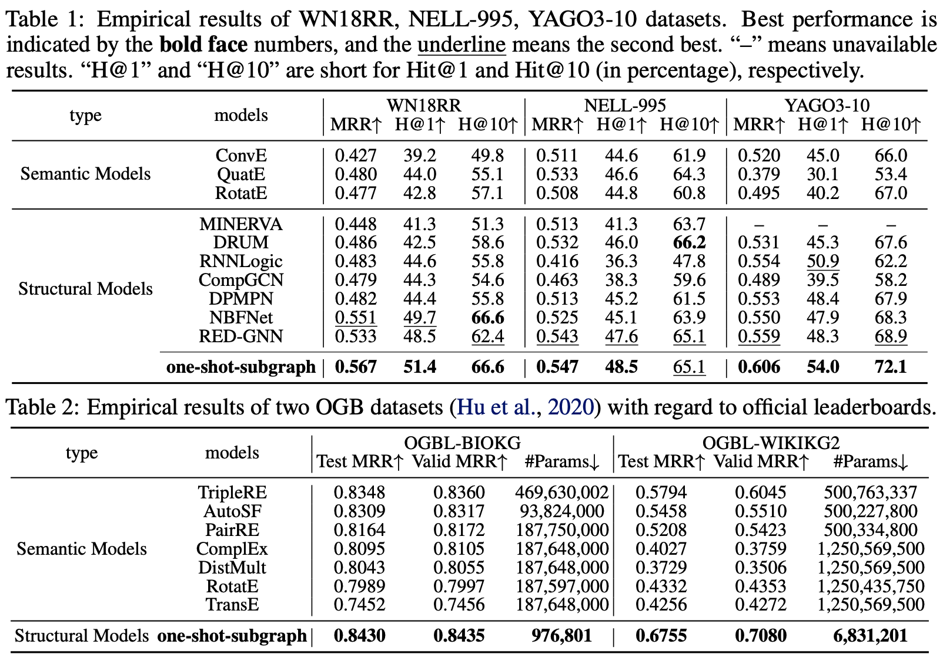
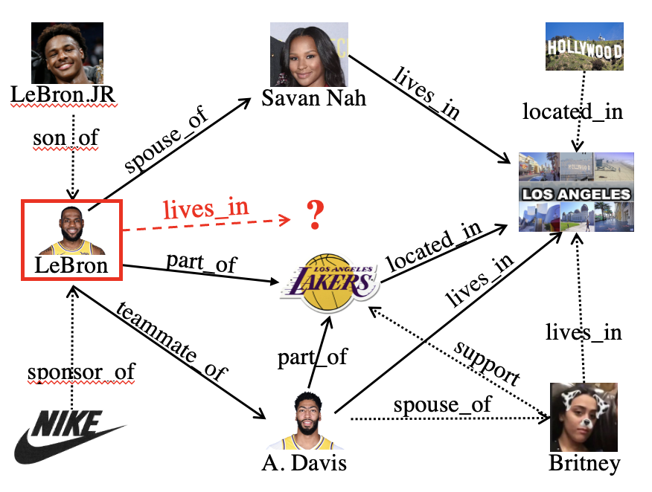
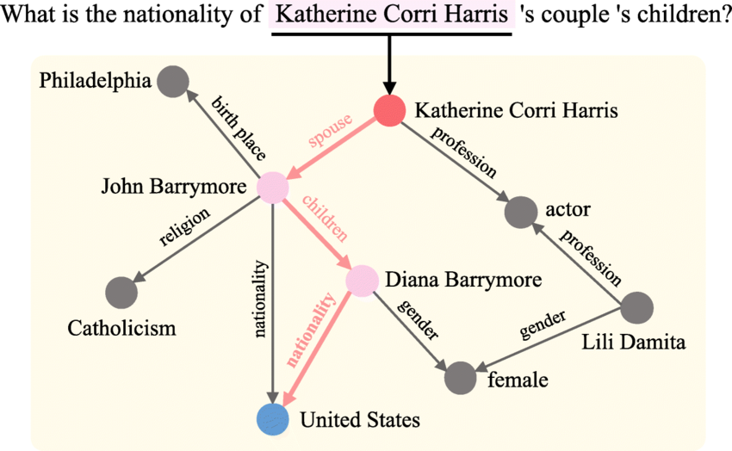
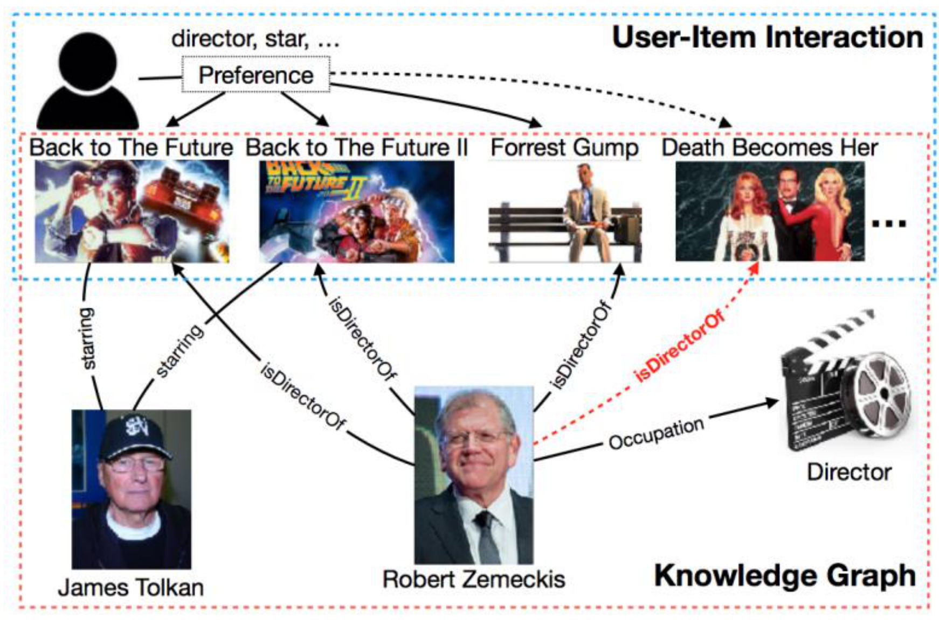
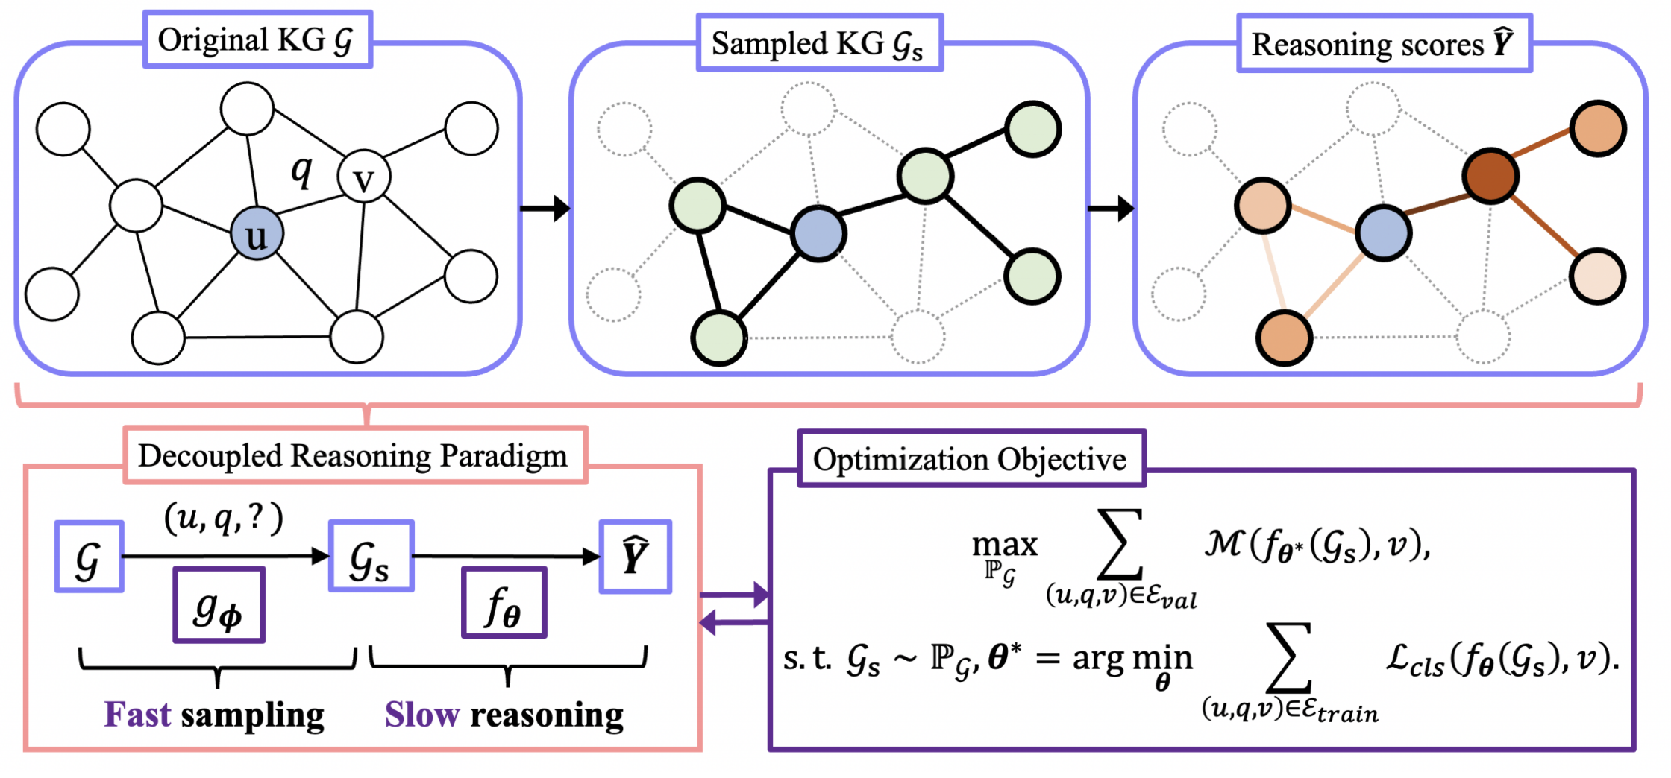
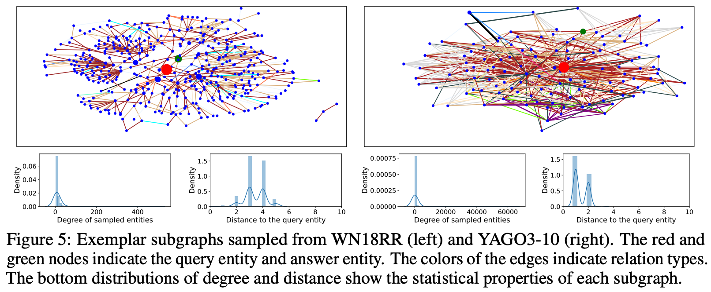
Question: Is all the information necessary for reasoning on knowledge graphs? 🤔
Less is More: One-shot Subgraph Reasoning
on Large-scale Knowledge Graphs
Zhanke Zhou, Yongqi Zhang, Jiangchao Yao, Quanming Yao, Bo Han
Paper Code Slides
Problem: Link Prediction on KG
Method: one-shot-subgraph reasoning
Experiments
KG reasoning with query:
(LeBron, lives_in, ?)
Applications: QA / RecSys
Design principle
first to efficiently identify a subgraph (system1) ➔ sampler
then effectively reason on the subgraph (system2) ➔ predictor
Only partial knowledge stored in human brain is relevant to a question
Generating candidates and then ranking the promising ones are common
Structural models (e.g., GNNs) for KG reasoning
propagate the message with the graph structure
update entity representation at each propagation step
Implementation
10% entities
10% entities
10% entities
The Scalability Issue
Computation Complexity
$$𝒢$$
$$H$$
$$(u,q,?)$$
$$\hat{Y}$$
$$𝒢$$
$$(u,q,?)$$
$$\hat{Y}$$
structural
$$f_{θ}$$
$$f_{θ}$$
$$f_{θ}$$
semantic
Parameter Complexity
The three key steps of one-shot-subgraph reasoning are
1. generate the sampling distribution
2. extract a subgraph with top entities and edges
3. inference on the subgraph and get the final prediction
semantic models structural models complexity comparison
semantic models (computation-efficient but parameter-expensive)
$p\left(u,q,v\right)$ is measured by a scoring function with representations $h_{u},h_{q}, h_{v}$
structural models (parameter-efficient but computation-expensive)
learn the structures by leveraging the relational paths between $u$ and $v$
or use the graph structure for reasoning, capturing more complex semantics
$f_{θ}$acts on $𝓖$ to obtain $\hat{Y}$ of all entities
The whole graph ($𝓖$), model ($f_{θ}$), and prediction ($\hat{Y}$) are coupled
How to efficiently and effectively conduct subgraph reasoning on KG? 🤔

Slide 2
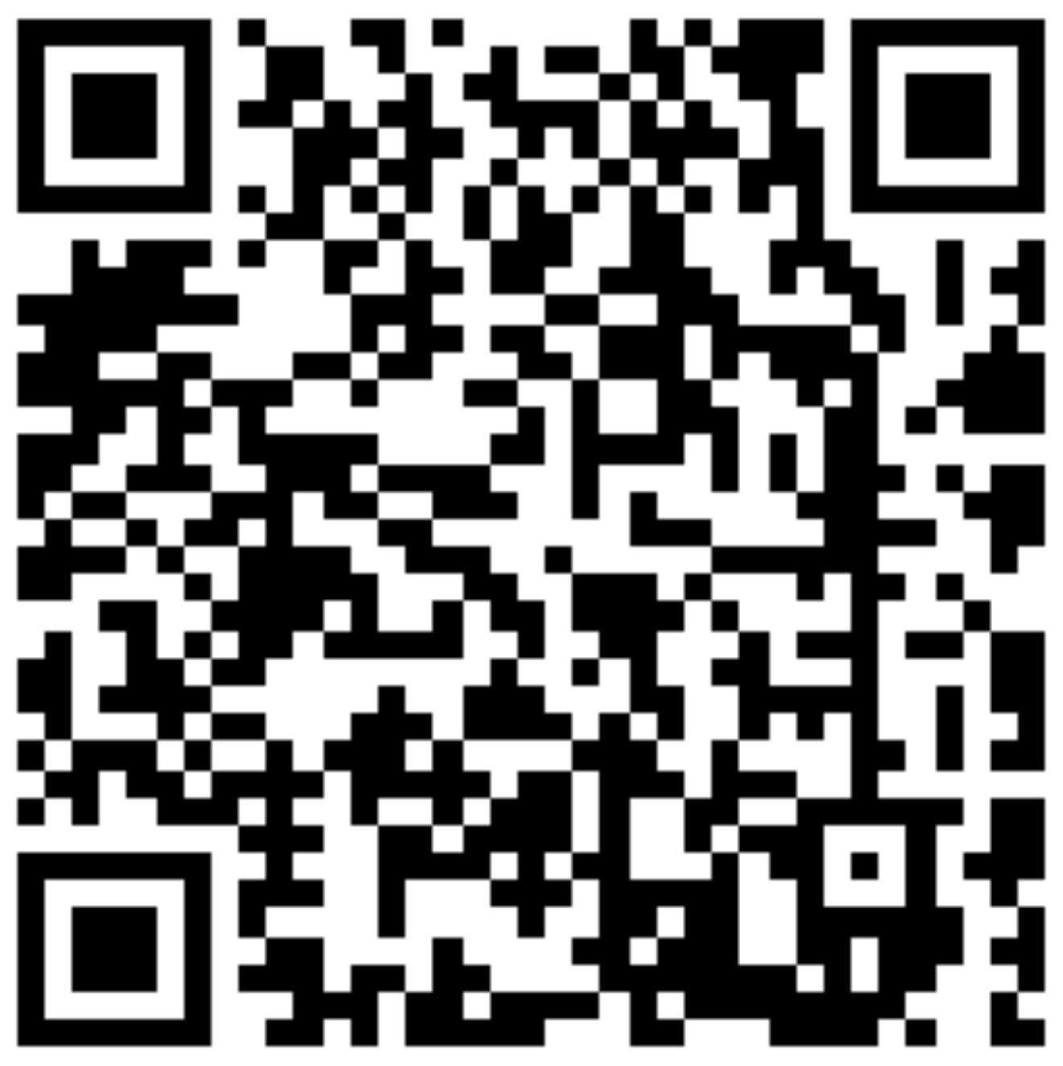
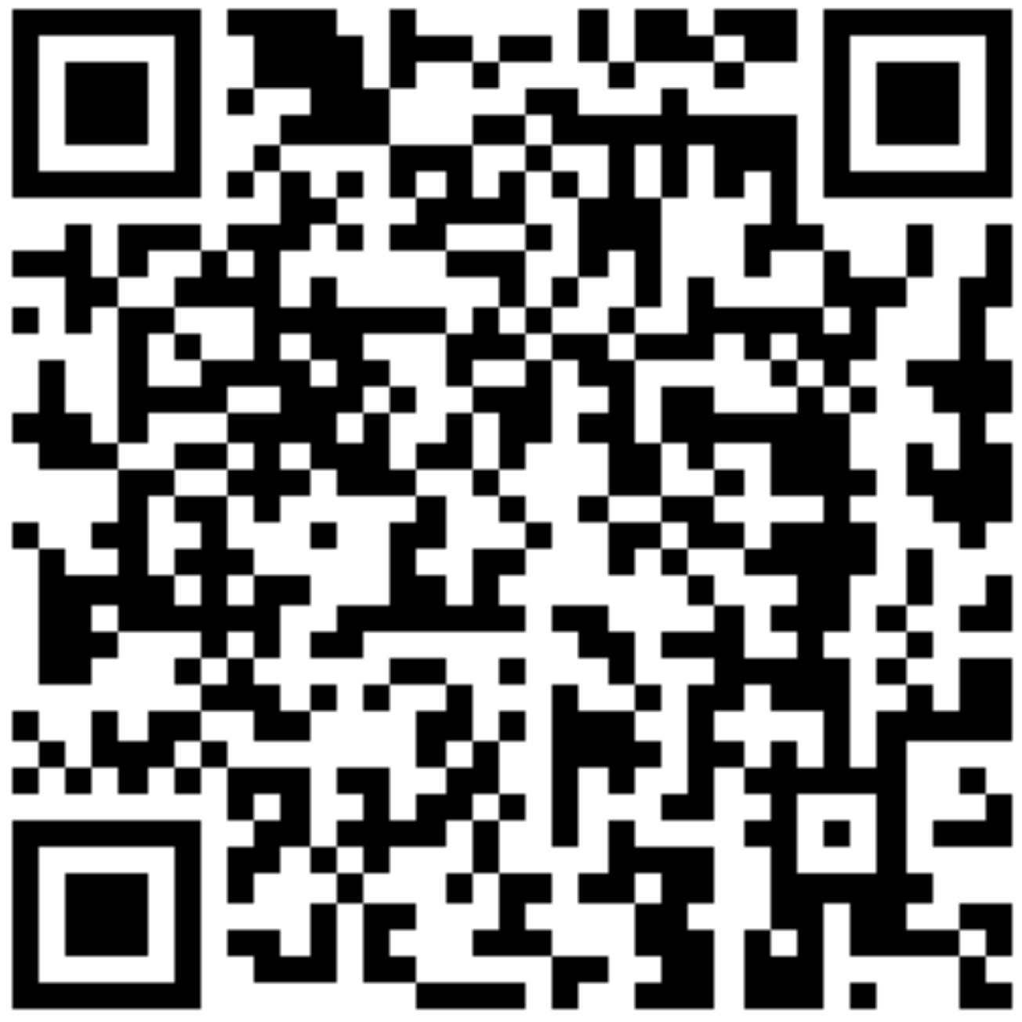
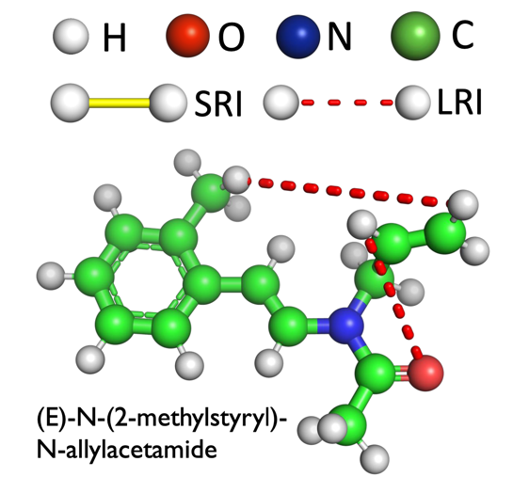
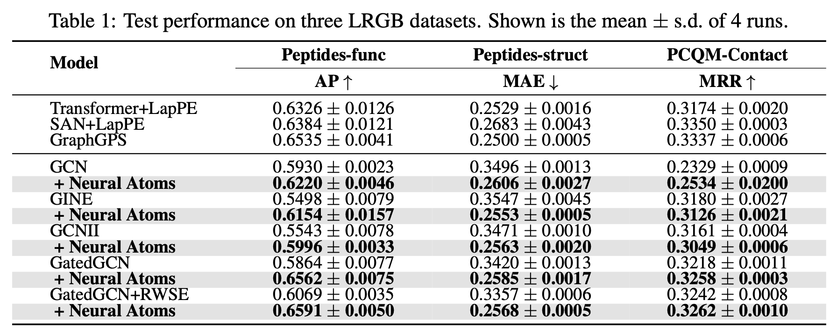
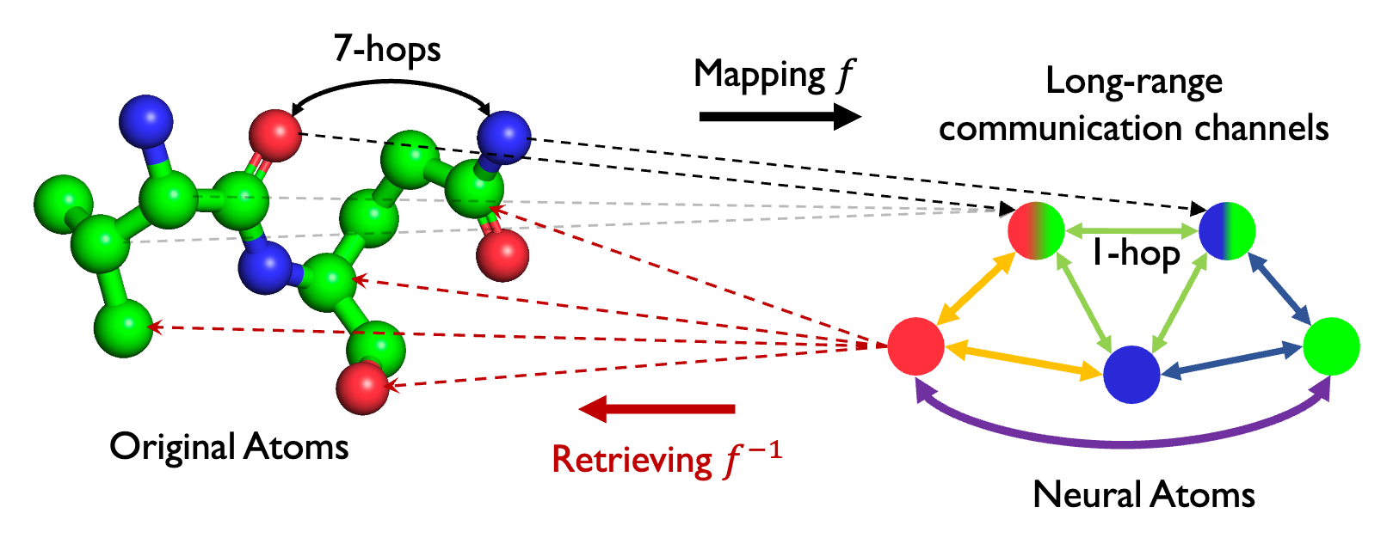
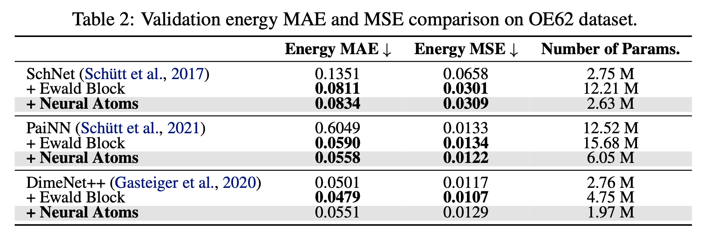
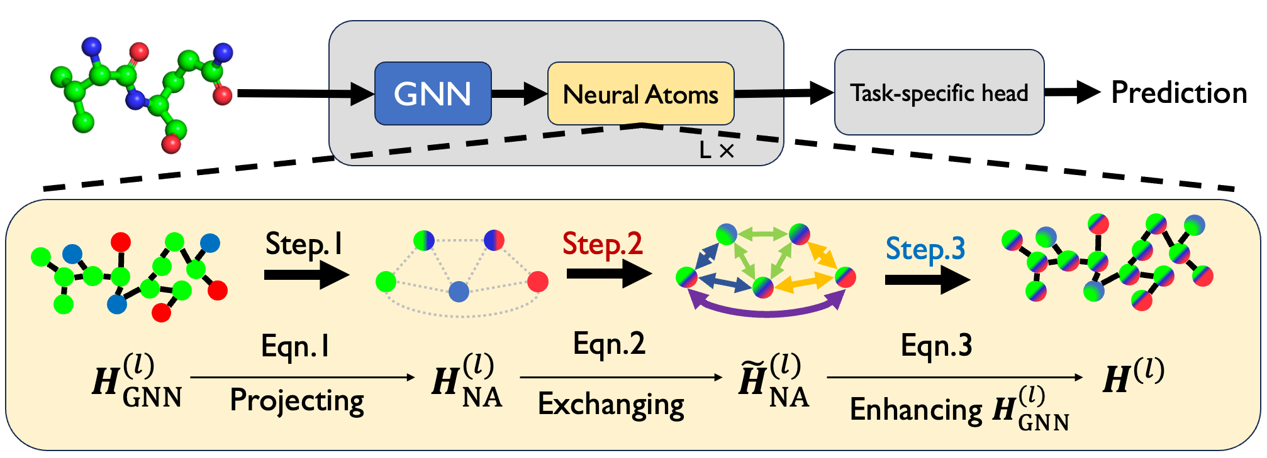
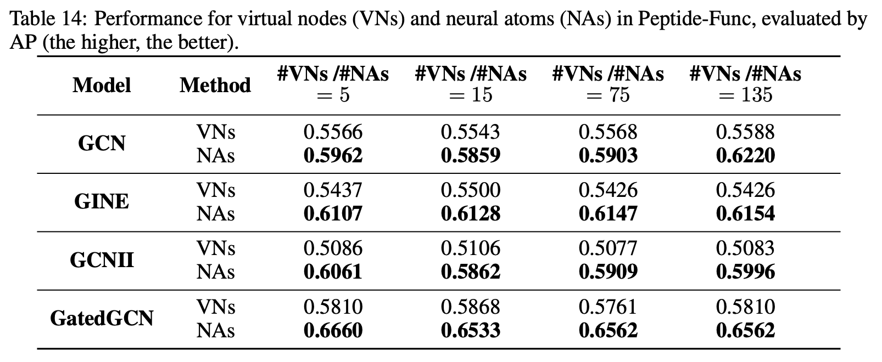
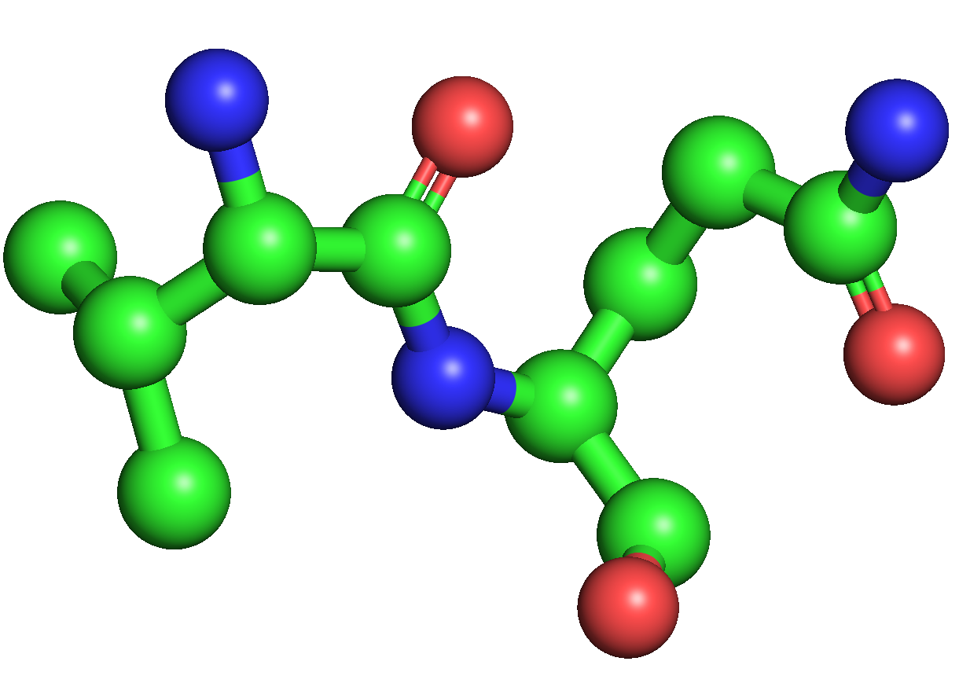
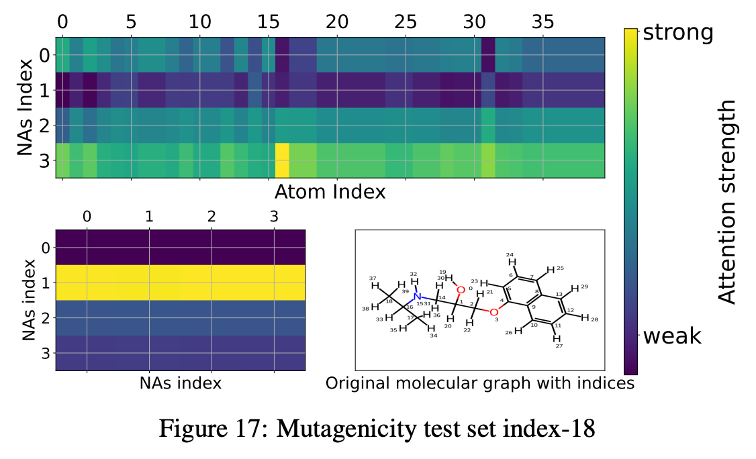
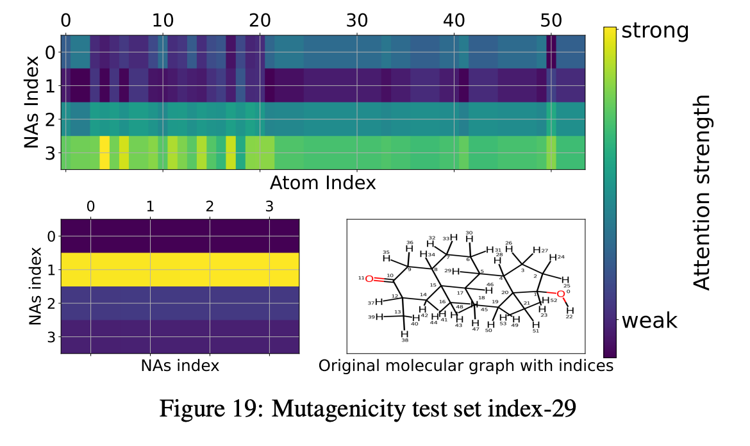
Question: Can we model distant interactions with a single jump in molecular graphs? 🤔
Neural Atoms: Propagating Long-Range Interaction
In Molecular Graphs hrough Efficient Communication Channel
Xuan Li*, Zhanke Zhou*, Jiangchao Yao, Yu Rong, Lu Zhang, Bo Han
Paper
Code
Background: Long-range Interactions
Neural Atoms
Empirical Study
Molecular graphs consist of different types of atom interaction with different properties and functions.
→ Neural atoms can boost the performance of various GNNs up to 27.32%.
- The short-range interaction (SRI) forms the structure of the molecular graph.
- The long-range interaction (LRI) could determine physical and chemical properties.
Limitations of existing approaches
Learning to project all the original atoms into a few neural atoms that abstract the collective information of atomic groups in a molecule.
→ Neural atoms without 3D information and half the #params. achieve competitiveness or outperform the Ewald-based approach (previous SOTA).
Graph Neural Network
Stacking multiple GNN layers to capture LRI?
Over-smoothing: representations become indistinguishable;
Over-squashing: overwhelming information be squashed.
Implementation
Graph Transformer
→ Neural Atoms are better than multiple fully connected Virtual Nodes.
Using a fully connected graph to capture LRI?
Irrelevant interactions: the LRIs are naturally sparse;
Additional computation: unnecessary node-pair attentions.
Motivation
Step-1. Project atom representations $H_{GNN}^{(𝓁)}$to neural atom representations $H_{NA}^{(𝓁)}$.
Can we model distant interactions with a single jump in molecular graphs?
Step-2. Exchange information among neural atoms $H_{NA}^{(𝓁)}↦{\overset{˜}{H}}_{NA}^{(𝓁)}$.
→ Neural Atoms have sparse attention and establish inter-communications.
Advantages
Learnable projection from atoms to neural atoms;
Reducing the multi-hop long-range interaction to single-hop;
GNN-agnostic and plug-in-and-play.
Step-3. Project neural atoms back and enhance the atoms’ representation ${(H_{GNN}^{\left(𝓁\right)}, \overset{˜}{H}}_{NA}^{(𝓁)})↦H^{\left(𝓁\right)}$.

Slide 3
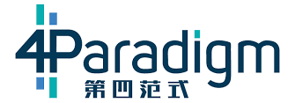
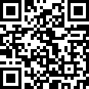
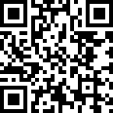
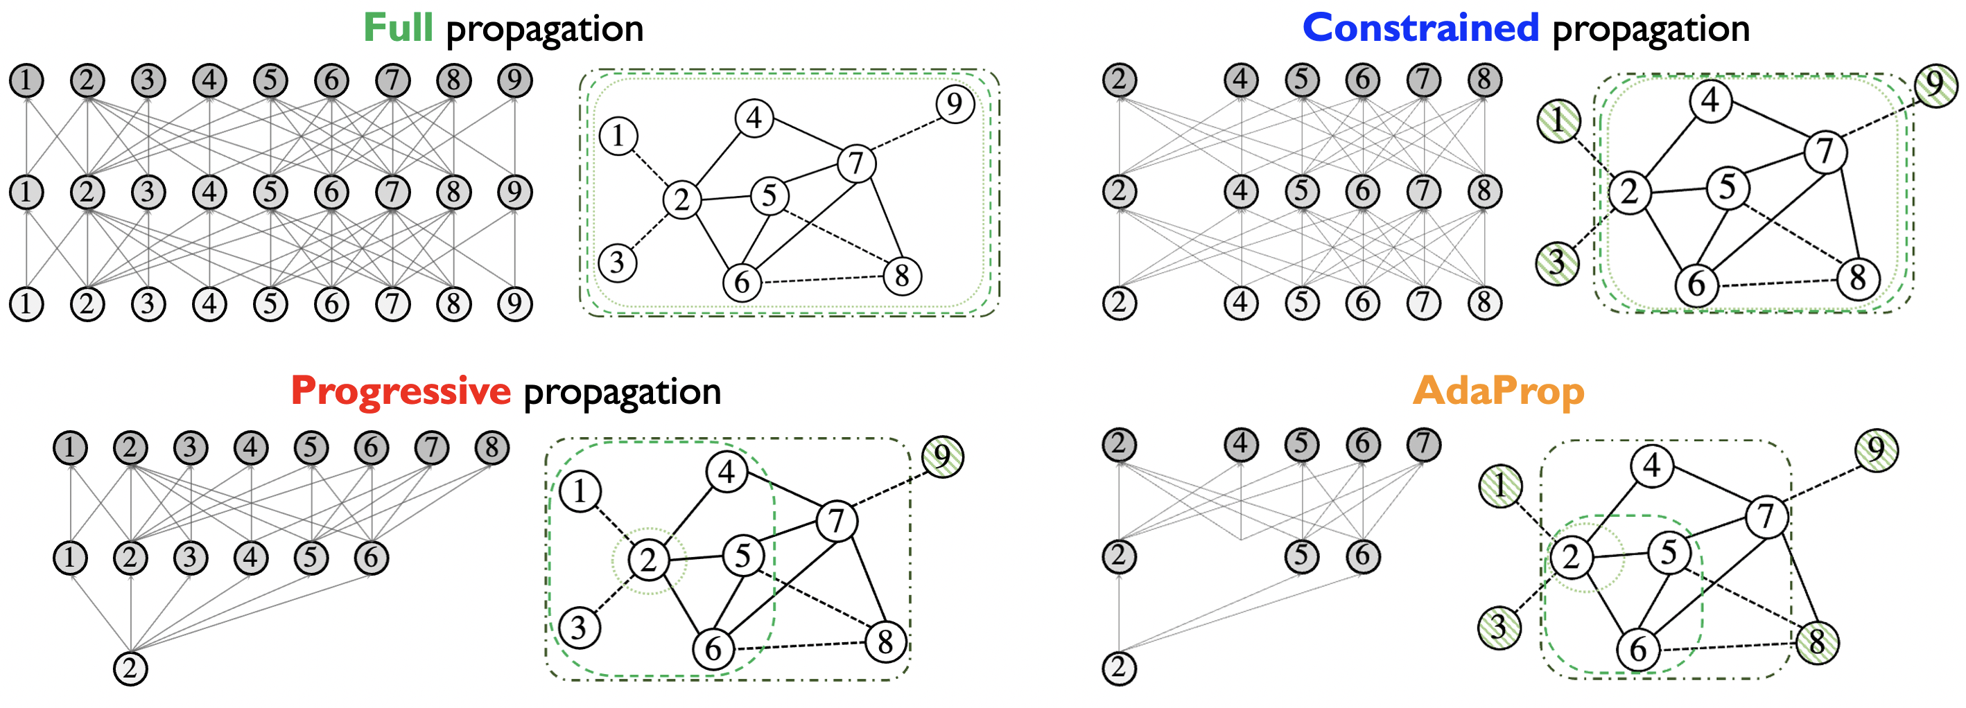
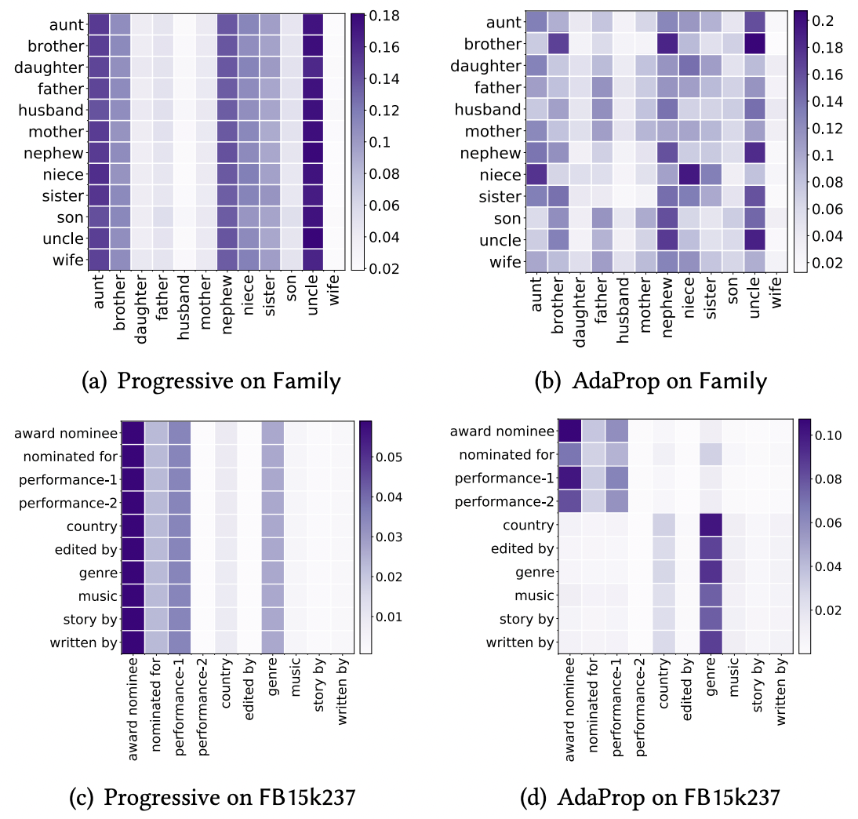
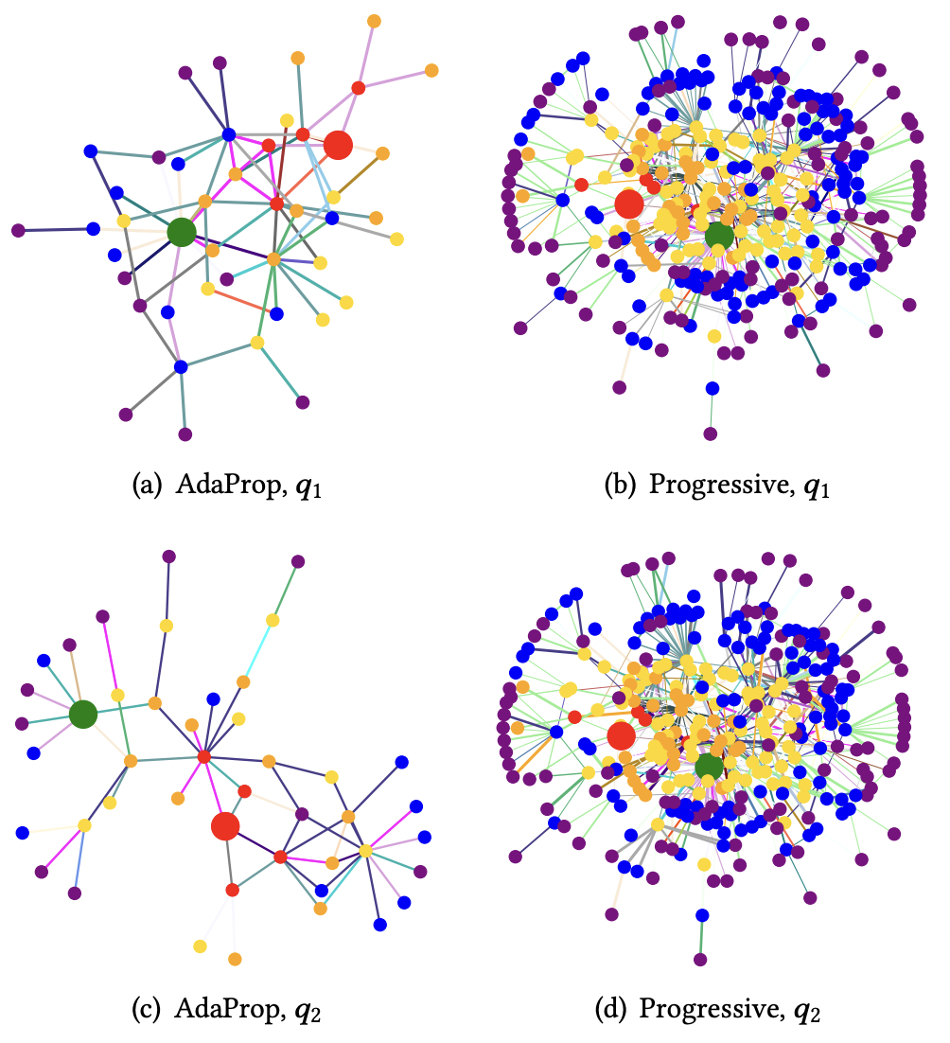
Paper
Code
AdaProp: Learning Adaptive Propagation for Graph Neural Network based Knowledge Graph Reasoning
*Yongqi Zhang, *Zhanke Zhou, Quanming Yao, Xiaowen Chu, Bo Han
Contact: zhangyongqi@4paradigm.com, cszkzhou@comp.hkbu.edu.hk
TL;DR: An important design component of GNN-based KG reasoning methods is called the propagation path, which contains a set of involved entities in each propagation step. Existing methods use hand-designed propagation paths, ignoring the correlation between the entities and the query relation. In addition, the number of involved entities will explosively grow at larger propagation steps. In this work, we are motivated to learn an adaptive propagation path in order to filter out irrelevant entities while preserving promising targets.
Problem & Challenges
An overall comparison with
existing propagation schemes
Problem formulation: Reduce the size of propagation path through sampling
Two challenges of the sampling strategy $S\left(⋅\right)$
the target answer $e_{a}$ is unknown given $\left(e_{q},r_{q},?\right)$
semantic dependency is complex
Existing sampling approaches are not applicable
no target preserving
no relation consideration
no direct supervision
Background: KG Reasoning
KG reasoning with query: (LeBron, lives_in, ?)
Applications: QA / Recommendation
Method: adaptively sample semantically relevant entities during propagation
Adaprop achieves smaller complexity, deeper steps and query-dependent.
Comprehensive Experiments
Design1: Connection-preserving Incremental Sampling
Key idea: Preserve the previous entities
& sample from the newly visited ones
Evaluation with transductive settings
Incremental sampling with only linear complexity
Graph Neural Network-based methods for KG reasoning
propagate the message with the graph structure
update entity representation at each propagation step
Evaluation with inductive settings
Details in each step: Candidate generation and sampling
The Propagation Path
Heatmaps of relation type ratios
in the propagation path
Exemplar propagation paths
on FB15k237-v1 dataset
Design2: Learning-based and Sematic-aware Distribution
Query-dependent propagation path ${\hat{𝓖}}_{e_{q},r_{q}}^{L}$
${\hat{𝒢}}_{e_{q},r_{q}}^{L}=\left\{𝒱_{e_{q},r_{q}}^{0}, 𝒱_{e_{q},r_{q}}^{1},…,𝒱_{e_{q},r_{q}}^{L}\right\}$ as the sets of involved entities
in each propagation step for query $\left(e_{q},r_{q},?\right)$
Key idea: Introduce a parameterized distribution & borrow knowledge from the GNN
Parameterized sampling distribution:
Sharing the knowledge in GNN representations $h_{e}^{ℓ}$
Adaptive based on the learnable parameters $θ^{ℓ}$
Learning strategy:
Gumbel-trick to enable backward propagation on hard samples.
Sampling: get top-K based on gumbel-logits
$G_{e}≔g\left(h_{e}^{ℓ};θ^{ℓ}\right)−\log\left(−\log{U_{e}}\right)$ with $U_{e}∼Uniform(0,1)$ for the candidate entities
Enable backpropagation: straight-through estimation
$h_{e}^{ℓ}=\left(1−no_grad\left(p^{ℓ}(e)\right)+p^{ℓ}(e)\right)⋅h_{e}^{ℓ}$ for the selected entities
Problems when $L$ is large
Full propagation: large memory cost & over-smoothing
Constrained propagation: extremely high inference cost
Progressive propagation: exponentially increased nodes
semantic-aware
connection-preserving

Slide 4
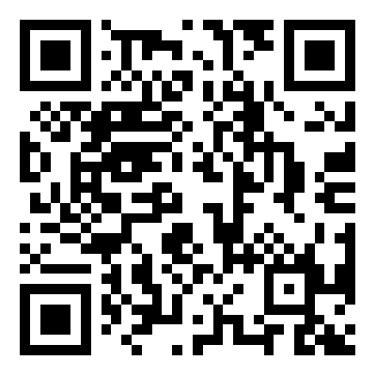
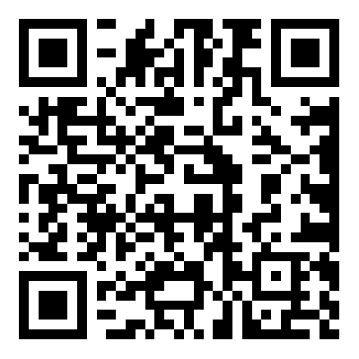
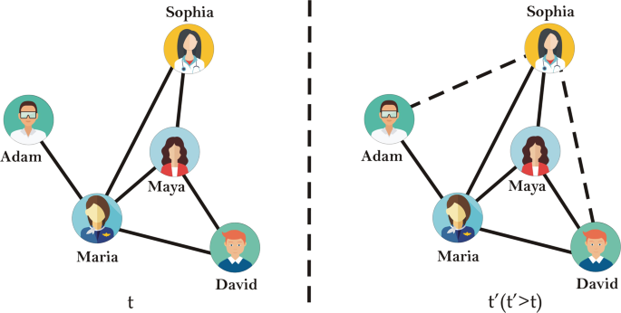
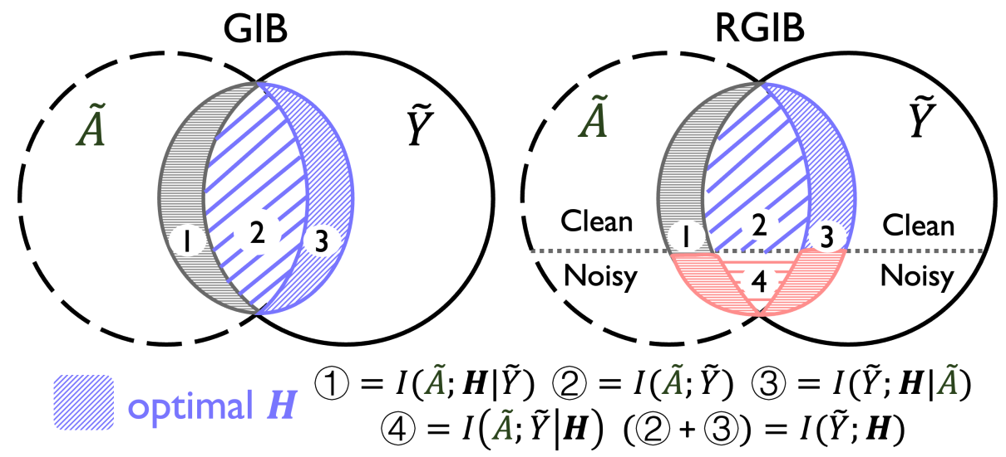
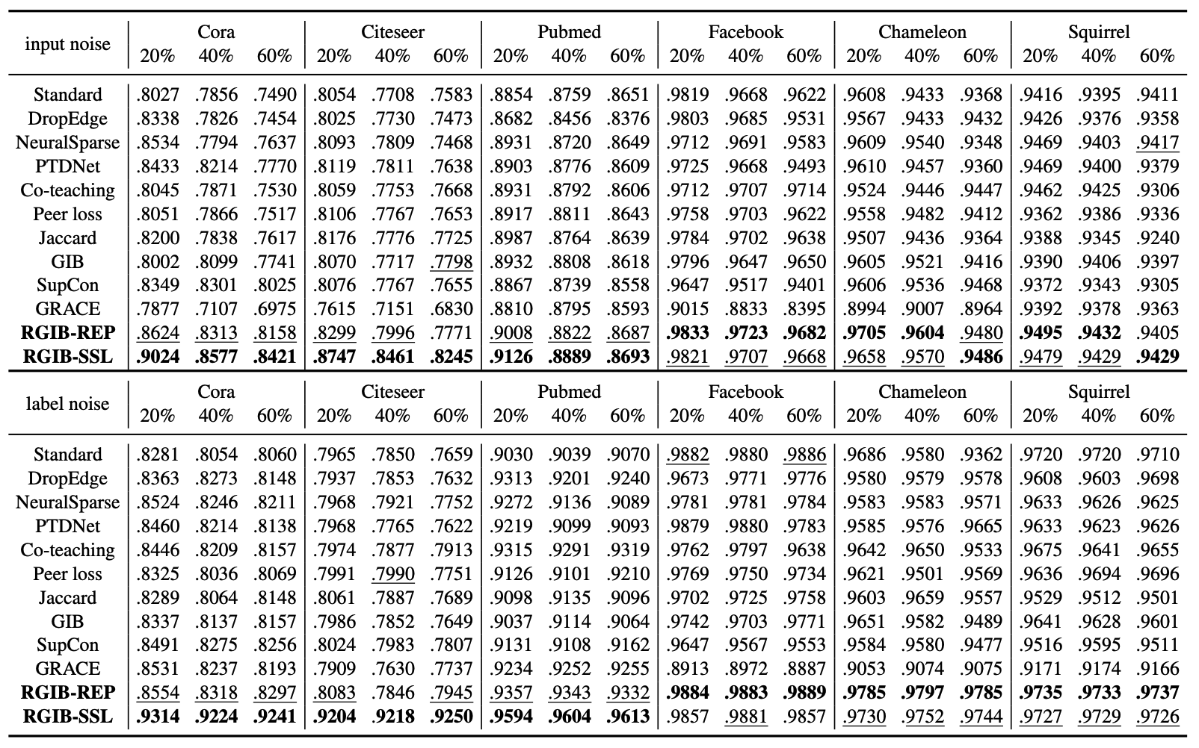
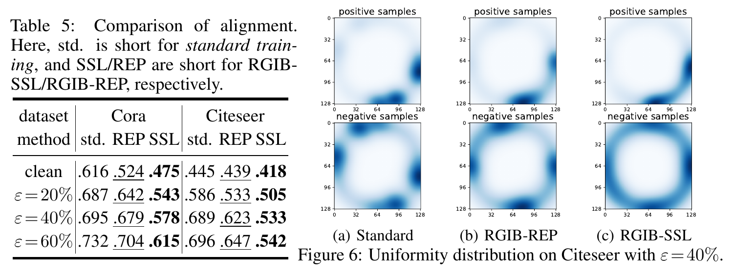
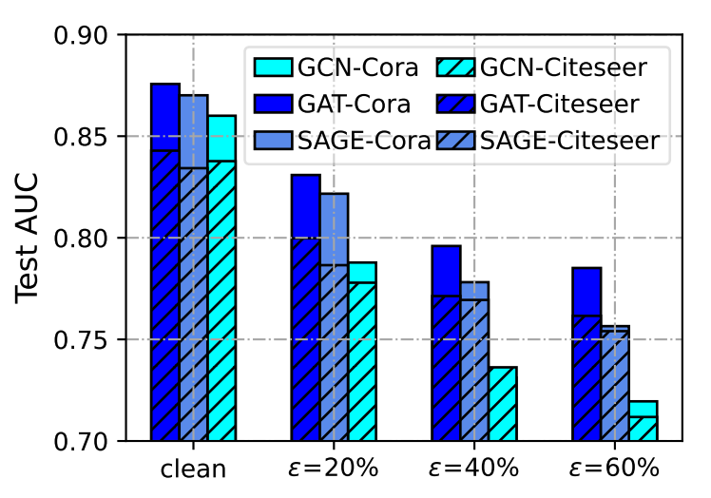
Combating Bilateral Edge Noise
for Robust Link Prediction
Zhanke Zhou, Jiangchao Yao, Jiaxu Liu, Xiawei Guo,
Quanming Yao, Li He, Liang Wang, Bo Zheng, Bo Han
Paper Code
Problem: Link Prediction with Noise
Method: Robust Graph Information Bottleneck
Experiments
RGIB performs the best in all six datasets under the bilateral noise:
The link prediction task:
based on the observed links
to predict the latent links
The Bilateral Edge Noise
Existing graph benchmarks are generally clean.
However, graph data can be noisy in practical scenarios:
the observed graph is often with noisy edges (input noise)
the predictive graph often contains noisy labels (label noise)
these two kinds of noise can exist at the same time (by random split)
RGIB consistently surpasses all the baselines under the unilateral noise:
➔ GIB is vulnerable to label noise for its maximum label supervision
In this work, we further balance the mutual dependence
among graph topology $\tilde{A}$, target labels $\tilde{Y}$, and representation $H$
build a new learning objective RGIB for robust representation
We call this kind of noise as the “bilateral edge noise”
Instantiation: RGIB-SSL and RGIB-REP
➔ the graph representation has obvious improvement in distribution:
The Effects of Bilateral Edge Noise
RGIB RGIB-SSL RGIB-REP
The noise leads to performance degradation and representation collapse:
RGIB-SSL optimizes the representation with self-supervised learning
to achieve a tractable approximation of the MI terms
integrate a uniformity term and an alignment term with graph augmentation
adopt the contrastive learning technique and contrast pair of samples
Future Directions
performance drop
representation collapse
RGIB-REP purifies the noisy signals with reparameterization mechanism
latent variables $Z_{Y}$ and $Z_{A}$ are clean signals extracted from noisy $\tilde{Y}$ and $\tilde{A}$
$I\left(H;Z_{Y}\right)$ measures the supervised signals with selected samples $Z_{Y}$
$I(Z_{A};\tilde{A})$ and $I(Z_{Y};\tilde{Y}$) help to select the clean information from noisy $\tilde{A},\tilde{Y}$
New instantiations of RGIB, e.g., approximation of the MI terms
New scenarios with noise, e.g., feature noise, other structural noise
New graph learning tasks, e.g., node classification, graph classification
New theoretical analysis, e.g., information theory, graph generation model
➔ How to improve the robustness of GNNs under edge noise? 🤔

